Slide 1
ME469: Advection Operators: Review
Stefan P. Domino^{1,2}
¹ Computational Thermal and Fluid Mechanics, Sandia National Laboratories
² Institute for Computational and Mathematical Engineering, Stanford
SAND2018-4536 PE

Slide 2
Transient Advection/Diffusion: Step Function as Initial Condition Central, AKA Galerkin
Goal: Run our model equation with a variety of Peclet numbers using a step function as the initial condition

Slide 3
Transient Advection/Diffusion: Step Function as Initial Condition First-order Upwind
Goal: Run our model equation with a variety of Peclet numbers using a step function as the initial condition

Slide 4
Functional form for η – Linked to Peclet number, Pe Many ad-hoc choices, however, a common physical approach is tanh
- peclet_function_form:
velocity: tanh
mixture_fraction: tanh
- peclet_function_tanh_transition:
velocity: 5000.0
mixture_fraction: 2.0
- peclet_function_tanh_width:
velocity: 200.0
mixture_fraction: 4.0

Slide 5
Kappa = 0 Method of Hirsh Numerical Computation of Internal and External Flows, vol. 2, John Wiley & Sons, 1990.
For κ = 0, recast as: (Algebra…..)
Where,
Above, define a “limiter” function that “senses” when the solution is smooth (tends towards unity) and when the solution is oscillatory (tends towards zero)
G_{j} is the projected nodal gradient at each node (or cell-center) that is treated in a deferred-correction context, i.e., this quantity is lagged from the previous iteration
So-called “gradient reconstruction” schemes
Reconstruct a higher-order stencil through extrapolation
Derived by substituting κ = 0, and
using the projected nodal gradient
definition – or – just by noting an
extrapolation using a gradient
Assignment: Algebra!!!

Slide 6
Kappa = 0 Method of Hirsh: CVFEM Numerical Computation of Internal and External Flows, vol. 2, John Wiley & Sons, 1990.
For κ = 0, recast as: (Algebra…..)
Where,
Above, define a “limiter” function that “senses” when the solution is smooth (tends towards unity) and when the solution is oscillatory (tends towards zero)
G_{j} is the projected nodal gradient at each node (or cell-center) that is treated in a deferred-correction context, i.e., this quantity is lagged from the previous iteration
So-called “gradient reconstruction” schemes
Reconstruct a higher-order stencil through extrapolation
CVFEM surface integration point can
be along the edge, or at the
standard SCS location with modified
distance verctir
Assignment: Algebra!!!

Slide 7
Projected Nodal Gradient: Refresher
Objective: We desire a nodal variable that represents the gradient of a scalar φ, G_{j}φ
We can view the nodal gradient as continuous at the nodes/DOF location, while discontinuous within element/control volume boundaries:
Let’s minimize this difference (L₂):
by solving:
Lumped projected nodal gradient
(piecewise constant w)

Slide 8
Projected Nodal Gradient: Pseudo Code (Edge-based)
for ( stk::mesh::Bucket::size_type k = 0 ; k < length ; ++k ) {
stk::mesh::Entity nodeL/nodeR = edge_node_rels[0]/edge_node_rels[1];
const double qL = *stk::mesh::field_data( *scalarQ_, nodeL);
const double qR = *stk::mesh::field_data( *scalarQ_, nodeR);
const double qip = 0.5*(qL + qR);
const double invVolL = 1.0/volL;
const double invVolR = 1.0/volR;
for ( int j = 0; j < nDim; ++j ) {
const double aj = areaVector[k*nDim];
gradQL[j] += aj*qip *invVolL;
gradQR[j] -= aj*qip*invVolR;
}
}
}
Rule: Area vector points from low to high global node ID

Slide 9
Projected Nodal Gradient: Pseudo Code (CVFEM)
for ( int ip = 0; ip < numScsIp_; ++ip ) {
// left and right nodes for this ip
const int il = lrscv[2*ip];
const int ir = lrscv[2*ip+1];
double qIp = 0.0;
const int offSet = ip*nodesPerElem_;
for (int ic=0; ic < nodesPerElem;++ic ) {
qIp += N[offSet+ic]*p_scalarQ[ic];
}
// assemble to il/ir
for ( int j = 0; j < nDim_; ++j ) {
double fac = qIp*areaVec[ip*nDim_+j];
gradQL[j] += fac*inv_volL;
gradQR[j] -= fac*inv_volR;
}
}

Slide 10
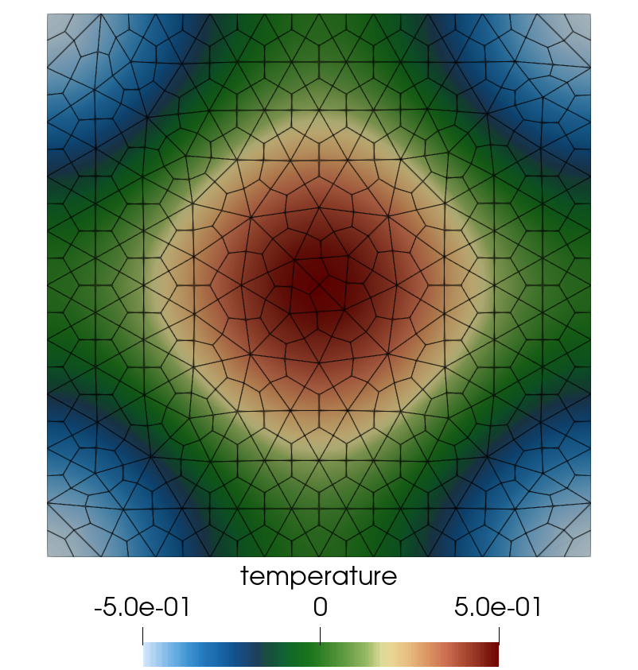
For Instance, Verification of The Diffusion Operator
n2 (L)
n3 (R)
e2

Slide 11
Solver Nuance
Recall, we like to solve our systems in residual- or delta-form:
k+1
k
k+1
k

Slide 12
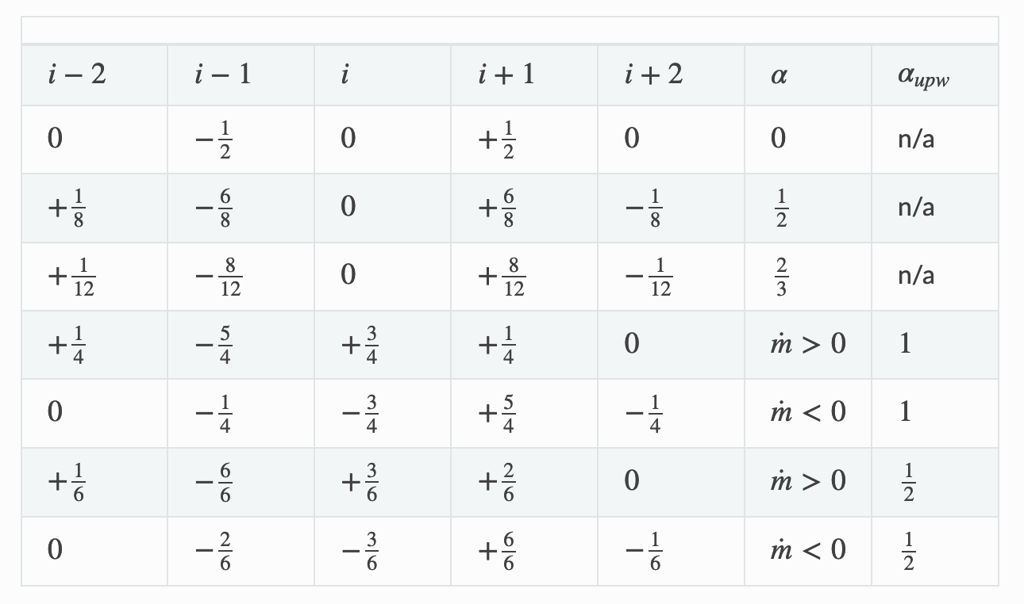
The Idealized Stencil Set
With Nalu input file specifications
- alpha_upw:
velocity: 1.0
- alpha:
velocity: 1.0
- upw_factor:
velocity: 1.0
- limiter:
velocity: [yes/no]
(zero reverts
to first-order)

Slide 13
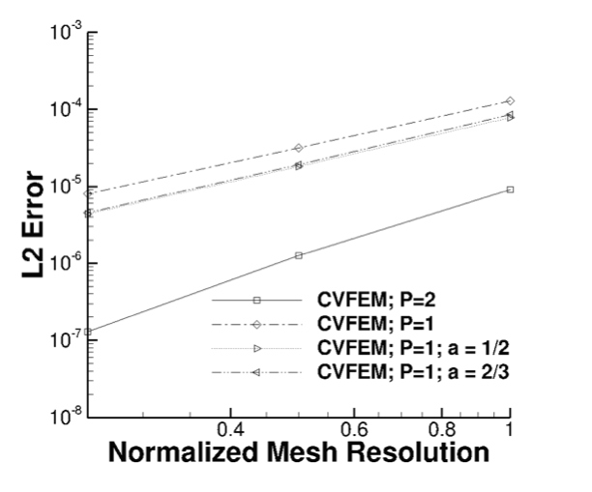
Pseudo 4th order Verification Results
Verification using Central (linear and quadratic) compared to pseudo 4th order
Lower error, however, formally second-order accurate

