Slide 1
ME469: Common Discretization Approaches: Comparing CVFEM and FEM
Stefan P. Domino^{1,2}
¹ Computational Thermal and Fluid Mechanics, Sandia National Laboratories
² Institute for Computational and Mathematical Engineering, Stanford
SAND2018-4536 PE

Slide 2
Element-Based Stencil Comparison
FEM (A) and CVFEM (B)
(A)
(B)

Slide 3

Philosophy: Bridges, not Walls
ME469 Tenant: Let’s work to understand how each method relate to one another
FVM
CVFEM
FD
GFEM

Slide 4
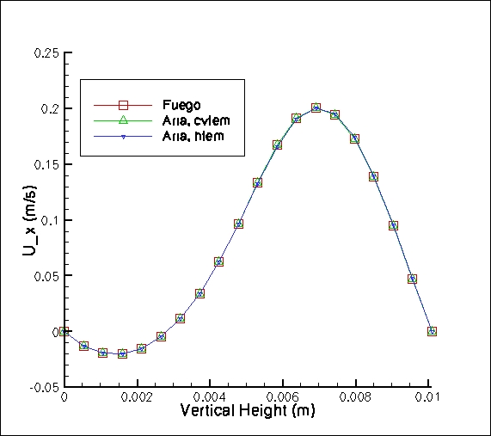
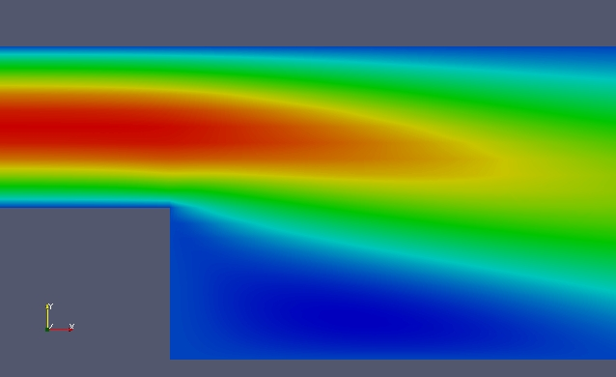
Laminar Backstep
Laminar back step (Re = 389 based on step height) comparing two code implementations for CVFEM (Sierra/Fuego and Sierra Aria), FEM (within Aria – here termed, “hybrid” FEM, or HFEM – essentially, the same low-Mach CVFEM approach with full integration-by-parts).
X-component of velocity
Vertical line represents one-D
line plot location

Slide 5
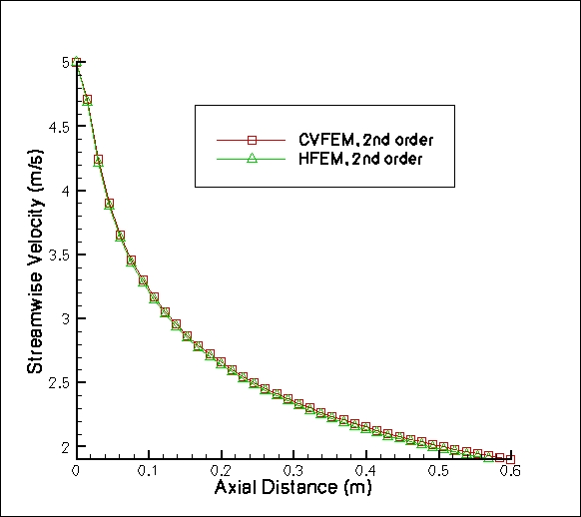
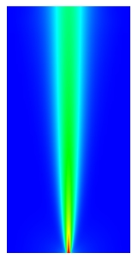
Laminar Jet
Y-component of velocity

Slide 6
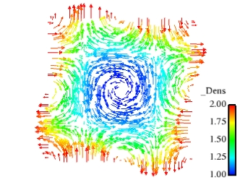
Order of Accuracy
Comparison of a linear underlying basis (nominally, second-order in space
Challenging two-dimensional variable density low-Mach flow using method of manufactured solutions; DOFS: u, v, p and Z; density = f(Z)

