Slide 1
ME469: A Verification and Validation (V&V) Methodology (Review)
Stefan P. Domino^{1,2}
¹ Computational Thermal and Fluid Mechanics, Sandia National Laboratories
² Institute for Computational and Mathematical Engineering, Stanford
SAND2018-4536 PE

Slide 2
Verification vs Validation (V&V)? The Formal Lexicon (REVIEW)
Verification: Are we solving the equations correctly?
Represents an exercise in computational mathematics
Given an equation, is the solution converging at known rates?
Validation: Are we solving the correct equations?
Represents an exercise in understanding the physics associated with the real world use case
In this course, we will strongly focus on verification
Establishing the correctness of the numerical implementation is key
Comparisons of the numerical results to reality is not the primary objective
Verification challenges?
Knowledge of the true solution, i.e., exact analytical solutions
How many exact solutions exist for our class of physics? Not many!
Hint: Method of Manufactured Solutions (MMS)

Slide 3
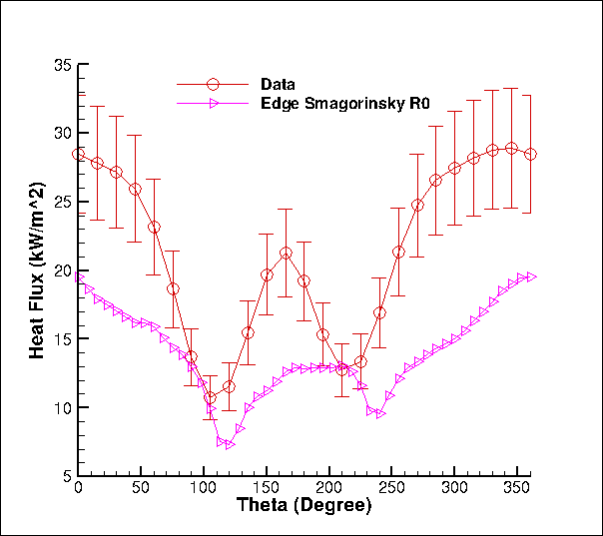
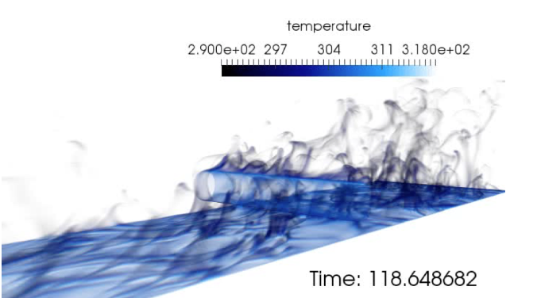
Challenge: Understanding Errors/Uncertainties….
One mesh, one model, unknown code/numerical pedigree…
We need to distinguish the types of errors/uncertainties:
Conceptual uncertainty, δ_{input}
Model-form error/uncertainty, δ_{model}
Discretization Error, δ_{numerical}
Code Error, δ_{numerical}
What credible scientific hypothesis can be tested in this context?
Heat flux to the cylinder
Volume-rendered temperature
Time-averaged heat flux to cylinder

Slide 4
Review of the Method of Manufactured Solutions (MMS): Providing confidence that the code implementation converges to the proper solution
We understand that the number of analytical solutions to test our code implementation are very few in number
How can we test the numerical accuracy of our implementation that, in general, solves very complex physics?
Specifically, as we refine the mesh and time step, how does the error respond?
Consider a simple heat conduction PDE:
With given [steady] manufactured solution:
New, analytically modified system that includes a new source term that we can implement in the code base:
The error is computed to be the difference between the analytical, or manufactured solution and our numerical simulation, T^{h}
We can now refine the mesh and timestep, while computing the error to ensure that the rate of reduction is expected
For example, if we believe our scheme is 2nd or 3rd order in space accuracy, one uniform refinement should reduce the error by 4x or 8x, respectively

Slide 5

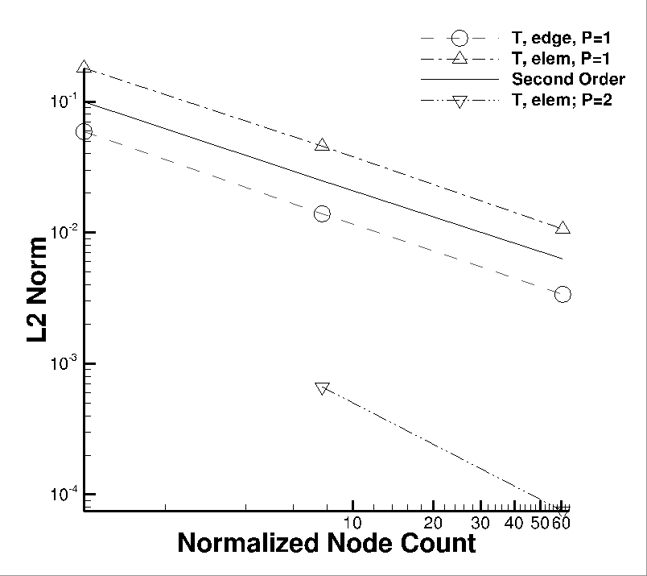
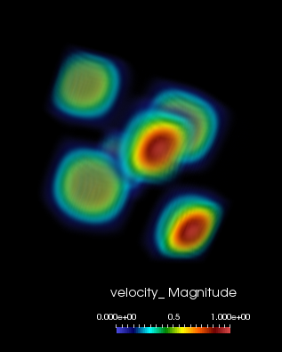
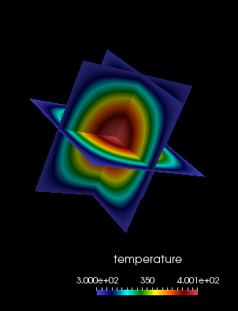
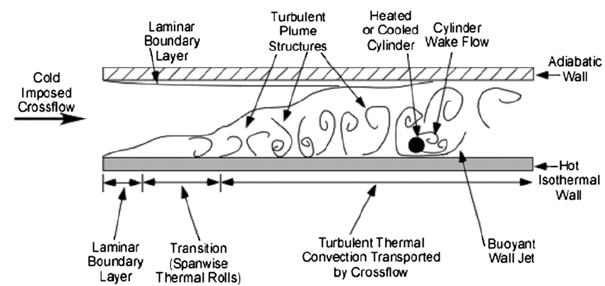
Spatial Code Verification for a low-Mach, Variable-Density Flow
Density is a function of static enthalpy transport via the standard ideal gas, ρ = f(P,M,R,T)
Temperature range maps to experiment (see below)
Arbitrary buoyancy source term via rotated gravity vector
Collective study now provides confidence in the interplay between numerical and modeling accuracy
See, “Exploring model-form uncertainties in large-eddy simulations”, Domino et al, 2016
Velocity Mag
Temperature
Kearney experimental configuration

Slide 6
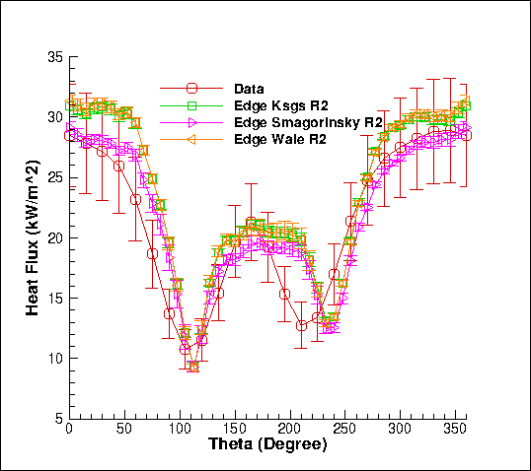
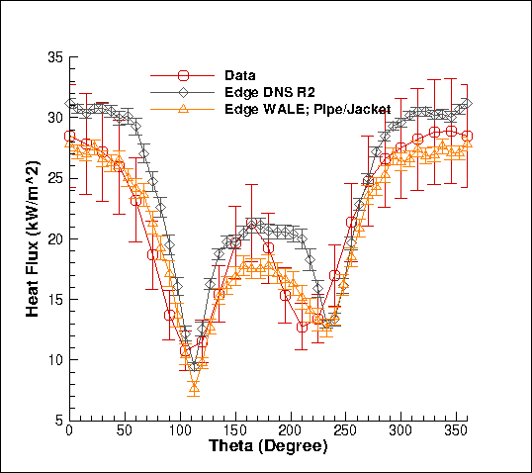
Review of a Strong V&V Process
Numerical UQ
Establish a sound LES-based V&V process (with uncertainty quantification) that includes the following attributes:
Phenomena Identification and Ranking (PIRT)
Code and solution verification (numerical error, δ_{numerical})
Validation including solution sensitivity to model inputs (δ_{input})
Structural uncertainty (model form error, δ_{model})
Physics assumptions (your conceptual model)
Structural UQ
Sources of error and uncertainty in simulation
δ_{numerical} , δ_{input} , δ_{model}
Physics UQ
10x
reduction
Non-isothermal MMS
“An assessment of atypical mesh topologies for low-Mach LES”, Domino et al., Comp & Fluids, 2019

Slide 7
Code or Conceptual Error? Part 1: Time Splitting
Case Study: An Algorithm is thought to be second-order-in-time accurate with one nonlinear iteration: True or False?
Issa, “Solution of the implicitly discretized fluid flow equations by operator splitting”, JCP (1985).
Advent of the “Pressure-implicit with Splitting of Operators”, or PISO
PISO is a scheme that defines a series of predictors and correctors in the context of a fully implicit solve
Conclusion?
Sometimes we code a method correctly, however, have a conceptual error in our understanding of whether or not a scheme is design-order accurate when run in the suggested manner

Slide 8
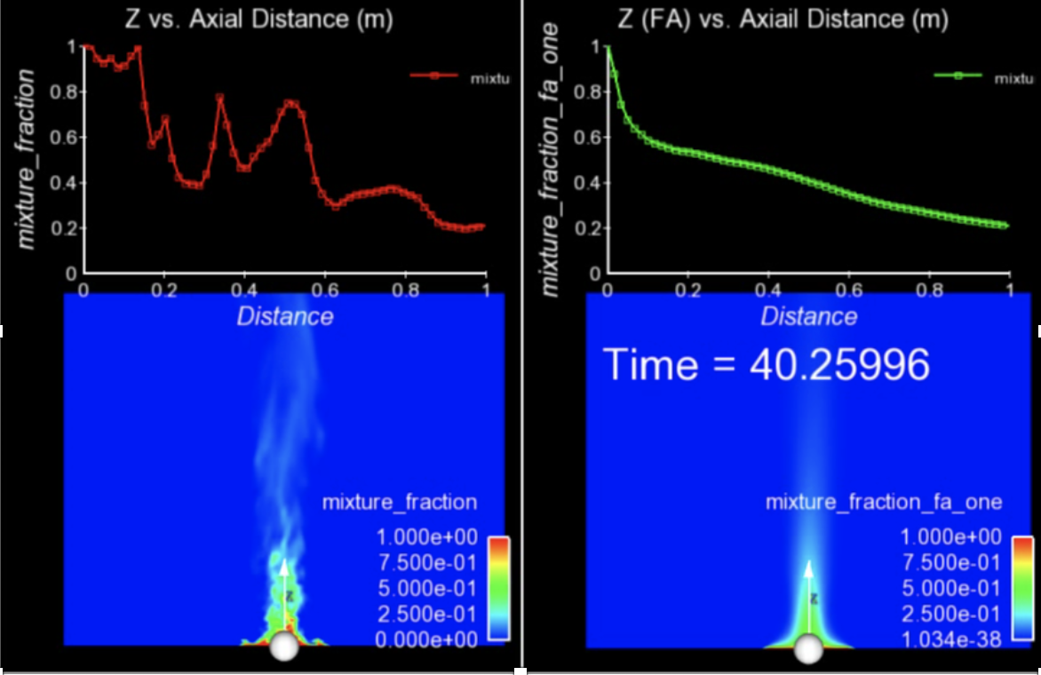
Finally…. For Transient Flows, Averaging is Required
The bane of turbulent validation: converged statistics require many flow-through times
Statistical convergence of a given simulation may require many flow-through-times; additional source of uncertainty and/or requirement for quantification of solution convergence

Slide 9
Essentials of Code Verification: Review
Taxonomy: One verifies code and validates models
Code verification establishes the numerical accuracy of the underlying discretization for the given partial differential equation set
Code verification seeks to provide the temporal and spatial accuracy of the underlying discretization approach
For temporal discretization error,
A two-state Backward Euler time integrator should be first-order in time, specifically the error should scale with Δt
A three-state BDF2 time integrator should scale with Δt²
A multi-stake Runge-Kutta schemes can achieve higher-order accuracy
For spatial discretization error,
A method is design-order if the observed order of accuracy is Δx^{P+1}, where P is the underlying basis polynomial order
Oberkampf and Trucano, Verification and validation in computational fluid dynamics, Progress in Aerospace Sciences,
Volume 38, Issue 3, 2002, https://doi.org/10.1016/S0376-0421(02)00005-2.

