Slide 1
ME469: Introduction to the low-Mach Number Approximation (Review)
Stefan P. Domino^{1,2}
¹ Computational Thermal and Fluid Mechanics, Sandia National Laboratories
² Institute for Computational and Mathematical Engineering, Stanford
SAND2018-4536 PE

Slide 2
Consider a Variable Density, non-Isothermal Fluid Flow System
Consider the variable density (non-isothermal) equations of motion (momentum and continuity) with energy transport:
Equation of State (EOS) provides the P and ρ relationship
See Paolucci (1982) or Baum (1978) for the low-Mach pedigree
Number of Equations = (3+nDim) = Number of unknowns
Constitutive Relationships
(2+nDim)
(3+nDim)

Slide 3
Dimensionless Form
Non-dimensionalization is via a characteristic velocity and length scale:

Slide 4
Dimensionless Form
Non-dimensionalization is via a characteristic velocity and length scale:
Conclusions: In the limit of zero Mach number, the energy equation is simplified, while the momentum equation is not well defined and, in fact, singular

Slide 5
Exploration of the Pressure Singularity
To explore the singularity, write each DOF as an asymptotic series:
The resulting zeroth-order equations are as follows:

Slide 6
Exploration of the Pressure Singularity: Ramifications
In order for the zeroth-order momentum equation to be well conditioned in the limit of zero Mach number, must be spatially zero with
p₀ is a constant-in-space, possibly variable-in-time thermodynamic pressure
p₁ is the variable in space pressure, which is also known as the “motion pressure”, p^{m}
Recall, this is simply a perturbation about the full thermodynamic pressure:

Slide 7
Final low-Mach Equation Set
The resulting Equation set is as follows:
Equation of state given by the thermodynamic pressure:
Energy transport is only required when the system modeled has a temperature difference
EOS does not provide an equation for closure: An alternative approach is required for motion pressure!
2+nDim

Slide 8
Sneak Peak: Classic Pressure Projection Algorithm
Solve Momentum Equation (with a provisional motion pressure):
Solve Continuity, given the computed velocity:
Update velocity:
In future tutorials, we will be more formal in nomenclature, however, for now, the concept of this “incremental pressure projection scheme” is to solve momentum with a provisional pressure, and then use the continuity constraint to update (or project) the velocity into the space of known divergence. Monolithic approaches are also viable

Slide 9



Thought Experiment…
Large domain, one door, one “exit”
Maples Pavilion

Slide 10
Thought Experiment…
Large domain, one door, one “exit”
Walls
Inflow
Out – In = 0 (at t = to+0.0000000001)
Outflow
Walls

Slide 11
Multigrid Methods: The Approach
Multigrid methods (MG) are essential for efficient solver performance in fluids-based Elliptic systems
In simple, structured domains, this can be geometric (GMG), while in unstructured, algebraic (AMG)
Restriction (from fine to coarse mesh)
Prolongation (from coarse to fine mesh)

Slide 12
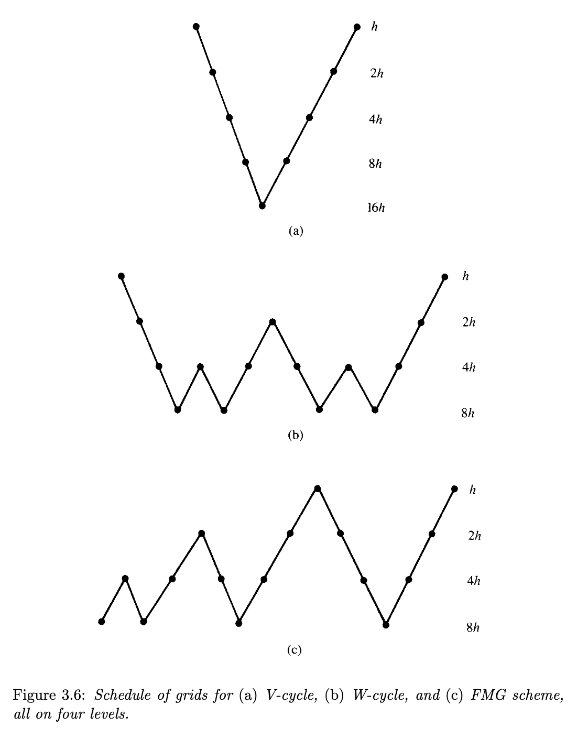
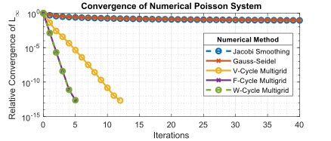
Multigrid Methods: V- and W-Cycles
Briggs (2000)
https://en.wikipedia.org/wiki/Multigrid_method

