Slide 1


Principle of Database Management
Weather forecast system
Instructor: Dr.Nguyen Thi Thuy Loan
Member list:
Phạm Đông Quân ITDSIU19015
Lê Thanh Phương Nam ITITUN19008
Lê Triệu Long ITDSIU19044
Nguyễn Huỳnh Thủy Tiên ITDSIU19056
Vũ Xuân Linh ITDSIU19008

Slide 2

Content
1
Introduction
4
Database implementation
2
Requirement analysis
5
Demos
3
Database design

Slide 3

1. Introduction
This project is a system that use a combination of science and technology for making accurate predictions on weather conditions of a particular location at a particular time based on multiple parameters, such as temperature, humidity, wind speed, etc.
The system has an administrator login to update the database to provide more accurate prediction. The predictions made by the systems will based on historical data stored in the database.

Slide 4
2.Requirement
Design a database to maintain historical data for weather forecasting system
1
Maintain the weather conditions data ( Cid, Wind Speed, Temperature, Humidity, Date Time) base on location parameters City ( Cid, Name).
2
Maintain user data ( Uid, role, password) with role has 2 types (Admin, User)

Slide 5
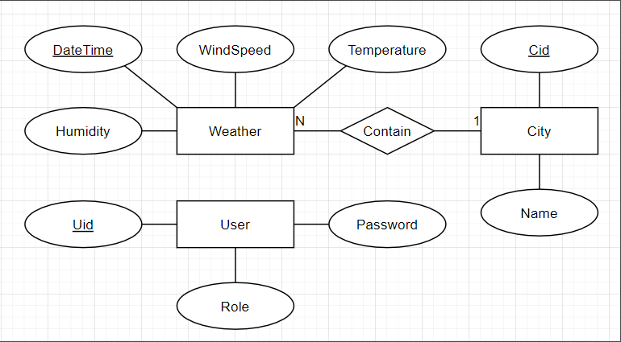
2.Requirement
Entity-Relationship Diagram

Slide 6
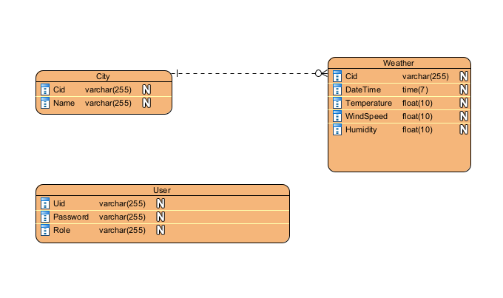
3. Database design

Slide 7
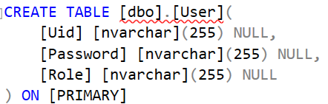
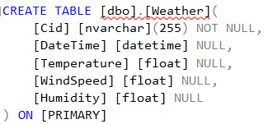
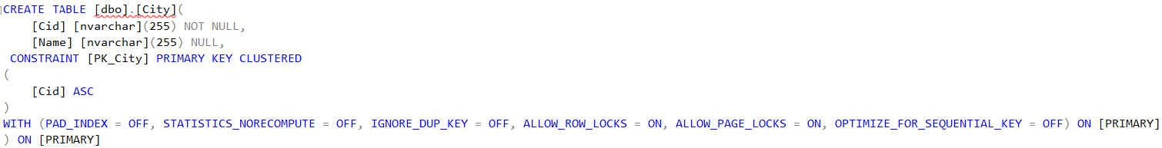
4. Database implementation

Slide 8
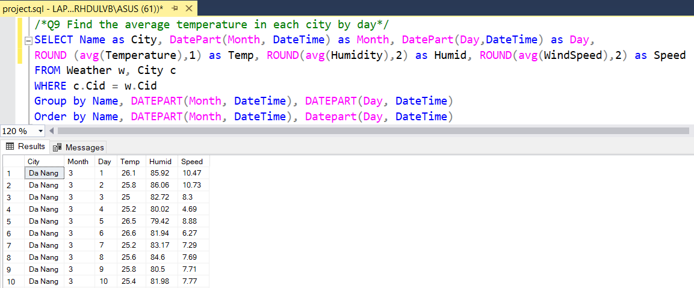
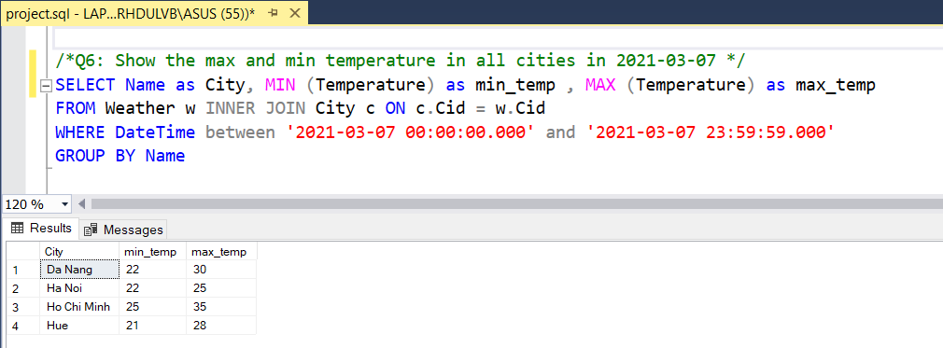
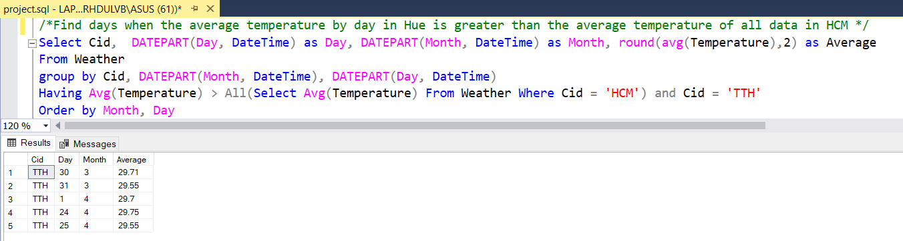
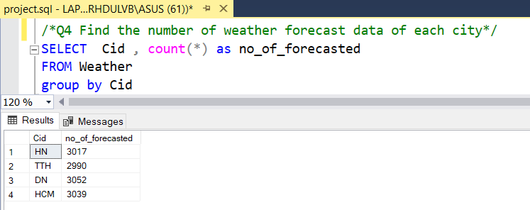
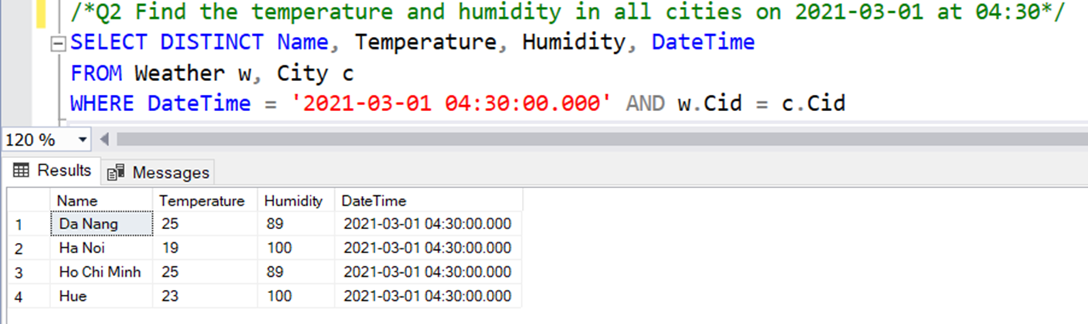
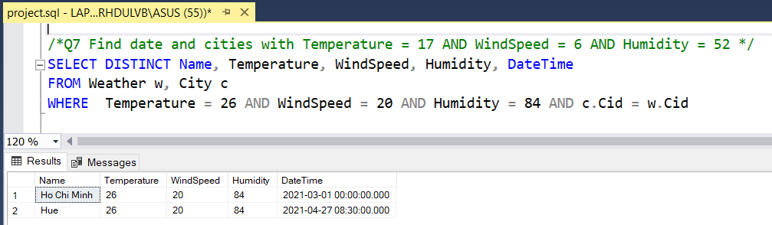
4. Database implementation

Slide 9
5. Demos

Slide 10
Thanks for listening

