Slide 1
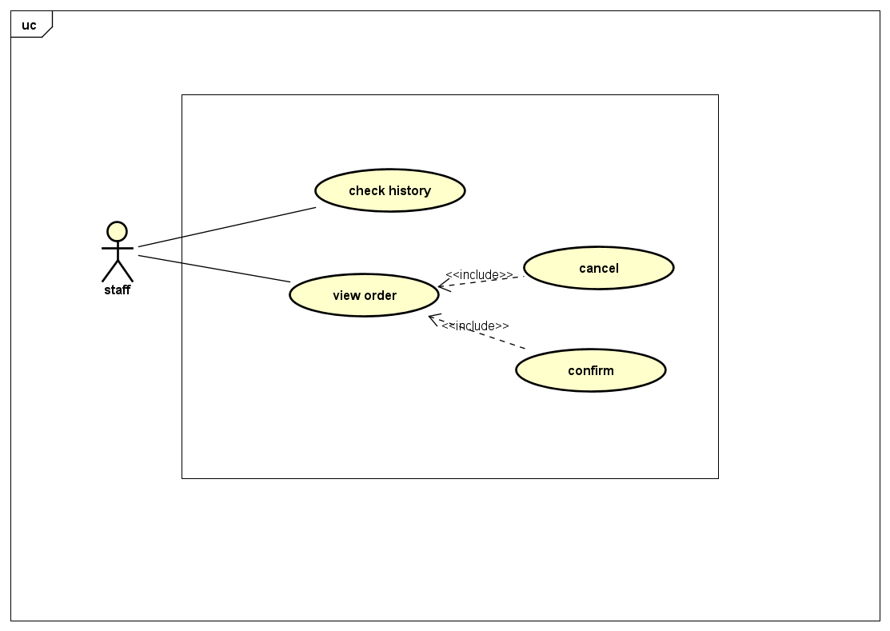

Slide 2
Use case name | View order
Scenario | Staff check an order
Trigger even | Staff click button “View order”
Brief description | Staff click “View order” button
Actors | Staff
Related use case | none
Precondition | Staff login to system
Postcoditions | Staff can see the history
Flow of Activity | Actors | System
 | Click “View order” button | System request order list from database and return to Staff
Exception condition | System error or no connection

Slide 3
Use case name | Cancel
Scenario | Staff cancel the order of customer
Trigger even | Staff click button “cancel”
Brief description | When the customer or manager require to cancel one particular order, the staff will delete that order.
Actors | Staff
Related use case | View order
Precondition | The staff login to account
Postcoditions | The staff receive the requirement of canceling one order. Then, he/she view that order.
Flow of Activity | Actors | System
 | Staff click “view orders” button Staff click “filter by requirement” Staff choose one order in “required to be cancel”. 4. Staff click “cancel” button | System request order list from database and return to Staff System classify order by requirement. After that, there are some orders labeled as “required to be cancel” System show information of that order. System requires updating in database and return message to Staff
Exception condition | Staff logout the account System error or no connection

Slide 4
Use case name | View history
Scenario | Everyone check history of an order
Trigger even | Everyone click button “history”
Brief description | History is order which could be labeled as “delivered successfully” or “canceled”. This order includes informations such as customer’s name, product, price, amount. Ev
Actors | Everyone including: Staff, Manager, User
Related use case | none
Precondition | Everyone have an account
Postcoditions | Everyone login to account.
Flow of Activity | Actors | System
 | Click “history” button Staff click one order | System show order list which contains orders labeled as “delivered successfully” or “canceled” System request that order from database and return to staff
Exception condition | Staff logout the account System error or no connection

Slide 5
Use case name | confirm
Scenario | Staff and deliver confirm an order which is delivered successfully
Trigger even | Deliver click “deliver successfully” + Staff click “confirm”
Brief description | After deliver clicking “deliver successfully” , staff click “confirm” to update information of order in database
Actors | Staff, Deliver
Related use case | View order
Precondition | Staff, Deliver have an account
Postcoditions | Staff, Deliver login to account.
Flow of Activity | Actors | System
 | Deliver click “deliver successfully” button Staff click “confirm” | System send message to Staff System request updating order in database and then return message to staff
Exception condition | Staff logout the account System error or no connection

