Slide 1
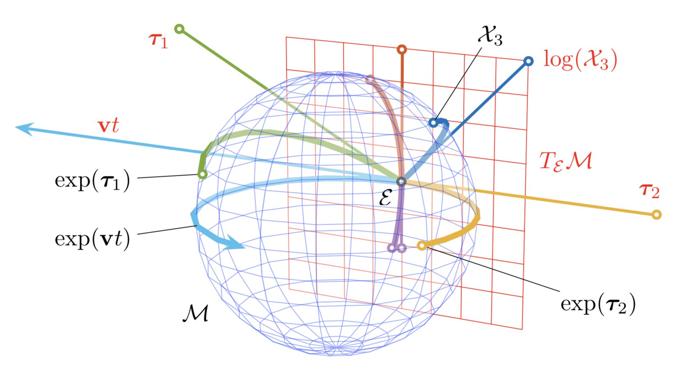
Lie Groups and Lie Algebras

Slide 2
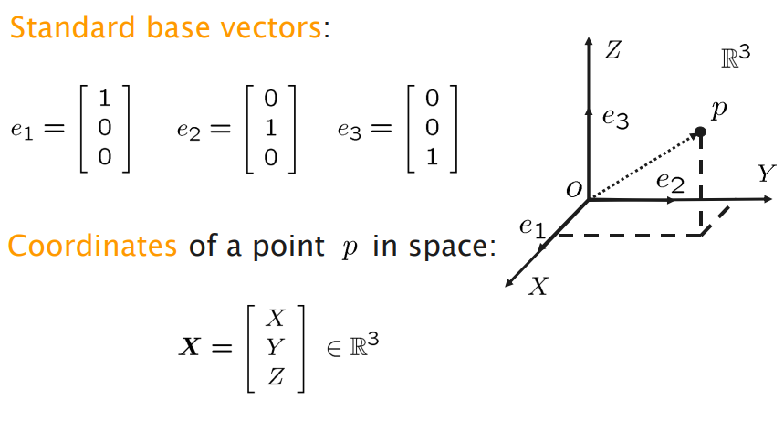
Rigid Body Transformations
Cartesian coordinates, Points and Vectors

Slide 3
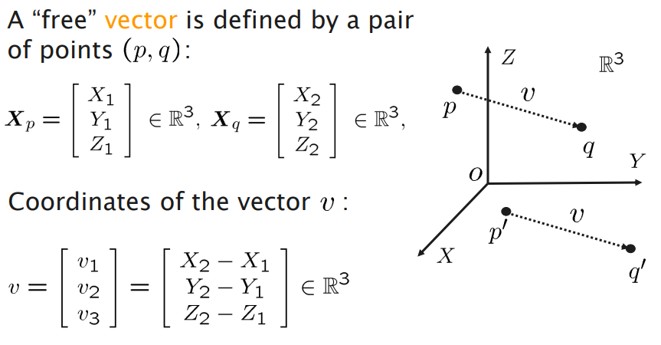
Rigid Body Transformations
Cartesian coordinates, Points and Vectors

Slide 4
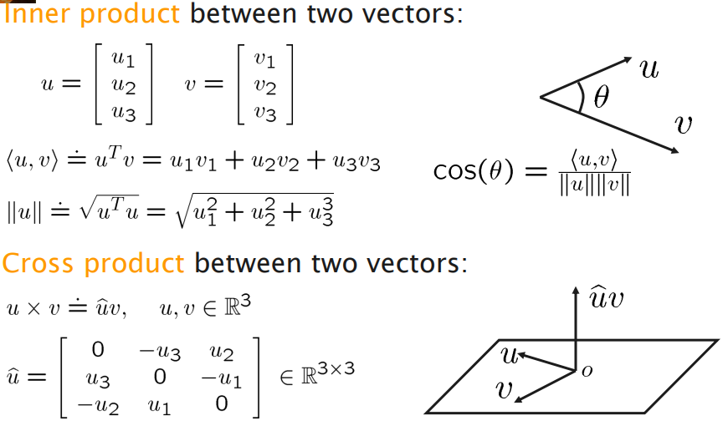
Rigid Body Transformations
Cartesian coordinates, Points and Vectors

Slide 5
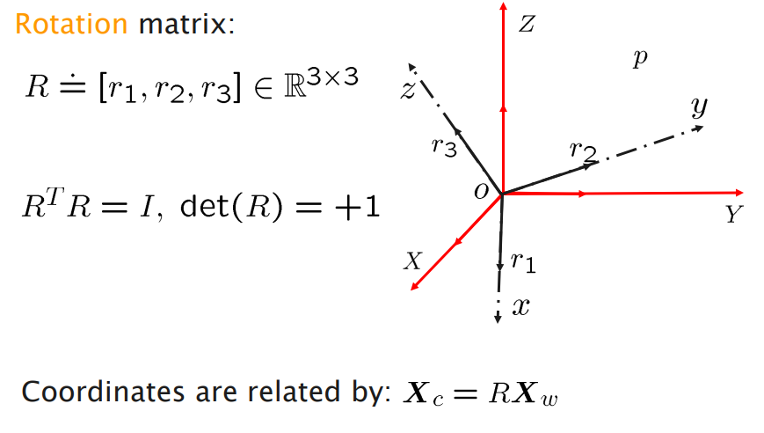
Rigid Body Transformations
Cartesian coordinates, Points and Vectors

Slide 6
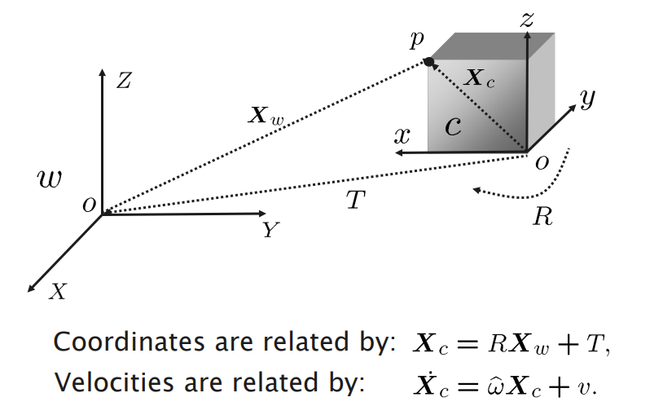
Rigid Body Transformations
Cartesian coordinates, Points and Vectors

Slide 7
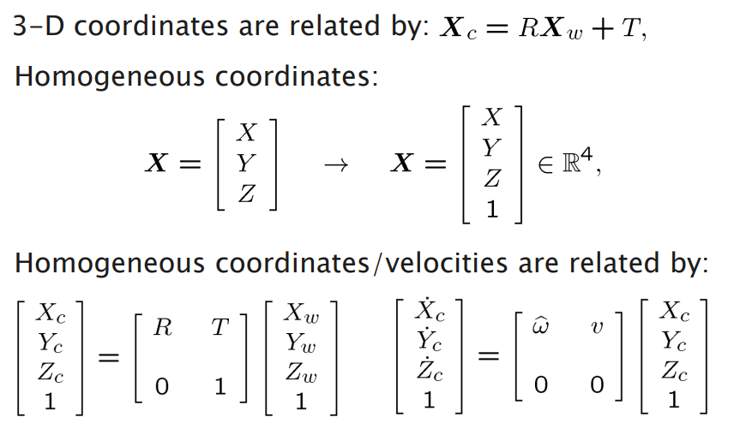
Rigid Body Transformations
Homogeneous Coordinates

Slide 8
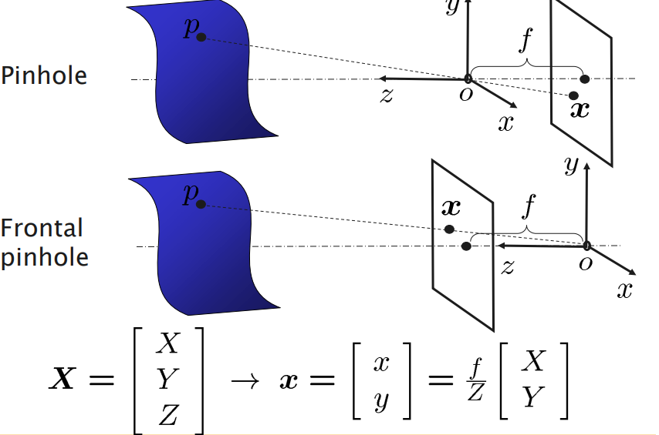
Rigid Body Transformations
Perspective Imaging

Slide 9
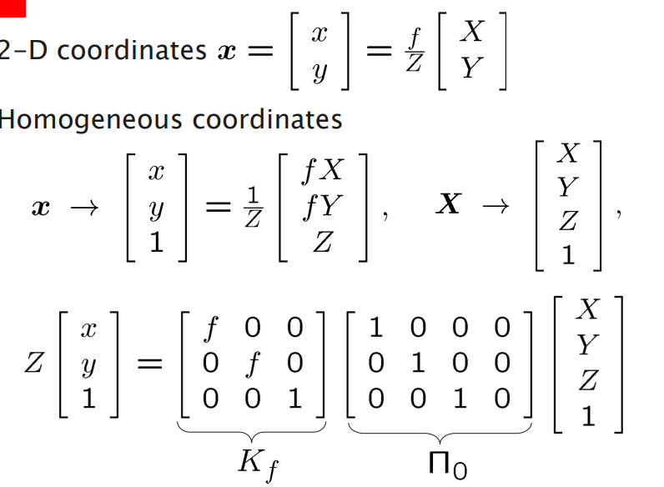
Rigid Body Transformations
Camera Model ging

Slide 10
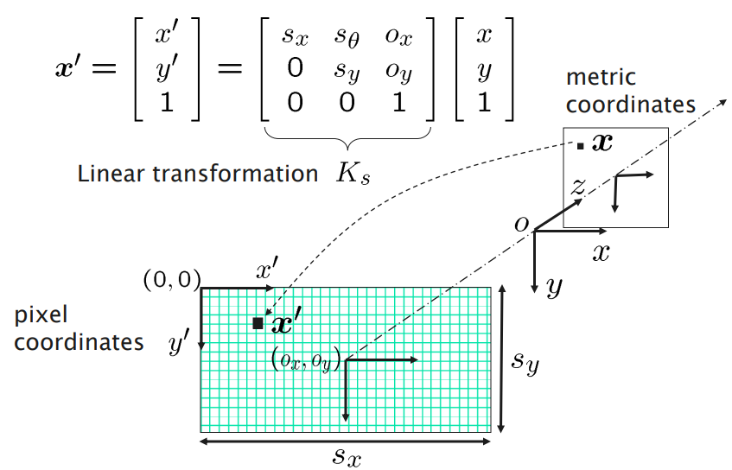
Rigid Body Transformations
Pixel Coordinates
https://www.uio.no/studier/emner/matnat/ifi/nedlagte-emner/INF3320/h03/undervisningsmateriale/lecture3.pdf

Slide 11
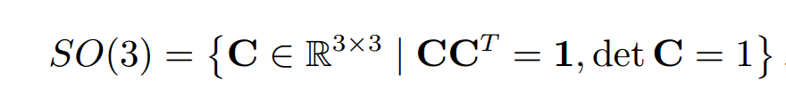
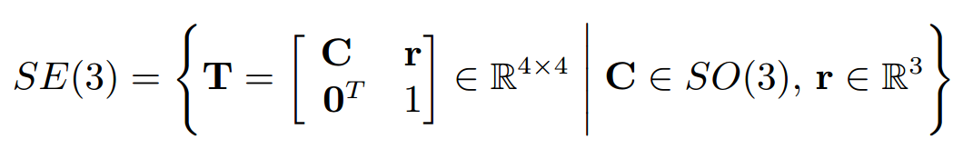
Lie Groups

Slide 12
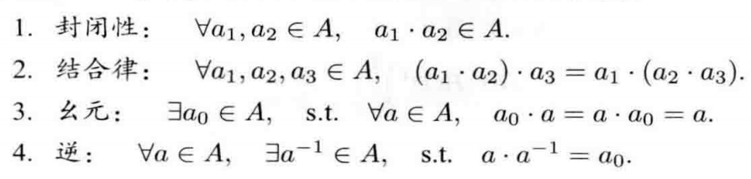
Lie Groups

Slide 13
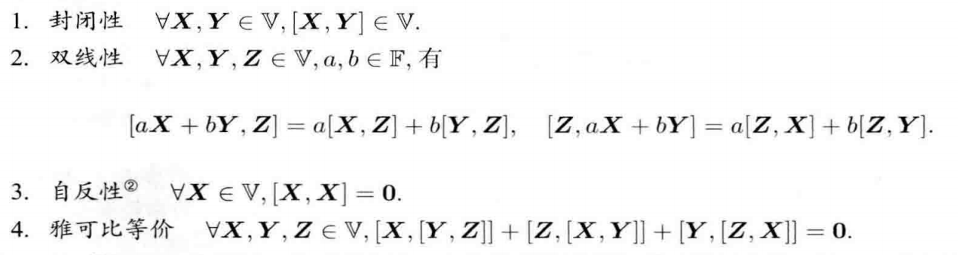
Lie Groups

Slide 14
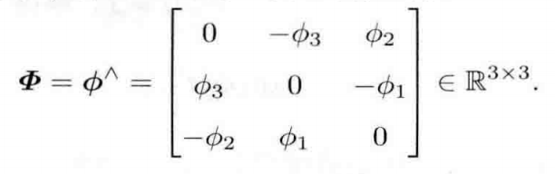
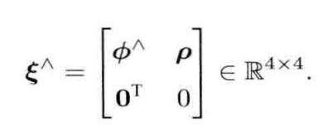
Lie Groups

Slide 15
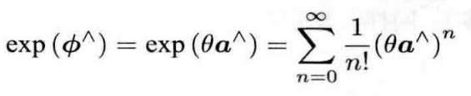
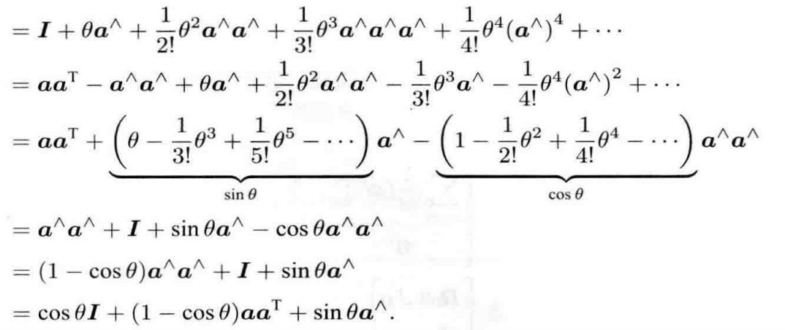
Lie Groups

Slide 16
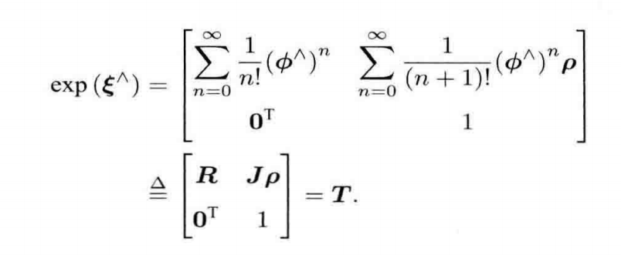
Lie Groups

Slide 17
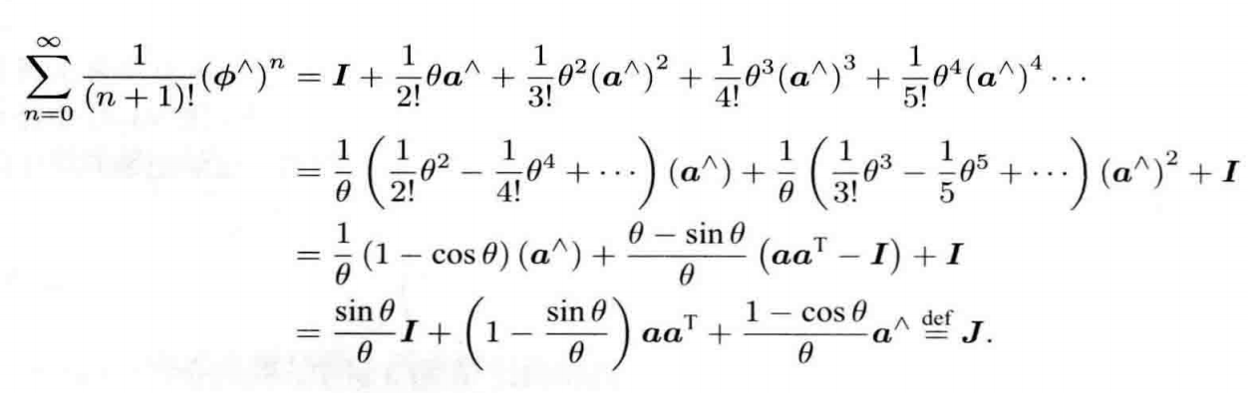
Lie Groups

Slide 18
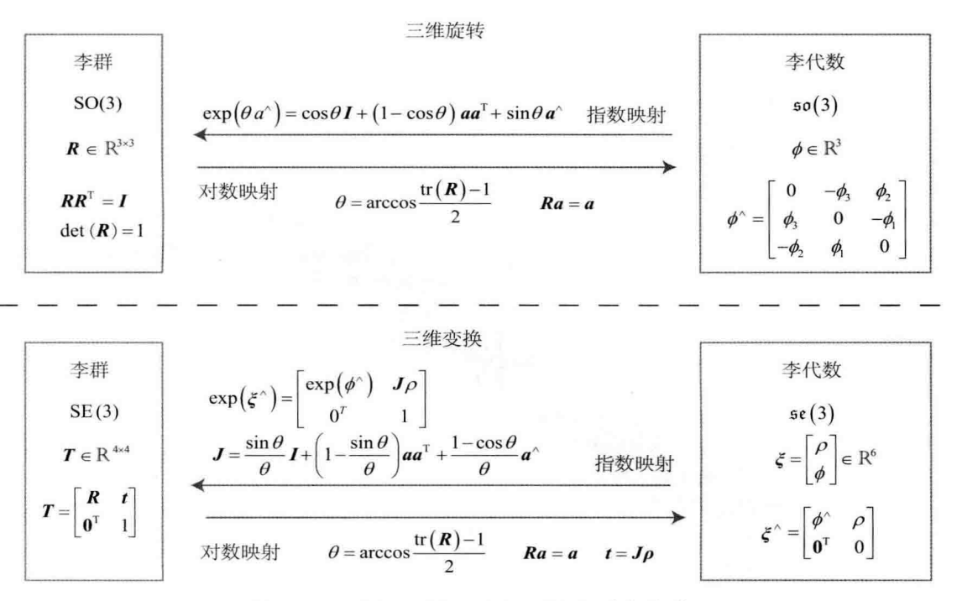
Lie Groups

Slide 19

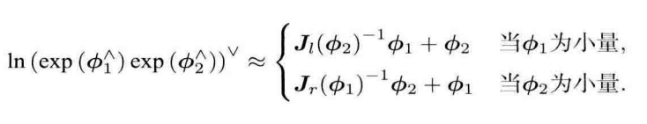
Lie Groups
BCH公式：

Slide 20
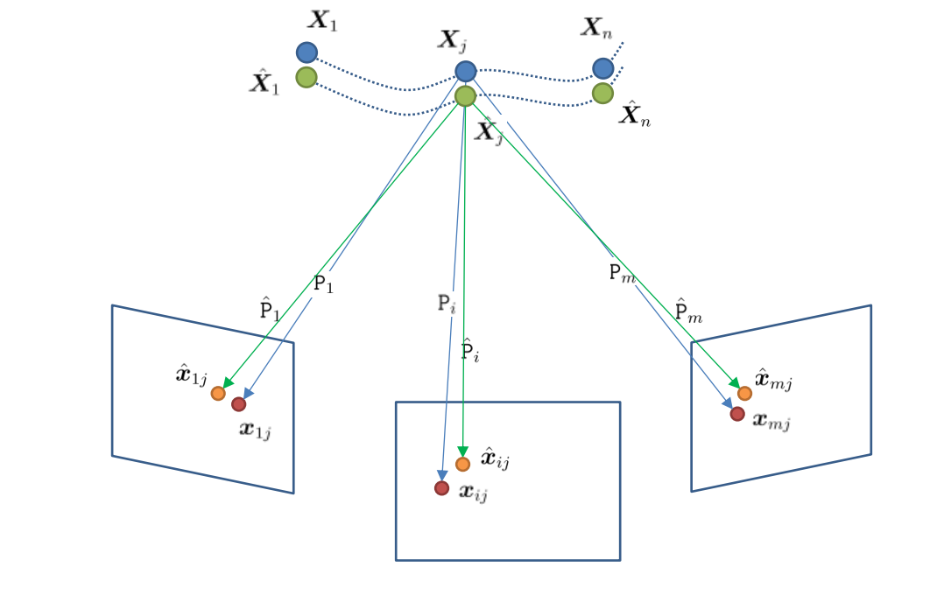


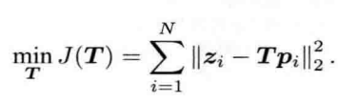
Lie Groups

Slide 21
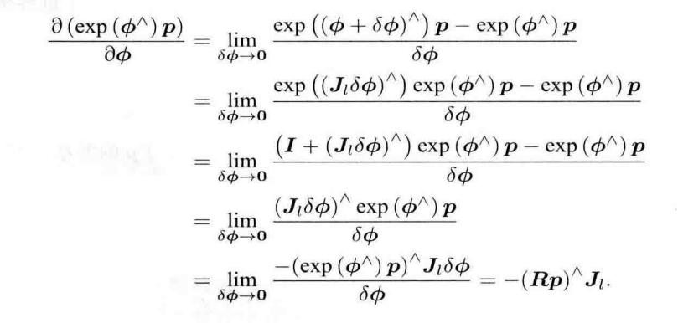
Lie Groups

Slide 22
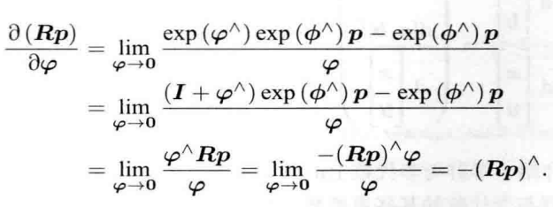
Lie Groups

Slide 23

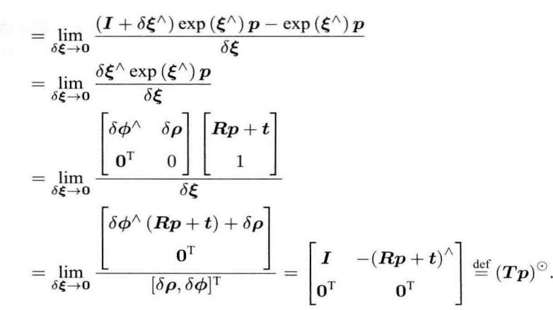
Lie Groups

