Slide 1




视觉SLAM
Quaternions
April 3th, 2022 https://github.com/duyongquan/LTSLAM
AibotBeginer 视觉SLAM
quandy2020@126.com

Slide 2
2
Outline
Introduction
Rotations in two dimensions
Rotations in three dimensions
Quaternions
Quaternions derivative
Quaternions interpolation

Slide 3
Introduction
3
简介

Slide 4
4
Introduction
Transformation of coordinates (position and orientation)
1
flight control of aircraft and rockets
2
move-ment of manipulators in robotics
3
computer graphics
Two rotations
1
Euler anglesare the angles of rotationof a three-dimensional coordinate frame. A rotation of Euler angles is represented as amatrix of trigonometric functions of the angles
2
Quaternions are an algebraic structure that extends the familiar concept of complex numbers. While quaternions are much less intuitive than angles, rotations defined by quaternions can be computed more efficiently and with more stability, and therefore are widely used

Slide 5
Rotations in two dimensions
5
二维旋转

Slide 6
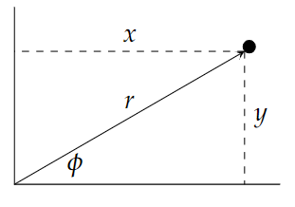
6
Rotations in two dimensions
Cartesian and polar coordinates
1
相对于参考系，二维空间中的向量或位置（向量的尖端）
可以用笛卡尔坐标 (x,y) 或极坐标 (r,φ) 给出
2
转转表示公式

Slide 7
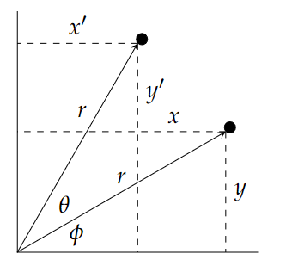
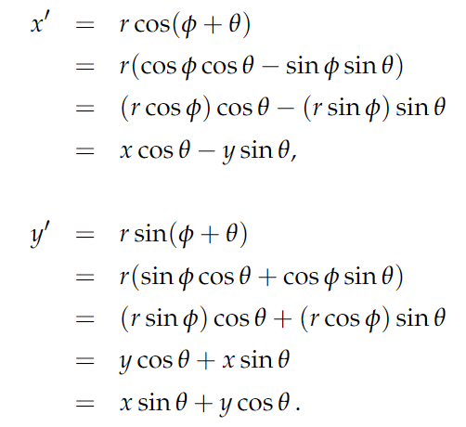
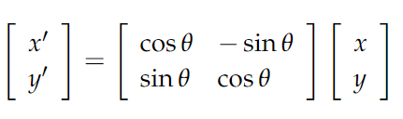
7
Rotations in two dimensions
Rotating a vector
现在假设向量旋转了角度θ：
新向量的极坐标为(r,φ+θ)
矩阵形式

Slide 8

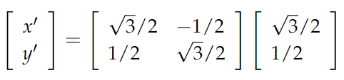

8
Rotations in two dimensions
A geometric derivation of the rotation matrix
令 r=1 并令 θ 和 φ 都为 30°
我们现在可以计算 x′ 和 y′ 的值：

Slide 9
9
Rotations in two dimensions
A geometric derivation of the rotation matrix
令 r=1 并令 θ 和 φ 都为 30°
我们现在可以计算 x′ 和 y′ 的值：

Slide 10
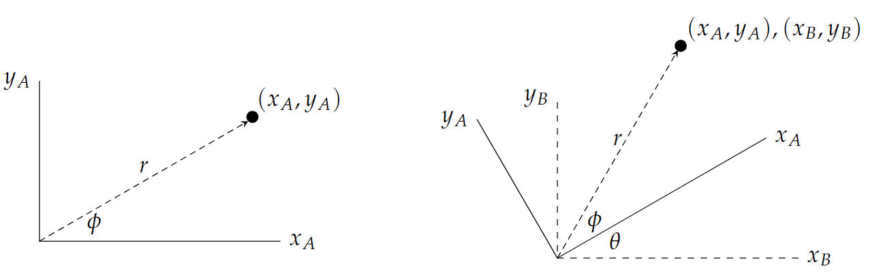
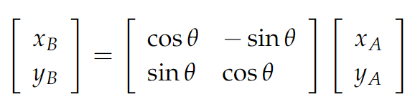
10
Rotations in two dimensions
Rotating the frame of reference
将矢量旋转θ的效果和旋转参考系得到的效果相同。下面的左图显示了参考框坐标系中的向量。右图显示了坐标系A相对于新坐标系B旋转θ后的相同矢量
给定坐标系中点的坐标

Slide 11
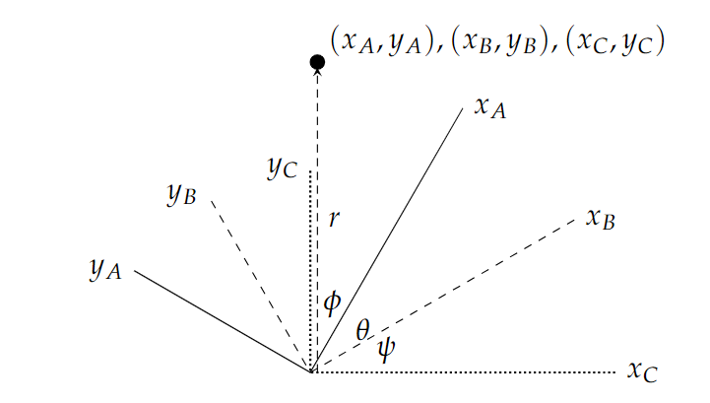

11
Rotations in two dimensions
Multiple rotations
将坐标系 B 相对于新坐标系 C 旋转 ψ

Slide 12
Rotations in three dimensions
12
三维旋转

Slide 13
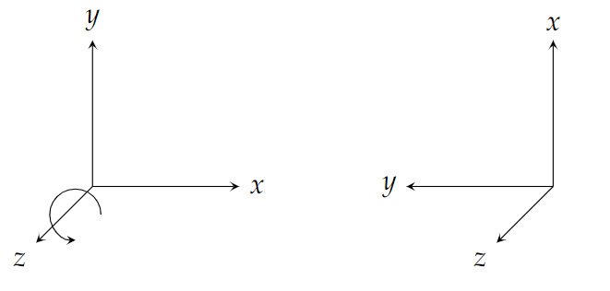
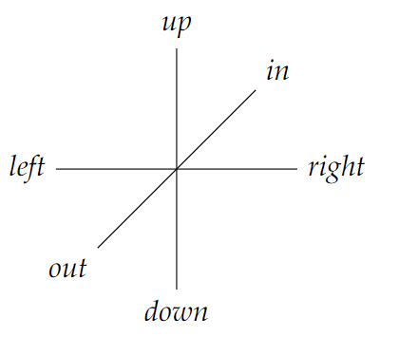
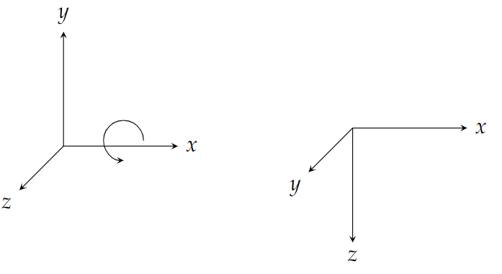
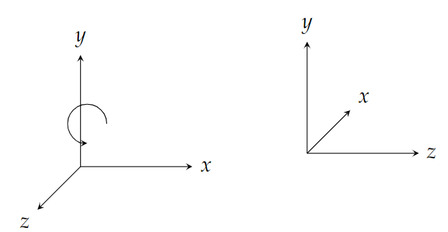
13
Rotations in three dimensions
Rotations around the three axes

Slide 14
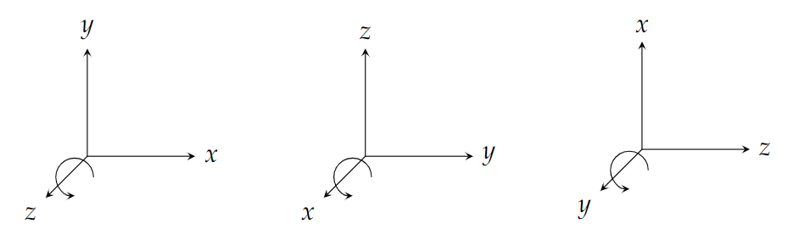
14
Rotations in three dimensions
The right hand rule

Slide 15
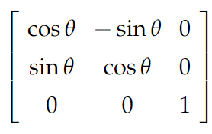
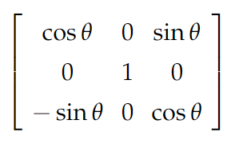
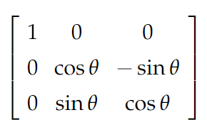
15
Rotations in three dimensions
Matrices for three-dimensional rotations
z-axis
y-axis
x-axis

Slide 16
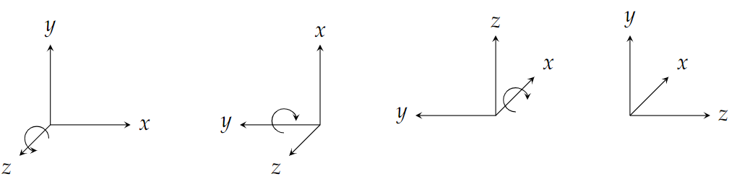
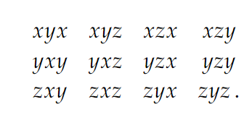
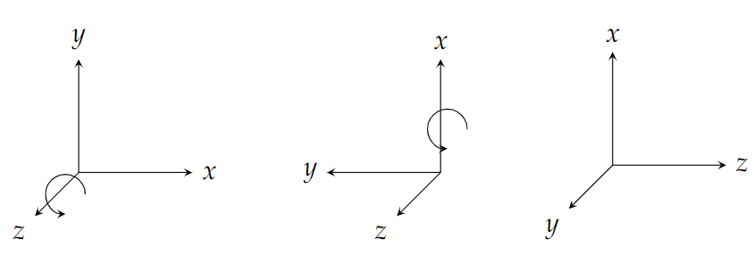
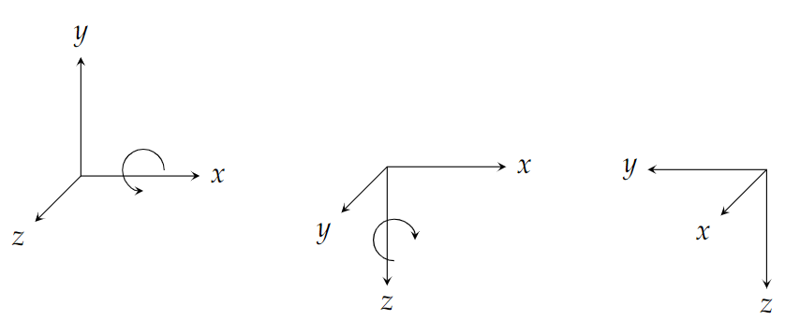
16
Rotations in three dimensions
Multiple rotations

Slide 17
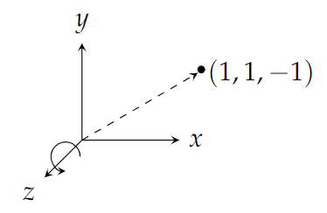
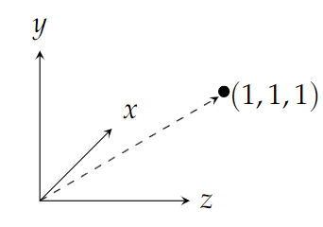
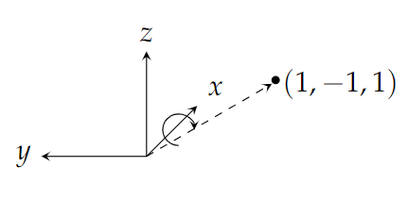
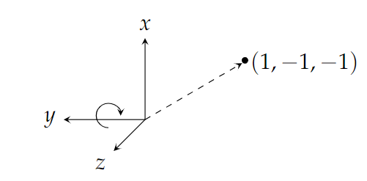
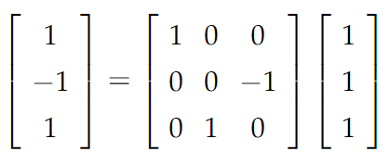
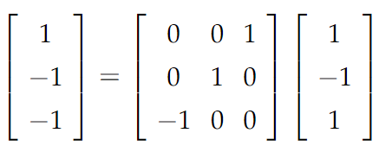
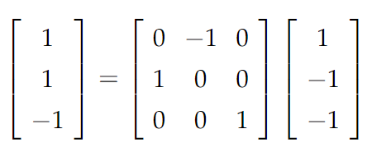
17
Rotations in three dimensions
Euler angles for transforming a vector
x-axis
y-axis
z-axis

Slide 18
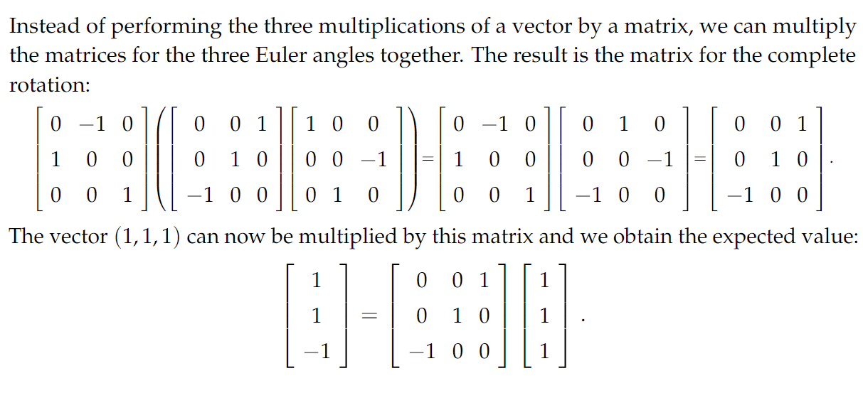
18
Rotations in three dimensions
One matrix for three rotations

Slide 19
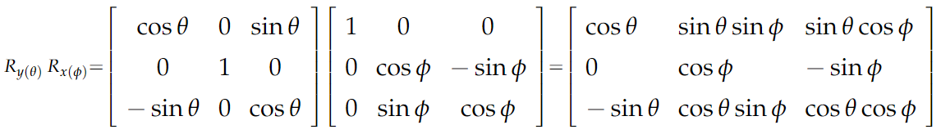
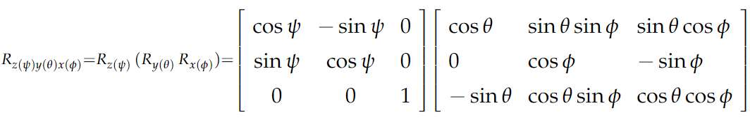
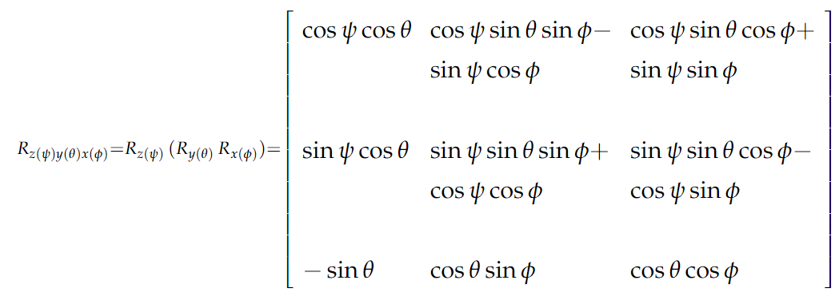
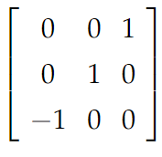

19
Rotations in three dimensions
The matrix for an arbitrary rotation
First multiply the rotation around the x-axis by the rotation around the y-axis
Then, multiply the result by the rotation around the z-axis:

Slide 20
Quaternions
20
四元数

Slide 21
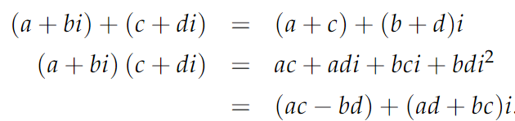

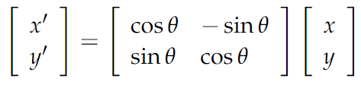
21
Quaternions
Complex numbers
复数可以表示平面中的向量和点。 数字 x+iy 用从 (0, 0) 到点 (x,y) 的向量标识。 复数乘法可用于旋转向量。 由欧拉公式
这是 (x,y) 通过 θ 的二维旋转：

Slide 22
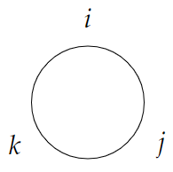
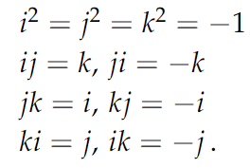
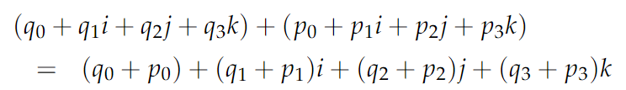
22
Quaternions
The algebra of quaternions
四元数是一个形式为 的 4 元组，其中 qi 是实数，符号 i、j、k
满足以下恒等式：
two quaternion add

Slide 23
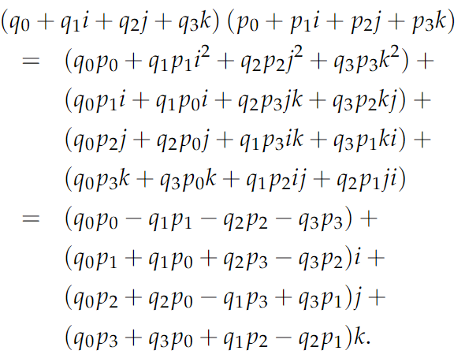
23
Quaternions
The algebra of quaternions
two quaternion multiply

Slide 24
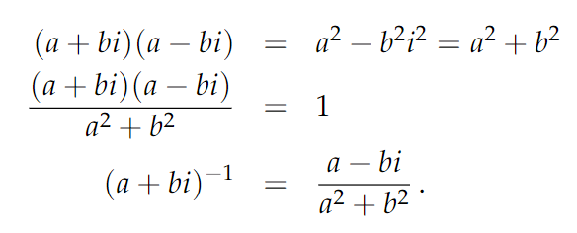
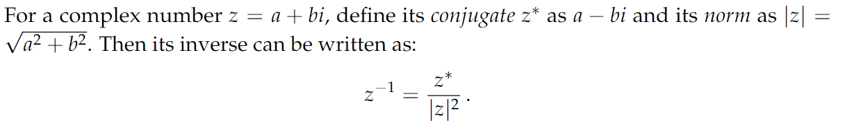
24
Quaternions
The conjugate and absolute value of a complex number
complex inverse

Slide 25


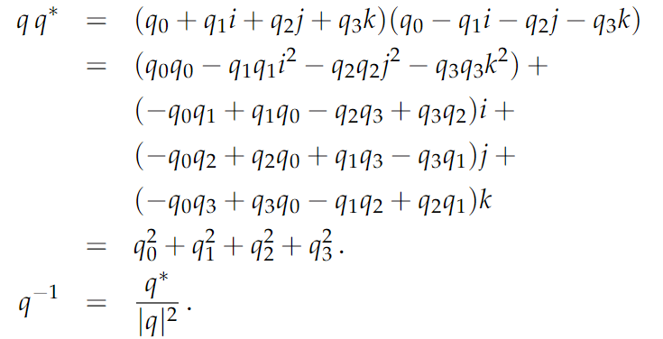
25
Quaternions
The conjugate and norm of a quaternion
quaternion conjugate
quaternion norm
quaternion inverse

Slide 26

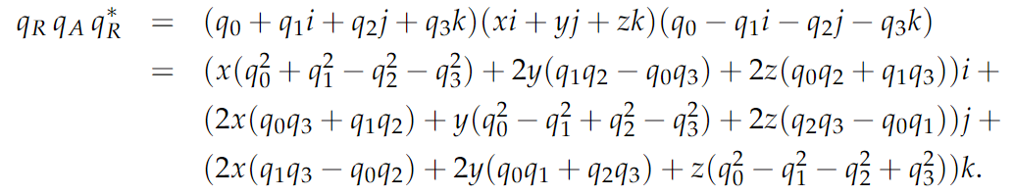
26
Quaternions
Quaternions for rotations
三维空间中的向量可以表示为纯四元数，从一个坐标系 A 到另一个坐标系 B 的旋转由共轭运算给出
此操作将产生一个四元数 $q_{B}$，它也是一个向量，因为它没有实部
：

Slide 27
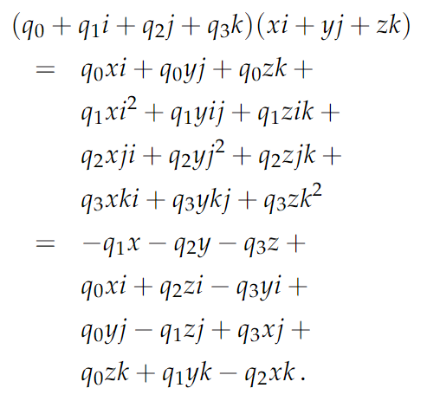
27
Quaternions
Multiplication of three quaternions
我们计算四分位数的乘法来改变坐标系
将前两个因子相乘

Slide 28
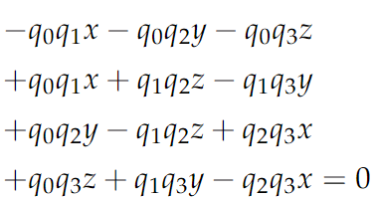
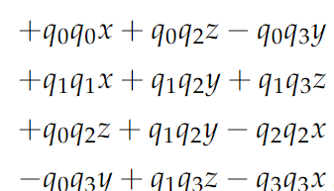
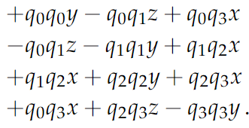
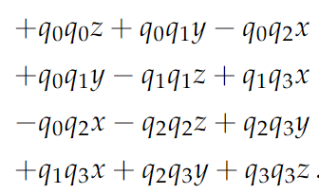
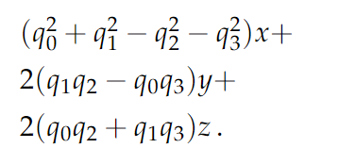
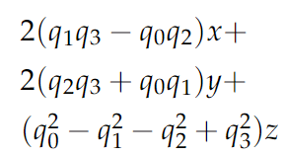
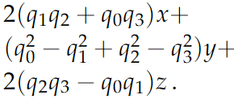
28
Quaternions
Multiplication of three quaternions
real part
coefficient of j
coefficient of k
coefficient of z
Collecting terms gives
Collecting terms gives
Collecting terms gives

Slide 29




29
Quaternions
From a quaternion to a rotation matrix
矩阵可以简化，因为旋转四元数的范数是 1:
从中我们有以下等式
化简后矩阵变为

Slide 30






30
Quaternions
From a matrix of angles to a quaternion
rotation matrix M trace
$$q_{0}$$
$$q_{1}$$
类似地，q2 和 q3

Slide 31




31
Quaternions
From Euler angles to a quaternion
给定一个角度的旋转，可以计算相应的四元数。 考虑围绕 z 轴的旋转 ψ
根据上一节中的公式并使用 Trace(M) =2 cosψ+1

Slide 32




32
Quaternions
Example
https://www.3dgep.com/understanding-quaternions/

Slide 33
Quaternions derivative
33
四元数导数

Slide 34




34
Quaternions derivative
Time derivatives
定义
四元素导数

Slide 35
Quaternions Interpolation
35
四元数插值

Slide 36

36
Quaternions Interpolation
Slerp插值
主体思想其实就是施密特正交，先根据 $q_{a}$ 和 $q_{b}$解算出两个正 $t=0$ 交的四元数，然后通过加权算出最终的 $q(t)$ 。下图能很好的说明白这个事。

Slide 37


