Slide 1
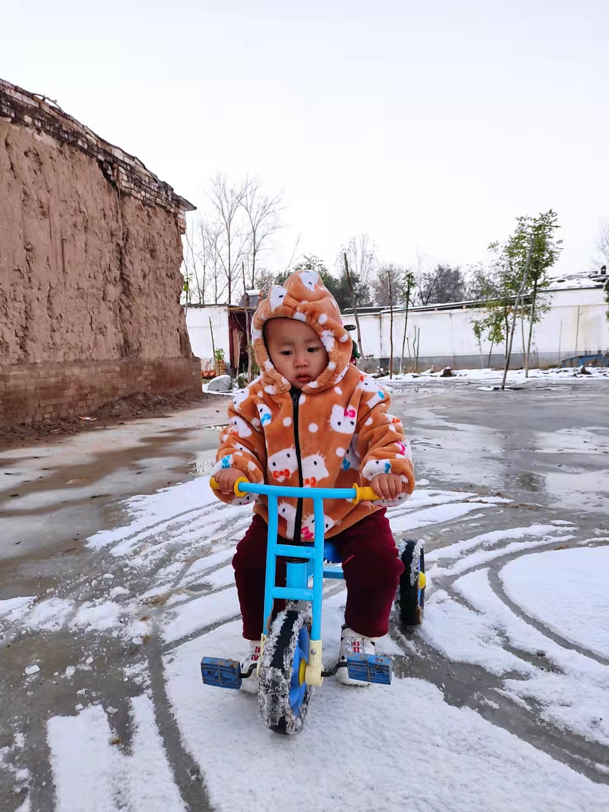



视觉SLAM
非线性优化Ceres
Mar 12th, 2022 https://github.com/duyongquan/LTSLAM
AibotBeginer 视觉SLAM
quandy2020@126.com

Slide 2
2
Outline
Introduction
kinematics
On Derivatives
Modeling Non-linear Least Squares
Solving Non-linear Least Squares
Covariance Estimation
General Unconstrained Minimization

Slide 3
Introduction
3
简介

Slide 4
4
Introduction
Ceres 可以解决以下形式的边界约束鲁棒化非线性最小二乘问题
参数描述

Slide 5
Tutorial demos
5
例子

Slide 6
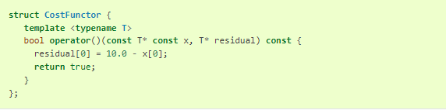
6
Tutorial demos
Demo : Hello World
Step 1 : write a functor that will evaluate this the function
Step 2 : initial value
Step 3 : build the problem.
Step 4 : set up the cost function
Step 5 : run the solver

Slide 7
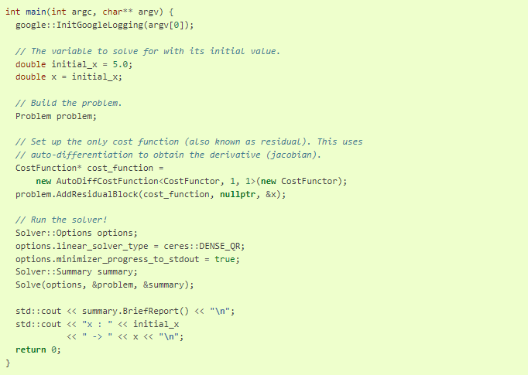
7
Tutorial demos
Demo : Hello World

Slide 8
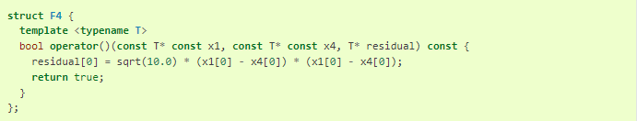
8
Tutorial demos
Demo : Powell's Function
objective functor

Slide 9
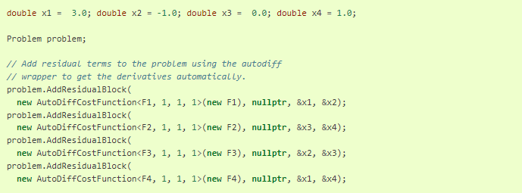
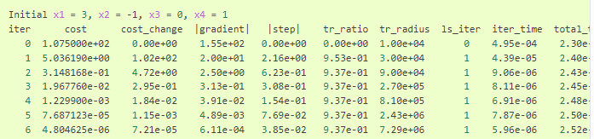
9
Tutorial demos
Demo : Powell's Function

Slide 10
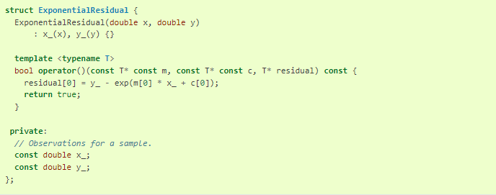
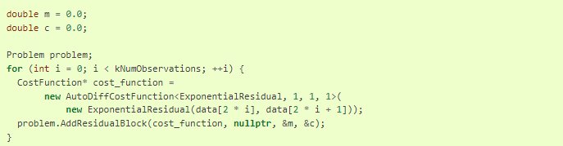
10
Tutorial demos
Demo : Curve Fitting
objective functor

Slide 11
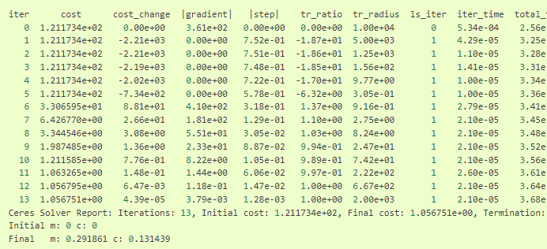
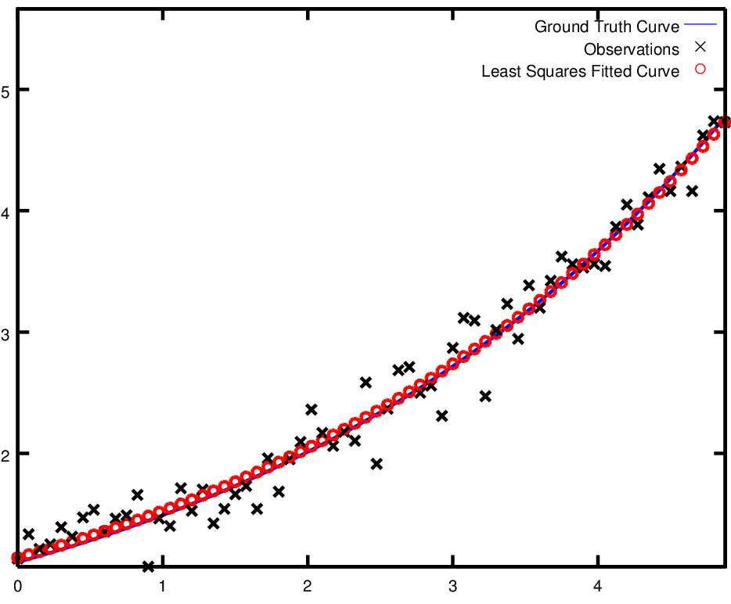
11
Tutorial demos
Demo : Curve Fitting

Slide 12
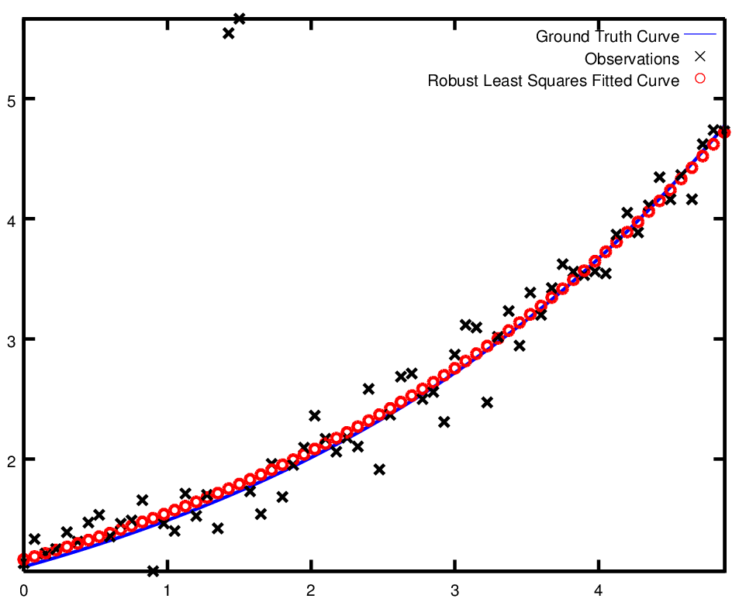
12
Tutorial demos
Demo : Robust Curve Fitting

Slide 13
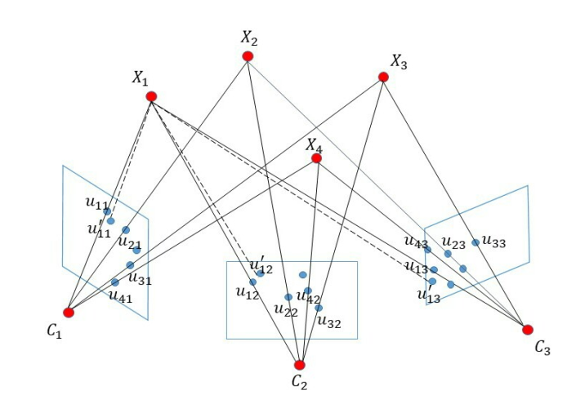
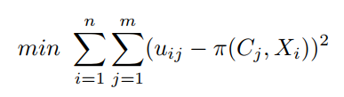
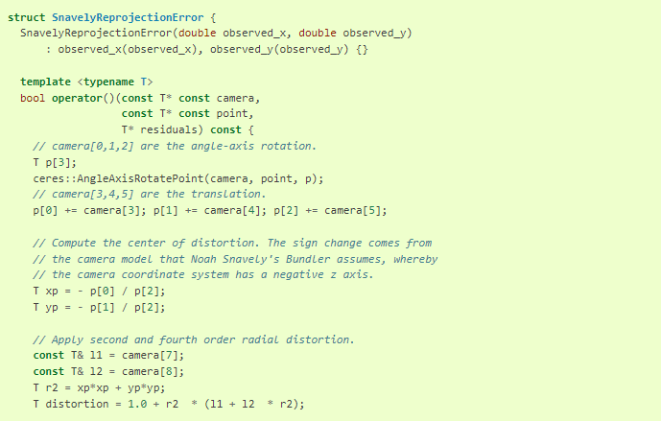
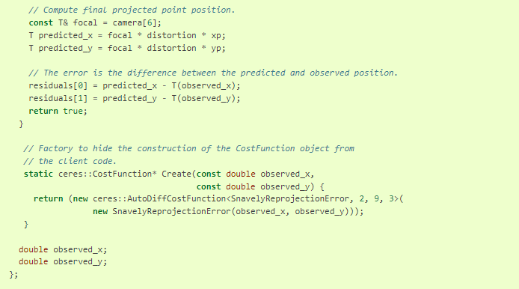
13
Tutorial demos
Demo : Bundle Adjustment

Slide 14


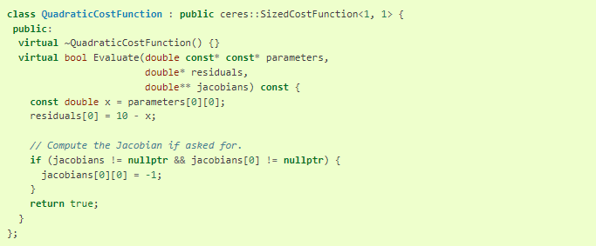
14
Tutorial demos
Derivatives
Numeric Derivatives
Analytic Derivatives

Slide 15
On Derivatives
15
导数

Slide 16
16
On Derivatives
Derivatives

Slide 17


