Slide 1
Module 16: Troubleshoot Static and Default Routes
Instructor Materials
Switching, Routing and Wireless Essentials v7.0 (SRWE)
Notes:
Cisco Networking Academy Program
Switching, Routing and Wireless Essentials v7.0 (SRWE)
Module 16: Troubleshoot Static and Default Routes

Slide 2
Instructor Materials – Module 16 Planning Guide
This PowerPoint deck is divided in two parts:
Instructor Planning Guide
Information to help you become familiar with the module
Teaching aids
Instructor Class Presentation
Optional slides that you can use in the classroom
Begins on slide # 9
Note: Remove the Planning Guide from this presentation before sharing with anyone.
For additional help and resources go to the Instructor Home Page and Course Resources for this course. You also can visit the professional development site on netacad.com, the official Cisco Networking Academy Facebook page, or Instructor Only FB group.
Notes:
2

Slide 3
What to Expect in this Module
To facilitate learning, the following features within the GUI may be included in this module:
Feature | Description
Animations | Expose learners to new skills and concepts.
Videos | Expose learners to new skills and concepts.
Check Your Understanding(CYU) | Per topic online quiz to help learners gauge content understanding.
Interactive Activities | A variety of formats to help learners gauge content understanding.
Syntax Checker | Small simulations that expose learners to Cisco command line to practice configuration skills.
PT Activity | Simulation and modeling activities designed to explore, acquire, reinforce, and expand skills.

Slide 4
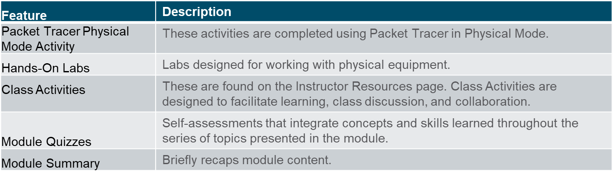
What to Expect in this Module (Cont.)
To facilitate learning, the following features may be included in this module:

Slide 5
Check Your Understanding
Check Your Understanding activities are designed to let students quickly determine if they understand the content and can proceed, or if they need to review.
Check Your Understanding activities do not affect student grades.
There are no separate slides for these activities in the PPT. They are listed in the notes area of the slide that appears before these activities.
Notes:
5

Slide 6
Packet Tracer Physical Mode Activities
These activities are completed using Packet Tracer in Physical Mode.
They are designed to emulate the corresponding Labs.
They can be used instead of the lab when access to physical equipment is not possible.
Packet Tracer Physical Mode activities may not have as much scaffolding as the PT activities that immediately precede them.
Notes:
6

Slide 7
Module 16: Activities
What activities are associated with this module?
Page # | Activity Type | Activity Name | Optional?
16.1.2 | Check Your Understanding | Packet Processing with Static Routes | Recommended
16.2.4 | Syntax Checker | Troubleshoot IPv4 Static and Default Routes | Recommended
16.3.1 | Packet Tracer | Troubleshoot Static and Default Routes | Recommended
16.3.2 | Packet Tracer Physical Mode | Packet Tracer – Troubleshoot Static and Default Routes – Physical Mode | Recommended
16.3.2 | Lab | Troubleshoot Static and Default Routes | Recommended
16.3.4 | Module Quiz | Troubleshoot Static and Default Routes | Recommended
Notes:
7

Slide 8
Module 16: Best Practices
Prior to teaching Module 16, the instructor should:
Review the activities and assessments for this module.
Try to include as many questions as possible to keep students engaged during classroom presentation.
After this Module, the Routing Concepts and Configuration Exam is available, covering Modules 14-16
Topic 16.1
Ask the students or have a class discussion
What kinds of problems do you think an incorrectly configured static route create?
What kind of configuration errors can be caused by configuring a static route?
Topic 16.2
Ask the students or have a class discussion
Given a topology, can you explain how a packet travels from source to destination?
Which commands would help you solve a static route problem?
Notes:
8

Slide 9
Module 16: Troubleshoot Static and Default Routes
Switching, Routing and Wireless Essentials v7.0 (SRWE)
Notes:
Cisco Networking Academy Program
Switching, Routing and Wireless Essentials v7.0 (SRWE)
Module 16: Troubleshoot Static and Default Routes

Slide 10
Module Objectives
Module Title: Troubleshoot Static and Default Routes
Module Objective: Troubleshoot static and default route configurations.
Topic Title | Topic Objective
Packet Processing with Static Routes | Explain how a router processes packets when a static route is configured.
Troubleshoot IPv4 Static and Default Route Configuration | Troubleshoot common static and default route configuration issues.
Notes:
10
16 – Troubleshoot Static and Default Routes
16.0 – Introduction
16.0.2 – What will I learn to do in this module?

Slide 11
16.1 Packet Processing with Static Routes
Notes:
16 – Troubleshoot Static and Default Routes
16.1 – Packet Processing with Static Routes

Slide 12
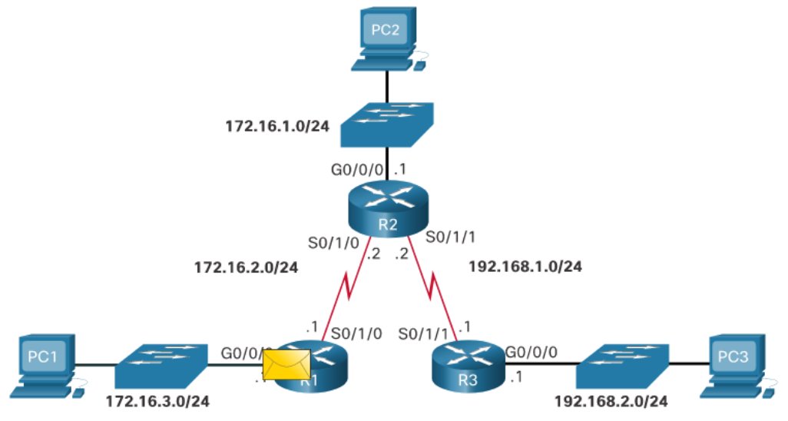
Packet Processing with Static Routes Static Routes and Packet Forwarding
PC1 addresses a packet to PC3 and sends it to the default gateway address.
When the packet arrives on the R1 G0/0/0 interface, R1 decapsulates the packet and searches the routing table for a matching destination network entry.
If the destination IP address:
Matches a static route entry, R1 will use the static route to identify the next-hop IP address or exit interface.
Does not match a specific route to the destination network, then R1 will use the default static route (if configured).
Does not match a route table entry, then R1 will drop the packet and send an ICMP message back to the source (i.e., PC1).
Notes:
16 – Troubleshoot Static and Default Routes
16.1 – Packet Processing with Static Routes
16.1.1 – Static Routes and Packet Forwarding

Slide 13
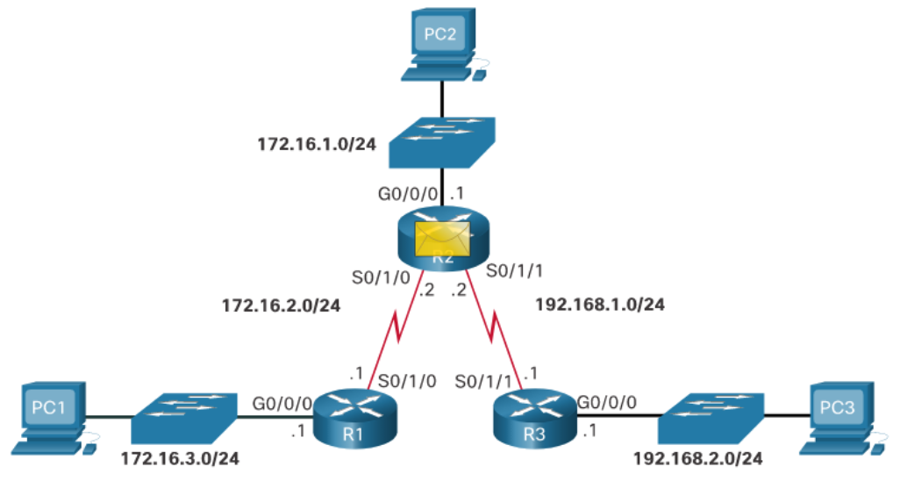
Packet Processing with Static Routes Static Routes and Packet Forwarding (Cont.)
Assuming R1 matched a routing table entry, it encapsulates the packet in a new frame and forwards it out of interface S0/1/0 to R2.
R2 receives the packet on its S0/1/0 interface.
It decapsulates and processes the packet the same way R1 did.
When R2 finds a match in the routing table, it uses the identified next-hop IP address or exit interface and sends the packet out of its interface S0/1/1 towards R3.
Notes:
16 – Troubleshoot Static and Default Routes
16.1 – Packet Processing with Static Routes
16.1.1 – Static Routes and Packet Forwarding (Cont.)

Slide 14
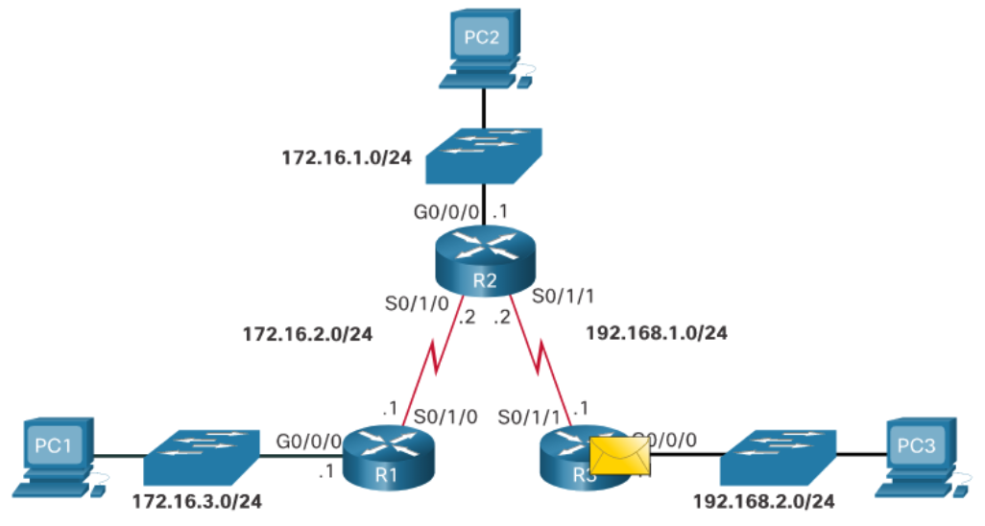
Packet Processing with Static Routes Static Routes and Packet Forwarding (Cont.)
R3 receives the packet, decapsulates it, and searches the routing table for a match.
The destination IP address of PC3 matches the directly connected G0/0/0 interface. Therefore, R3 searches the ARP table for the Layer 2 MAC address of PC3.
If no ARP entry exists, then R3 sends an ARP request out of the G0/0/0 interface.
PC3 responds with an ARP reply containing its MAC address.
R3 encapsulates the packet in a new frame and uses the PC3 MAC address as the destination MAC address and the G0/0/0 MAC address as the source MAC address.
The frame is forwarded out of interface G0/0/0 and PC3 receives and processes it accordingly.
Notes:
16 – Troubleshoot Static and Default Routes
16.1 – Packet Processing with Static Routes
16.1.1 – Static Routes and Packet Forwarding (Cont.)
16.1.2 – Check Your Understanding - Packet Processing with Static Routes

Slide 15
16.2 Troubleshoot IPv4 Static and Default Route Configuration
Notes:
16 – Troubleshoot Static and Default Routes
16.2 – Troubleshoot IPv4 Static and Default Route Configuration

Slide 16
Troubleshoot IPv4 Static and Default Route Configuration Network Changes
Networks fail for a number of reasons:
An interface can fail
A service provider drops a connection
Links can become oversaturated
An administrator may enter a wrong configuration.
Network administrators are responsible for pinpointing and solving the problem.
To efficiently find and solve these issues, it is advantageous to be intimately familiar with tools to help isolate routing problems quickly.
Notes:
16 – Troubleshoot Static and Default Routes
16.2 – Troubleshoot IPv4 Static and Default Route Configuration
16.2.1 – Network Changes

Slide 17
Troubleshoot IPv4 Static and Default Route Configuration Common Troubleshooting Commands
Command | Description
ping | Verify Layer 3 connectivity to destination. Extended pings provide additional options.
traceroute | Verify path to destination network. It uses ICMP echo reply messages to determine the hops to the destination.
show ip route | Displays the routing table. Used to verify route entries for destination IP addresses.
show ip interface brief | Displays the status of device interfaces. Used to verify the operational status and IP address of an interface.
show cdp neighbors | Displays a list of directly connected Cisco devices. Also used to validate Layer 1 and 2 connectivity.
Notes:
16 – Troubleshoot Static and Default Routes
16.2 – Troubleshoot IPv4 Static and Default Route Configuration
16.2.2 – Common Troubleshooting Commands

Slide 18
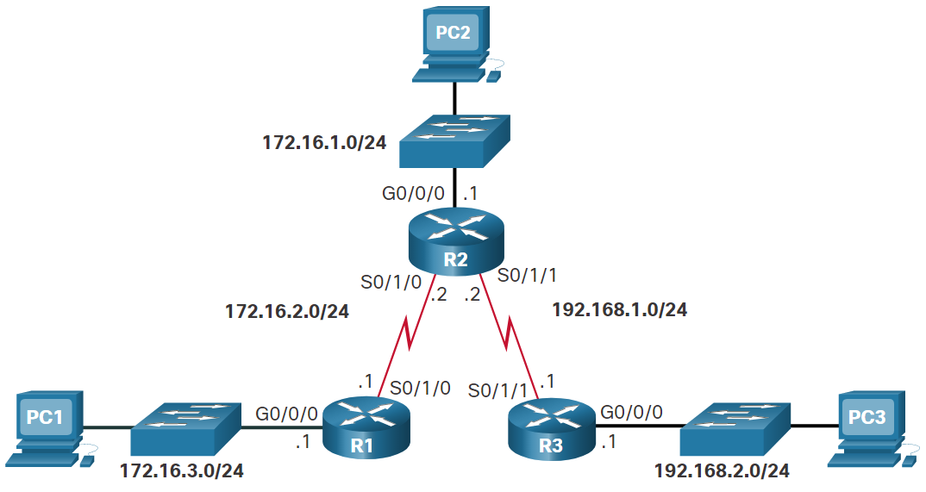
Troubleshoot IPv4 Static and Default Route Configuration Solve a Connectivity Problem
Connectivity from PC1 to PC3 fails.
Extended pings from the R1 G0/0/0 interface to PC3 fail.
Pings from R1 (i.e., S0/1/0 interface) to R2 are successful.
Pings from R1 (i.e., S0/1/0 interface) to R3 are successful.
R2 routing table reveals the problem and the incorrect static route is removed.
A new static route solves the problem.
ip route 172.16.3.0 255.255.255.0 172.16.2.1
R2# show ip route | begin Gateway
Gateway of last resort is not set
172.16.0.0/16 is variably subnetted, 5 subnets, 2 masks
C 172.16.1.0/24 is directly connected, GigabitEthernet0/0/0
L 172.16.1.1/32 is directly connected, GigabitEthernet0/0/0
C 172.16.2.0/24 is directly connected, Serial0/l/0
L 172.16.2.2/32 is directly connected, Serial0/l/0
S 172.16.3.0/24 [1/0] via 192.168.1.1
192.168.1.0/24 is variably subnetted, 2 subnets, 2 masks
C 192.168.1.0/24 is directly connected, Serial0/1/1
L 192.168.1.2/32 is directly connected, Serial0/1/1
S 192.168.2.0/24 [1/0] via 192.168.1.1
R2#
Notes:
16 – Troubleshoot Static and Default Routes
16.2 – Troubleshoot IPv4 Static and Default Route Configuration
16.2.3 –Solve a Connectivity Problem
16.2.4 – Syntax Checker - Troubleshoot IPv4 Static and Default Routes

Slide 19
16.3 Module Practice and Quiz
Notes:
16 – Troubleshoot Static and Default Routes
16.3 - Module Practice and Quiz

Slide 20
Structured Design Packet Tracer – Troubleshoot Static and Default Routes
In this activity you will troubleshoot and static and default routes and repair any errors that you find.
Troubleshoot IPv4 static routes.
Troubleshoot IPv6 static routes.
Configure IPv4 static routes.
Configure IPv4 default routes.
Configure IPv6 static routes.
Notes:
16 – Troubleshoot Static and Default Routes
16.3 - Module Practice and Quiz
16.3.1 – Packet Tracer – Troubleshoot Static and Default Routes

Slide 21
Structured Design Packet Tracer – Troubleshoot Static and Default Routes – Physical Mode Lab - Troubleshoot Static and Default Routes
In this Packet Tracer Physical Mode activity and in the Lab, you will complete the following objectives:
Evaluate Network Operation
Gather Information, Create an Action Plan, and Implement Corrections
Notes:
16 – Troubleshoot Static and Default Routes
16.3 - Module Practice and Quiz
16.3.2 – PTPT and Lab - Troubleshoot Static and Default Routes

Slide 22
Module Practice and Quiz What did I learn in this module?
A host sends a packet to another host and sends it to the default gateway address.
When the packet arrives on a router interface, it decapsulates the packet and searches the routing table for a matching destination network entry.
If the destination IP address:
Matches a static route entry, the router will use the static route to identify the next hop IP address or exit interface.
Does not match a specific route to the destination network, then the router will use the default static route (if configured).
Does not match a route table entry, then the router will drop the packet and send an ICMP message back to the source.
If the router matched a routing table entry, then the router encapsulates the packet and forwards it out of the appropriate interface.
The packet is forwarded from router to router until it reaches its destination network.
Notes:
16 – Troubleshoot Static and Default Routes
16.3 - Module Practice and Quiz
16.3.3 – What did I learn in this module?

Slide 23
Module Practice and Quiz What did I learn in this module? (Cont.)
When the packet reaches the destination network, that router will search the routing table for a match.
When the destination IP address matches a directly connected Ethernet interface, the router searches the ARP table for the Layer 2 MAC address of the destination IP address.
If no ARP entry exists, the router sends an ARP request out of the Ethernet interface
The destination host responds with an ARP reply containing its MAC address.
The router then encapsulates the packet in a new frame. It uses the MAC address of the destination host as the frame destination MAC address, and the MAC address of the router Ethernet interface as the source MAC address in the frame.
The frame is forwarded out of the appropriate interface.
The packet arrives on the network interface card (NIC) interface of destination host and is processed accordingly.
Notes:
16 – Troubleshoot Static and Default Routes
16.3 - Module Practice and Quiz
16.3.3 – What did I learn in this module? (Cont.)

Slide 24
Module Practice and Quiz What did I learn in this module? (Cont.)
Common IOS troubleshooting commands to troubleshoot IPv4 Static and default routes include:
ping
traceroute
show ip route
show ip interface brief
show cdp neighbors detail
Notes:
16 – Troubleshoot Static and Default Routes
16.3 - Module Practice and Quiz
16.3.3 – What did I learn in this module? (Cont.)
16.3.4 – Module Quiz – Troubleshoot Static and Default Routes

