Slide 1
Module 2: Switching Concepts
Instructor Materials
Switching, Routing, and Wireless Essentials v7.0 (SRWE)
Notes:
Cisco Networking Academy Program
Switching, Routing and Wireless Essentials v7.0 (SRWE)
Module 2: Switching Concepts

Slide 2
Instructor Materials – Module 2 Planning Guide
This PowerPoint deck is divided in two parts:
Instructor Planning Guide
Information to help you become familiar with the module
Teaching aids
Instructor Class Presentation
Optional slides that you can use in the classroom
Begins on slide # 10
Note: Remove the Planning Guide from this presentation before sharing with anyone.
For additional help and resources go to the Instructor Home Page and Course Resources for this course. You also can visit the professional development site on netacad.com, the official Cisco Networking Academy Facebook page, or Instructor Only FB group.
Notes:
2

Slide 3
What to Expect in this Module
To facilitate learning, the following features within the GUI may be included in this module:
Feature | Description
Animations | Expose learners to new skills and concepts.
Videos | Expose learners to new skills and concepts.
Check Your Understanding(CYU) | Per topic online quiz to help learners gauge content understanding.
Interactive Activities | A variety of formats to help learners gauge content understanding.
Syntax Checker | Small simulations that expose learners to Cisco command line to practice configuration skills.
PT Activity | Simulation and modeling activities designed to explore, acquire, reinforce, and expand skills.

Slide 4
What to Expect in this Module (Cont.)
To facilitate learning, the following features may be included in this module:
Feature | Description
Hands-On Labs | Labs designed for working with physical equipment.
Class Activities | These are found on the Instructor Resources page. Class Activities are designed to facilitate learning, class discussion, and collaboration.
Module Quizzes | Self-assessments that integrate concepts and skills learned throughout the series of topics presented in the module.
Module Summary | Briefly recaps module content.

Slide 5
Check Your Understanding
Check Your Understanding activities are designed to let students quickly determine if they understand the content and can proceed, or if they need to review.
Check Your Understanding activities do not affect student grades.
There are no separate slides for these activities in the PPT. They are listed in the notes area of the slide that appears before these activities.
Notes:
5

Slide 6
Module 2: Activities
What activities are associated with this module?
Page # | Activity Type | Activity Name | Optional?
2.1.4 | Video | MAC Address Tables on Connected Switches | Recommended
2.1.8 | Activity | Switch It! | Recommended
2.2.4 | Check Your Understanding | Switching Domains | Recommended
2.3.2 | Module Quiz | Switching Concepts | Recommended
Notes:
6

Slide 7
Module 2: Best Practices (Cont.)
Prior to teaching Module 2, the instructor should:
Review the activities and assessments for this module.
Try to include as many questions as possible to keep students engaged during classroom presentation.
Topic 2.1
Explain the difference between a routing table and MAC address table.
It might be helpful to also explain the difference in function of a Layer 1 hub, which can only flood traffic. A layer 2 switch, which can 1. flood, if it is a broadcast or the unicast destination is unknown 2. forward traffic, when the unicast destination is in the table and 3. Filter traffic, when the switch receives a frame where the source and destination are on the same port. A layer 3 router can forward, if the destination is in the routing table or filter, if the destination is not in the table. Layer 3 is never allowed to flood traffic.
Compare and contrast the switching methods. Store-and-forward will not only eliminate CRC errors, but also runts and giants. Fragment-free can only eliminate runts.
Notes:
7

Slide 8
Module 2: Best Practices (Cont.)
Topic 2.2
Compare and contrast collision domains with broadcast domains. Ask the students what creates the problem of the collision domain. Then ask what is the solution. The problem is extending the network at layer 1, e.g. adding hubs (half-duplex) to the network. The solution is the layer 2 switch (full-duplex), which should eliminate the collision domain. However, if a connection from a switch that is in auto-negotiation fails, then we have the potential for a duplex mismatch. If one of the interfaces goes to half-duplex then a collision domain is created on that link even with the microsegmentation of the switch.
When discussing the broadcast domain, ask the class which layer causes this issue and which will be the solution. The issue is at layer 1 and / or layer 2 extending the LAN, both will flood traffic. The solution is the layer 3 router that will not flood broadcasts.
Notes:
8

Slide 9
Module 2: Best Practices (Cont.)
Topic 2.2
A good analogy to describe the router with broadcasts is in the movie Lord of the Rings where Gandalf the grey in the Mines of Morea yells “You shall not pass!”. While the router interface that is part of LAN will listen to the broadcast, it will not pass nor flood the broadcast.
Consider what would happen if layer 3 passed broadcasts. Broadcasts are like an intercom at nationwide department or grocery store. They should be at the local store, but imagine the chaos if every time someone got onto the intercom it was flooded through to all of the stores in that chain! Imagine if someone sent a broadcast to their printer for a MAC address and it went to everyone on the internet because layer 3 flooded it! This is why layer 3 never has flooding as an option.
Also remember that a broadcast is like an intercom announcement and may be used to locate one device, just as an intercom might reach one person in the store. The broadcast can also be used to send messages to all devices.
Notes:
9

Slide 10
Module 2: Switching Concepts
Switching, Routing, and Wireless Essentials v7.0 (SRWE)
Notes:
Cisco Networking Academy Program
Switching, Routing and Wireless Essentials v7.0 (SRWE)
Module 2: Switching Concepts

Slide 11
Module Objectives
Module Title: Switching Concepts
Module Objective: Explain how Layer 2 switches forward data.
Topic Title | Topic Objective
Frame Forwarding | Explain how frames are forwarded in a switched network.
Switching Domains | Compare a collision domain to a broadcast domain.
Notes:
11
2 – Switching Concepts
2.0 – Introduction
2.0.2 – What will I learn to do in this module?

Slide 12
2.1 Frame Forwarding
Notes:
2 – Switching Concepts
2.1 – Frame Forwarding

Slide 13
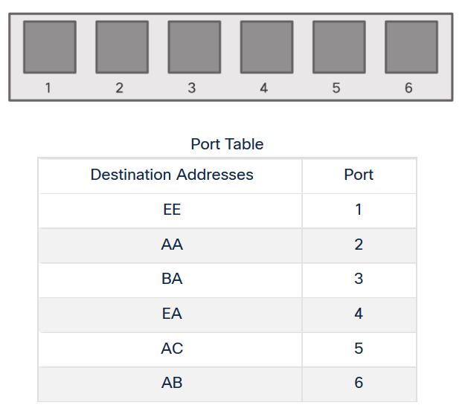
Frame Forwarding Switching in Networking
Two terms are associated with frames entering or leaving an interface:
Ingress – entering the interface
Egress – exiting the interface
A switch forwards based on the ingress interface and the destination MAC address.
A switch uses its MAC address table to make forwarding decisions.
Note: A switch will never allow traffic to be forwarded out the interface it received the traffic.
Notes:
2 – Switching Concepts
2.1 – Frame Forwarding
2.1.1 – Switching in Networking

Slide 14
Frame Forwarding The Switch MAC Address Table
A switch will use the destination MAC address to determine the egress interface.
Before a switch can make this decision it must learn what interface the destination is located.
A switch builds a MAC address table, also known as a Content Addressable Memory (CAM) table, by recording the source MAC address into the table along with the port it was received.
Notes:
2 – Switching Concepts
2.1 – Frame Forwarding
2.1.2 – The Switch MAC Address Table

Slide 15
Frame Forwarding The Switch Learn and Forward Method
The switch uses a two step process:
Step 1. Learn – Examines Source Address
Adds the source MAC if not in table
Resets the time out setting back to 5 minutes if source is in the table
Step 2. Forward – Examines Destination Address
If the destination MAC is in the MAC address table it is forwarded out the specified port.
If a destination MAC is not in the table, it is flooded out all interfaces except the one it was received.
Notes:
2 – Switching Concepts
2.1 – Frame Forwarding
2.1.3 – The Switch Learn and Forward Method

Slide 16
Frame Forwarding Video – MAC Address Tables on Connected Switches
This video will cover the following:
How switches build MAC address tables
How switches forward frames based on the content of their MAC address tables
Notes:
2 – Switching Concepts
2.1 – Frame Forwarding
2.1.4 – Video – MAC Address Tables on Connected Switches

Slide 17
Frame Forwarding Switch Forwarding Methods
Switches use software on application-specific-integrated circuits (ASICs) to make very quick decisions.
A switch will use one of two methods to make forwarding decisions after it receives a frame:
Store-and-forward switching - Receives the entire frame and ensures the frame is valid. Store-and-forward switching is Cisco’s preferred switching method.
Cut-through switching – Forwards the frame immediately after determining the destination MAC address of an incoming frame and the egress port.
Notes:
2 – Switching Concepts
2.1 – Frame Forwarding
2.1.5 – Switch Forwarding Methods

Slide 18
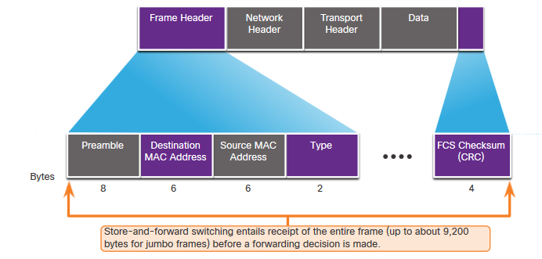
Frame Forwarding Store-and-Forward Switching
Store-and-forward has two primary characteristics:
Error Checking – The switch will check the Frame Check Sequence (FCS) for CRC errors. Bad frames will be discarded.
Buffering – The ingress interface will buffer the frame while it checks the FCS. This also allows the switch to adjust to a potential difference in speeds between the ingress and egress ports.
Notes:
2 – Switching Concepts
2.1 – Frame Forwarding
2.1.6 – Store-and-Forward Switching

Slide 19
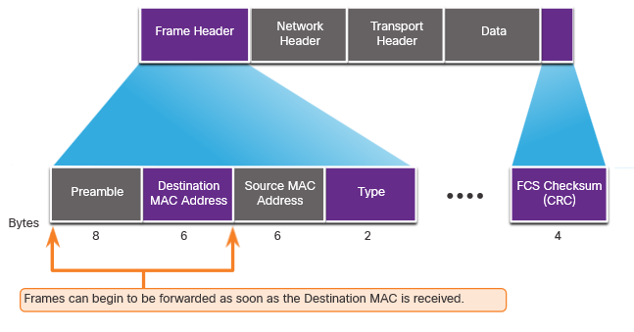
Frame Forwarding Cut-Through Switching
Cut-through forwards the frame immediately after determining the destination MAC.
Fragment (Frag) Free method will check the destination and ensure that the frame is at least 64 Bytes. This will eliminate runts.
Concepts of Cut-Through switching:
Is appropriate for switches needing latency to be under 10 microseconds
Does not check the FCS, so it can propagate errors
May lead to bandwidth issues if the switch propagates too many errors
Cannot support ports with differing speeds going from ingress to egress
Notes:
2 – Switching Concepts
2.1 – Frame Forwarding
2.1.7 – Cut-Through Switching
2.1.8 – Activity – Switch It!

Slide 20
2.2 Switching Domains
Notes:
2 – Switching Concepts
2.2 – Switching Domains

Slide 21
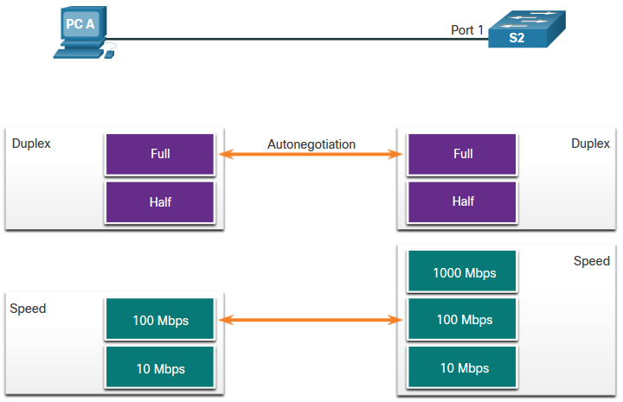
Switching Domains Collision Domains
Switches eliminate collision domains and reduce congestion.
When there is full duplex on the link the collision domains are eliminated.
When there is one or more devices in half-duplex there will now be a collision domain.
There will now be contention for the bandwidth.
Collisions are now possible.
Most devices, including Cisco and Microsoft use auto-negotiation as the default setting for duplex and speed.
Notes:
2 – Switching Concepts
2.2 – Switching Domains
2.2.1 – Collision Domains

Slide 22
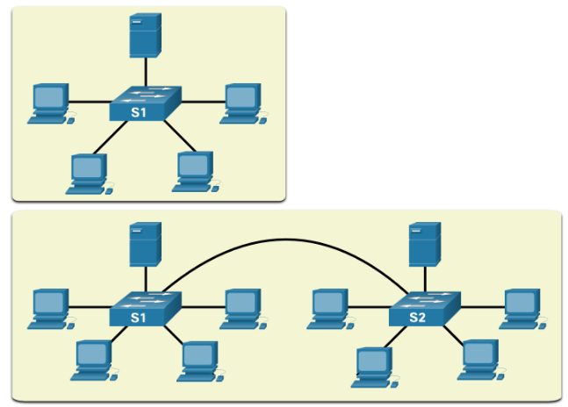
Switching Domains Broadcast Domains
A broadcast domain extends across all Layer 1 or Layer 2 devices on a LAN.
Only a layer 3 device (router) will break the broadcast domain, also called a MAC broadcast domain.
The broadcast domain consists of all devices on the LAN that receive the broadcast traffic.
When the layer 2 switch receives the broadcast it will flood it out all interfaces except for the ingress interface.
Too many broadcasts may cause congestion and poor network performance.
Increasing devices at Layer 1 or layer 2 will cause the broadcast domain to expand.
Notes:
2 – Switching Concepts
2.2 – Switching Domains
2.2.2 – Broadcast Domains

Slide 23
Switching Domains Alleviated Network Congestion
Switches use the MAC address table and full-duplex to eliminate collisions and avoid congestion.
Features of the switch that alleviate congestion are as follows:
Protocol | Function
Fast Port Speeds | Depending on the model, switches may have up to 100Gbps port speeds.
Fast Internal Switching | This uses fast internal bus or shared memory to improve performance.
Large Frame Buffers | This allows for temporary storage while processing large quantities of frames.
High Port Density | This provides many ports for devices to be connected to LAN with less cost. This also provides for more local traffic with less congestion.
Notes:
2 – Switching Concepts
2.2 – Switching Domains
2.2.3 – Alleviated Network Congestion
2.2.4 – Check Your Understanding - Switching Domains

Slide 24
2.3 Module Practice and Quiz
Notes:
2 – Switching Concepts
2.3 – Module Practice and Quiz

Slide 25
Module Practice and Quiz What did I learn in this module?
Frame Forwarding
Ingress is the entry port, egress is the exit port.
The switch builds a MAC address table to forward frames on the LAN.
The switch can use either the store-and-forward or cut-through method of switch forwarding.
Switching Domains
Ethernet ports in half-duplex will be a part of a collision domain.
Full-duplex will eliminate collision domains.
A switch will flood out all interfaces except the ingress port if the frame is a broadcast or if the unicast destination MAC is unknown.
Broadcast domains may be broken up by a layer 3 device, like a router.
Switches extend broadcast domains, but can eliminate collision domains and relieve congestion.
Notes:
2 – Switching Concepts
2.3 – Module Practice and Quiz
2.3.1 – What did I learn in this module?

Slide 26
Module 2: Switching Concepts New Terms and Commands
content accessible memory (CAM)
MAC address table
store-and-forward switching
cut-through switching
automatic buffering
fragment free switching
collision domains
broadcast domains

