Slide 1
Module 3: VLANs
Instructor Materials
Switching, Routing, and Wireless Essentials v7.0 (SRWE)
Notes:
Cisco Networking Academy Program
Switching, Routing, and Wireless Essentials v7.0 (SRWE)
Module 3: VLANs

Slide 2
Instructor Materials – Module 3 Planning Guide
This PowerPoint deck is divided in two parts:
Instructor Planning Guide
Information to help you become familiar with the module
Teaching aids
Instructor Class Presentation
Optional slides that you can use in the classroom
Begins on slide # 13
Note: Remove the Planning Guide from this presentation before sharing with anyone.
For additional help and resources go to the Instructor Home Page and Course Resources for this course. You also can visit the professional development site on netacad.com, the official Cisco Networking Academy Facebook page, or Instructor Only FB group.
Notes:
2

Slide 3
What to Expect in this Module
To facilitate learning, the following features within the GUI may be included in this module:
Feature | Description
Animations | Expose learners to new skills and concepts.
Videos | Expose learners to new skills and concepts.
Check Your Understanding(CYU) | Per topic online quiz to help learners gauge content understanding.
Interactive Activities | A variety of formats to help learners gauge content understanding.
Syntax Checker | Small simulations that expose learners to Cisco command line to practice configuration skills.
PT Activity | Simulation and modeling activities designed to explore, acquire, reinforce, and expand skills.

Slide 4
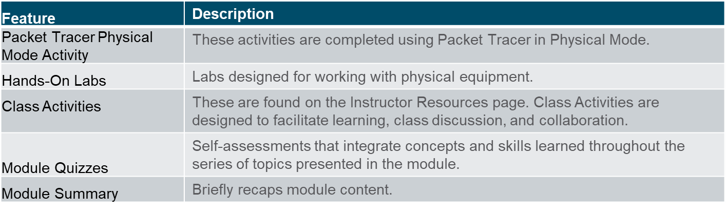
What to Expect in this Module (Cont.)
To facilitate learning, the following features may be included in this module:

Slide 5
Check Your Understanding
Check Your Understanding activities are designed to let students quickly determine if they understand the content and can proceed, or if they need to review.
Check Your Understanding activities do not affect student grades.
There are no separate slides for these activities in the PPT. They are listed in the notes area of the slide that appears before these activities.
Notes:
5

Slide 6
Packet Tracer Physical Mode Activities
These activities are completed using Packet Tracer in Physical Mode.
They are designed to emulate the corresponding Labs.
They can be used instead of the lab when access to physical equipment is not possible.
Packet Tracer Physical Mode activities may not have as much scaffolding as the PT activities that immediately precede them.
Notes:
6

Slide 7
Module 3: Activities
What activities are associated with this module?
Page # | Activity Type | Activity Name | Optional?
3.1.4 | Packet Tracer | Who Hears the Broadcast? | Recommended
3.1.5 | Check Your Understanding | Overview of VLANs | Recommended
3.2.8 | Packet Tracer | Investigate a VLAN Implementation | Recommended
3.2.9 | Check Your Understanding | VLANs in a Multi-Switched Environment | Recommended
3.3.11 | Syntax Checker | VLAN Configuration | Recommended
3.3.12 | Packet Tracer | VLAN Configuration | Recommended
3.4.5 | Packet Tracer | Configure Trunks | Recommended
3.4.6 | Packet Tracer Physical Mode | Packet Tracer – Configure VLANs and Trunking – Physical Mode | Recommended
3.4.6 | Lab | Configure VLANs and Trunking | Recommended
3.5.5 | Packet Tracer | Configure DTP | Recommended
3.5.6 | Check Your Understanding | Dynamic Trunking Protocol | Recommended
3.6.1 | Packet Tracer | Implement VLANs and Trunking | Recommended
3.6.2 | Lab | Implement VLANs and Trunking | Recommended
3.6.4 | Module Quiz | VLANs | Recommended
Notes:
7

Slide 8
Module 3: Best Practices (Cont.)
Prior to teaching Module 3, the instructor should:
Review the activities and assessments for this module.
Try to include as many questions as possible to keep students engaged during classroom presentation.
Topic 3.1
Ask the class if they know what a VLAN is. A helpful analogy is that VLANs are like multiple classes being conducted in one large common area. Layer 2 VLANs are like walls that can be built around the groups. However, layer 2 cannot create doors. We will see layer 3 help us with this. Layer 2 can create broadcast domains, but cannot route traffic between these groups because layer 2 does not understand the IP addressing of each group.
Explain that VLAN 1 is the default everything VLAN. The reason for this is that the switch is designed to function by default with out extra configuration. This is not best practice, but it can do this. We can buy a switch, plug it in and it will function fine passing LAN traffic.
Notes:
8

Slide 9
Module 3: Best Practices (Cont.)
Topic 3.2
Discuss the importance trunks compared to the legacy way of connecting. The legacy way connected access ports for each VLAN between the switches. Obviously this could consume a lot of ports.
Tagging is critical for trunking to work. Many years ago Cisco supported isl trunking, dot1q is preferred on todays network for many reasons, one of the biggest reasons is because dot1q supports QoS and isl does not.
Ask the class why Voice VLAN is tied to an access interface and not a trunk. There are several reasons for this. Back in 2005 a VoIP was connected to a trunk interface. Back then we did not have port-security, which requires the end device to be connected to an access interface. Also understanding why the phone should be traffic should be separated from the data traffic. First, UDP and TCP traffic do not mix well because of TCP starvation. This is where TCP gets dropped when our buffers get full because it will be resent, but then cuts it traffic in half. UDP takes more bandwidth and repeats the cycle (TCP is dropped again and cuts it half by another half) until there is almost no TCP traffic.
Notes:
9

Slide 10
Module 3: Best Practices (Cont.)
Topic 3.2 (Cont.)
Voice traffic is some of the most sensitive traffic we have in regards to QoS compared to data traffic.
Also explaining how a VoIP phone boots up may help the class understand why voice and data traffic are separated. When CDP tells the phone what VLAN it is on the phone will tag its traffic for DHCP and request an IP address, but the DHCP server has some critical information to pass onto the phone. Option 150 from the DHCP server tells the VoIP phone where the TFTP server is located. The TFTP server has the firmware of the phone. This firmware tells the phone what functions it can do, like transfer calls, park calls, do conference calls, but more importantly what the buttons on the phone will do; for instance the phone number(s) associated to the phone, what are the speed dials, etc. The phone will actually fail to boot if it receives an IP for the data network instead of for voice.
Notes:
10

Slide 11
Module 3: Best Practices (Cont.)
Topic 3.3
Have the class tell you the difference between extended and normal VLANs.
Have the class create both types of VLANs in Packet Tracer. You may need them to put the switch into VTP transparent mode to create the extended VLANs.
Topic 3.4
Have the class create a trunk in Packet Tracer between two switches. Have them change the native VLAN and see if they start receiving CDP error messages.
One practice good practice is to use the range command and shutdown all interfaces on all switches before beginning the labs. This will help trunks to come up cleanly and without CDP errors. Just remind the students to bring up all interfaces as they configure them for use.
Notes:
11

Slide 12
Module 3: Best Practices (Cont.)
Topic 3.5
Explain the importance the importance of DTP issues and why Cisco recommends that we make a trunk or an access interface statically on one or the other with use of DTP.
Emphasize to the class that trunk and access configurations each side of a link will have no communications.
Notes:
12

Slide 13
Module 3: VLANs
Switching, Routing, and Wireless Essentials v7.0 (SRWE)
Notes:
Cisco Networking Academy Program
Switching, Routing, and Wireless Essentials v7.0 (SRWE)
Module 3: VLANs

Slide 14
Module Objectives
Module Title: Protocols and Models
Module Objective: Explain how network protocols enable devices to access local and remote network resources.
Topic Title | Topic Objective
Overview of VLANs | Explain the purpose of VLANs in a switched network.
VLANs in a Multi-Switched Environment | Explain how a switch forwards frames based on VLAN configuration in a multi-switch environment.
VLAN Configuration | Configure a switch port to be assigned to a VLAN based on requirements.
VLAN Trunks | Configure a trunk port on a LAN switch.
Dynamic Trunking Protocol | Configure Dynamic Trunking Protocol (DTP).
Notes:
14
3 – VLANs
3.0 – Introduction
3.0.2 – What will I learn to do in this module?

Slide 15
3.1 Overview of VLANs
Notes:
3 – VLANs
3.1 – Overview of VLANs

Slide 16
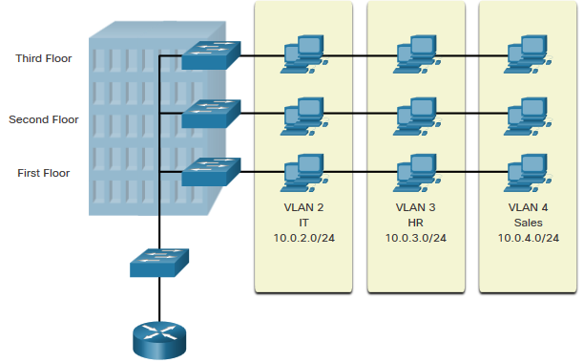
Overview of VLANs VLAN Definitions
VLANs are logical connections with other similar devices.
Placing devices into various VLANs have the following characteristics:
Provides segmentation of the various groups of devices on the same switches
Provide organization that is more manageable
Broadcasts, multicasts and unicasts are isolated in the individual VLAN
Each VLAN will have its own unique range of IP addressing
Smaller broadcast domains
Notes:
3 – VLANs
3.1 – Overview of VLANs
3.1.1 – VLAN Definitions

Slide 17
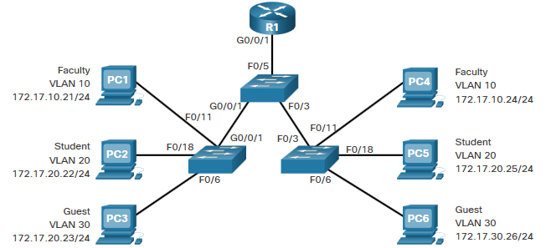
Overview of VLANs Benefits of a VLAN Design
Benefits of using VLANs are as follows:
Benefits | Description
Smaller Broadcast Domains | Dividing the LAN reduces the number of broadcast domains
Improved Security | Only users in the same VLAN can communicate together
Improved IT Efficiency | VLANs can group devices with similar requirements, e.g. faculty vs. students
Reduced Cost | One switch can support multiple groups or VLANs
Better Performance | Small broadcast domains reduce traffic, improving bandwidth
Simpler Management | Similar groups will need similar applications and other network resources
Notes:
3 – VLANs
3.1 – Overview of VLANs
3.1.2 – Benefits of a VLAN Design

Slide 18
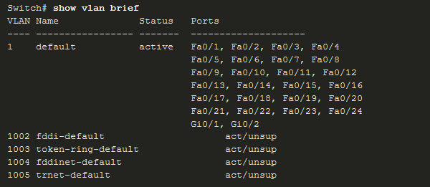
Overview of VLANs Types of VLANs
Default VLAN
VLAN 1 is the following:
The default VLAN
The default Native VLAN
The default Management VLAN
Cannot be deleted or renamed
Note: While we cannot delete VLAN1 Cisco will recommend that we assign these default features to other VLANs
Notes:
3 – VLANs
3.1 – Overview of VLANs
3.1.3 – Types of VLANs

Slide 19
Overview of VLANs Types of VLANs (Cont.)
Data VLAN
Dedicated to user-generated traffic (email and web traffic).
VLAN 1 is the default data VLAN because all interfaces are assigned to this VLAN.
Native VLAN
This is used for trunk links only.
All frames are tagged on an 802.1Q trunk link except for those on the native VLAN.
Management VLAN
This is used for SSH/Telnet VTY traffic and should not be carried with end user traffic.
Typically, the VLAN that is the SVI for the Layer 2 switch.
Notes:
3 – VLANs
3.1 – Overview of VLANs
3.1.3 – Types of VLANs (Cont.)

Slide 20
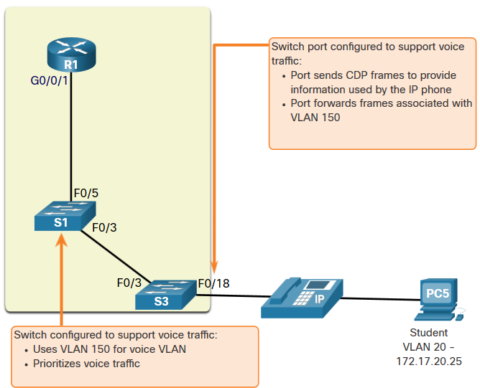
Overview of VLANs Types of VLANs (Cont.)
Voice VLAN
A separate VLAN is required because Voice traffic requires:
Assured bandwidth
High QoS priority
Ability to avoid congestion
Delay less that 150 ms from source to destination
The entire network must be designed to support voice.
Notes:
3 – VLANs
3.1 – Overview of VLANs
3.1.3 – Types of VLANs (Cont.)

Slide 21
Overview of VLANs Packet Tracer – Who Hears the Broadcast?
In this Packet Tracer activity, you will do the following:
Observe Broadcast Traffic in a VLAN Implementation
Complete Review Questions
Notes:
3 – VLANs
3.1 – Overview of VLANs
3.1.4 – Packet Tracer – Who Hears the Broadcast?
3.1.5 – Check Your Understanding – Overview of VLANs

Slide 22
3.2 VLANs in a Multi-Switched Environment
Notes:
3 – VLANs
3.2 – VLANs in a Multi-Switched Environment

Slide 23
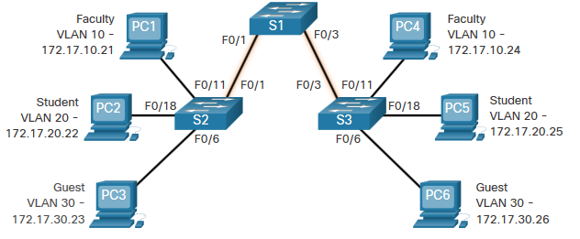
VLANs in a Multi-Switched Environment Defining VLAN Trunks
A trunk is a point-to-point link between two network devices.
Cisco trunk functions:
Allow more than one VLAN
Extend the VLAN across the entire network
By default, supports all VLANs
Supports 802.1Q trunking
Notes:
3 – VLANs
3.2 – VLANs in a Multi-Switched Environment
3.2.1 – Defining VLAN Trunks

Slide 24
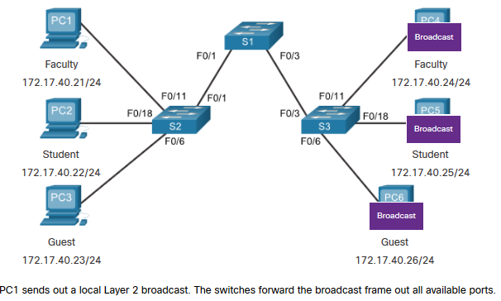
VLANs in a Multi-Switched Environment Networks without VLANs
Without VLANs, all devices connected to the switches will receive all unicast, multicast, and broadcast traffic.
Notes:
3 – VLANs
3.2 – VLANs in a Multi-Switched Environment
3.2.2 – Networks without VLANs

Slide 25
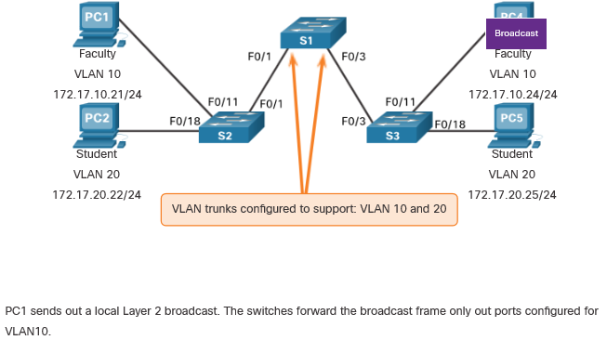
VLANs in a Multi-Switched Environment Networks with VLANs
With VLANs, unicast, multicast, and broadcast traffic is confined to a VLAN. Without a Layer 3 device to connect the VLANs, devices in different VLANs cannot communicate.
Notes:
3 – VLANs
3.2 – VLANs in a Multi-Switched Environment
3.2.3 – Networks with VLANs

Slide 26
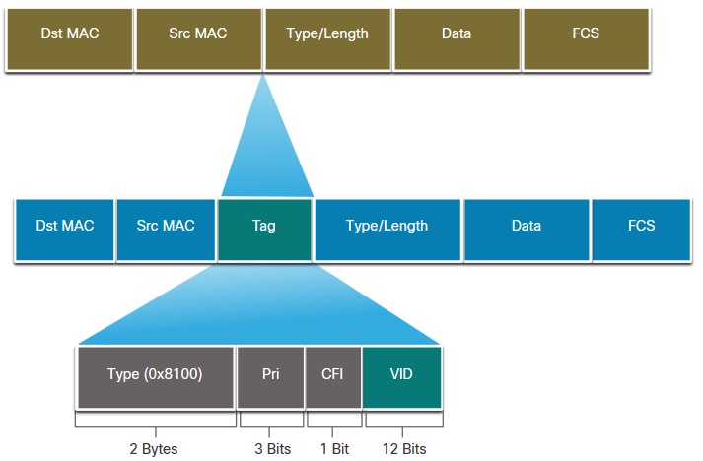
VLANs in a Multi-Switched Environment VLAN Identification with a Tag
The IEEE 802.1Q header is 4 Bytes
When the tag is created the FCS must be recalculated.
When sent to end devices, this tag must be removed and the FCS recalculated back to its original number.
802.1Q VLAN Tag Field | Function
Type | 2-Byte field with hexadecimal 0x8100 This is referred to as Tag Protocol ID (TPID)
User Priority | 3-bit value that supports
Canonical Format Identifier (CFI) | 1-bit value that can support token ring frames on Ethernet
VLAN ID (VID) | 12-bit VLAN identifier that can support up to 4096 VLANs
Notes:
3 – VLANs
3.2 – VLANs in a Multi-Switched Environment
3.2.4 – VLAN Identification with a Tag

Slide 27
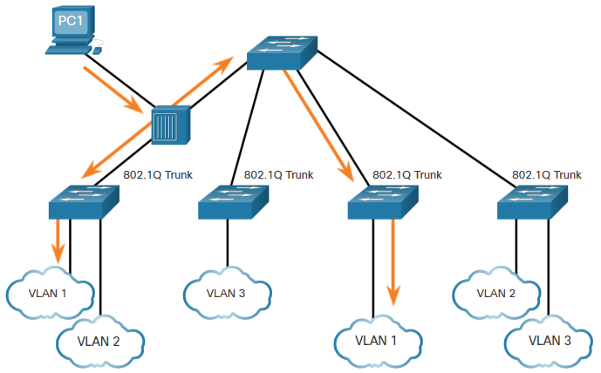
VLANs in a Multi-Switched Environment Native VLANs and 802.1Q Tagging
802.1Q trunk basics:
Tagging is typically done on all VLANs.
The use of a native VLAN was designed for legacy use, like the hub in the example.
Unless changed, VLAN1 is the native VLAN.
Both ends of a trunk link must be configured with the same native VLAN.
Each trunk is configured separately, so it is possible to have a different native VLANs on separate trunks.
Notes:
3 – VLANs
3.2 – VLANs in a Multi-Switched Environment
3.2.5 – Native VLANs and 802.1Q Tagging

Slide 28
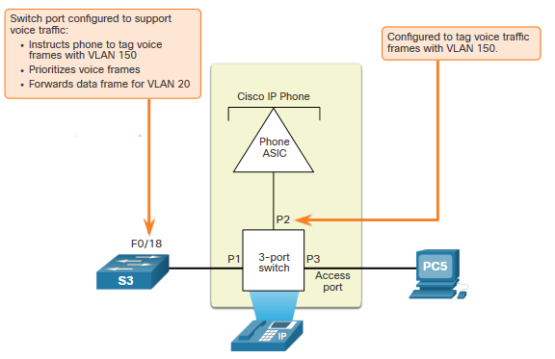
VLANs in a Multi-Switched Environment Voice VLAN Tagging
The VoIP phone is a three port switch:
The switch will use CDP to inform the phone of the Voice VLAN.
The phone will tag its own traffic (Voice) and can set Cost of Service (CoS). CoS is QoS for layer 2.
The phone may or may not tag frames from the PC.
Traffic | Tagging Function
Voice VLAN | tagged with an appropriate Layer 2 class of service (CoS) priority value
Access VLAN | can also be tagged with a Layer 2 CoS priority value
Access VLAN | is not tagged (no Layer 2 CoS priority value)
Notes:
3 – VLANs
3.2 – VLANs in a Multi-Switched Environment
3.2.6 – Voice VLAN Tagging

Slide 29
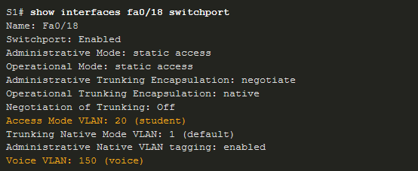
VLANs in a Multi-Switched Environment Voice VLAN Verification Example
The show interfaces fa0/18 switchport command can show us both data and voice VLANs assigned to the interface.
Notes:
3 – VLANs
3.2 – VLANs in a Multi-Switched Environment
3.2.7 – Voice VLAN Verification Example

Slide 30
VLANs in a Multi-Switched Environment Packet Tracer – Investigate a VLAN Implementation
In this Packet Tracer activity, you will:
Part 1: Observe Broadcast Traffic in a VLAN Implementation
Part 2: Observe Broadcast Traffic without VLANs
Notes:
3 – VLANs
3.2 – VLANs in a Multi-Switched Environment
3.2.8 – Packet Tracer – Investigate a VLAN Implementation
3.2.9 – Check Your Understanding – VLANs in a Multi-Switch Environment

Slide 31
3.3 VLAN Configuration
Notes:
3 – VLANs
3.3 – VLAN Configuration

Slide 32
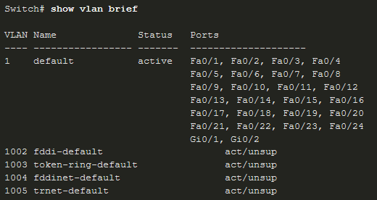
VLAN Configuration VLAN Ranges on Catalyst Switches
Catalyst switches 2960 and 3650 support over 4000 VLANs.
Normal Range VLAN 1 – 1005 | Extended Range VLAN 1006 - 4095
Used in Small to Medium sized businesses | Used by Service Providers
1002 – 1005 are reserved for legacy VLANs | Are in Running-Config
1, 1002 – 1005 are auto created and cannot be deleted | Supports fewer VLAN features
Stored in the vlan.dat file in flash | Requires VTP configurations
VTP can synchronize between switches
Notes:
3 – VLANs
3.3 – VLAN Configuration
3.3.1 – VLAN Ranges on Catalyst Switches

Slide 33
VLAN Configuration VLAN Creation Commands
VLAN details are stored in the vlan.dat file. You create VLANs in the global configuration mode.
Task | IOS Command
Enter global configuration mode. | Switch# configure terminal
Create a VLAN with a valid ID number. | Switch(config)# vlan vlan-id
Specify a unique name to identify the VLAN. | Switch(config-vlan)# name vlan-name
Return to the privileged EXEC mode. | Switch(config-vlan)# end
Enter global configuration mode. | Switch# configure terminal
Notes:
3 – VLANs
3.3 – VLAN Configuration
3.3.2 – VLAN Creation Commands

Slide 34
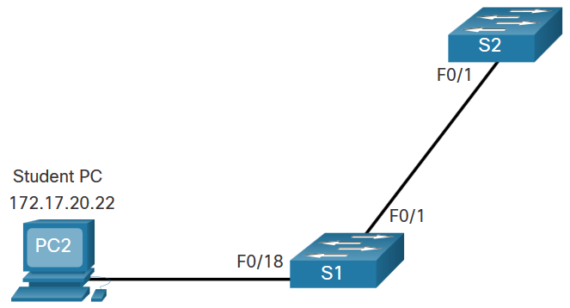
VLAN Configuration VLAN Creation Example
If the Student PC is going to be in VLAN 20, we will create the VLAN first and then name it.
If you do not name it, the Cisco IOS will give it a default name of vlan and the four digit number of the VLAN. E.g. vlan0020 for VLAN 20.
Prompt | Command
S1# | Configure terminal
S1(config)# | vlan 20
S1(config-vlan)# | name student
S1(config-vlan)# | end
Notes:
3 – VLANs
3.3 – VLAN Configuration
3.3.3 – VLAN Creation Example

Slide 35
VLAN Configuration VLAN Port Assignment Commands
Once the VLAN is created, we can then assign it to the correct interfaces.
Task | Command
Enter global configuration mode. | Switch# configure terminal
Enter interface configuration mode. | Switch(config)# interface interface-id
Set the port to access mode. | Switch(config-if)# switchport mode access
Assign the port to a VLAN. | Switch(config-if)# switchport access vlan vlan-id
Return to the privileged EXEC mode. | Switch(config-if)# end
Notes:
3 – VLANs
3.3 – VLAN Configuration
3.3.4 – VLAN Port Assignment Commands

Slide 36
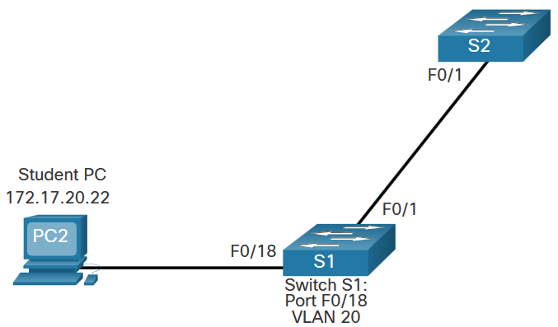
VLAN Configuration VLAN Port Assignment Example
We can assign the VLAN to the port interface.
Once the device is assigned the VLAN, then the end device will need the IP address information for that VLAN
Here, Student PC receives 172.17.20.22
Prompt | Command
S1# | Configure terminal
S1(config)# | Interface fa0/18
S1(config-if)# | Switchport mode access
S1(config-if)# | Switchport access vlan 20
S1(config-if)# | end
Notes:
3 – VLANs
3.3 – VLAN Configuration
3.3.5 – VLAN Port Assignment Example

Slide 37
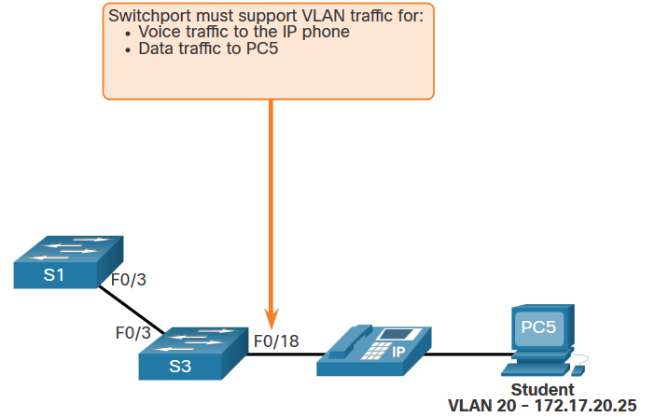
VLAN Configuration Data and Voice VLANs
An access port may only be assigned to one data VLAN. However it may also be assigned to one Voice VLAN for when a phone and an end device are off of the same switchport.
Notes:
3 – VLANs
3.3 – VLAN Configuration
3.3.6 – Data and Voice VLANs

Slide 38
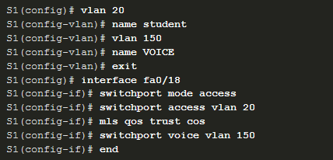
VLAN Configuration Data and Voice VLAN Example
We will want to create and name both Voice and Data VLANs.
In addition to assigning the data VLAN, we will also assign the Voice VLAN and turn on QoS for the voice traffic to the interface.
The newer catalyst switch will automatically create the VLAN, if it does not already exist, when it is assigned to an interface.
Note: QoS is beyond the scope of this course. Here we do show the use of the mls qos trust [cos | device cisco-phone | dscp | ip-precedence] command.
Notes:
3 – VLANs
3.3 – VLAN Configuration
3.3.7 – Data and Voice VLAN Example

Slide 39

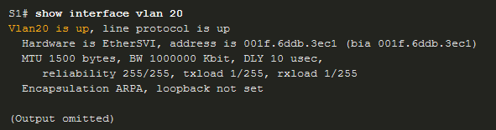
VLAN Configuration Verify VLAN Information
Use the show vlan command. The complete syntax is:
show vlan [brief | id vlan-id | name vlan-name | summary]
Task | Command Option
Display VLAN name, status, and its ports one VLAN per line. | brief
Display information about the identified VLAN ID number. | id vlan-id
Display information about the identified VLAN name. The vlan-name is an ASCII string from 1 to 32 characters. | name vlan-name
Display VLAN summary information. | summary
Notes:
3 – VLANs
3.3 – VLAN Configuration
3.3.8 – Verify VLAN Information

Slide 40
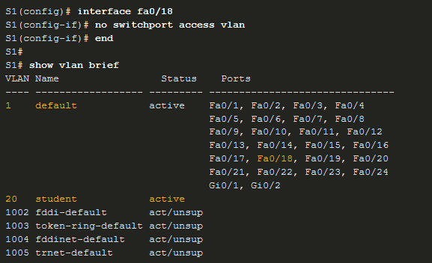
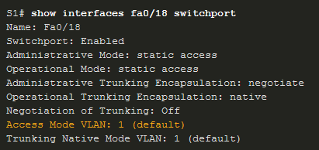
VLAN Configuration Change VLAN Port Membership
There are a number of ways to change VLAN membership:
re-enter switchport access vlan vlan-id command
use the no switchport access vlan to place interface back in VLAN 1
Use the show vlan brief or the show interface fa0/18 switchport commands to verify the correct VLAN association.
Notes:
3 – VLANs
3.3 – VLAN Configuration
3.3.9 – Change VLAN Port Membership

Slide 41
VLAN Configuration Delete VLANs
Delete VLANs with the no vlan vlan-id command.
Caution: Before deleting a VLAN, reassign all member ports to a different VLAN.
Delete all VLANs with the delete flash:vlan.dat or delete vlan.dat commands.
Reload the switch when deleting all VLANs.
Note: To restore to factory default – unplug all data cables, erase the startup-configuration and delete the vlan.dat file, then reload the device.
Notes:
3 – VLANs
3.3 – VLAN Configuration
3.3.10 – Delete VLANs
3.3.11 – Syntax Checker – VLAN Configuration

Slide 42
VLAN Configuration Packet Tracer – VLAN Configuration
In this Packet Tracer activity, you will perform the following:
Verify the Default VLAN Configuration
Configure VLANs
Assign VLANs to Ports
Notes:
3 – VLANs
3.3 – VLAN Configuration
3.3.12 – Packet Tracer – VLAN Configuration

Slide 43
3.4 VLAN Trunks
Notes:
3 – VLANs
3.4 – VLAN Trunks

Slide 44
VLAN Trunks Trunk Configuration Commands
Configure and verify VLAN trunks. Trunks are layer 2 and carry traffic for all VLANs.
Task | IOS Command
Enter global configuration mode. | Switch# configure terminal
Enter interface configuration mode. | Switch(config)# interface interface-id
Set the port to permanent trunking mode. | Switch(config-if)# switchport mode trunk
Sets the native VLAN to something other than VLAN 1. | Switch(config-if)# switchport trunk native vlan vlan-id
Specify the list of VLANs to be allowed on the trunk link. | Switch(config-if)# switchport trunk allowed vlan vlan-list
Return to the privileged EXEC mode. | Switch(config-if)# end
Notes:
3 – VLANs
3.4 – VLAN Trunks
3.4.1 – Trunk Configuration Commands

Slide 45
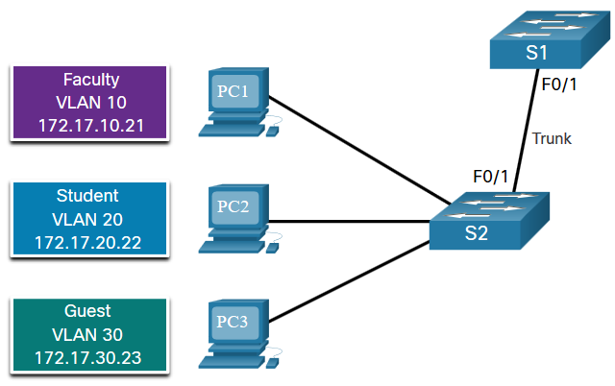
VLAN Trunks Trunk Configuration Example
The subnets associated with each VLAN are:
VLAN 10 - Faculty/Staff - 172.17.10.0/24
VLAN 20 - Students - 172.17.20.0/24
VLAN 30 - Guests - 172.17.30.0/24
VLAN 99 - Native - 172.17.99.0/24
F0/1 port on S1 is configured as a trunk port.
Note: This assumes a 2960 switch using 802.1q tagging. Layer 3 switches require the encapsulation to be configured before the trunk mode.
Prompt | Command
S1(config)# | Interface fa0/1
S1(config-if)# | Switchport mode trunk
S1(config-if)# | Switchport trunk native vlan 99
S1(config-if)# | Switchport trunk allowed vlan 10,20,30,99
S1(config-if)# | end
Notes:
3 – VLANs
3.4 – VLAN Trunks
3.4.2 – Trunk Configuration Example

Slide 46
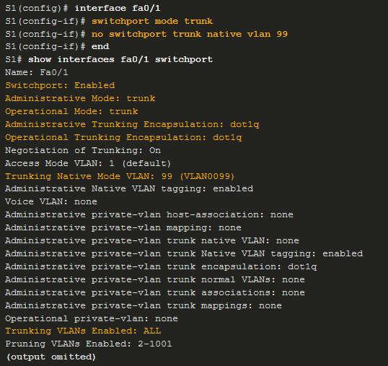
VLAN Trunks Verify Trunk Configuration
Set the trunk mode and native vlan.
Notice sh int fa0/1 switchport command:
Is set to trunk administratively
Is set as trunk operationally (functioning)
Encapsulation is dot1q
Native VLAN set to VLAN 99
All VLANs created on the switch will pass traffic on this trunk
Notes:
3 – VLANs
3.4 – VLAN Trunks
3.4.3 – Verify Trunk Configuration

Slide 47
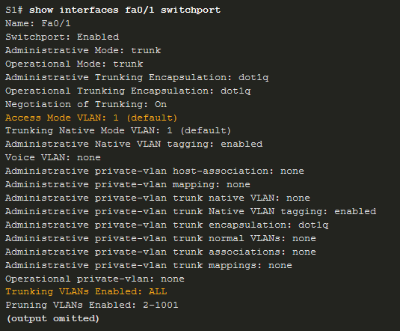

VLAN Trunks Reset the Trunk to the Default State
Reset the default trunk settings with the no command.
All VLANs allowed to pass traffic
Native VLAN = VLAN 1
Verify the default settings with a sh int fa0/1 switchport command.
Notes:
3 – VLANs
3.4 – VLAN Trunks
3.4.4 – Reset the Trunk to the Default State

Slide 48
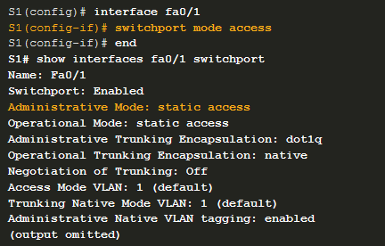
VLAN Trunks Reset the Trunk to the Default State (Cont.)
Reset the trunk to an access mode with the switchport mode access command:
Is set to an access interface administratively
Is set as an access interface operationally (functioning)
Notes:
3 – VLANs
3.4 – VLAN Trunks
3.4.4 – Reset the Trunk to the Default State (Cont.)

Slide 49
VLAN Trunks Packet Tracer – Configure Trunks
In this Packet Tracer activity, you will perform the following:
Verify VLANs
Configure Trunks
Notes:
3 – VLANs
3.4 – VLAN Trunks
3.4.5 – Packet Tracer – Configure Trunks

Slide 50
VLAN Trunks Packet Tracer – Configure VLANs and Trunking – Physical Mode Lab – Configure VLANs and Trunking
In this Packet Tracer Physical Mode activity and in the Lab, you will complete the following objectives:
Build the Network and Configure Basic Device Settings
Create VLANs and Assign Switch Ports
Maintain VLAN Port Assignments and the VLAN Database
Configure an 802.1Q Trunk Between the Switches
Delete the VLAN Database (In the Lab only.)
Notes:
3 – VLANs
3.4 – VLAN Trunks
3.4.6 – PTPM and Lab – Configure VLANs and Trunks

Slide 51
3.5 Dynamic Trunking Protocol
Notes:
3 – VLANs
3.5 – Dynamic Trunking Protocol

Slide 52

Dynamic Trunking Protocol Introduction to DTP
Dynamic Trunking Protocol (DTP) is a proprietary Cisco protocol.
DTP characteristics are as follows:
On by default on Catalyst 2960 and 2950 switches
Dynamic-auto is default on the 2960 and 2950 switches
May be turned off with the nonegotiate command
May be turned back on by setting the interface to dynamic-auto
Setting a switch to a static trunk or static access will avoid negotiation issues with the switchport mode trunk or the switchport mode access commands.
Notes:
3 – VLANs
3.5 – Dynamic Trunking Protocol
3.5.1 – Introduction to DTP

Slide 53
Dynamic Trunking Protocol Negotiated Interface Modes
The switchport mode command has additional options.
Use the switchport nonegotiate interface configuration command to stop DTP negotiation.
Option | Description
access | Permanent access mode and negotiates to convert the neighboring link into an access link
dynamic auto | Will becomes a trunk interface if the neighboring interface is set to trunk or desirable mode
dynamic desirable | Actively seeks to become a trunk by negotiating with other auto or desirable interfaces
trunk | Permanent trunking mode and negotiates to convert the neighboring link into a trunk link
Notes:
3 – VLANs
3.5 – Dynamic Trunking Protocol
3.5.2 – Negotiated Interface Modes

Slide 54
Dynamic Trunking Protocol Results of a DTP Configuration
DTP configuration options are as follows:
 | Dynamic Auto | Dynamic Desirable | Trunk | Access
Dynamic Auto | Access | Trunk | Trunk | Access
Dynamic Desirable | Trunk | Trunk | Trunk | Access
Trunk | Trunk | Trunk | Trunk | Limited connectivity
Access | Access | Access | Limited connectivity | Access
Notes:
3 – VLANs
3.5 – Dynamic Trunking Protocol
3.5.3 – Results of a DTP Configuration

Slide 55
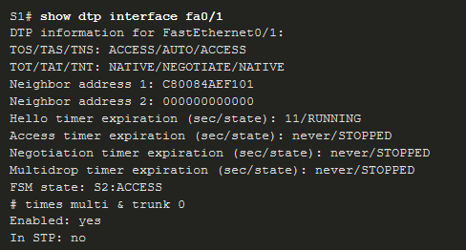
Dynamic Trunking Protocol Verify DTP Mode
The default DTP configuration is dependent on the Cisco IOS version and platform.
Use the show dtp interface command to determine the current DTP mode.
Best practice recommends that the interfaces be set to access or trunk and to turnoff DTP
Notes:
3 – VLANs
3.5 – Dynamic Trunking Protocol
3.5.4 – Verify DTP Mode

Slide 56
Dynamic Trunking Protocol Packet Tracer – Configure DTP
In this Packet Tracer activity, you will perform the following:
Configure static trunking
Configure and verify DTP
Notes:
3 – VLANs
3.5 – Dynamic Trunking Protocol
3.5.5 – Packet Tracer – Configure DTP
3.5.6 – Check Your Understanding – Dynamic Trunking Protocol

Slide 57
3.6 Module Practice and Quiz
Notes:
3 – VLANs
3.6 – Module Practice and Quiz

Slide 58
Module Practice and Quiz Packet Tracer – Implement VLANs and Trunking
In this Packet Tracer activity, you will perform the following:
Configure VLANs
Assign Ports to VLANs
Configure Static Trunking
Configure Dynamic Trunking
Notes:
3 – VLANs
3.6 – Module Practice and Quiz
3.6.1 – Packet Tracer – Implement VLANs and Trunking

Slide 59
Module Practice and Quiz Lab – Implement VLANs and Trunking
In this lab, you will perform the following:
Build the Network and Configure Basic Device Settings
Create VLANs and Assign Switch Ports
Configure an 802.1Q Trunk between the Switches
Notes:
3 – VLANs
3.6 – Module Practice and Quiz
3.6.2 – Lab – Implement VLANs and Trunking

Slide 60
Module Practice and Quiz What did I learn in this module?
VLANs are based on logical instead of physical connections.
VLANs can segment networks based on function, team, or application.
Each VLAN is considered a separate logical network.
A trunk is a point-to-point link that carries more than one VLAN.
VLAN tag fields include the type, user priority, CFI and VID.
A separate voice VLAN is required to support VoIP.
Normal range VLAN configurations are stored in the vlan.dat file in flash.
An access port can belong to one data VLAN at a time, but may also have a Voice VLAN.
Notes:
3 – VLANs
3.6 – Module Practice and Quiz
3.6.3 – What did I learn in this module?

Slide 61
Module Practice and Quiz What did I learn in this module? (Cont.)
A trunk is a Layer 2 link between two switches that carries traffic for all VLANs.
Trunks will need tagging for the various VLANs, typically 802.1q .
IEEE 802.1q tagging makes provision for one native VLAN that will remain untagged.
An interface can be set to trunking or nontrunking.
Trunk negotiation is managed by the Dynamic Trunking Protocol (DTP).
DTP is a Cisco proprietary protocol that manages trunk negotiations.
Notes:
3 – VLANs
3.6 – Module Practice and Quiz
3.6.3 – What did I learn in this module? (Cont.)
3.6.4 – Module Quiz – Protocols and Models

Slide 62
Module Practice and Quiz New Terms and Commands
VLAN Logical broadcast domain Data VLAN Default VLAN Native VLAN Management VLAN show vlan brief Voice VLAN VLAN Trunk VLAN Segmentation IEEE 802.1Q VLAN Tagging Canonical Format Identifier (CFI) | User Priority VLAN ID Type show interfaces int switchport
Notes:
New Terms and Commands

Slide 63
Module Practice and Quiz New Terms and Commands
Normal Range VLANs Extended Range VLANs vlan vlan-id name vlan-name switchport mode access switchport access vlan vlan-id interface range no switchport access vlan vlan-id no vlan vlan-id delete flash:vlan.dat | delete vlan.dat show vlan show interfaces show vlan summary show interfaces vlan vlan_id switchport mode trunk switchport trunk allowed vlan vlan_list switchport trunk native vlan vlan_id no switchport trunk allowed vlan | no switchport trunk native vlan show interfaces switchport no switchport access vlan vlan_id show interfaces trunk show interfaces int_id trunk
Notes:
New Terms and Commands

