Slide 1
Module 4: Inter-VLAN Routing
Instructor Materials
Switching, Routing and Wireless Essentials v7.0 (SRWE)
Notes:
Cisco Networking Academy Program Switching, Routing and Wireless Essentials v7.0 (SRWE)
Module 4: Inter-VLAN Routing

Slide 2
Instructor Materials – Module 4 Planning Guide
This PowerPoint deck is divided in two parts:
Instructor Planning Guide
Information to help you become familiar with the module
Teaching aids
Instructor Class Presentation
Optional slides that you can use in the classroom
Begins on slide # 11
Note: Remove the Planning Guide from this presentation before sharing with anyone.
For additional help and resources go to the Instructor Home Page and Course Resources for this course. You also can visit the professional development site on netacad.com, the official Cisco Networking Academy Facebook page, or Instructor Only FB group.
Notes:
2

Slide 3
What to Expect in this Module
To facilitate learning, the following features within the GUI may be included in this module:
Feature | Description
Animations | Expose learners to new skills and concepts.
Videos | Expose learners to new skills and concepts.
Check Your Understanding(CYU) | Per topic online quiz to help learners gauge content understanding.
Interactive Activities | A variety of formats to help learners gauge content understanding.
Syntax Checker | Small simulations that expose learners to Cisco command line to practice configuration skills.
PT Activity | Simulation and modeling activities designed to explore, acquire, reinforce, and expand skills.

Slide 4
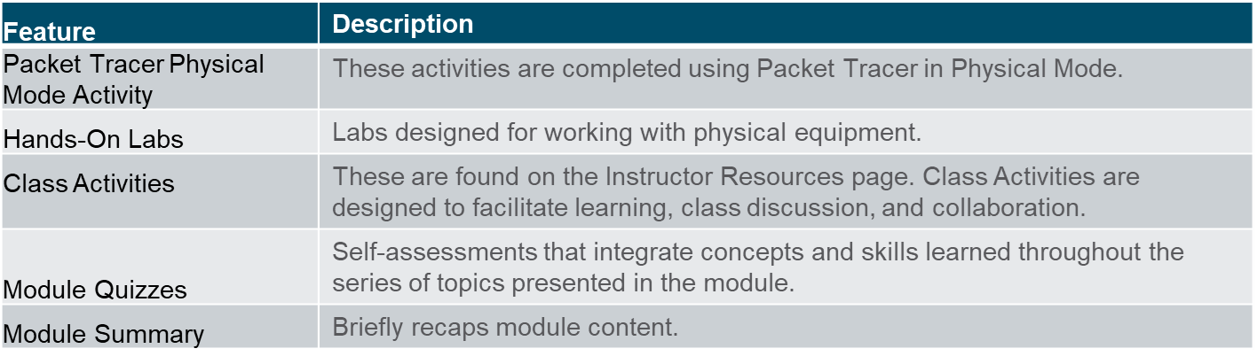
What to Expect in this Module (Cont.)
To facilitate learning, the following features may be included in this module:

Slide 5
Check Your Understanding
Check Your Understanding activities are designed to let students quickly determine if they understand the content and can proceed, or if they need to review.
Check Your Understanding activities do not affect student grades.
There are no separate slides for these activities in the PPT. They are listed in the notes area of the slide that appears before these activities.
Notes:
5

Slide 6
Packet Tracer Physical Mode Activities
These activities are completed using Packet Tracer in Physical Mode.
They are designed to emulate the corresponding Labs.
They can be used instead of the lab when access to physical equipment is not possible.
Packet Tracer Physical Mode activities may not have as much scaffolding as the PT activities that immediately precede them.
Notes:
6

Slide 7
Module 4: Activities
What activities are associated with this module?
Page # | Activity Type | Activity Name | Optional?
4.1.5 | Check Your Understanding | Inter-VLAN Routing Operations | Recommended
4.2.7 | Packet Tracer | Configure Router-on-a-Stick Inter-VLAN Routing | Recommended
4.2.8 | Lab | Configuring 802.1Q Trunk-Based Inter-VLAN Routing | Recommended
4.3.8 | Packet Tracer | Configure Layer 3 Switching and inter-VLAN Routing | Recommended
4.4.7 | Check Your Understanding | Troubleshoot Inter-VLAN Routing | Recommended
4.4.8 | Packet Tracer | Troubleshoot Inter-VLAN Routing | Recommended
4.4.9 | Packet Tracer Physical Mode | Packet Tracer – Troubleshoot Inter-VLAN Routing – Physical Mode | Recommended
4.4.9 | Lab | Troubleshoot Inter-VLAN Routing | Recommended
Notes:
7

Slide 8
Module 4: Activities (Cont.)
What activities are associated with this module?
Page # | Activity Type | Activity Name | Optional?
4.5.1 | Packet Tracer | Inter-VLAN Routing Challenge | Recommended
4.5.2 | Lab | Implement Inter-VLAN Routing | Recommended
4.5.4 | Module Quiz | Inter-VLAN Routing | Recommended
Notes:
8

Slide 9
Module 4: Best Practices
Prior to teaching Module 4, the instructor should:
Review the activities and assessments for this module.
Try to include as many questions as possible to keep students engaged during classroom presentation.
After this Module, the Switching Concepts, VLANs, and InterVLAN Routing Exam is available, covering Modules 1-4.
Topic 4.1
Ask the students or have a class discussion
What do you think is a contributor to the limit on the number of VLANs supported by Router-on-a-Stick Inter-VLAN Routing?
What do you think the difference is between a router loopback interface and a router subinterface?
Topic 4.2
Ask the students or have a class discussion
What do you think the primary benefit provided by Router-on-a-stick as opposed to Legacy Inter-VLAN Routing?
How does the router handle designation of the Native VLAN?
Notes:
9

Slide 10
Module 4: Best Practices (Cont.)
Topic 4.3
Ask the students or have a class discussion
What is the biggest savings you can see with using a Layer 3 Switch as an Inter-VLAN Router?
What is the impact of the no switchport command?
Topic 4.4
Ask the students or have a class discussion
What do you think is the most common cause of errors in the implementation of Inter-VLAN Routing?
Given all the moving parts, what kind of Inter-VLAN Routing do you think lends itself to the lowest number of implementation errors?
Notes:
10

Slide 11
Module 4: Inter-VLAN Routing
Switching, Routing and Wireless Essentials v7.0 (SRWE)
Notes:
Switching, Routing and Wireless Essentials v7.0 (SRWE)
Module 4: Inter-VLAN Routing

Slide 12
Module Objectives
Module Title: Inter-VLAN Routing
Module Objective: Troubleshoot inter-VLAN routing on Layer 3 devices
Topic Title | Topic Objective
Inter-VLAN Routing Operation | Describe options for configuring inter-VLAN routing.
Router-on-a-Stick Inter-VLAN Routing | Configure router-on-a-stick inter-VLAN routing.
Inter-VLAN Routing using Layer 3 Switches | Configure inter-VLAN routing using Layer 3 switching.
Troubleshoot Inter-VLAN Routing | Troubleshoot common inter-VLAN configuration issues.
Notes:
12

Slide 13
4.1 Inter-VLAN Routing Operation
Notes:
4- Inter-VLAN Routing
4.1 – Inter-VLAN Routing Operation

Slide 14
Inter-VLAN Routing Operation What is Inter-VLAN Routing?
VLANs are used to segment switched Layer 2 networks for a variety of reasons. Regardless of the reason, hosts in one VLAN cannot communicate with hosts in another VLAN unless there is a router or a Layer 3 switch to provide routing services.
Inter-VLAN routing is the process of forwarding network traffic from one VLAN to another VLAN.
There are three inter-VLAN routing options:
Legacy Inter-VLAN routing - This is a legacy solution. It does not scale well.
Router-on-a-Stick - This is an acceptable solution for a small to medium-sized network.
Layer 3 switch using switched virtual interfaces (SVIs) - This is the most scalable solution for medium to large organizations.
Notes:
4 – Inter-VLAN Routing
4.1 – Inter-VLAN Routing Operation
4.1.1 - What is Inter-VLAN Routing?

Slide 15
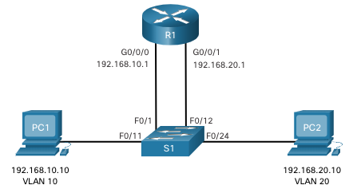
Inter-VLAN Routing Operation Legacy Inter-VLAN Routing
The first inter-VLAN routing solution relied on using a router with multiple Ethernet interfaces. Each router interface was connected to a switch port in different VLANs. The router interfaces served as the default gateways to the local hosts on the VLAN subnet.
Legacy inter-VLAN routing using physical interfaces works, but it has a significant limitation. It is not reasonably scalable because routers have a limited number of physical interfaces. Requiring one physical router interface per VLAN quickly exhausts the physical interface capacity of a router.
Note: This method of inter-VLAN routing is no longer implemented in switched networks and is included for explanation purposes only.
Notes:
4 – Inter-VLAN Routing
4.1 – Inter-VLAN Routing Operation
4.1.2 – Legacy Inter-VLAN Routing

Slide 16
Inter-VLAN Routing Operation Router-on-a-Stick Inter-VLAN Routing
The ‘router-on-a-stick’ inter-VLAN routing method overcomes the limitation of the legacy inter-VLAN routing method. It only requires one physical Ethernet interface to route traffic between multiple VLANs on a network.
A Cisco IOS router Ethernet interface is configured as an 802.1Q trunk and connected to a trunk port on a Layer 2 switch. Specifically, the router interface is configured using subinterfaces to identify routable VLANs.
The configured subinterfaces are software-based virtual interfaces. Each is associated with a single physical Ethernet interface. Subinterfaces are configured in software on a router. Each subinterface is independently configured with an IP address and VLAN assignment. Subinterfaces are configured for different subnets that correspond to their VLAN assignment. This facilitates logical routing.
When VLAN-tagged traffic enters the router interface, it is forwarded to the VLAN subinterface. After a routing decision is made based on the destination IP network address, the router determines the exit interface for the traffic. If the exit interface is configured as an 802.1q subinterface, the data frames are VLAN-tagged with the new VLAN and sent back out the physical interface
Note: The router-on-a-stick method of inter-VLAN routing does not scale beyond 50 VLANs.
Notes:
4 – Inter-VLAN Routing
4.1 – Inter-VLAN Routing Operation
4.1.3 – Router-on-a-Stick Inter-VLAN Routing

Slide 17
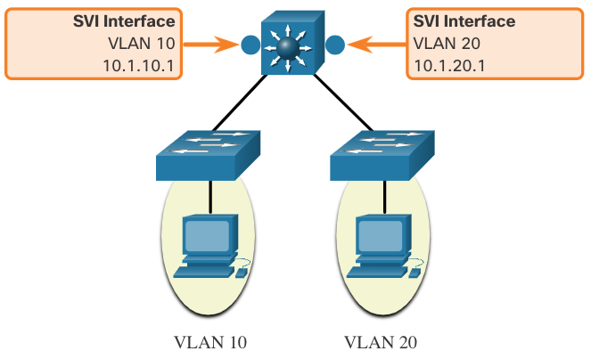
Inter-VLAN Routing Operation Inter-VLAN Routing on a Layer 3 Switch
The modern method of performing inter-VLAN routing is to use Layer 3 switches and switched virtual interfaces (SVI). An SVI is a virtual interface that is configured on a Layer 3 switch, as shown in the figure.
Note: A Layer 3 switch is also called a multilayer switch as it operates at Layer 2 and Layer 3. However, in this course we use the term Layer 3 switch.
Notes:
4 – Inter-VLAN Routing
4.1 – Inter-VLAN Routing Operation
4.1.4 - Inter-VLAN Routing on a Layer 3 Switch

Slide 18
Inter-VLAN Routing Operation Inter-VLAN Routing on a Layer 3 Switch (Cont.)
Inter-VLAN SVIs are created the same way that the management VLAN interface is configured. The SVI is created for a VLAN that exists on the switch. Although virtual, the SVI performs the same functions for the VLAN as a router interface would. Specifically, it provides Layer 3 processing for packets that are sent to or from all switch ports associated with that VLAN.
The following are advantages of using Layer 3 switches for inter-VLAN routing:
They are much faster than router-on-a-stick because everything is hardware switched and routed.
There is no need for external links from the switch to the router for routing.
They are not limited to one link because Layer 2 EtherChannels can be used as trunk links between the switches to increase bandwidth.
Latency is much lower because data does not need to leave the switch in order to be routed to a different network.
They more commonly deployed in a campus LAN than routers.
The only disadvantage is that Layer 3 switches are more expensive.
Notes:
4 – Inter-VLAN Routing
4.1 – Inter-VLAN Routing Operation
4.1.4 - Inter-VLAN Routing on a Layer 3 Switch (Cont.)
4.1.5 – Check Your Understanding – Inter-VLAN Routing Operation

Slide 19
4.2 Router-on-a-Stick Inter-VLAN Routing
Notes:
4- Inter-VLAN Routing
4.2 – Router-on-a-Stick Inter-VLAN Routing

Slide 20
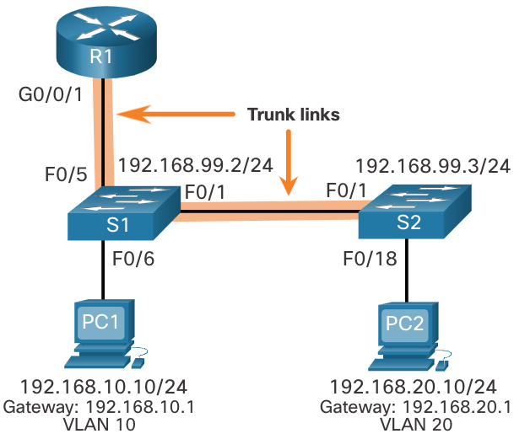
Router-on-a-Stick Inter-VLAN Routing Router-on-a-Stick Scenario
In the figure, the R1 GigabitEthernet 0/0/1 interface is connected to the S1 FastEthernet 0/5 port. The S1 FastEthernet 0/1 port is connected to the S2 FastEthernet 0/1 port. These are trunk links that are required to forward traffic within and between VLANs.
To route between VLANs, the R1 GigabitEthernet 0/0/1 interface is logically divided into three subinterfaces, as shown in the table. The table also shows the three VLANs that will be configured on the switches.
Assume that R1, S1, and S2 have initial basic configurations. Currently, PC1 and PC2 cannot ping each other because they are on separate networks. Only S1 and S2 can ping each other, but they but are unreachable by PC1 or PC2 because they are also on different networks.
To enable devices to ping each other, the switches must be configured with VLANs and trunking, and the router must be configured for inter-VLAN routing.
Subinterface | VLAN | IP Address
G0/0/1.10 | 10 | 192.168.10.1/24
G0/0/1.20 | 20 | 192.168.20.1/24
G0/0/1.30 | 99 | 192.168.99.1/24
Notes:
4 – Inter-VLAN Routing
4.2 - Router-on-a-Stick Inter-VLAN Routing
4.2.1 – Router-on-a-Stick Scenario

Slide 21
Router-on-a-Stick Inter-VLAN Routing S1 VLAN and Trunking Configuration
Complete the following steps to configure S1 with VLANs and trunking:
Step 1. Create and name the VLANs.
Step 2. Create the management interface.
Step 3. Configure access ports.
Step 4. Configure trunking ports.
Notes:
4 – Inter-VLAN Routing
4.2 - Router-on-a-Stick Inter-VLAN Routing
4.2.2 – S1 VLAN and Trunking Configuration

Slide 22
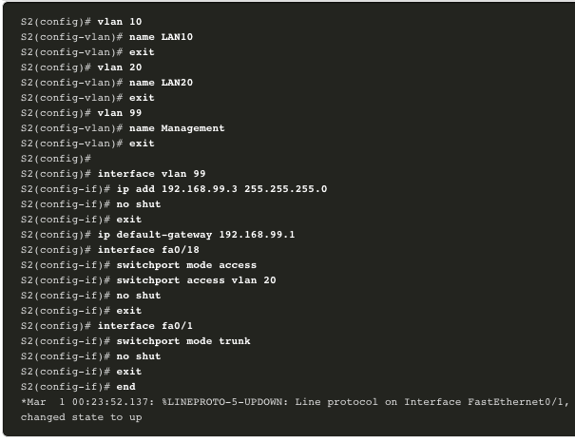
Router-on-a-Stick Inter-VLAN Routing S2 VLAN and Trunking Configuration
The configuration for S2 is similar to S1.
Notes:
4 – Inter-VLAN Routing
4.2 - Router-on-a-Stick Inter-VLAN Routing
4.2.3 – S2 VLAN and Trunking Configuration

Slide 23
Router-on-a-Stick Inter-VLAN Routing R1 Subinterface Configuration
The router-on-a-stick method requires you to create a subinterface for each VLAN to be routed. A subinterface is created using the interface interface_id subinterface_id global configuration mode command. The subinterface syntax is the physical interface followed by a period and a subinterface number. Although not required, it is customary to match the subinterface number with the VLAN number.
Each subinterface is then configured with the following two commands:
encapsulation dot1q vlan_id [native] - This command configures the subinterface to respond to 802.1Q encapsulated traffic from the specified vlan-id. The native keyword option is only appended to set the native VLAN to something other than VLAN 1.
ip address ip-address subnet-mask - This command configures the IPv4 address of the subinterface. This address typically serves as the default gateway for the identified VLAN.
Repeat the process for each VLAN to be routed. Each router subinterface must be assigned an IP address on a unique subnet for routing to occur. When all subinterfaces have been created, enable the physical interface using the no shutdown interface configuration command. If the physical interface is disabled, all subinterfaces are disabled.
Notes:
4 – Inter-VLAN Routing
4.2 - Router-on-a-Stick Inter-VLAN Routing
4.2.4 – R1 Subinterface Configuration

Slide 24
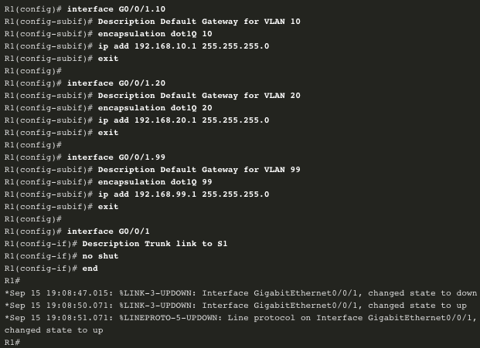
Router-on-a-Stick Inter-VLAN Routing R1 Subinterface Configuration (Cont.)
In the configuration, the R1 G0/0/1 subinterfaces are configured for VLANs 10, 20, and 99.
Notes:
4 – Inter-VLAN Routing
4.2 - Router-on-a-Stick Inter-VLAN Routing
4.2.4 – R1 Subinterface Configuration (Cont.)

Slide 25
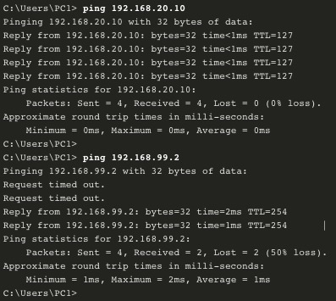
Router-on-a-Stick Inter-VLAN Routing Verify Connectivity Between PC1 and PC2
The router-on-a-stick configuration is complete after the switch trunk and the router subinterfaces have been configured. The configuration can be verified from the hosts, router, and switch.
From a host, verify connectivity to a host in another VLAN using the ping command. It is a good idea to first verify the current host IP configuration using the ipconfig Windows host command.
Next, use ping to verify connectivity with PC2 and S1, as shown in the figure. The ping output successfully confirms inter-VLAN routing is operating.
Notes:
4 – Inter-VLAN Routing
4.2 - Router-on-a-Stick Inter-VLAN Routing
4.2.5 – Verify Connectivity Between PC1 and PC2

Slide 26
Router-on-a-Stick Inter-VLAN Routing Router-on-a-Stick Inter-VLAN Routing Verification
In addition to using ping between devices, the following show commands can be used to verify and troubleshoot the router-on-a-stick configuration.
show ip route
show ip interface brief
show interfaces
show interfaces trunk
Notes:
4 – Inter-VLAN Routing
4.2 - Router-on-a-Stick Inter-VLAN Routing
4.2.6 – Router-on-a-Stick Inter-VLAN Routing Verification

Slide 27
Router-on-a-Stick Inter-VLAN Routing Packet Tracer– Configure Router-on-a-Stick Inter-VLAN Routing
In this Packet Tracer, you will complete the following objectives:
Part 1: Add VLANs to a Switch
Part 2: Configure Subinterfaces
Part 3: Test connectivity with Inter-VLAN Routing
Notes:
4 – Inter-VLAN Routing
4.2 - Router-on-a-Stick Inter-VLAN Routing
4.2.7 – Packet Tracer – Configure Router-on-a-Stick Inter-VLAN Routing

Slide 28
Router-on-a-Stick Inter-VLAN Routing Lab – Configure Router-on-a-Stick Inter-VLAN Routing
In this lab, you will complete the following objectives:
Part 1: Build the Network and Configure Basic Device Settings
Part 2: Configure Switches with VLANs and Trunking
Part 3: Configure Trunk-Based Inter-VLAN Routing
Notes:
4 – Inter-VLAN Routing
4.2 - Router-on-a-Stick Inter-VLAN Routing
4.2.8 – Lab– Configure Router-on-a-Stick Inter-VLAN Routing

Slide 29
4.3 Inter-VLAN Routing using Layer 3 Switches
Notes:
4- Inter-VLAN Routing
4.3 – Inter-VLAN Routing using Layer 3 Switches

Slide 30
Inter-VLAN Routing using Layer 3 Switches Layer 3 Switch Inter-VLAN Routing
Inter-VLAN routing using the router-on-a-stick method is simple to implement for a small to medium-sized organization. However, a large enterprise requires a faster, much more scalable method to provide inter-VLAN routing.
Enterprise campus LANs use Layer 3 switches to provide inter-VLAN routing. Layer 3 switches use hardware-based switching to achieve higher-packet processing rates than routers. Layer 3 switches are also commonly implemented in enterprise distribution layer wiring closets.
Capabilities of a Layer 3 switch include the ability to do the following:
Route from one VLAN to another using multiple switched virtual interfaces (SVIs).
Convert a Layer 2 switchport to a Layer 3 interface (i.e., a routed port). A routed port is similar to a physical interface on a Cisco IOS router.
To provide inter-VLAN routing, Layer 3 switches use SVIs. SVIs are configured using the same interface vlan vlan-id command used to create the management SVI on a Layer 2 switch. A Layer 3 SVI must be created for each of the routable VLANs.
Notes:
4 – Inter-VLAN Routing
4.3 – Inter-VLAN Routing using Layer 3 Switches
4.3.1 – Layer 3 Switch Inter-VLAN Routing

Slide 31
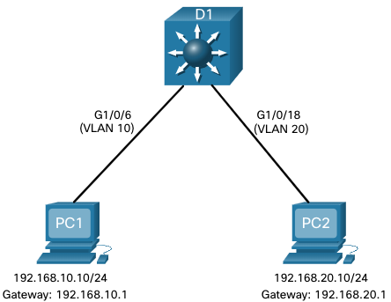
Inter-VLAN Routing using Layer 3 Switches Layer 3 Switch Scenario
In the figure, the Layer 3 switch, D1, is connected to two hosts on different VLANs. PC1 is in VLAN 10 and PC2 is in VLAN 20, as shown. The Layer 3 switch will provide inter-VLAN routing services to the two hosts.
Notes:
4 – Inter-VLAN Routing
4.3 – Inter-VLAN Routing using Layer 3 Switches
4.3.2 – Layer 3 Switch Scenario

Slide 32
Inter-VLAN Routing using Layer 3 Switches Layer 3 Switch Configuration
Complete the following steps to configure S1 with VLANs and trunking:
Step 1. Create the VLANs. In the example, VLANs 10 and 20 are used.
Step 2. Create the SVI VLAN interfaces. The IP address configured will serve as the default gateway for hosts in the respective VLAN.
Step 3. Configure access ports. Assign the appropriate port to the required VLAN.
Step 4. Enable IP routing. Issue the ip routing global configuration command to allow traffic to be exchanged between VLANs 10 and 20. This command must be configured to enable inter-VAN routing on a Layer 3 switch for IPv4.
Notes:
4 – Inter-VLAN Routing
4.3 – Inter-VLAN Routing using Layer 3 Switches
4.3.3 – Layer 3 Switch Configuration

Slide 33
Inter-VLAN Routing using Layer 3 Switches Layer 3 Switch Inter-VLAN Routing Verification
Inter-VLAN routing using a Layer 3 switch is simpler to configure than the router-on-a-stick method. After the configuration is complete, the configuration can be verified by testing connectivity between the hosts.
From a host, verify connectivity to a host in another VLAN using the ping command. It is a good idea to first verify the current host IP configuration using the ipconfig Windows host command.
Next, verify connectivity with PC2 using the ping Windows host command. The successful ping output confirms inter-VLAN routing is operating.
Notes:
4 – Inter-VLAN Routing
4.3 – Inter-VLAN Routing using Layer 3 Switches
4.3.4 – Layer 3 Switch Inter-VLAN Routing Verification

Slide 34
Inter-VLAN Routing using Layer 3 Switches Routing on a Layer 3 Switch
If VLANs are to be reachable by other Layer 3 devices, then they must be advertised using static or dynamic routing. To enable routing on a Layer 3 switch, a routed port must be configured.
A routed port is created on a Layer 3 switch by disabling the switchport feature on a Layer 2 port that is connected to another Layer 3 device. Specifically, configuring the no switchport interface configuration command on a Layer 2 port converts it into a Layer 3 interface. Then the interface can be configured with an IPv4 configuration to connect to a router or another Layer 3 switch.
Notes:
4 – Inter-VLAN Routing
4.3 – Inter-VLAN Routing using Layer 3 Switches
4.3.5 - Routing on a Layer 3 Switch

Slide 35
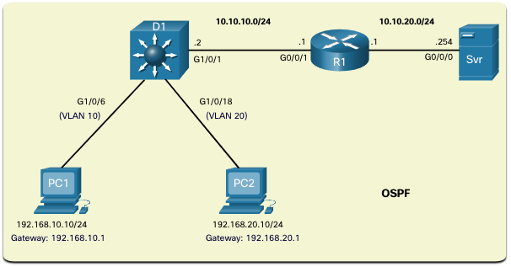
Inter-VLAN Routing using Layer 3 Switches Routing Scenario on a Layer 3 Switch
In the figure, the previously configured D1 Layer 3 switch is now connected to R1. R1 and D1 are both in an Open Shortest Path First (OSPF) routing protocol domain. Assume inter-VLAN has been successfully implemented on D1. The G0/0/1 interface of R1 has also been configured and enabled. Additionally, R1 is using OSPF to advertise its two networks, 10.10.10.0/24 and 10.20.20.0/24.
Note: OSPF routing configuration is covered in another course. In this module, OSPF configuration commands will be given to you in all activities and assessments. It is not required that you understand the configuration in order to enable OSPF routing on the Layer 3 switch.
Notes:
4 – Inter-VLAN Routing
4.3 – Inter-VLAN Routing using Layer 3 Switches
4.3.6 - Routing Scenario on a Layer 3 Switch

Slide 36
Inter-VLAN Routing using Layer 3 Switches Routing Configuration on a Layer 3 Switch
Complete the following steps to configure D1 to route with R1:
Step 1. Configure the routed port. Use the no switchport command to convert the port to a routed port, then assign an IP address and subnet mask. Enable the port.
Step 2. Enable routing. Use the ip routing global configuration command to enable routing.
Step 3. Configure routing. Use an appropriate routing method. In this example, Single-Area OSPFv2 is configured
Step 4. Verify routing. Use the show ip route command.
Step 5. Verify connectivity. Use the ping command to verify reachability.
Notes:
4 – Inter-VLAN Routing
4.3 – Inter-VLAN Routing using Layer 3 Switches
4.3.7 – Routing Configuration on a Layer 3 Switch

Slide 37
Inter-VLAN Routing using Layer 3 Switches Packet Tracer – Configure Layer 3 Switching and inter-VLAN Routing
In this Packet Tracer, you will complete the following objectives:
Part 1: Configure Layer 3 Switching
Part 2: Configure Inter-VLAN Routing
Part 3: Configure IPv6 Inter-VLAN Routing
Notes:
4 – Inter-VLAN Routing
4.3 – Inter-VLAN Routing using Layer 3 Switches
4.3.7 – Packet Tracer – Configure Layer 3 Switch and Inter-VLAN Routing

Slide 38
4.4 Troubleshoot Inter-VLAN Routing
Notes:
4- Inter-VLAN Routing
4.4 – Troubleshoot Inter-VLAN Routing

Slide 39
Troubleshoot Inter-VLAN Routing Common Inter-VLAN Issues
There are a number of reasons why an inter-VAN configuration may not work. All are related to connectivity issues. First, check the physical layer to resolve any issues where a cable might be connected to the wrong port. If the connections are correct, then use the list in the table for other common reasons why inter-VLAN connectivity may fail.
Issue Type | How to Fix | How to Verify
Missing VLANs | Create (or re-create) the VLAN if it does not exist. Ensure host port is assigned to the correct VLAN. | show vlan [brief] show interfaces switchport ping
Switch Trunk Port Issues | Ensure trunks are configured correctly. Ensure port is a trunk port and enabled. | show interface trunk show running-config
Switch Access Port Issues | Assign correct VLAN to access port. Ensure port is an access port and enabled. Host is incorrectly configured in the wrong subnet. | show interfaces switchport show running-config interface ipconfig
Router Configuration Issues | Router subinterface IPv4 address is incorrectly configured. Router subinterface is assigned to the VLAN ID. | show ip interface brief show interfaces
Notes:
4 – Inter-VLAN Routing
4.4 - Troubleshoot Inter-VLAN Routing
4.4.1 – Common Inter-VLAN Issues

Slide 40
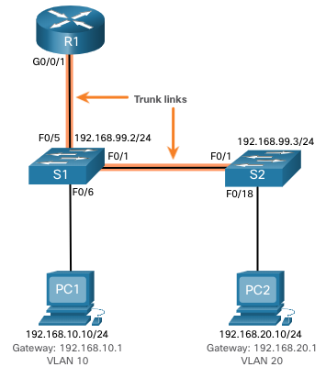
Troubleshoot Inter-VLAN Routing Troubleshoot Inter-VLAN Routing Scenario
Examples of some of these inter-VLAN routing problems will now be covered in more detail. This topology will be used for all of these issues.
Router R1 Subinterfaces
Subinterface | VLAN | IP Address
G0/0/0.10 | 10 | 192.168.10.1/24
G0/0/0.20 | 20 | 192.168.20.1/24
G0/0/0.30 | 99 | 192.168.99.1/24
Notes:
4 – Inter-VLAN Routing
4.4 - Troubleshoot Inter-VLAN Routing
4.4.2 – Troubleshoot Inter-VLAN Routing Scenario

Slide 41
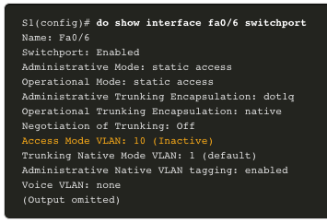
Troubleshoot Inter-VLAN Routing Missing VLANs
An inter-VLAN connectivity issue could be caused by a missing VLAN. The VLAN could be missing if it was not created, it was accidently deleted, or it is not allowed on the trunk link.
When a VLAN is deleted, any ports assigned to that VLAN become inactive. They remain associated with the VLAN (and thus inactive) until you assign them to a new VLAN or recreate the missing VLAN. Recreating the missing VLAN would automatically reassign the hosts to it.
Use the show interface interface-id switchport command to verify the VLAN membership of the port.
Notes:
4 – Inter-VLAN Routing
4.4 - Troubleshoot Inter-VLAN Routing
4.4.3 – Missing VLANs

Slide 42
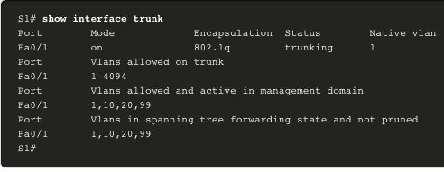
Troubleshoot Inter-VLAN Routing Switch Trunk Port Issues
Another issue for inter-VLAN routing includes misconfigured switch ports. In a legacy inter-VLAN solution, this could be caused when the connecting router port is not assigned to the correct VLAN.
However, with a router-on-a-stick solution, the most common cause is a misconfigured trunk port.
Verify that the port connecting to the router is correctly configured as a trunk link using the show interface trunk command.
If that port is missing from the output, examine the configuration of the port with the show running-config interface X command to see how the port is configured.
Notes:
4 – Inter-VLAN Routing
4.4 - Troubleshoot Inter-VLAN Routing
4.4.4 – Switch Trunk Port Issues

Slide 43
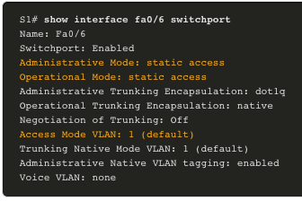
Troubleshoot Inter-VLAN Routing Switch Access Port Issues
When a problem is suspected with a switch access port configuration, use verification commands to examine the configuration and identify the problem.
A common indicator of this issue is the PC having the correct address configuration (IP Address, Subnet Mask, Default Gateway), but being unable to ping its default gateway.
Use the show vlan brief, show interface X switchport or show running-config interface X command to verify the interface VLAN assignment.
Notes:
4 – Inter-VLAN Routing
4.4 - Troubleshoot Inter-VLAN Routing
4.4.5 – Switch Access Port Issues

Slide 44
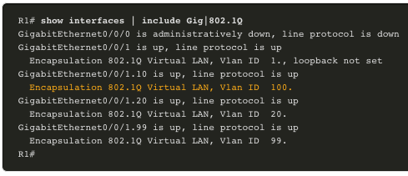
Troubleshoot Inter-VLAN Routing Router Configuration Issues
Router-on-a-stick configuration problems are usually related to subinterface misconfigurations.
Verify the subinterface status using the show ip interface brief command.
Verify which VLANs each of the subinterfaces is on. To do so, the show interfaces command is useful but it generates a great deal of additional unrequired output. The command output can be reduced using IOS command filters. In this example, use the include keyword to identify that only lines containing the letters “Gig” or “802.1Q”
Notes:
4 – Inter-VLAN Routing
4.4 - Troubleshoot Inter-VLAN Routing
4.4.6 – Router Configuration Issues
4.4.7 – Check Your Understanding – Troubleshoot Inter-VLAN Routing

Slide 45
Troubleshoot Inter-VLAN Routing Packet Tracer – Troubleshoot Inter-VLAN Routing
In this Packet Tracer activity, you will complete the following objectives:
Part 1: Locate Network Problems
Part 2: Implement the Solution
Part 3: Verify Network Connectivity
Notes:
4 – Inter-VLAN Routing
4.4 - Troubleshoot Inter-VLAN Routing
4.4.8 – Packet Tracer – Troubleshoot Inter-VLAN Routing

Slide 46
Troubleshoot Inter-VLAN Routing Packet Tracer – Troubleshoot Inter-VLAN Routing- Physical Mode Lab – Troubleshoot Inter-VLAN Routing
In this Packet Tracer Physical Mode activity, you will complete the following objectives:
Evaluate Network Operation
Gather Information, Create an Action Plan, and Implement Corrections
In this Lab, you will complete the following objectives:
Part 1: Build the Network and Load Device Configurations
Part 2: Troubleshoot the Inter-VLAN Routing Configuration
Part 3: Verify VLAN Configuration, Port Assignment and Trunking
Part 4: Test Layer 3 Connectivity
Notes:
4 – Inter-VLAN Routing
4.4 - Troubleshoot Inter-VLAN Routing
4.4.9 – PTPM and Lab – Troubleshoot Inter-VLAN Routing

Slide 47
4.5 Module Practice and Quiz
Notes:
4- Inter-VLAN Routing
4.5 – Module Practice and Quiz

Slide 48
Module Practice and Quiz Packet Tracer – Inter-VLAN Routing Challenge
In this Packet Tracer activity, you will demonstrate and reinforce your ability to implement inter-VLAN routing, including configuring IP addresses, VLANs, trunking, and subinterfaces.
Notes:
4 – Inter-VLAN Routing
4.5 – Module Practice and Quiz
4.5.1 – Packet Tracer – Inter-VLAN Routing Challenge

Slide 49
Module Practice and Quiz Lab– Implement Inter-VLAN Routing
In this lab, you will complete the following objectives:
Part 1: Build the Network and Configure Basic Device Settings
Part 2: Create VLANs and Assign Switch Ports
Part 3: Configure an 802.1Q Trunk between the Switches
Part 4: Configure Inter-VLAN Routing on the S1 Switch
Part 5: Verify Inter-VLAN Routing is Working
Notes:
4 – Inter-VLAN Routing
4.5 – Module Practice and Quiz
4.5.2 – Lab – Implement Inter-VLAN Routing

Slide 50
Module Practice and Quiz What Did I Learn In This Module?
Inter-VLAN routing is the process of forwarding network traffic from one VLAN to another VLAN.
Three options include legacy, router-on-a-stick, and Layer 3 switch using SVIs.
To configure a switch with VLANs and trunking, complete the following steps: create and name the VLANs, create the management interface, configure access ports, and configure trunking ports.
The router-on-a-stick method requires a subinterface to be created for each VLAN to be routed. A subinterface is created using the interface interface_id subinterface_id global configuration mode command.
Each router subinterface must be assigned an IP address on a unique subnet for routing to occur. When all subinterfaces have been created, the physical interface must be enabled using the no shutdown interface configuration command.
Enterprise campus LANs use Layer 3 switches to provide inter-VLAN routing. Layer 3 switches use hardware-based switching to achieve higher-packet processing rates than routers.
Capabilities of a Layer 3 switch include routing from one VLAN to another using multiple switched virtual interfaces (SVIs) and converting a Layer 2 switchport to a Layer 3 interface (i.e., a routed port).
To provide inter-VLAN routing, Layer 3 switches use SVIs. SVIs are configured using the same interface vlan vlan-id command used to create the management SVI on a Layer 2 switch.
Notes:
4 – Inter-VLAN Routing
4.5 – Module Practice and Quiz
4.5.3 – What Did I Learn In This Module?

Slide 51
Module Practice and Quiz What Did I Learn In This Module? (Cont.)
To configure a switch with VLANS and trunking, complete the following steps: create the VLANS, create the SVI VLAN interfaces, configure access ports, and enable IP routing.
To enable routing on a Layer 3 switch, a routed port must be configured. A routed port is created on a Layer 3 switch by disabling the switchport feature on a Layer 2 port that is connected to another Layer 3 device. The interface can be configured with an IPv4 configuration to connect to a router or another Layer 3 switch.
To configure a Layer 3 switch to route with a router, follow these steps: configure the routed port, enable routing, configure routing, verify routing, and verify connectivity.
There are a number of reasons why an inter-VAN configuration may not work. All are related to connectivity issues such as missing VLANs, switch trunk port issues, switch access port issues, and router configuration issues.
A VLAN could be missing if it was not created, it was accidently deleted, or it is not allowed on the trunk link.
Another issue for inter-VLAN routing includes misconfigured switch ports.
In a legacy inter-VLAN solution, a misconfigured switch port could be caused when the connecting router port is not assigned to the correct VLAN.
Notes:
4 – Inter-VLAN Routing
4.5 – Module Practice and Quiz
4.5.3 – What Did I Learn In This Module? (Cont.)

Slide 52
Module Practice and Quiz What Did I Learn In This Module? (Cont.)
With a router-on-a-stick solution, the most common cause is a misconfigured trunk port.
When a problem is suspected with a switch access port configuration, use ping and show interfaces interface-id switchport commands to identify the problem.
Router configuration problems with router-on-a-stick configurations are usually related to subinterface misconfigurations. Verify the subinterface status using the show ip interface brief command.
Notes:
4 – Inter-VLAN Routing
4.5 – Module Practice and Quiz
4.5.3 – What Did I Learn In This Module? (Cont.)
4.5.4 – Module Quiz – Inter-VLAN Routing

Slide 53
Module 4: Basic Device Configuration New Terms and Commands
Inter-VLAN Routing
Router-on-a-Stick
encapsulation dot1q X [ native ]
no switchport
router ospf
ip routing

