Slide 1


Pho Hotel Reviews
PHO DAC BIET
Daniel Ly • James Takeda • Nam Vo • Nathan Nguyen •
Kim Luong

Slide 2
Why the Hotel Reviews Dataset?
Hotels are a universal commodity, analyzing and improving them would only be beneficial
Gives insight on how customers feel about their experiences and opinions on the hotel
Allows hotel administratores to find ways to enhance their guests experience in the future

Slide 3
Overview
PROBLEMS | SOLUTION
PROCESS | RESULTS / CONCLUSION

Slide 4
PROBLEMS
How can we provide meaning to a dataset as large as the hotel reviews Excel file?
What tactics can we use to analyze such a large set of data?
How can we create a program that allows users to easily find the hotel statistic?
Notes:
Problem slide

Slide 5
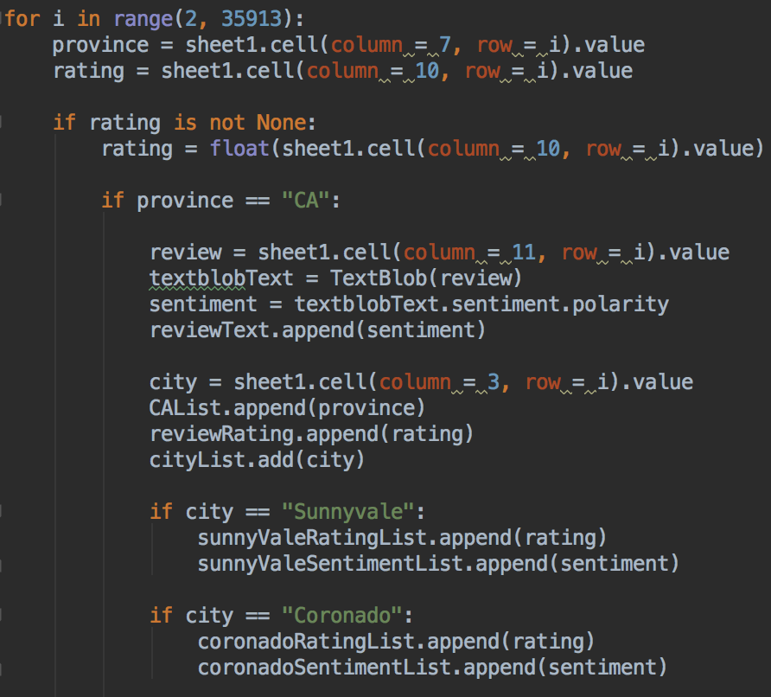

OUR METHODS
Created a loop in order to read the whole text file
Utilizing multiple if-conditions, we were able to dial in on the specific data we want to analyze
Filtered out provinces that are not California
Filtered out non-null ratings
Save the CA city names and add it to a set list...unique
Lastly, we saved every city’s corresponding rating and sentiment to their respective lists

Slide 6
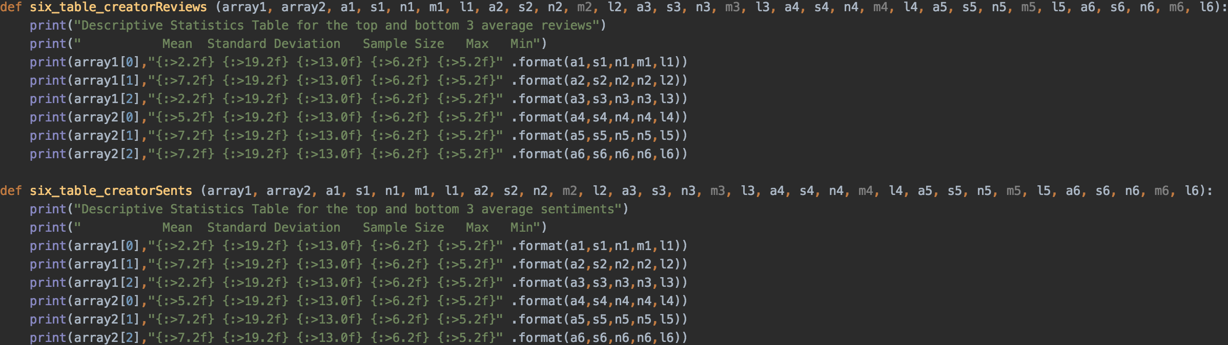
METHODS CONT.
These functions take several arguments and display them into a table to show the descriptive statistics

Slide 7
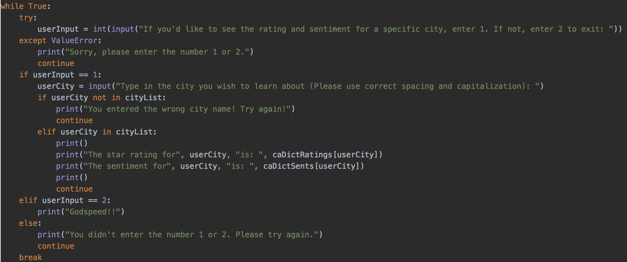
USER INPUT

Slide 8
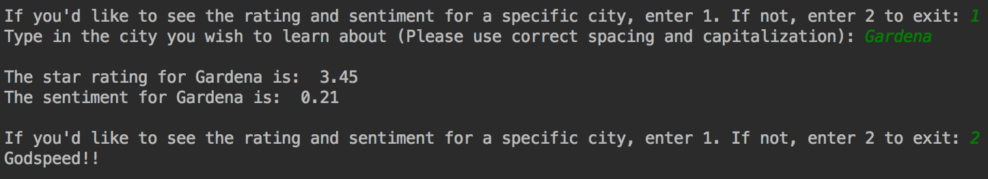
OUTPUT OF USER INPUT

Slide 9
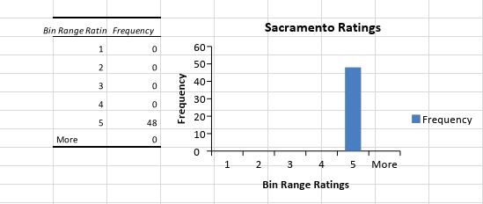
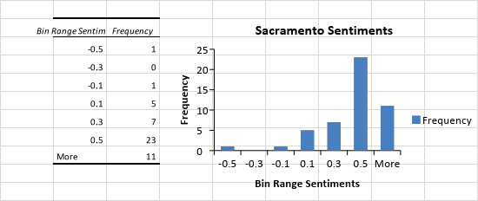
Sacramento
“This is a gorgeous hotel! We had our wedding here in November of 2011 and would not have changed a thing about the hotel. We had our ceremony in the Historic Ballroom on the first floor, then guests moved up to Scandals on the second floor for the cocktail hour and then the reception was on the seventh floor terrace with a view of the whole city!”

Slide 10
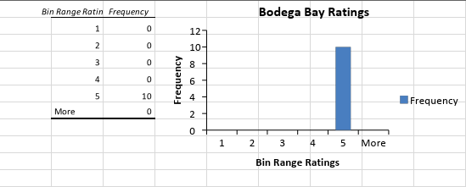
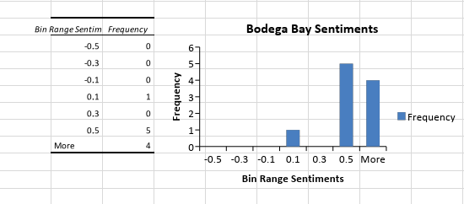
Bodega Bay
“We have not been able to go on vacation for a while because we are saving for our wedding. This was the perfect escape from our busy lives in San Francisco. Thank you for everything.”

Slide 11
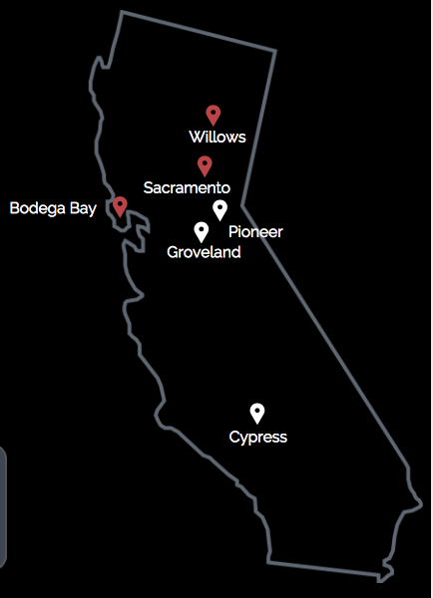
CONCLUSION
Top 3:
Bodega Bay
Willows
Sacramento
Bottom 3:
Groveland
Cypress
Pioneer
Notes:
Sacramento: 5 star review w lowest sentiment - 0.5 sentinel value: “This review is specifically for Melissa. We began the process with Harmony and were quite frustrated.”
Bodega Bay: 5 star review - 0.04 sentinel value: Unique and beautiful place. We admire the owner's hard work.
Groveland: 0 to share your opinion of this businesswith YP visitors across the United Statesand in your neighborhood
Given 35912 reviews, we figured out how to utilize our tools and provided

Slide 12
Q U E S T I O N S ?

