Slide 1
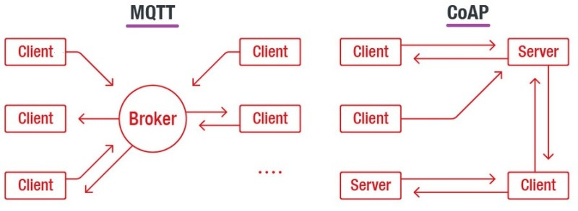
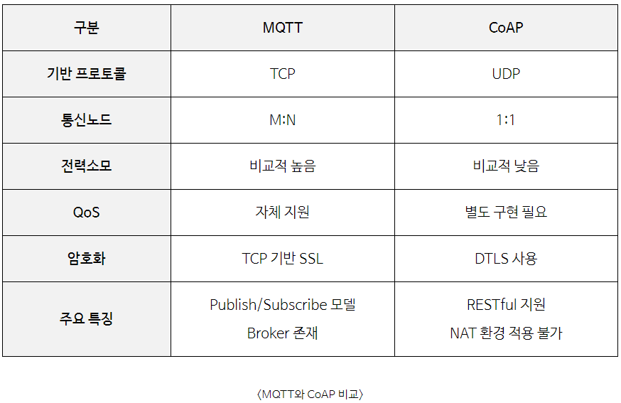
MQTT & COAP 프로토콜
Notes:
https://iotbyhvm.ooo/coap-vs-mqtt/

Slide 2
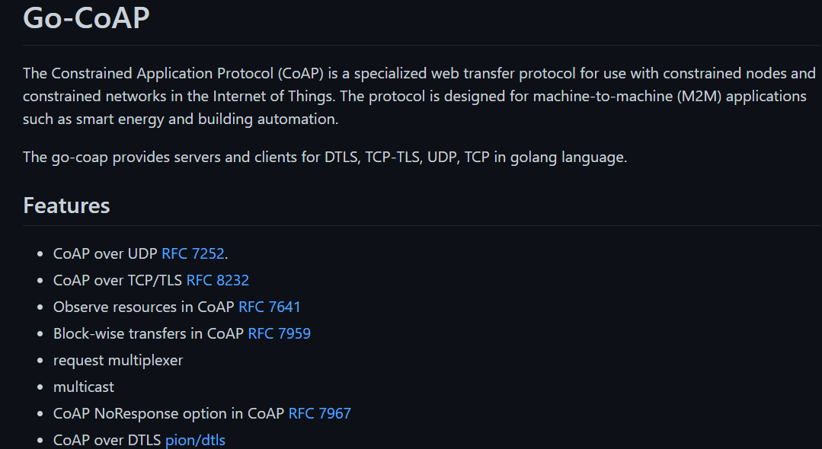
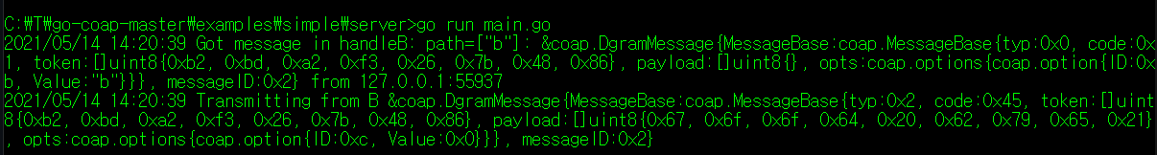
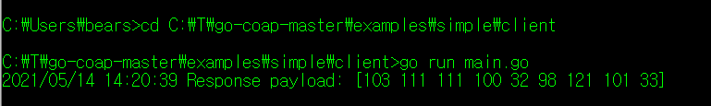
COAP 성능테스트
1. 샘플 환경 구성 (Go-GoAP) https://github.com/plgd-dev/go-coap
※ Go 언어 설치 필요
https://golang.org/
2. Server 실행
3. Client 실행
Notes:
https://blog.naver.com/lghmms/222105220159
https://blog.naver.com/wisestone2007/222098236666

Slide 3
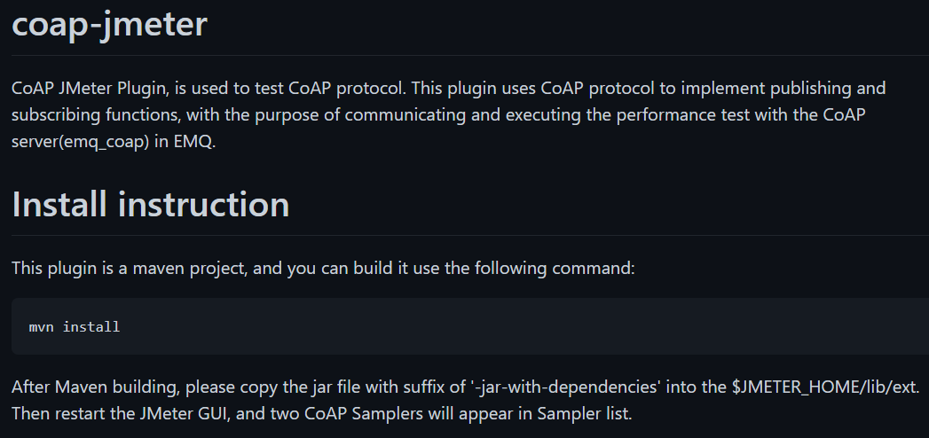
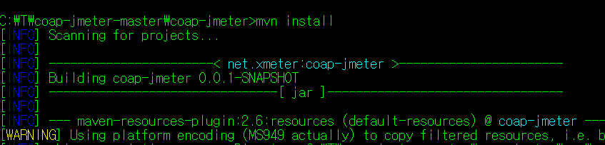

COAP 성능테스트
1. Coap 플러그인 https://github.com/xmeter-net/coap-jmeter
2. Maven Build
3. Plugin 파일 Jmeter 복사
생성된 Plugin파일(coap-xmeter-jar-with-dependencies.jar) 을 \lib\ext 폴더에 복사
Notes:
https://blog.naver.com/lghmms/222105220159
https://blog.naver.com/wisestone2007/222098236666

Slide 4
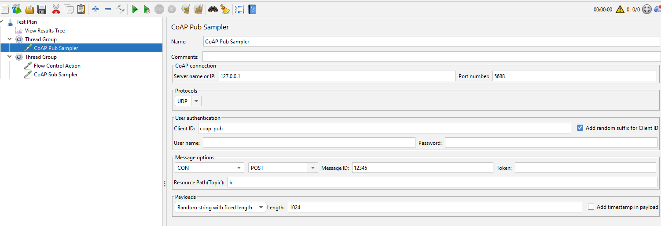
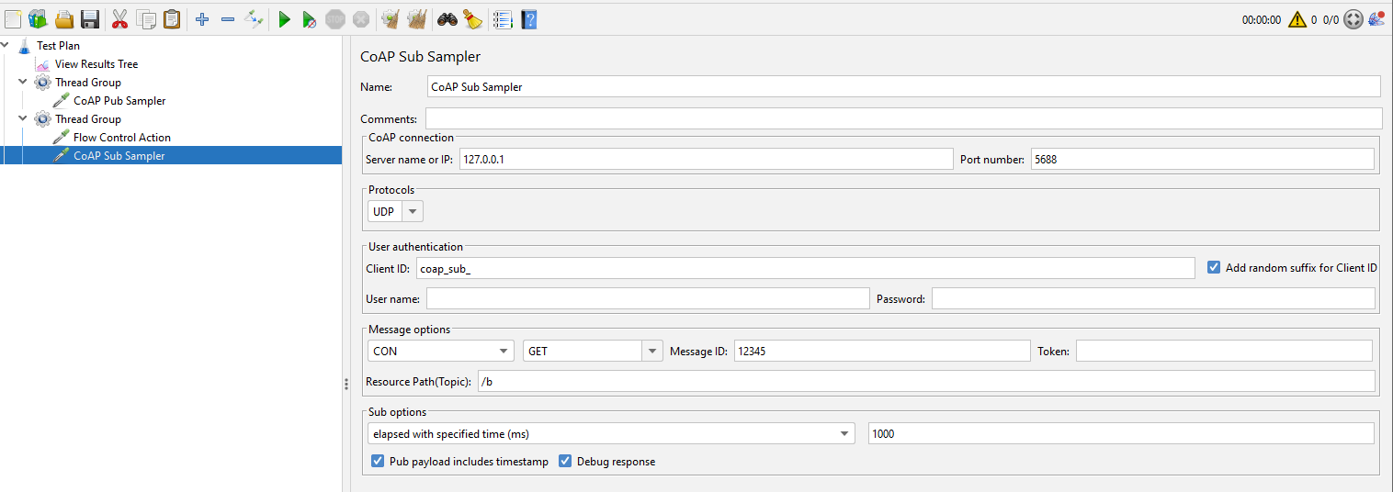
COAP 성능테스트
1. CoAP Pub Sampler
2. CoAP Sub Sampler
Notes:
https://blog.naver.com/lghmms/222105220159
https://blog.naver.com/wisestone2007/222098236666

Slide 5
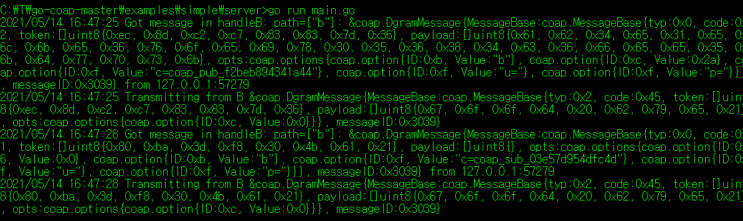
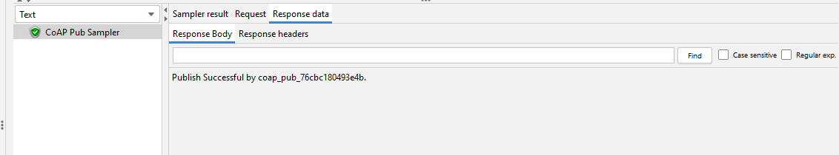
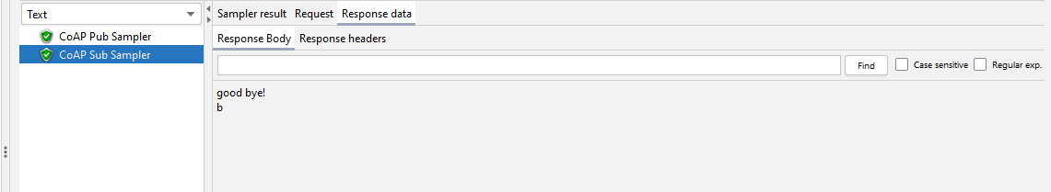
COAP 성능테스트
1. Go-CoAP Server 실행
2. Jmeter 실행 후 결과 확인(View Result Tree)
Notes:
https://blog.naver.com/lghmms/222105220159
https://blog.naver.com/wisestone2007/222098236666

Slide 6
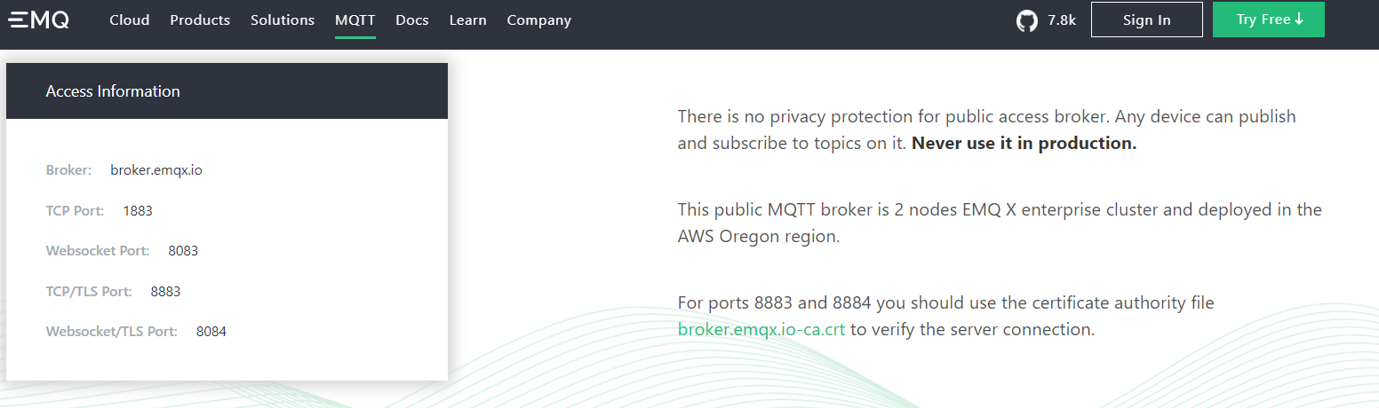
MQTT 성능테스트
1. MQTT Test Server https://www.emqx.io/mqtt/public-mqtt5-broker
Notes:
https://blog.naver.com/lghmms/222105220159
https://blog.naver.com/wisestone2007/222098236666

Slide 7
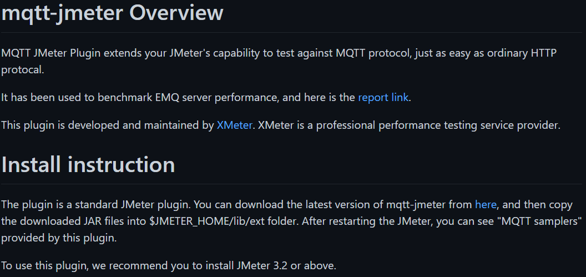

MQTT 성능테스트 (1. Plugin)
1. MQTT PlugIn https://github.com/xmeter-net/mqtt-jmeter
2. Plugin 파일 Jmeter 복사
Plugin파일(mqtt-xmeter-1.13-jar-with-dependencies.jar) 을 \lib\ext 폴더에 복사
Notes:
https://blog.naver.com/lghmms/222105220159
https://blog.naver.com/wisestone2007/222098236666

Slide 8
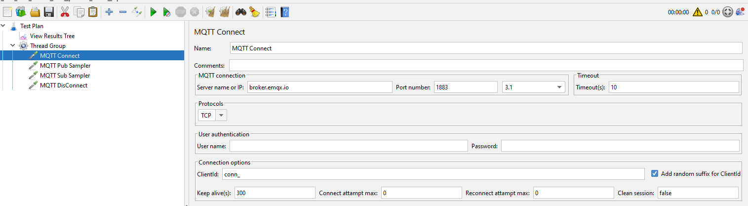
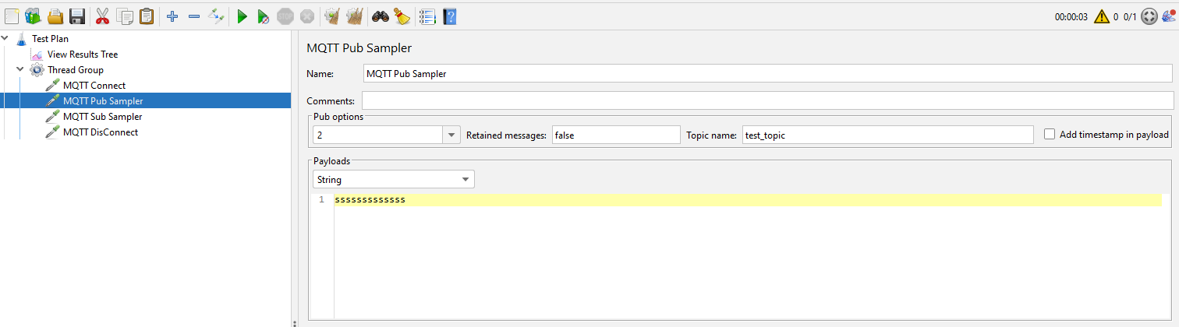
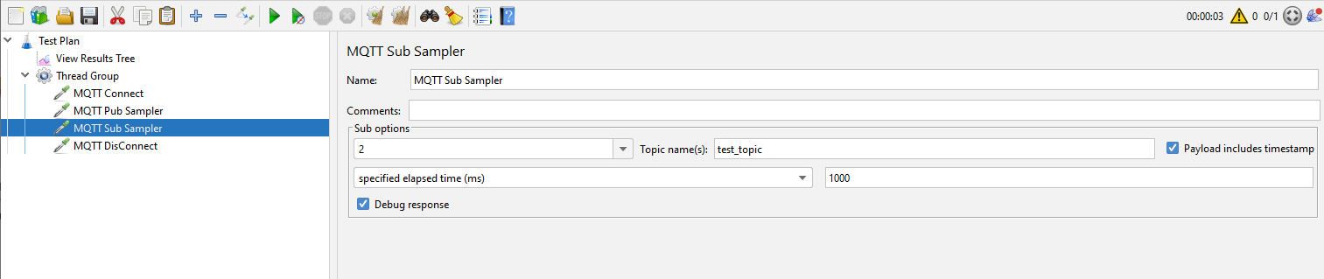
MQTT 성능테스트 (1. Plugin)
1. MTQQ Sampler 추가
Connect , Pub Sampler , Sub Sampler , DisConnect
Notes:
https://blog.naver.com/lghmms/222105220159
https://blog.naver.com/wisestone2007/222098236666

Slide 9
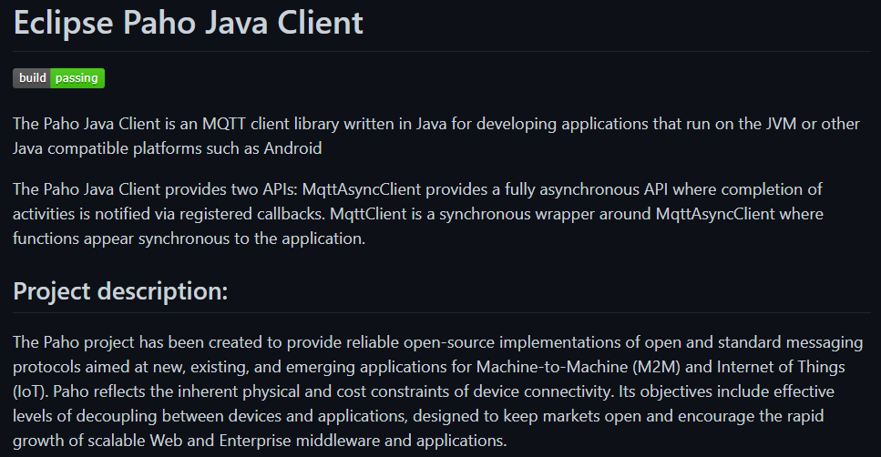
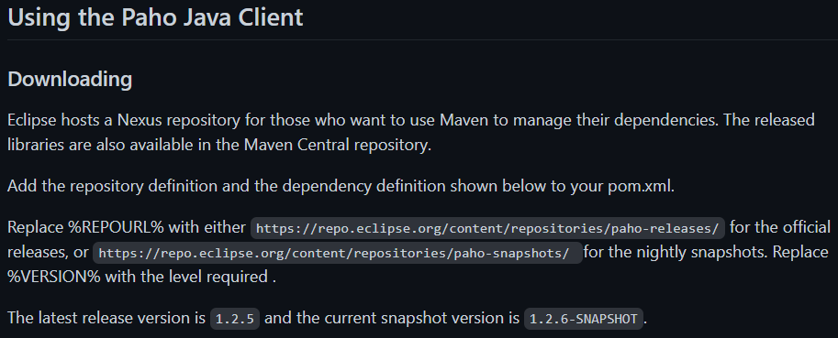

MQTT 성능테스트 (2. JSR223)
1. MTQQ Java Library(Jar) https://github.com/eclipse/paho.mqtt.java
2. MQTT Client Library 파일 Jmeter 복사
https://repo.eclipse.org/content/repositories/paho-releases/org/eclipse/paho/mqtt-client/0.4.0/
mqtt-client-0.4.0.jar 다운로드 후 /lib/ext 복사
Notes:
https://blog.naver.com/lghmms/222105220159
https://blog.naver.com/wisestone2007/222098236666

Slide 10
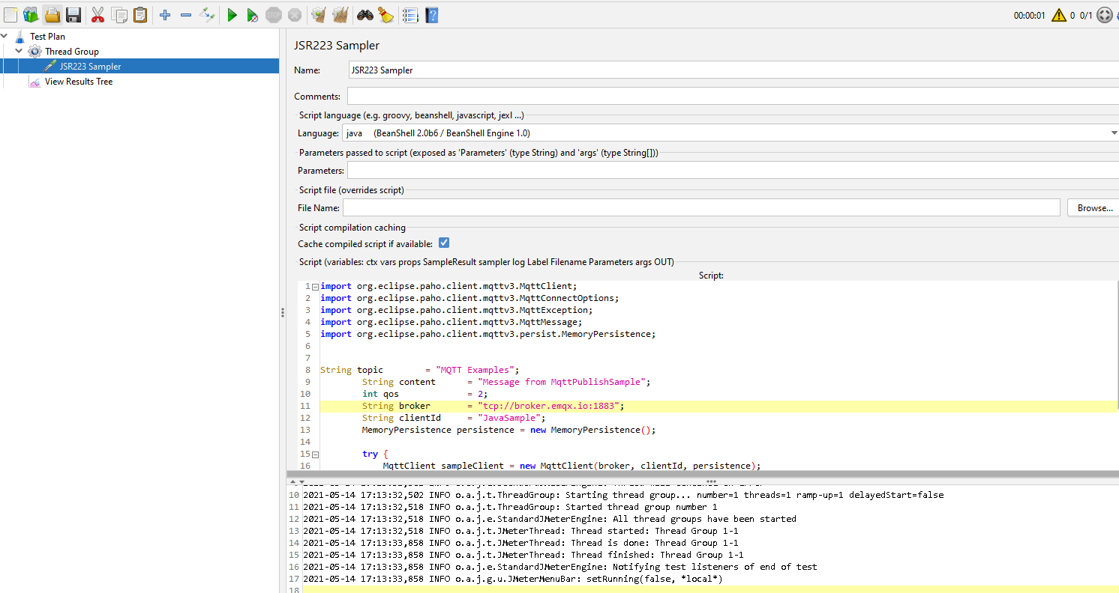
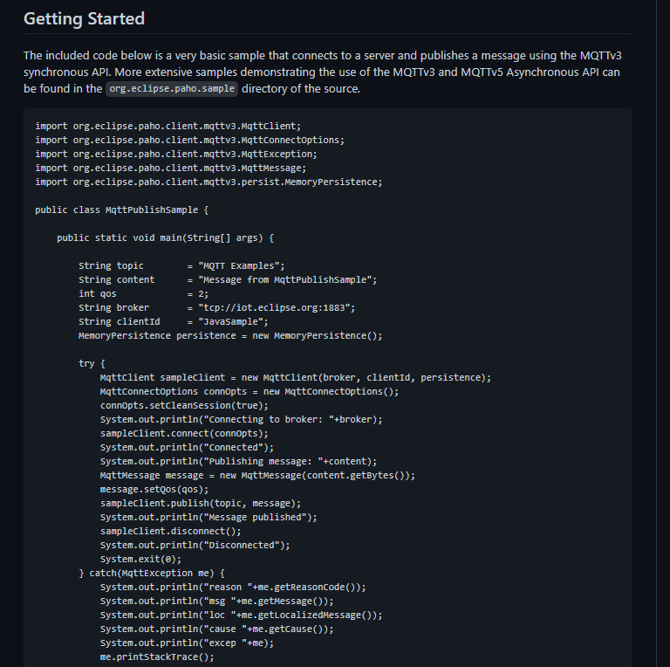
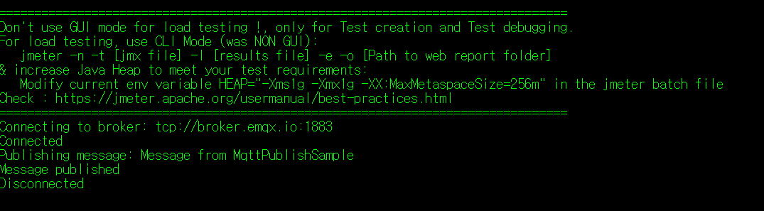
MQTT 성능테스트 (2. JSR223)
1. JSR223 Sampler 추가 후 Java Code 추가
Notes:
https://blog.naver.com/lghmms/222105220159
https://blog.naver.com/wisestone2007/222098236666

