Slide 1
Machine Learning
with scikit-learn
Andreas Müller
amueller@ais.uni-bonn.de
peekaboo-vision.blogspot.com

Slide 2
why learn?

Slide 3
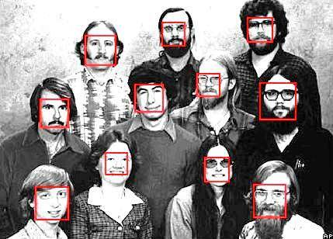

Slide 4
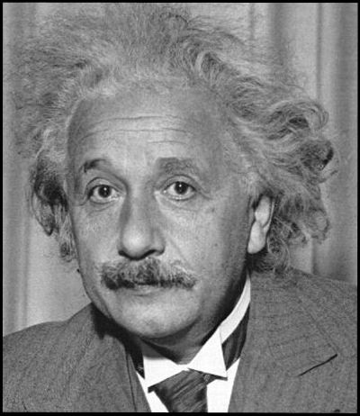

Slide 7
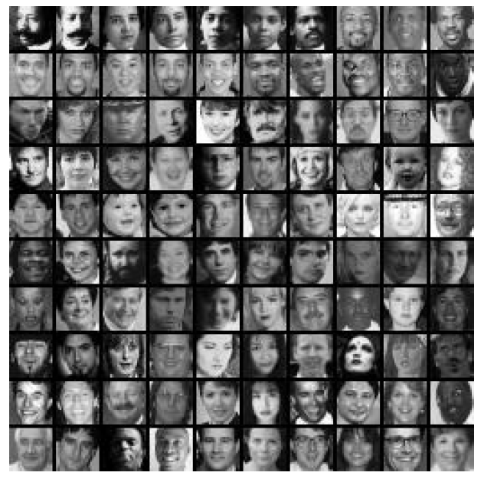
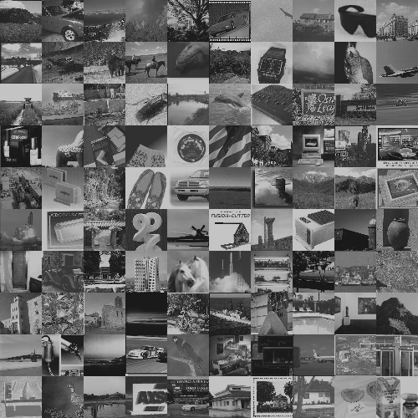
VS

Slide 8


Slide 9
why learn?
Better than you could do it!
Easy adaption to new tasks!

Slide 10
what can we learn

Slide 11
Classification
Hi friends, I have finally released 0.12.1. The tarball can be found on pypi: http://pypi.python.org/pypi/scikit-learn I am looking for volunteer to build windows binaries. I can't really give instruction, as I have never shipped windows binaries. The core idea is to run 'python setup.py bdist_wininst'. I know that they are caveat when doing these, as we had problem with them a while ago, but I am not sure how to proceed. Vlad, Fabian, any help with instructions? Beside, I am going to bed, so I think that the binaries will be uploaded tomorrow Gael
Check out what I'm talking about here: http://bit.ly/T0ZZ7E Hi, my dearie, We're doing pretty good here, how are you? You'll never believe it--I've been chubby for SO long I stopped those stupid fad diets and still hit my target weight! I wish I'd learned about this sooner. Oprah's guy? Dr. Oz? He says amazing things about this. Go ahead, be skeptical, but when you see me in my bikini, you'll KNOW it works lolol! Take care! Talk to you soon!

Slide 12
Classification
Hi friends, I have finally released 0.12.1. The tarball can be found on pypi: http://pypi.python.org/pypi/scikit-learn I am looking for volunteer to build windows binaries. I can't really give instruction, as I have never shipped windows binaries. The core idea is to run 'python setup.py bdist_wininst'. I know that they are caveat when doing these, as we had problem with them a while ago, but I am not sure how to proceed. Vlad, Fabian, any help with instructions? Beside, I am going to bed, so I think that the binaries will be uploaded tomorrow Gael
Check out what I'm talking about here: http://bit.ly/T0ZZ7E Hi, my dearie, We're doing pretty good here, how are you? You'll never believe it--I've been chubby for SO long I stopped those stupid fad diets and still hit my target weight! I wish I'd learned about this sooner. Oprah's guy? Dr. Oz? He says amazing things about this. Go ahead, be skeptical, but when you see me in my bikini, you'll KNOW it works lolol! Take care! Talk to you soon!
Ham
✓
✗
Spam

Slide 13
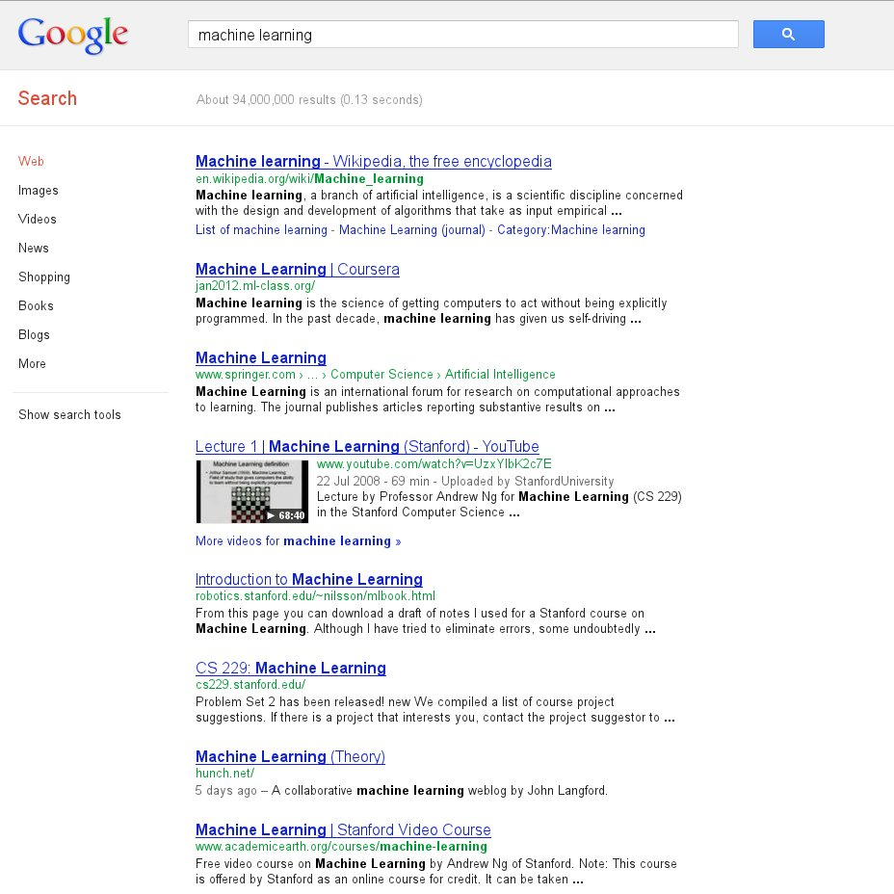
Ranking

Slide 14

Recommendations

Slide 15
Many more
Regression
Clustering
Dimensionality Reduction
Feature Selection
...

Slide 16
How do we learn?
Data representation

Slide 17
Data as Vectors : E-Mails
Hi friends, I have finally released 0.12.1. The tarball can be found on pypi: http://pypi.python.org/pypi/scikit-learn I am looking for volunteer to build windows binaries. I can't really give instruction, as I have never shipped windows binaries. The core idea is to run 'python setup.py bdist_wininst'. I know that they are caveat when doing these, as we had problem with them a while ago, but I am not sure how to proceed. Vlad, Fabian, any help with instructions? Beside, I am going to bed, so I think that the binaries will be uploaded tomorrow Gael
weight
binaries
python
diet
when
0 3 2 0 1 ...

Slide 18
Data as Vectors : E-Mails
Hi friends, I have finally released 0.12.1. The tarball can be found on pypi: http://pypi.python.org/pypi/scikit-learn I am looking for volunteer to build windows binaries. I can't really give instruction, as I have never shipped windows binaries. The core idea is to run 'python setup.py bdist_wininst'. I know that they are caveat when doing these, as we had problem with them a while ago, but I am not sure how to proceed. Vlad, Fabian, any help with instructions? Beside, I am going to bed, so I think that the binaries will be uploaded tomorrow Gael
weight
binaries
python
diet
when
0 3 2 0 1 ...
1 0 0 1 1 ...
Check out what I'm talking about here: http://bit.ly/T0ZZ7E Hi, my dearie, We're doing pretty good here, how are you? You'll never believe it--I've been chubby for SO long I stopped those stupid fad diets and still hit my target weight! I wish I'd learned about this sooner. Oprah's guy? Dr. Oz? He says amazing things about this. Go ahead, be skeptical, but when you see me in my bikini, you'll KNOW it works lolol! Take care! Talk to you soon!

Slide 19
Data as Vectors : E-Mails
Hi friends, I have finally released 0.12.1. The tarball can be found on pypi: http://pypi.python.org/pypi/scikit-learn I am looking for volunteer to build windows binaries. I can't really give instruction, as I have never shipped windows binaries. The core idea is to run 'python setup.py bdist_wininst'. I know that they are caveat when doing these, as we had problem with them a while ago, but I am not sure how to proceed. Vlad, Fabian, any help with instructions? Beside, I am going to bed, so I think that the binaries will be uploaded tomorrow Gael
weight
binaries
python
diet
when
0 3 2 0 1 ...
1 0 0 1 1 ...
Check out what I'm talking about here: http://bit.ly/T0ZZ7E Hi, my dearie, We're doing pretty good here, how are you? You'll never believe it--I've been chubby for SO long I stopped those stupid fad diets and still hit my target weight! I wish I'd learned about this sooner. Oprah's guy? Dr. Oz? He says amazing things about this. Go ahead, be skeptical, but when you see me in my bikini, you'll KNOW it works lolol! Take care! Talk to you soon!
Data for learning:
samples >> 1000
1000 < dictionary size < 100.000

Slide 20
Data as Vectors : Digits

Slide 21
How do we learn?
Workflow

Slide 22
Work flow (classification)
Parameters
Classifier

Slide 23
Work flow (classification)
Parameters
Training Data + labels
clf.fit(X_test, y_test)
Classifier
Model

Slide 24
Work flow (classification)
Parameters
Training Data + labels
Test Data
clf.fit(X_test, y_test)
clf.predict(X_test)
Classifier
Model
Prediction

Slide 25
Work flow (classification)
Parameters
Training Data + labels
Test Data
Test Labels
clf.fit(X_test, y_test)
clf.predict(X_test)
clf.score(X_test, y_test)
Classifier
Model
Prediction
Evaluation

Slide 26
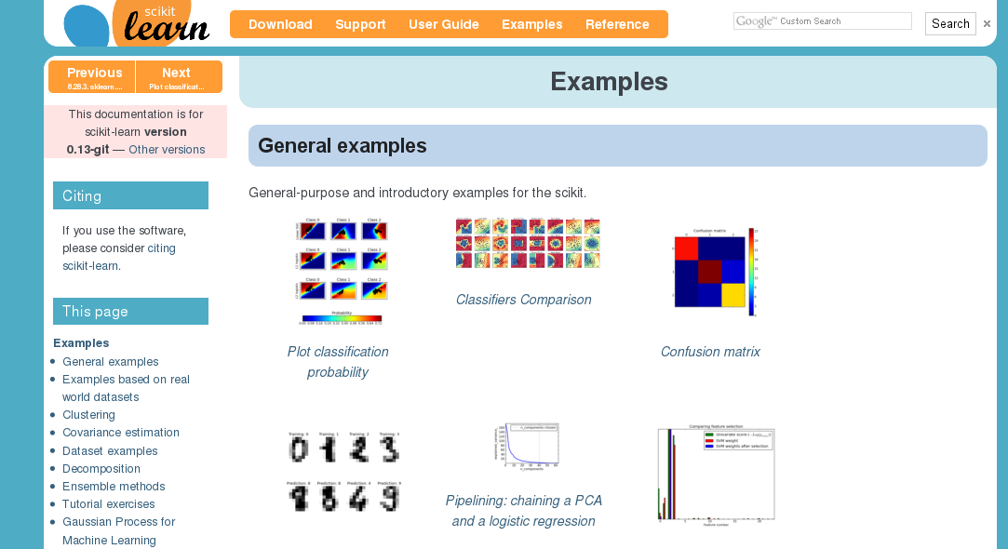
Resources
http://scikit-learn.org/dev GO THERE!

Slide 27

Talk Resources
Notebook sources, pdf, etc ..
gist.github.com/amueller
For Rendered Notebook: bit.ly/UaArq3 .. or follow me on twitter: @t3kcit

Slide 28
Questions ?
Also: come sprint with me!

