Slide 1





Accessible
Machine Learning
in Python
Andreas Müller
Associate Research Scientist
Columbia University
Scikit-learn Technical Committee
Notes:
Hi. Welcome ot may talk on accessible machine learning in Python.
A lot of my work is more on the software engineering side, so this talk will be a mixture of some of my research and some of my software engineering work.
A lot of my work is on scikit-learn, often via my team. However, that work is often very technical, and so I’m mostly leaving it out of this talk.

Slide 2
A real world ML workflow
Data Cleaning
Visualization
Model Building
Data Collection
Integration & Deployment
Model Evaluation
Notes:
I want to start with a quick overview of how I think about the machine learning workflow.
There’s many version of this, and it’s also known as box’s loop.
You start with defining the problem you want to solve, and collect the data. You do an initial data cleaning and visualization, then you work on model building and comparison, and do model evaluation.
Then, usually you integrate into a bigger system. That can be deployment or offline use within some bigger pipeline. There’s usually consequences of a model that can not be evaluated without actually using a model.
One of the points I want to emphasize is that this is not a feed-forward process, but there’s a feedback loop between the different steps. I drew it as a cycle but actually I think it’s best to think of it as a fully connected graph. After each step, you might go back to previous steps. Each step might tell you about a mistake you made earlier or something you can do better.
I titled this a real world ML workflow, because this is not how ML is usual treated in research or by existing ML tools.
Usually tools and research focus on a single step, most commonly the model building, and ignore the interdepencencies. I think we need to do better, and that is the focus of this talk.

Slide 3
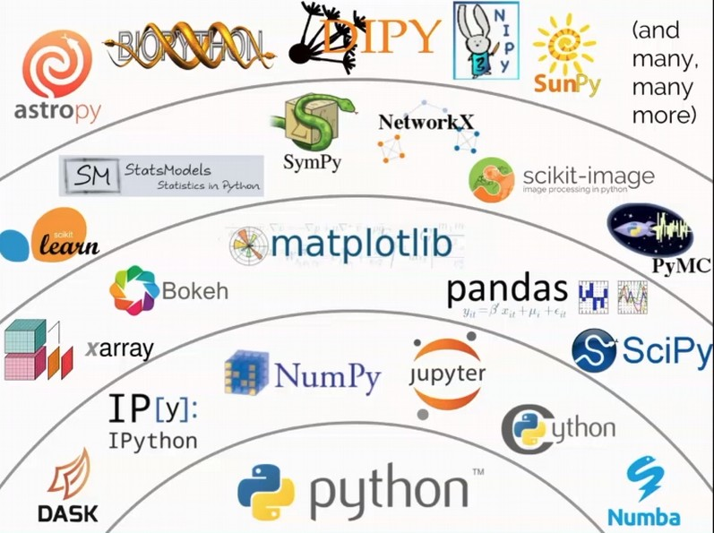
Notes:
Let me explain a bit more what I mean by the scientifc python ecosystem. Sometimes I and others just say “Python”. Python is the programming language that is used to build all these tools. But the real strength of the ecosystem is in all the tools that are created using Python and that integrate to create the ecosystem.
So at the bottom we have the language Python. Above that we have tools for efficient numeric computation, in particular numpy and cython, and tools for interactive computing and exploratory analysis, jupyter and ipython.
The layer above builds on these tools, and consists of libraries for working with n-dimensional data, doing data visualization, doing optimization and doing ETL.
Everybody that uses Python for data science in industry or academia uses this layer.

Slide 4
NumPy
Pandas
In-memory ndarrays (aka tensors)
Linear algebra
C interface
Homogeneous types
In-memory column store
Heterogeneous types
SQL-like operations - groupby - join - pivot - …

Slide 5

Machine Learning with Python and Scikit-learn
Notes:
Scikit-learn, as I said, is part of the scientific python ecosystem. It’s the main tool to do machine learning within this ecosystem, and arguably the most popular tool to do machine learning overall.
Scikit-learn is a tool focused on supervised learning, but also includes unsupervised learning, preprocessing, model selection, model evaluation and other tools around the machine learning process.

Slide 6
Classification
Regression
Clustering
Semi-Supervised Learning
Feature Selection
Feature Extraction
Manifold Learning
Dimensionality Reduction
Kernel Approximation
Hyperparameter Optimization
Evaluation Metrics
Out-of-core learning
…...

Slide 7
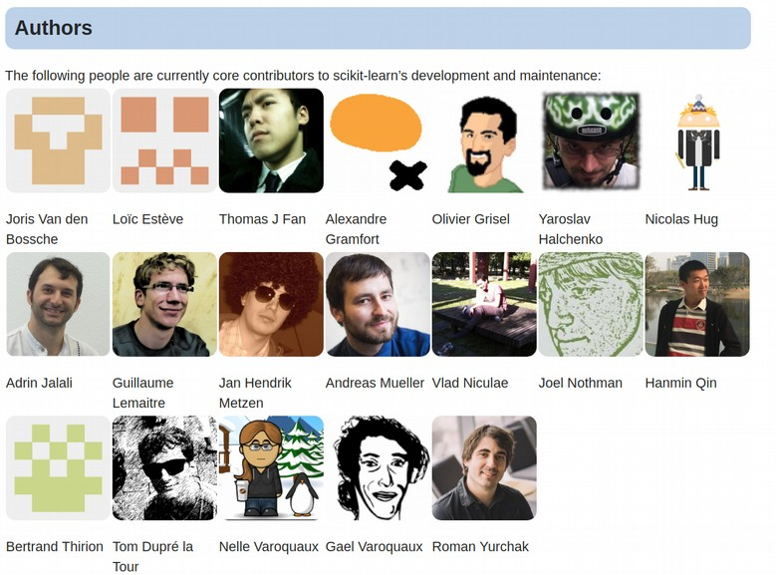

History?
Emeritus
Core Developers
Alexander Fabisch
Alexandre Passos
Angel Soler Gollonet
Arnaud Joly
Chris Gorgolewski
David Cournapeau
David Warde-Farley
Eduard Duchesnay
Fabian Pedragosa
Gilles Louppe
Jacob Schreiber
Jake Vanderplas
Jaques Grobler
Jarrod Millman
Kyle Kastner
Lars Buitinck
Manoj Kumar
Mathieu Blondel
Matthieu Brucher
Noel Dawe
Paolo Losi
Peter Prettenhofer
Raghav Rajagopalan
Robert Layton
Ron Weiss
Satrajit Ghosh
Shiqiao Du
Thouis (Ray) Jones
Vincent Dubourg
Vincent Michel
Virgile Fritsch
Wei Li
Notes:
The project was started around 2010 by a team working on Neuroscience at INRIA in Paris, and that team is still very involved. For example Alex Gramfort, Olivier Grisel, Bertrand Thiron and Gael Varoquaux are among the original authors.
There is currently 19 core developers, with a long list of past contributors. In total the project has had contributions from over 1,300 developers, including researchers from at least 34 US universities.
I have been contributing to the project for about 8 years.
Both I and INRIA have people working on the project on the clock, but a lot of the contributions are done by people in their free time.

Slide 8
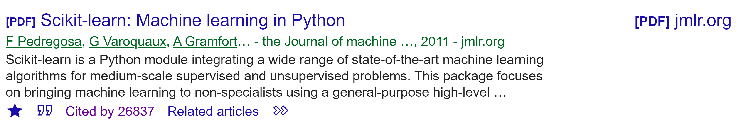
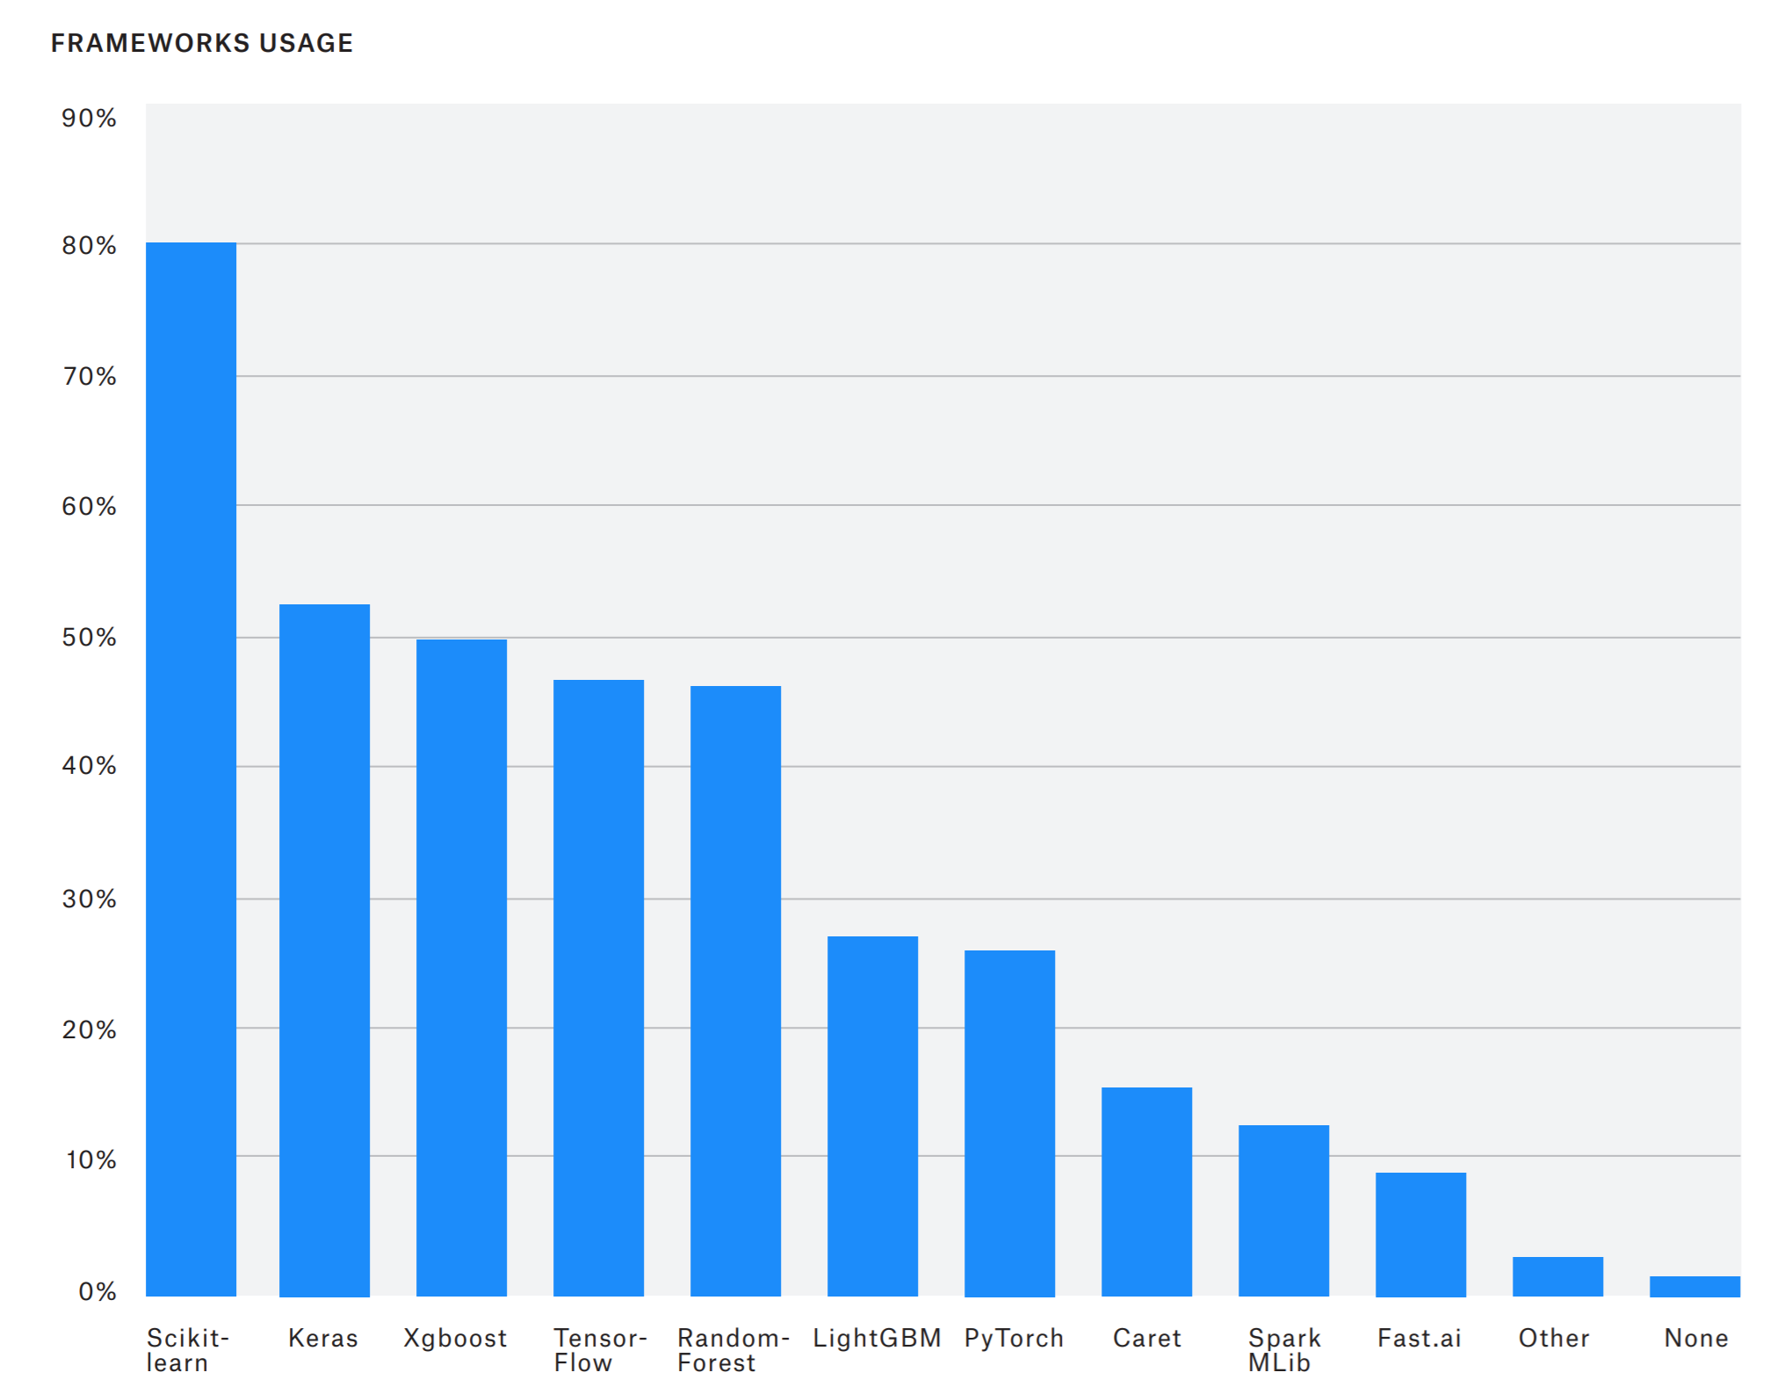
Our Mission:
Commoditize and Democratize Machine Learning
Notes:
The mission of scikit-learn is to commoditize and democratize machine learning.
We want to enable everybody to use machine learning and data science. We want to make it easy, and we want to make it easy to do it right.
We are not at the cutting edge of machine learning research, we are building tools that actually work, and work robustly, and are well documented and easy to use.
And I would say we’ve been quite successful.

Slide 9
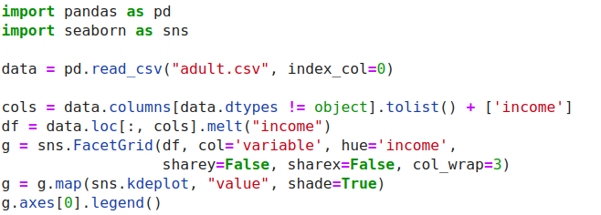
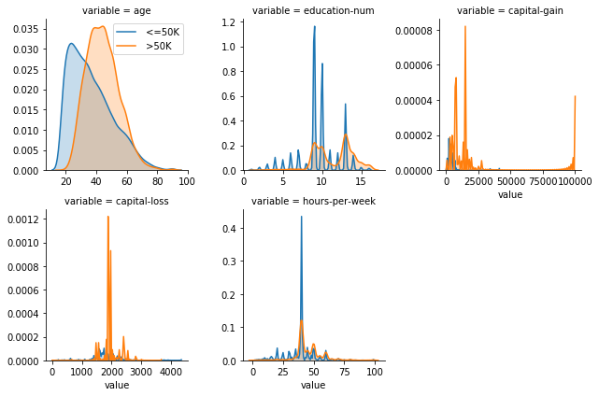
ML with sklearn & pandas
Notes:
Right now there are tools for these different steps available, but I think they are much too hard to use. For example, here is me doing some basic visualization on a standard ML benchmark dataset, the adult dataset. I want to figure out what the univariate distributions are for the two classes. I’ll use seaborn which is one of the most advanced visualisualization libraries for python. However, it’s not really made for supervised learning datasets and so to do what I want to do I have to come up with a pretty intricate call that I got by asking Michael Waskom on the issue tracker and that I probably have to look up every time.
And seaborn is great, but it’s not really the tool I need.

Slide 10
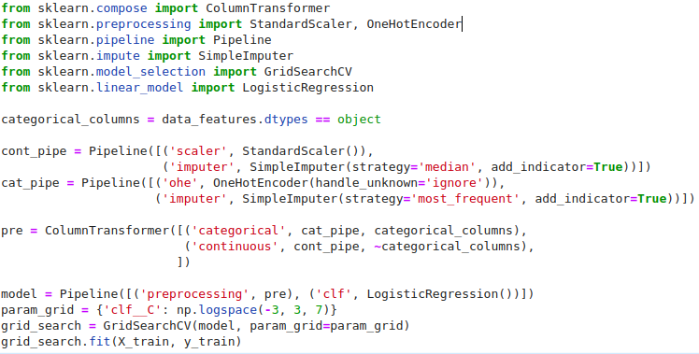
ML with sklearn & pandas
Notes:
Similarly when it comes to machine learning, I think there’s a lot to improve on. I spend a lot of time on scikit-learn and making it easier to use. But here’s basically what you’d have to do to learn a logistic regression model and tune the regularization parameter on this adult dataset. And keep in mind, this is not very dirty data, this is a pretty standard benchmark.
Scikit-learn is very explicit and very flexible which is great when you want to control what you’re doing very precisely. But for running a quick prototype it’s not ideal.
And I can come up with this code here pretty easily but I’m also responsible for a bunch of the things that are happening here. It could certainly be more intuitive.

Slide 11
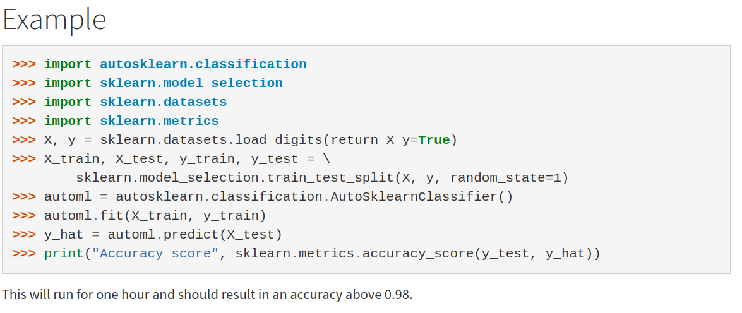
Automatic ML frameworks

Slide 12
A real world ML workflow
Data Cleaning
Visualization
Model Building
Data Collection
Integration & Deployment
Model Evaluation
Notes:
Coming back to the workflow I discussed earlier, my point here is not that the tools are bad, but that the tools we have make us focus on the wrong things.
Our tools require us to spend a lot of time on each individual step, and make it hard to iterate quickly between the different stages. In particular our tools make us spend time in the steps that should be easy, like the preprocessing, visualization and modeling. You should be spending time in collecting data and analyzing the model instead.
So let’s talk about what we can do about this situation.
The first thing I want to talk about is some flavors of AutoML that I’ve worked on. That is basically about automating the model building step.

Slide 13

data
analysis
baseline
library

Slide 14
dabl.clean
dabl.plot
Data Cleaning
Visualization
Model Building
Data Collection
dabl. AnyClassifier
Model Interpretation
business/science evaluation
dabl.explain
You actually have to think, sorry.

Slide 15

Detect types
Detect Missing / rare values
Detect ordinal vs categorical
Detect near-constant
Detect index
dabl.clean

Slide 16
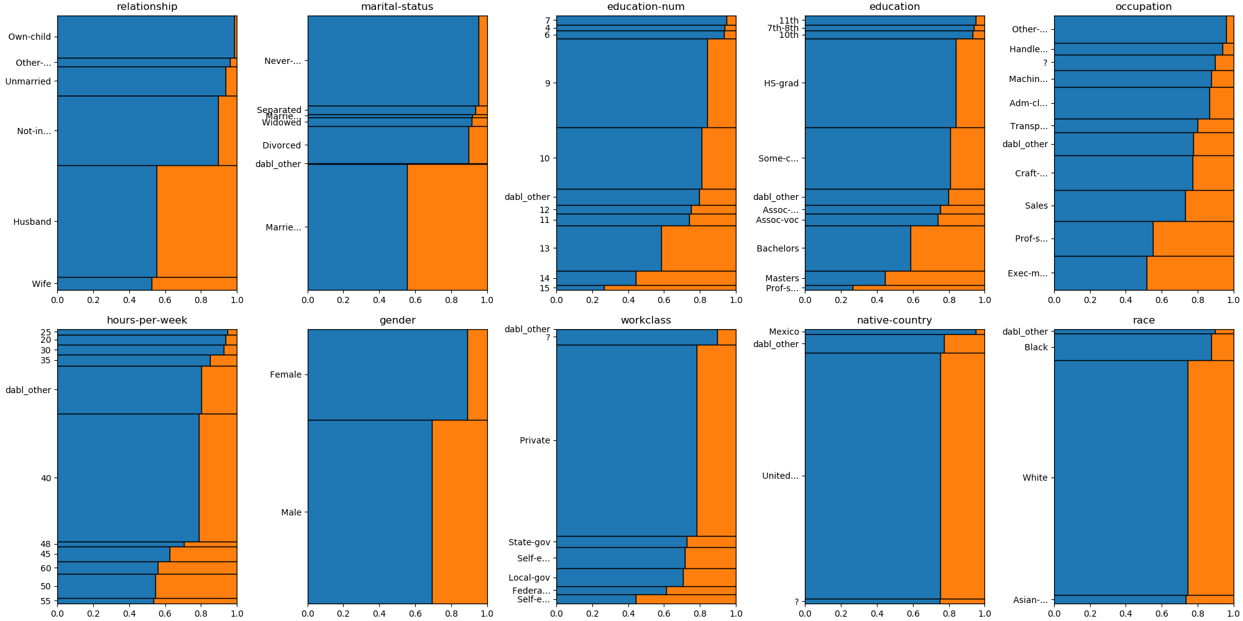
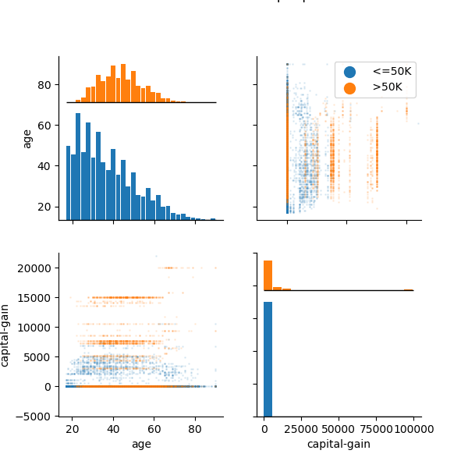
dabl.plot
data = pd.read_csv("adult.csv")
plot(data, 'income’)

Slide 17
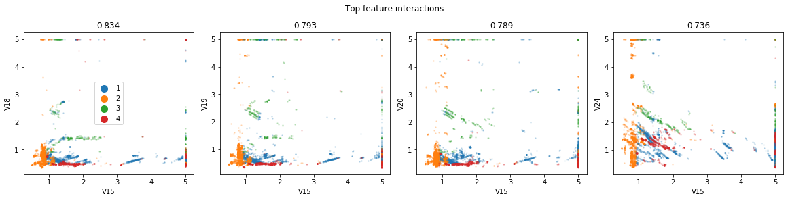
Automatic Scatterplot Selection
Work in progress: diverse sets of plots

Slide 18
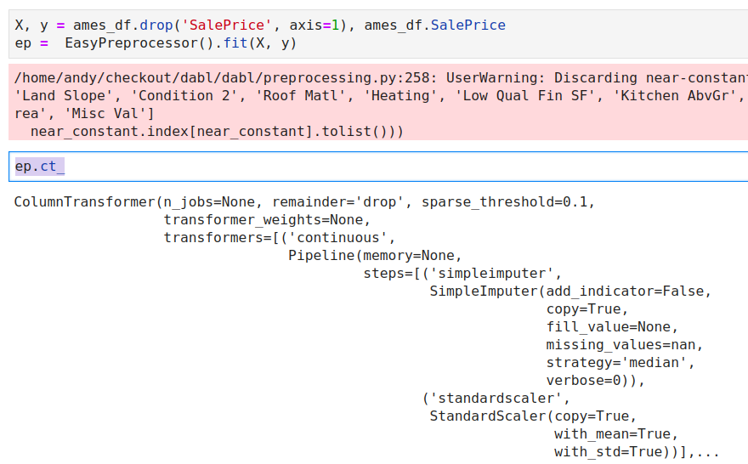
Preprocessing

Slide 19
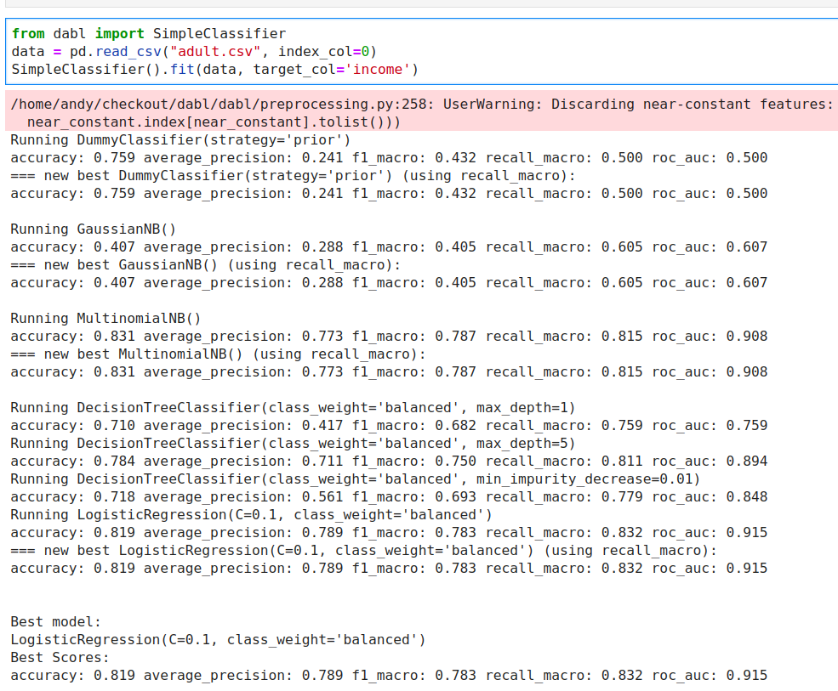

Slide 20

Automatic Model Selection
Successive Halving on a fixed, diverse portfolio:

Slide 21
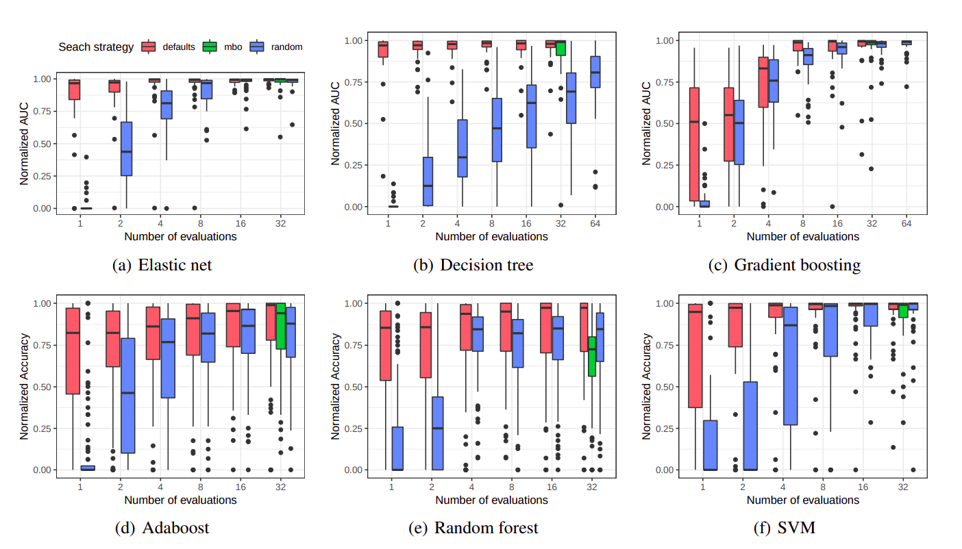
Pfisterer, Rijn, Probst, Mueller, Bischl: Learning Multiple Defaults for Machine Learning Algorithms https://arxiv.org/abs/1811.09409
Feurer, Eggensperger, Falkner, Lindauer, Hutter: Practical Automated Machine Learning https://ml.informatik.uni-freiburg.de/papers/18-AUTOML-AutoChallenge.pdf
Notes:
Ok so but how well does this actually work? The goal is to provide a solution that can easily be implemented and easily be used. We compared our approach against randomized search and bayesian optimization.
If the budget is very small, say we only allow 2 or 4 runs, then our approach is clearly superior. Bayesian optimization doesn’t really start working until you have 16 or 32 runs or so. However, we found that our ranked list actually performed quite well, even in that regime.
This comparison is a bit apples to oranges, as our algorithm is using meta-learning to produce a fixed list, while the other two are search algorithms that don’t exploit meta-learning. But as a user, what you really care about is performance vs budget, and I think we’re doing quite well.
Another interesting aspect that we didn’t look into is multi-fidelity optimization, or hyperband.
I’ll come back to this later, but basically our approach is orthogonal to hyperband, and once you have your prioritized list, you can just run hyperband or successive halving on it.

Slide 22


Slide 23
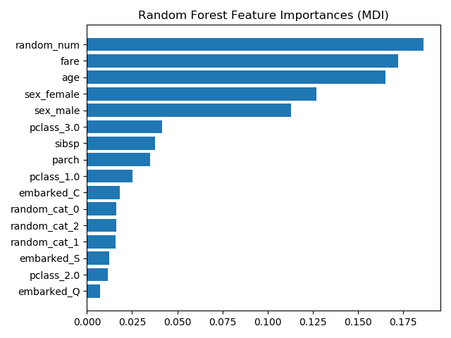
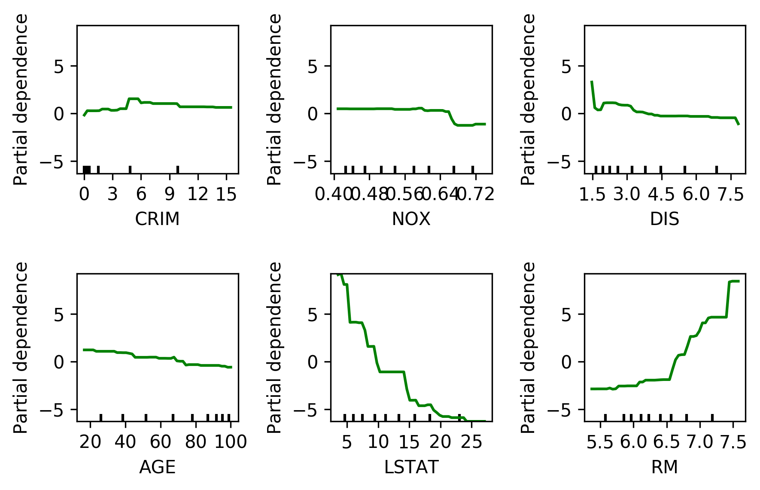
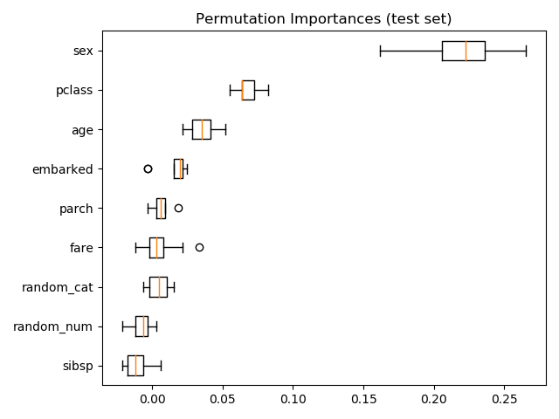
Model Explanation

Slide 24

Challenges of Scaling Up and Out

Slide 25
Interfaces
Libraries written against data structures
Solution:
Common standards (arrow)
Common API

Slide 26
Low-level Code
Libraries written in C
Libraries written against legacy Fortran code
Solution
New abstractions (LLVM, TVM?)
Create higher-level interfaces / protocols?

Slide 27
Eager vs Lazy
Everything is written predicated on eager in-memory computation.
Solution
Rewrite?
New interfaces might help?

Slide 28
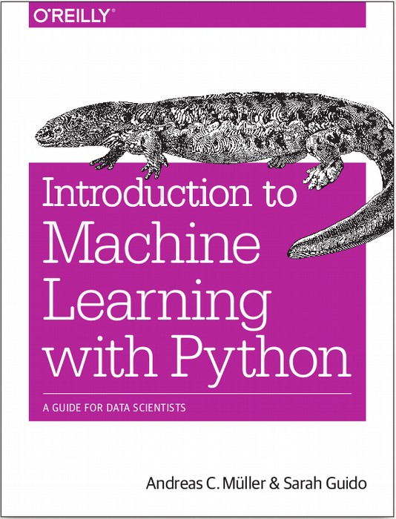




$ pip install dabl
https://amueller.github.io/dabl
amueller.github.io
@amuellerml
@amueller
andreasmuellerml@gmail.com
Notes:
Thank you for your attention and I’m happy to take any questions!

