Slide 1
dabl
Automatic ML with a human in the loop
Andreas Müller
Scikit-learn core developer
Principal Engineer @ Microsoft

Slide 2
A real world ML workflow
Data Cleaning
Visualization
Model Building
Problem statement
Data Collection
Application evaluation
Model Evaluation
Notes:
I want to start with a quick overview of how I think about the machine learning workflow.
There’s many version of this, and it’s also known as box’s loop.
You start with defining the problem you want to solve, and collect the data. You do an initial data cleaning and visualization, then you work on model building and comparison, and do model evaluation.
Then, usually you integrate into a bigger system. That can be deployment or offline use within some bigger pipeline. There’s usually consequences of a model that can not be evaluated without actually using a model.
One of the points I want to emphasize is that this is not a feed-forward process, but there’s a feedback loop between the different steps. I drew it as a cycle but actually I think it’s best to think of it as a fully connected graph. After each step, you might go back to previous steps. Each step might tell you about a mistake you made earlier or something you can do better.
I titled this a real world ML workflow, because this is not how ML is usual treated in research or by existing ML tools.
Usually tools and research focus on a single step, most commonly the model building, and ignore the interdepencencies. I think we need to do better, and that is the focus of this talk.

Slide 3
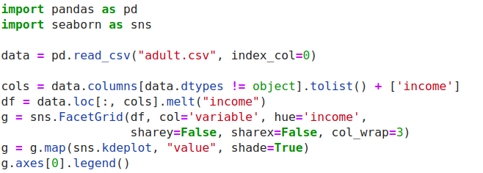
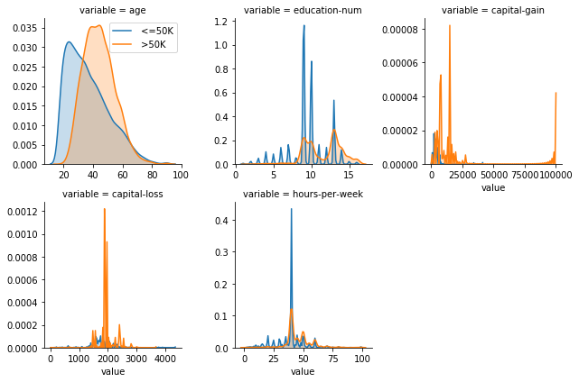
ML with sklearn & pandas
Notes:
Right now there are tools for these different steps available, but I think they are much too hard to use. For example, here is me doing some basic visualization on a standard ML benchmark dataset, the adult dataset. I want to figure out what the univariate distributions are for the two classes. I’ll use seaborn which is one of the most advanced visualisualization libraries for python. However, it’s not really made for supervised learning datasets and so to do what I want to do I have to come up with a pretty intricate call that I got by asking Michael Waskom on the issue tracker and that I probably have to look up every time.
And seaborn is great, but it’s not really the tool I need.

Slide 4
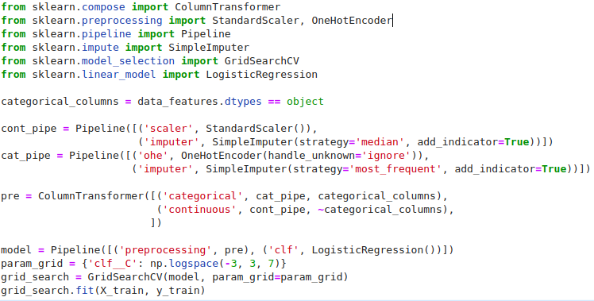
ML with sklearn & pandas
Notes:
Similarly when it comes to machine learning, I think there’s a lot to improve on. I spend a lot of time on scikit-learn and making it easier to use. But here’s basically what you’d have to do to learn a logistic regression model and tune the regularization parameter on this adult dataset. And keep in mind, this is not very dirty data, this is a pretty standard benchmark.
Scikit-learn is very explicit and very flexible which is great when you want to control what you’re doing very precisely. But for running a quick prototype it’s not ideal.
And I can come up with this code here pretty easily but I’m also responsible for a bunch of the things that are happening here. It could certainly be more intuitive.

Slide 5
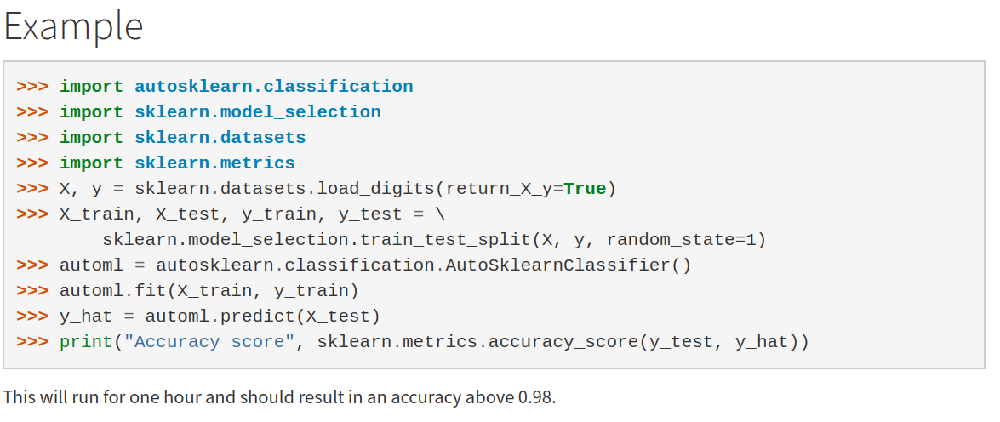
Automatic ML frameworks

Slide 6
data
analysis
baseline
library

Slide 7
dabl.clean
dabl.plot
Data Cleaning
Visualization
dabl. AnyClassifier
Model Building
Problem statement
Data Collection
Application evaluation
Model Evaluation
You actually have to think, sorry.
dabl.explain

Slide 8
Data cleaning
& preprocessing

Slide 9
dabl.clean
Detect types (can overwrite)
Detect Missing / rare values
Detect ordinal vs categorical
Detect near-constant
Detect index
Shout-out to “The ML Data Prep Zoo: Towards Semi-Automatic Data Preparation for ML” by Vraj Shah & Arun Kumar

Slide 10
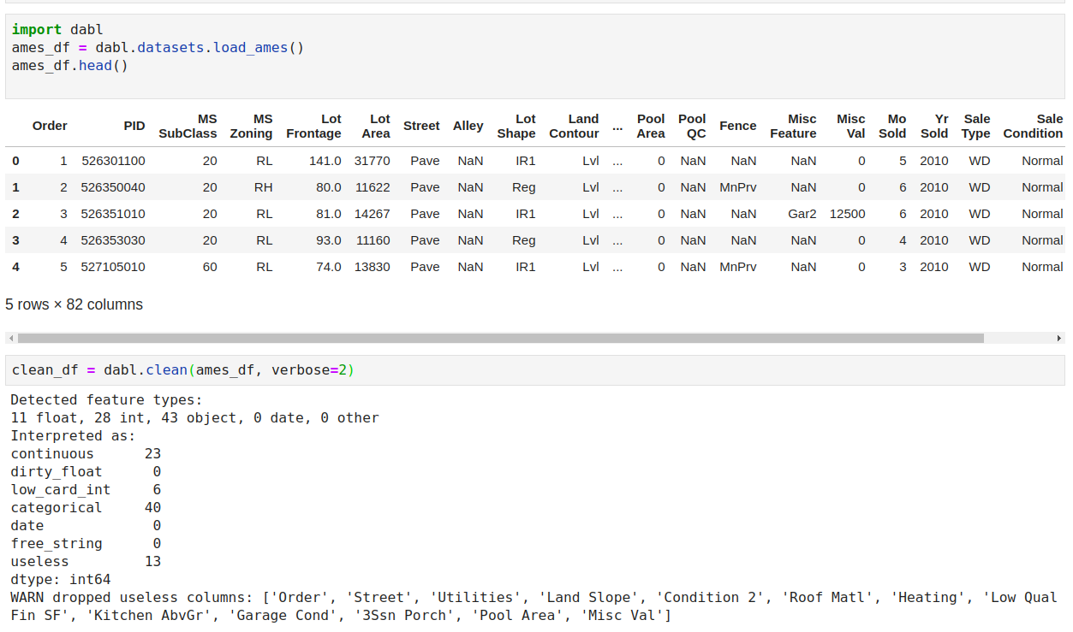

Slide 11
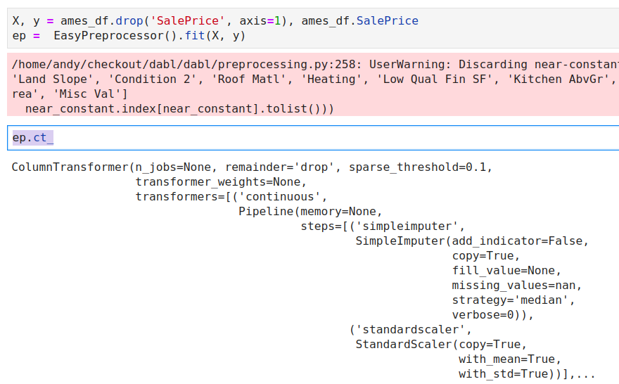
Preprocessing

Slide 12
Visualization

Slide 13
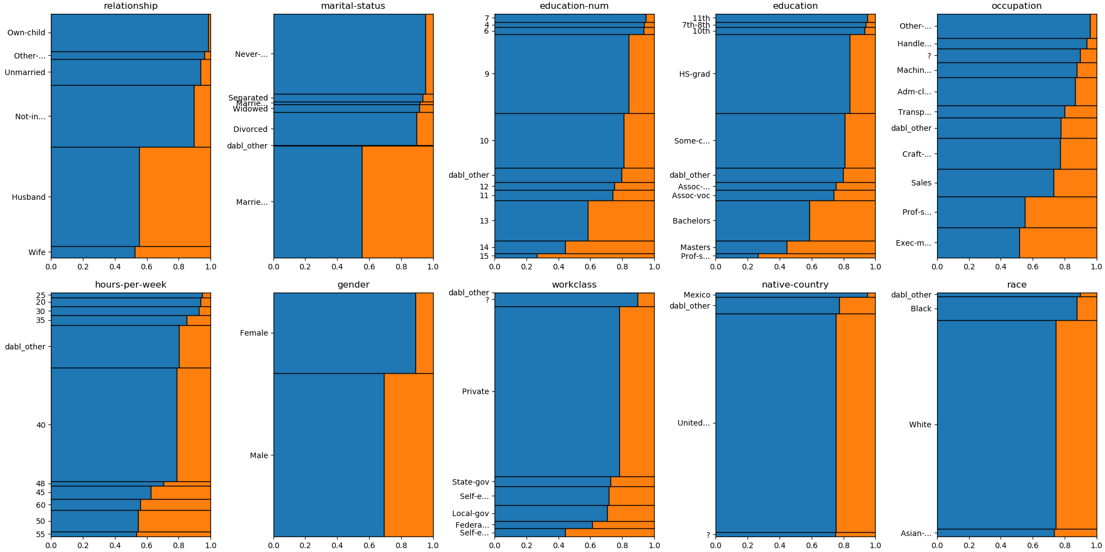
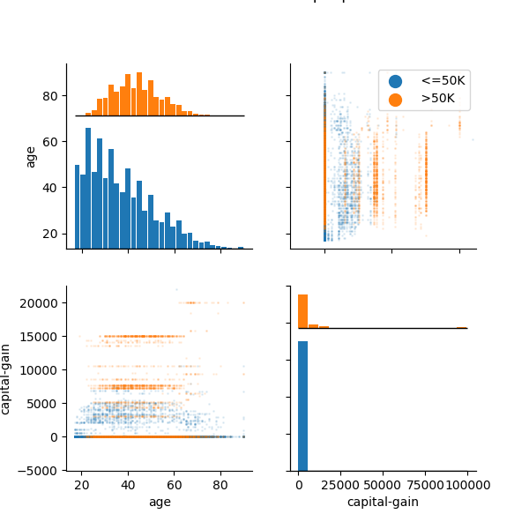
dabl.plot
data = pd.read_csv("adult.csv")
plot(data, 'income’)

Slide 14
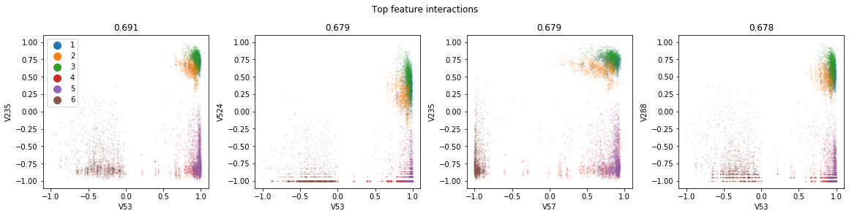
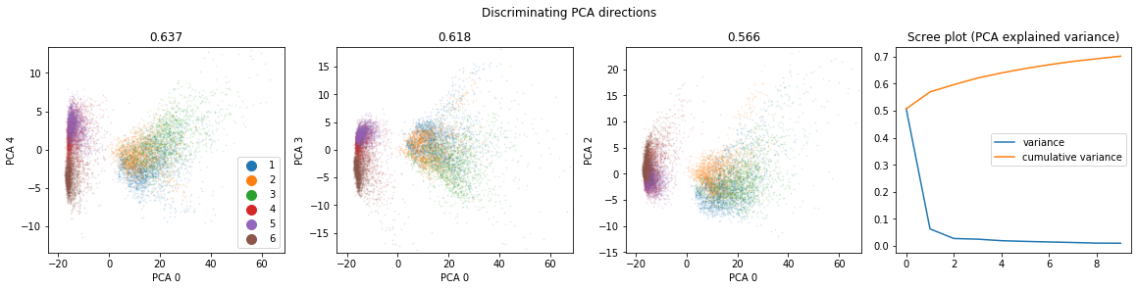
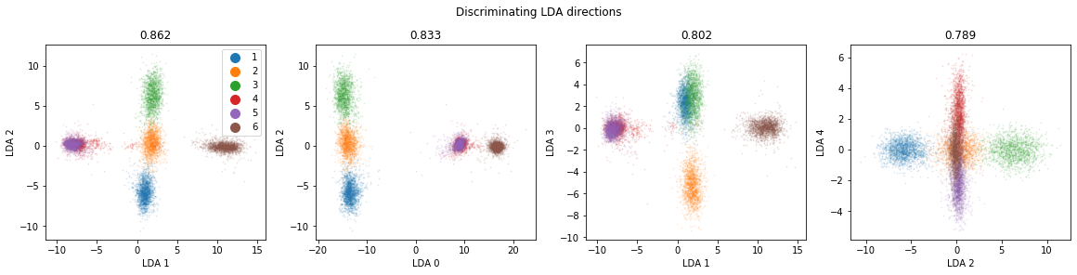
Pairwise Plots

Slide 15
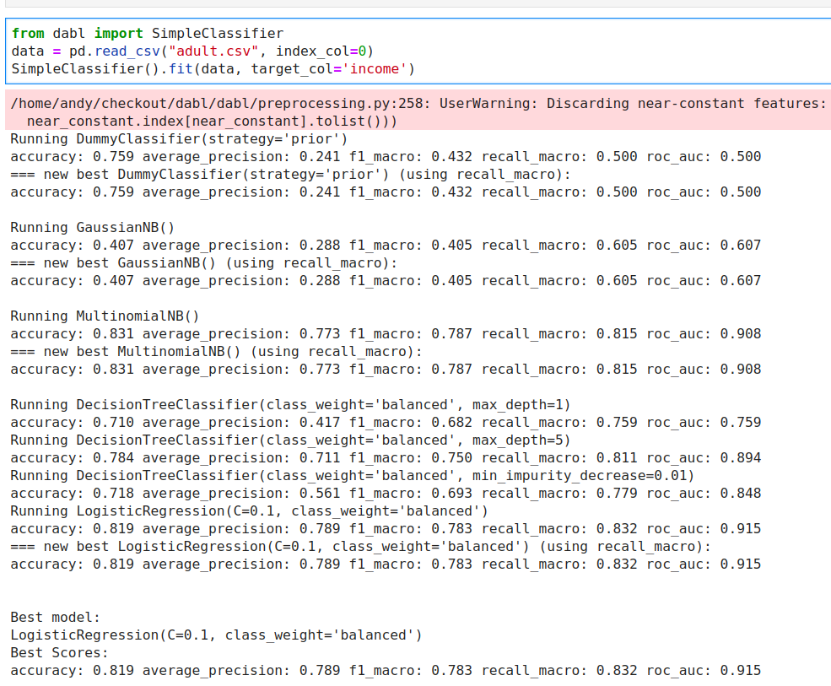
Simple Prototypes
Dummy Models
Naive Bayes
Stumps
Linear Models

Slide 16
Automatic Model Search

Slide 17
Portfolio creation
Run Hyper-parameter optimization across models on large benchmark suite (OpenML-CC18)
Evaluate all final models across all datasets
Greedily create portfolio of best-performing, diverse models
“Practical Automated Machine Learning
for the AutoML Challenge 2018” Feurer et. al.

Slide 18
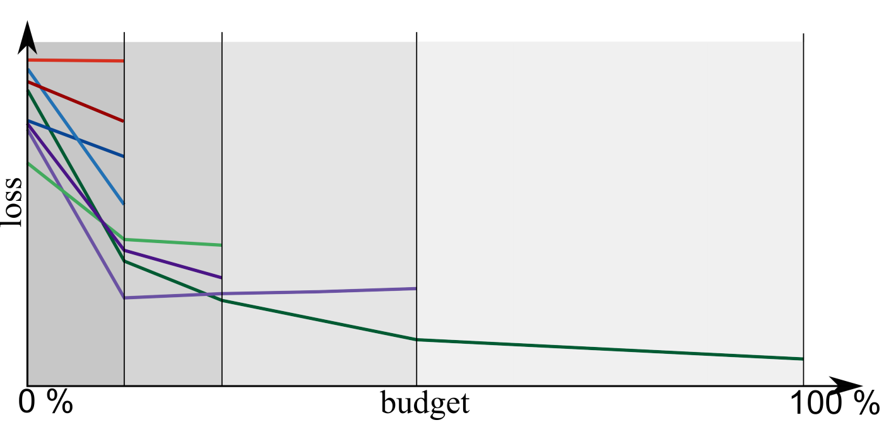
Successive Halving

Slide 19
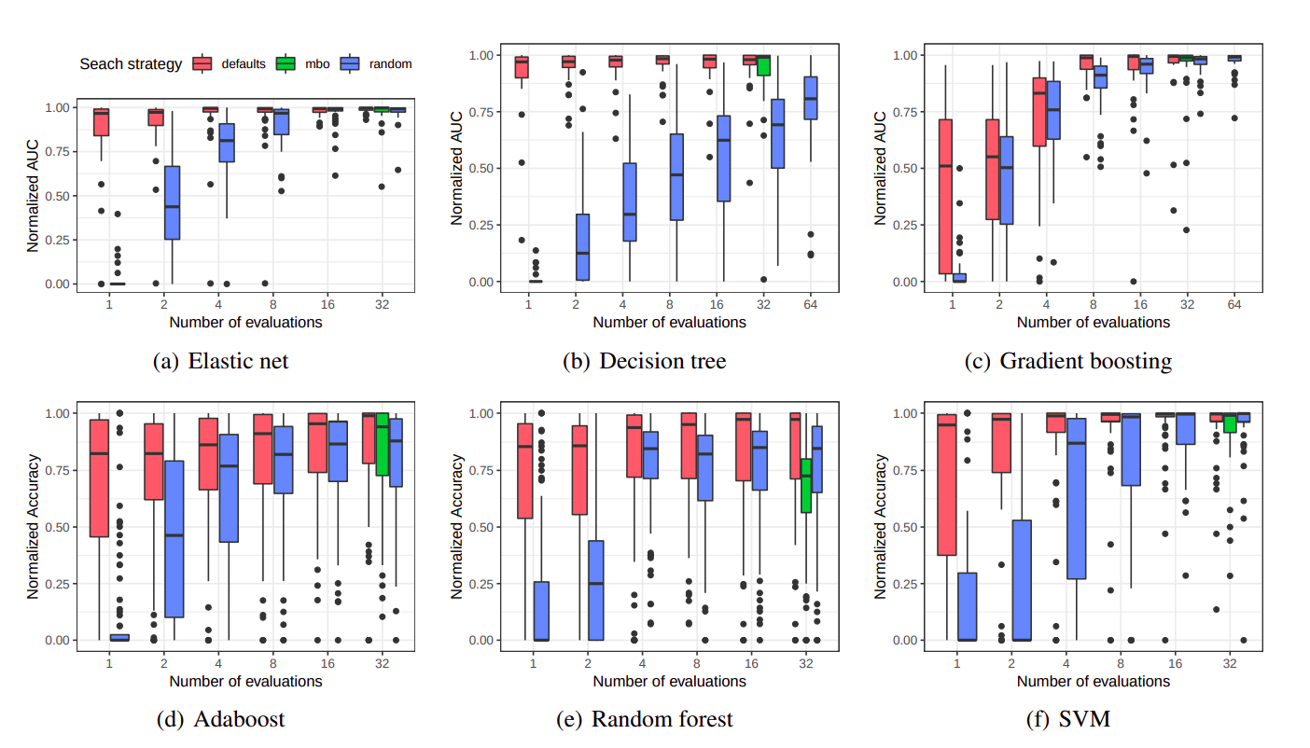
Pfisterer, Rijn, Probst, Mueller, Bischl: Learning Multiple Defaults for Machine Learning Algorithms https://arxiv.org/abs/1811.09409
Feurer, Eggensperger, Falkner, Lindauer, Hutter: Practical Automated Machine Learning https://ml.informatik.uni-freiburg.de/papers/18-AUTOML-AutoChallenge.pdf
Notes:
Ok so but how well does this actually work? The goal is to provide a solution that can easily be implemented and easily be used. We compared our approach against randomized search and bayesian optimization.
If the budget is very small, say we only allow 2 or 4 runs, then our approach is clearly superior. Bayesian optimization doesn’t really start working until you have 16 or 32 runs or so. However, we found that our ranked list actually performed quite well, even in that regime.
This comparison is a bit apples to oranges, as our algorithm is using meta-learning to produce a fixed list, while the other two are search algorithms that don’t exploit meta-learning. But as a user, what you really care about is performance vs budget, and I think we’re doing quite well.
Another interesting aspect that we didn’t look into is multi-fidelity optimization, or hyperband.
I’ll come back to this later, but basically our approach is orthogonal to hyperband, and once you have your prioritized list, you can just run hyperband or successive halving on it.

Slide 20
Model Explanation

Slide 21



Slide 22
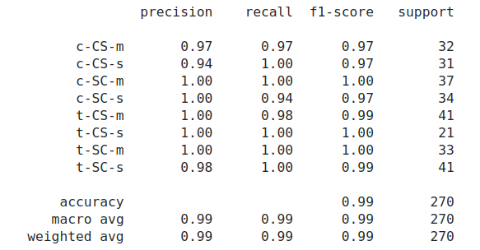
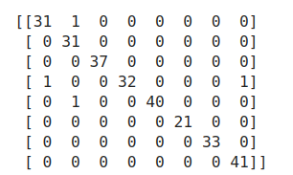
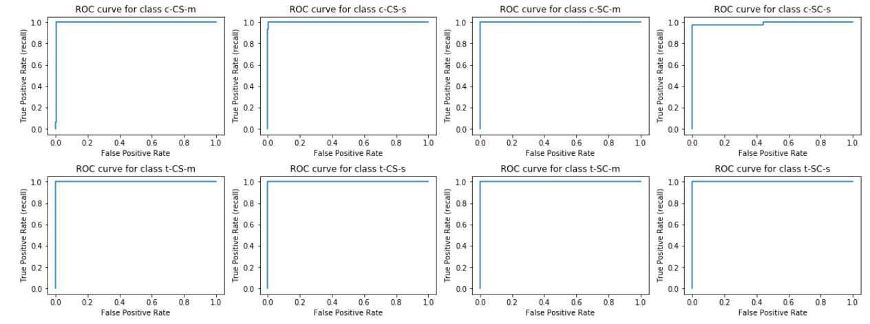
Metrics

Slide 23
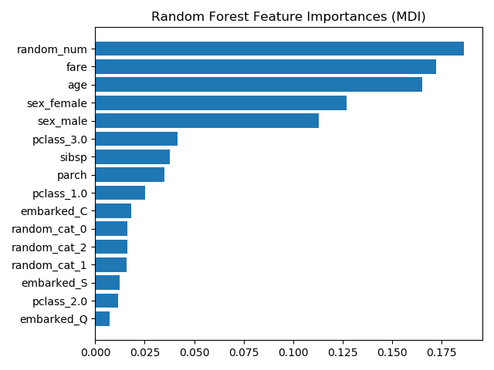
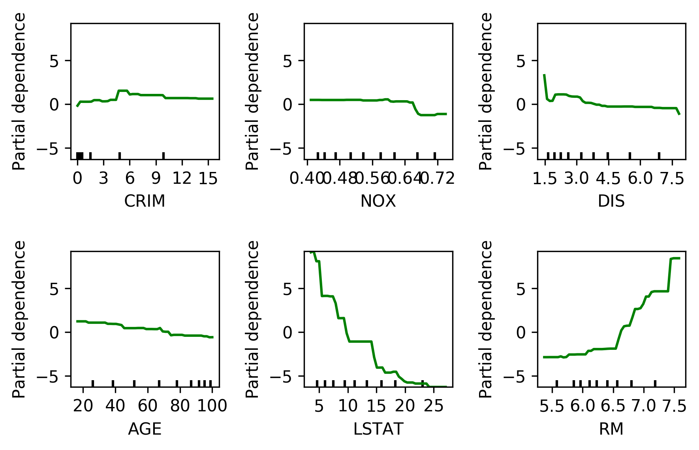
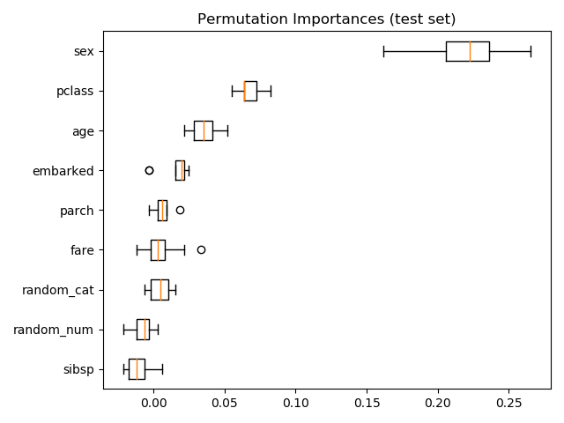
Model Explanation

Slide 24
Future Goals
Support for time series and text data
Time sensitive portfolios
Model compression / building explainable models

Slide 25
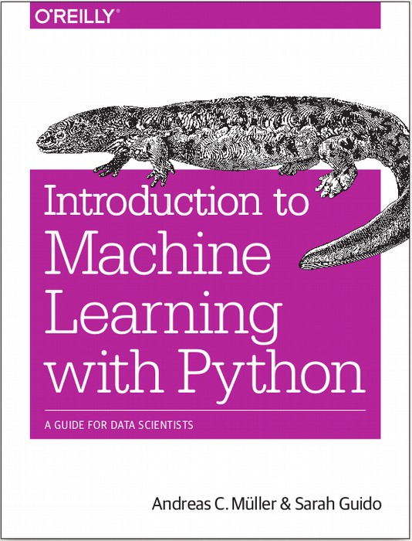




$ pip install dabl
https://dabl.github.io
amueller.github.io
@amuellerml
@amueller
andreas.mueller.ml@gmail.com
Notes:
Thank you for your attention and I’m happy to take any questions!

