Slide 1




The Future of
Accessible Machine Learning
in Python
Andreas Müller
Associate Research Scientist
Columbia University
Scikit-learn Technical Committee

Slide 2
A real world ML workflow
Data Cleaning
Visualization
Model Building
Data Collection
Integration & Deployment
Model Evaluation

Slide 3
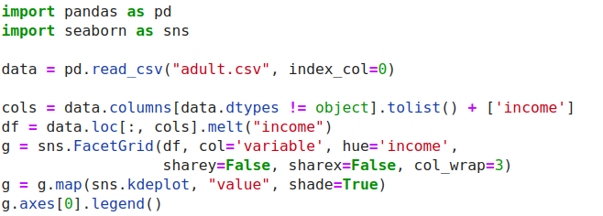
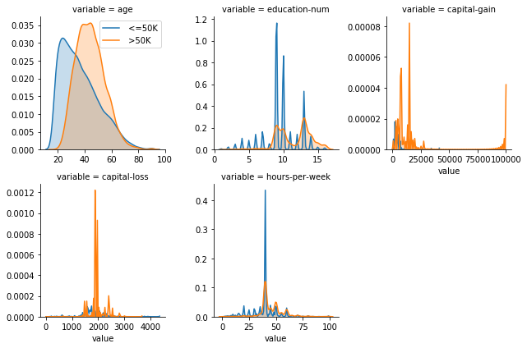
ML with sklearn & pandas

Slide 4
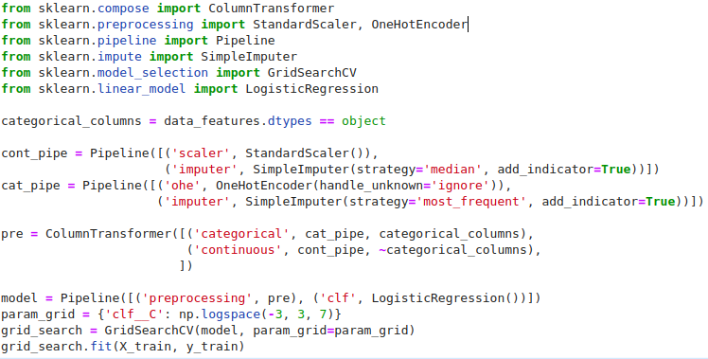
ML with sklearn & pandas

Slide 5
API issues in scikit-learn

Slide 6
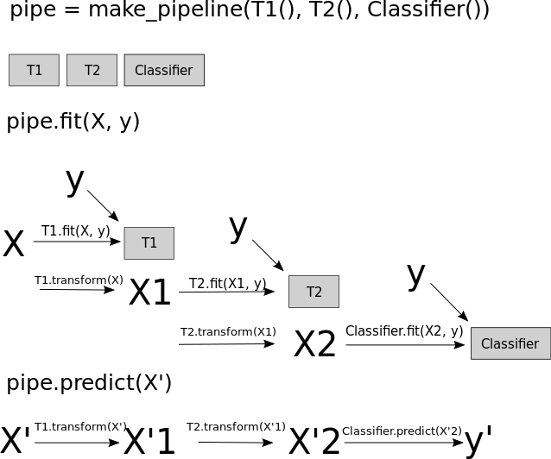

Slide 7
Enabling AutoML Research with OpenML

Slide 8
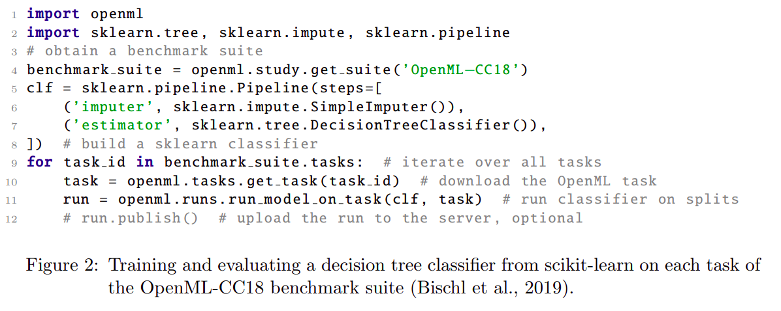
Feurer, Rijn, Kadra, Gijsbers, Mallik, Ravi, Mueller, Vanschoren, Hutter: OpenML-Python: an extensible Python API for OpenML https://arxiv.org/abs/1911.02490 (submitted to JMLR OSS)

Slide 9
Learning Defaults
Pfisterer, Rijn, Probst, Mueller, Bischl: Learning Multiple Defaults for Machine Learning Algorithms https://arxiv.org/abs/1811.09409

Slide 10
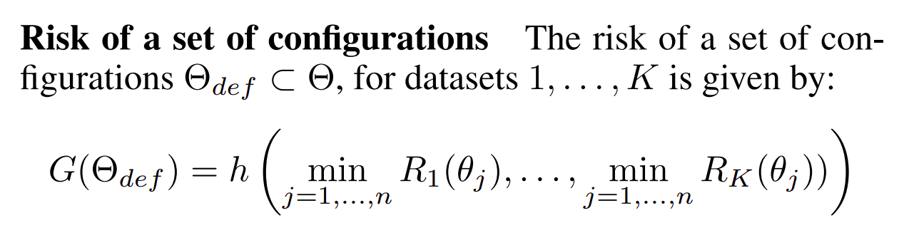

Slide 11
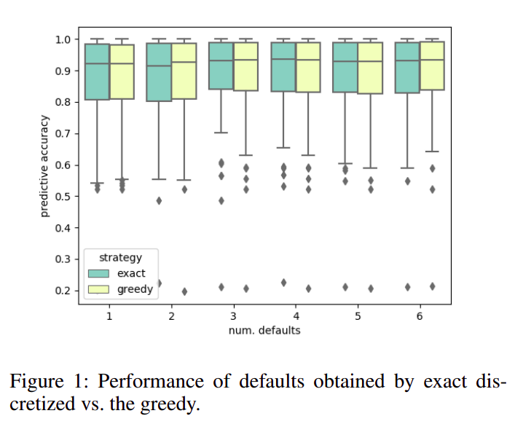

Slide 12
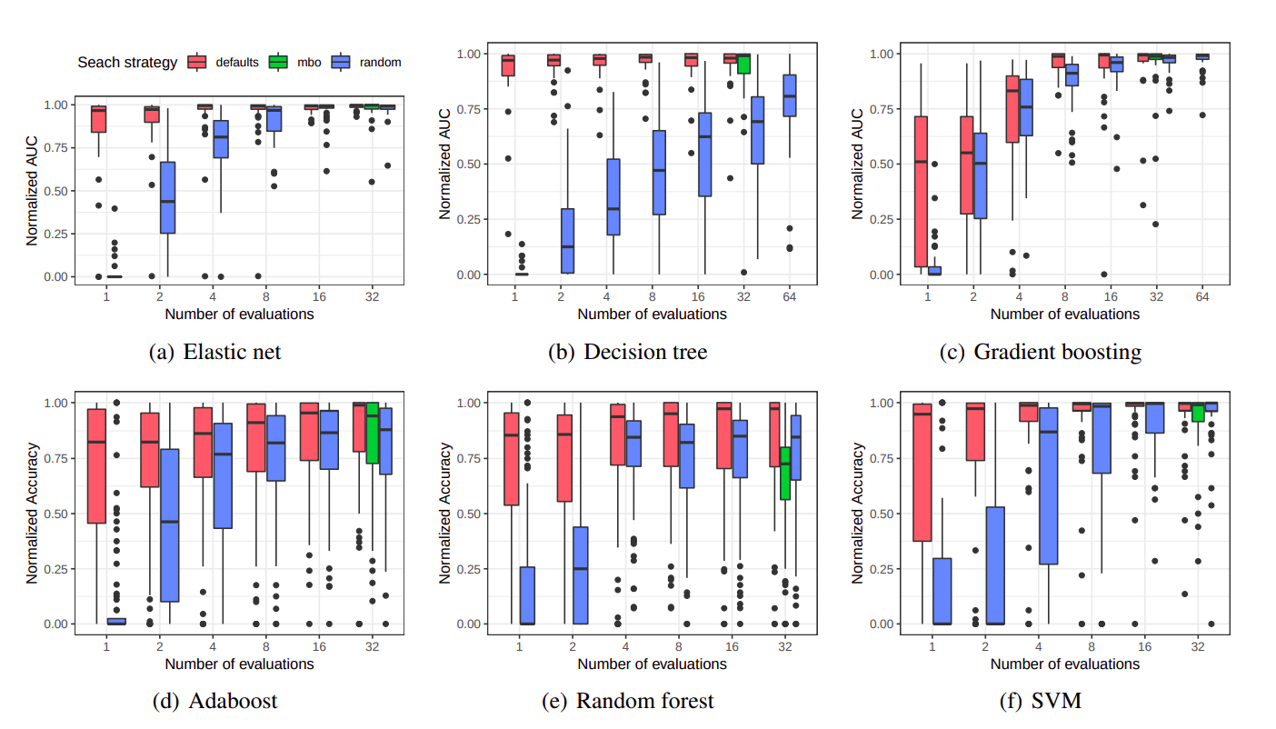

Slide 13
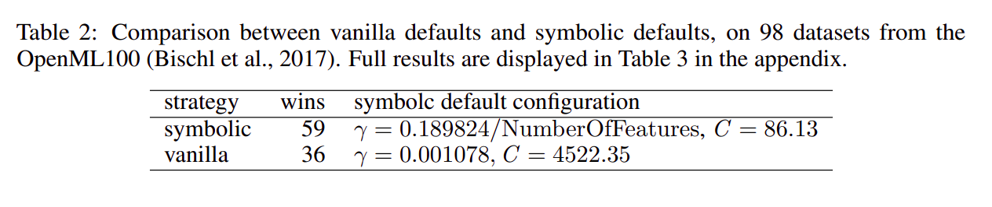
Rijn, Pfisterer, Thomas, Mueller, Bischl, Vanschoren: Meta Learning for Defaults – Symbolic Defaults
NeurIPs Metalearning Workshop 2018

Slide 14
data
analysis
baseline
library

Slide 15
dabl.clean
dabl.plot
Data Cleaning
Visualization
Model Building
Data Collection
dabl. AnyClassifier
Model Interpretation
business/science evaluation
dabl.explain
You actually have to think, sorry.

Slide 16
dabl.clean
Detect types (can overwrite)
Detect Missing / rare values
Detect ordinal vs categorical
Detect near-constant
Detect index

Slide 17
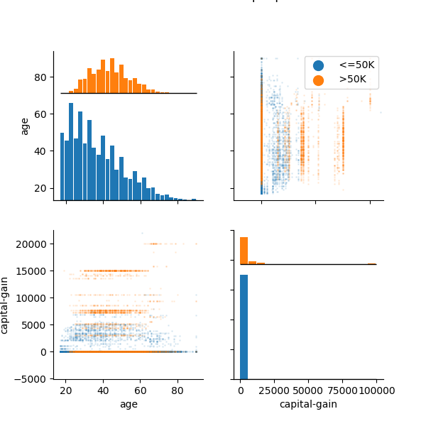
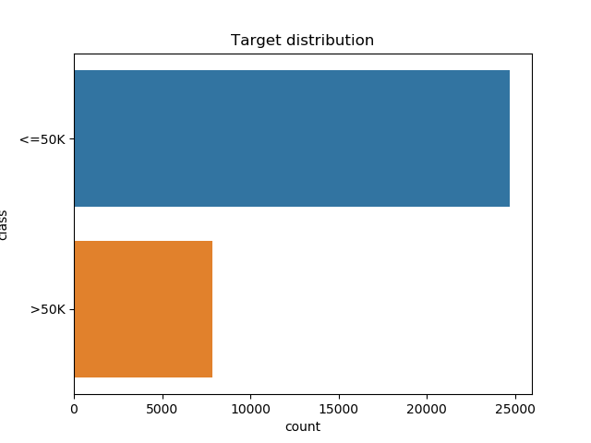
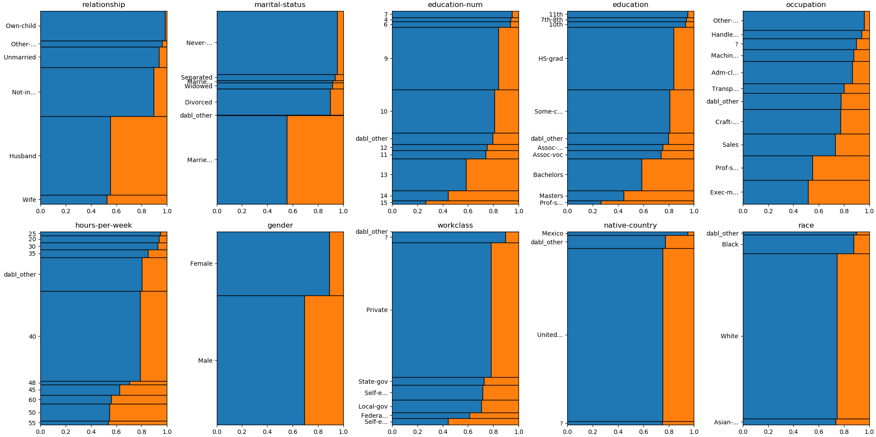
data = pd.read_csv("adult.csv", index_col=0)
plot(data, 'income', scatter_alpha=.1)

Slide 18
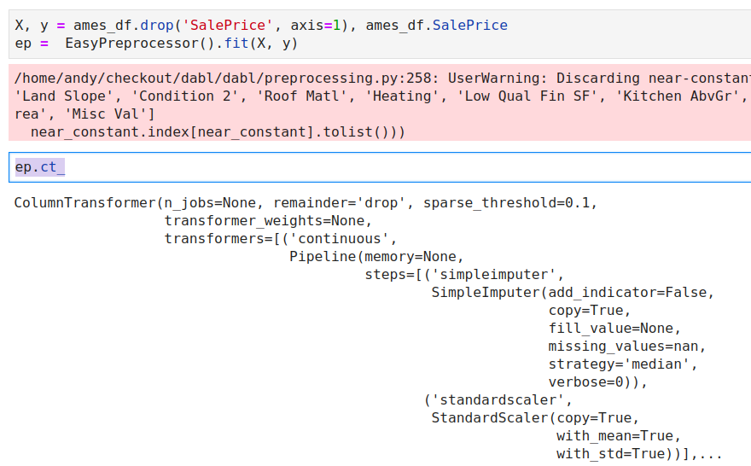
Preprocessing

Slide 19
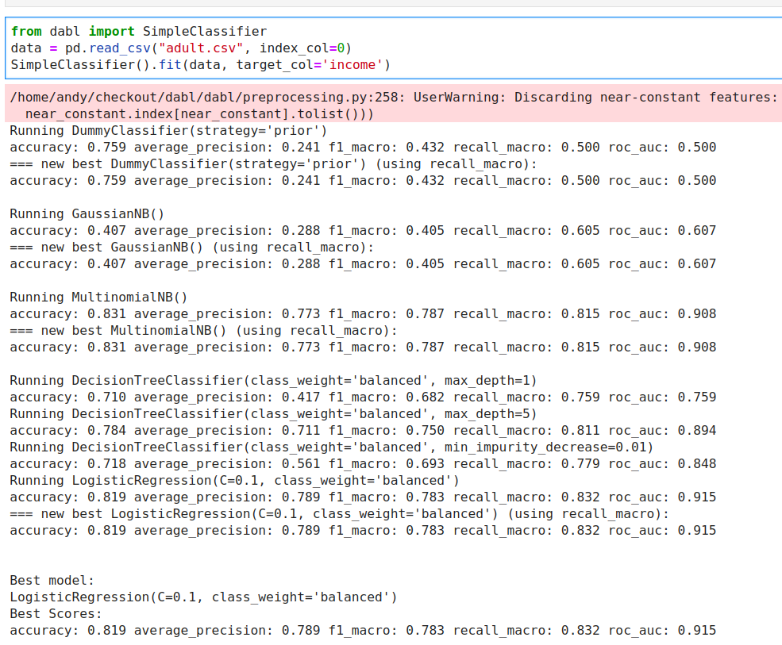
Either X, y
Or dataframe, target_col

Slide 20
Automatic Model Search

Slide 21

Successive Halving on a fixed, diverse portfolio:

Slide 22


Slide 23
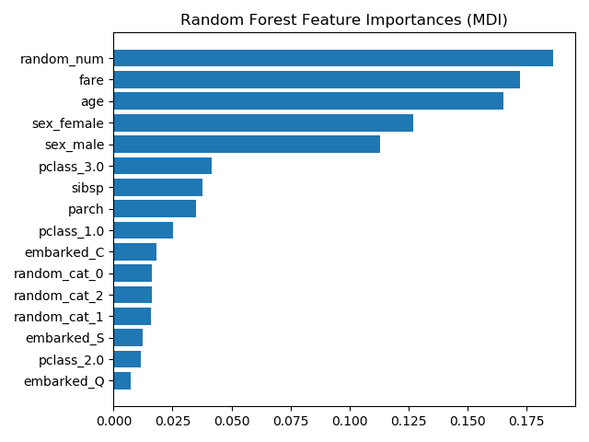
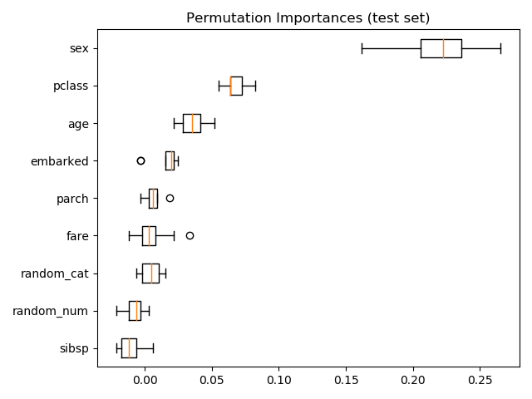
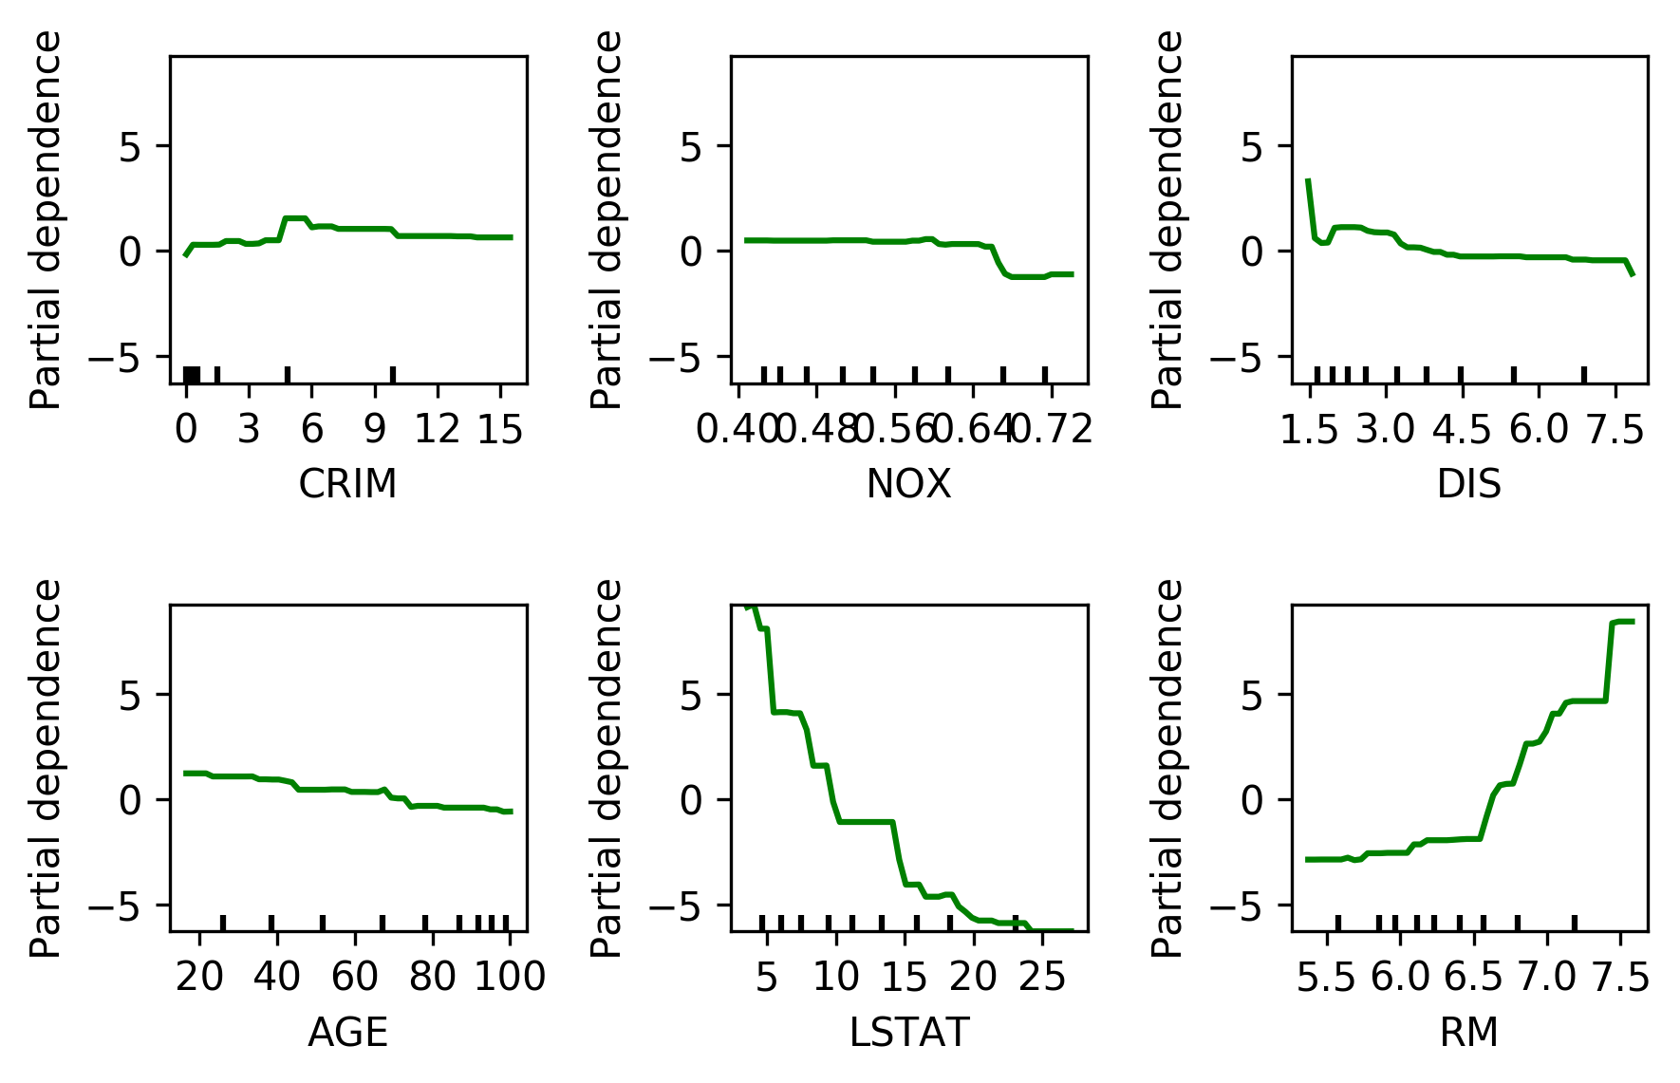
Model Explanation

Slide 24


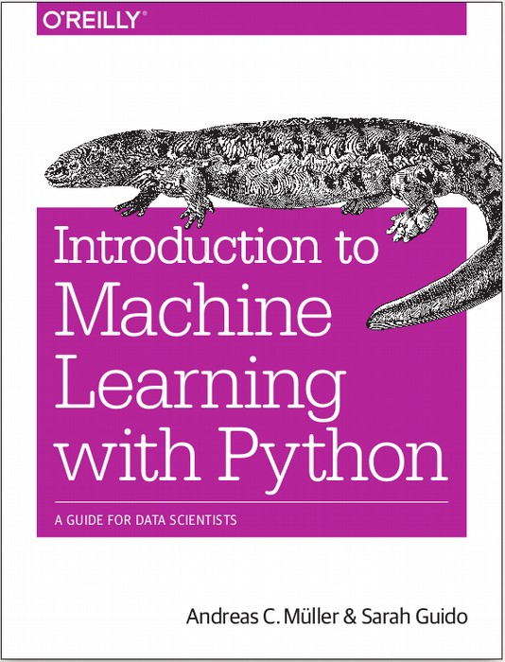


$ pip install dabl
amueller.github.io
@amuellerml
@amueller
andreas.mueller
@columbia.com
https://amueller.github.io/dabl
Notes:
Thank you for your attention and I’m happy to take any questions!

