Slide 1
Data in MySQL
NAM NGUYEN
Master in Big Data and Data Science
(2022-2023)
Data source: GitHub_NamNguyen_MySQL

Slide 2
Motivations
In this project we carry out the functional database design (E– R diagram and relational model) of a business model for a fashion wholesaler that distributes to 12,000 stores around the world.
Our aim is to summarize some data of suppliers, distributors and stores through the orders.
In most calculations we are interested in year-end (2022) summations for each store.
Stores will then be classified, based on that work, and enjoy different types of discounts.
On the other hand, we are also interested in the backup of daily updated orders.

Slide 3
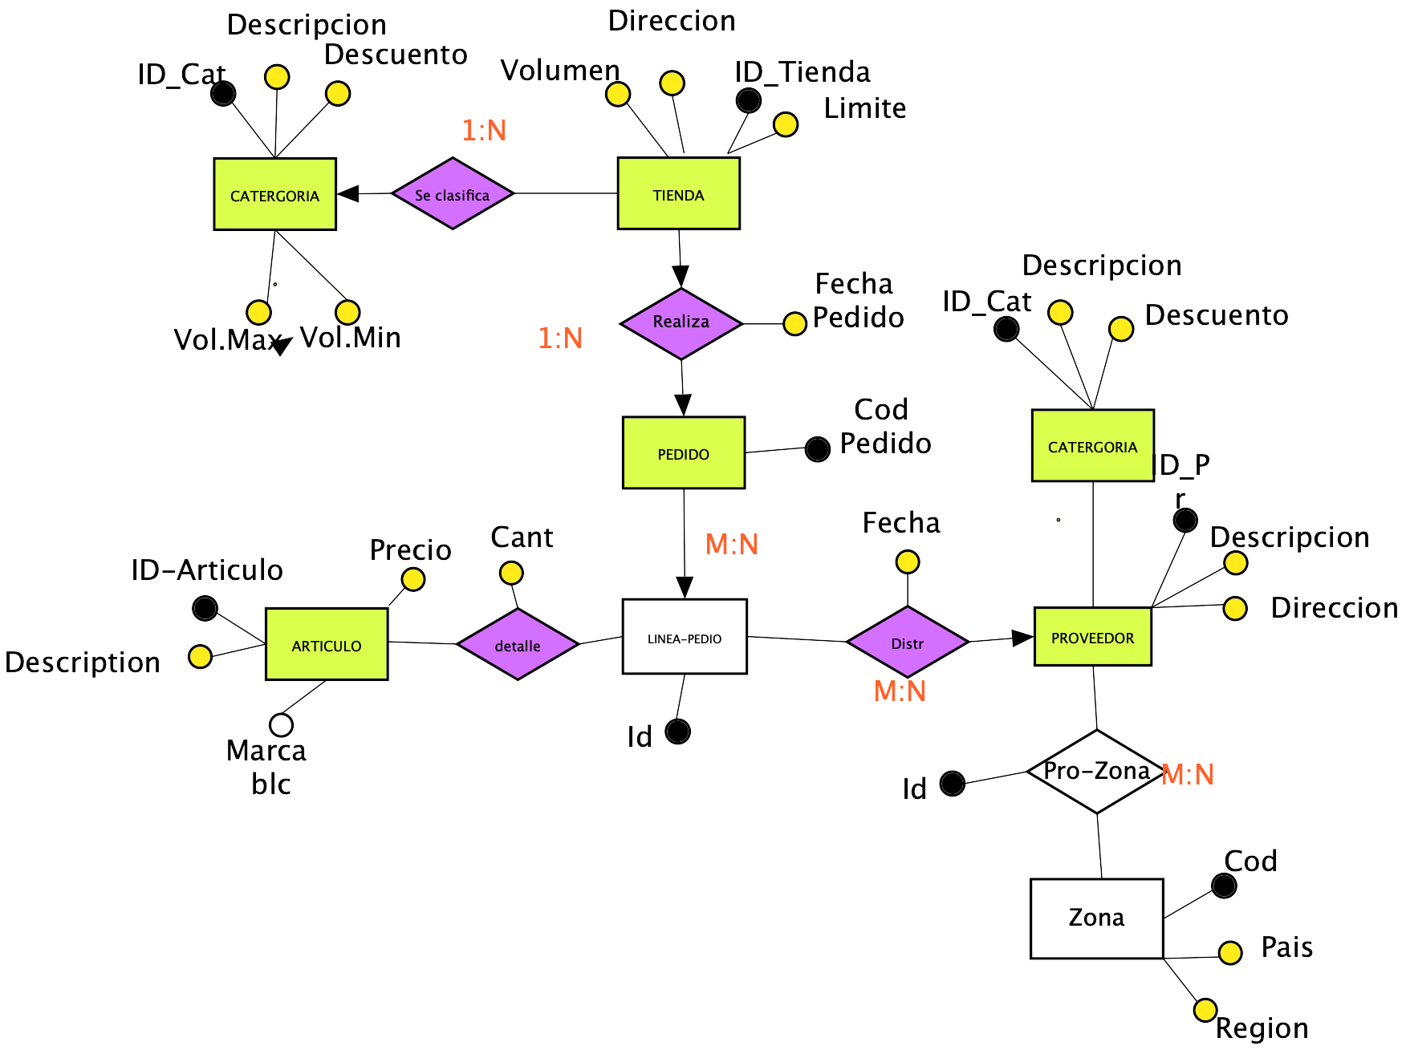
E-R Diagram

Slide 4
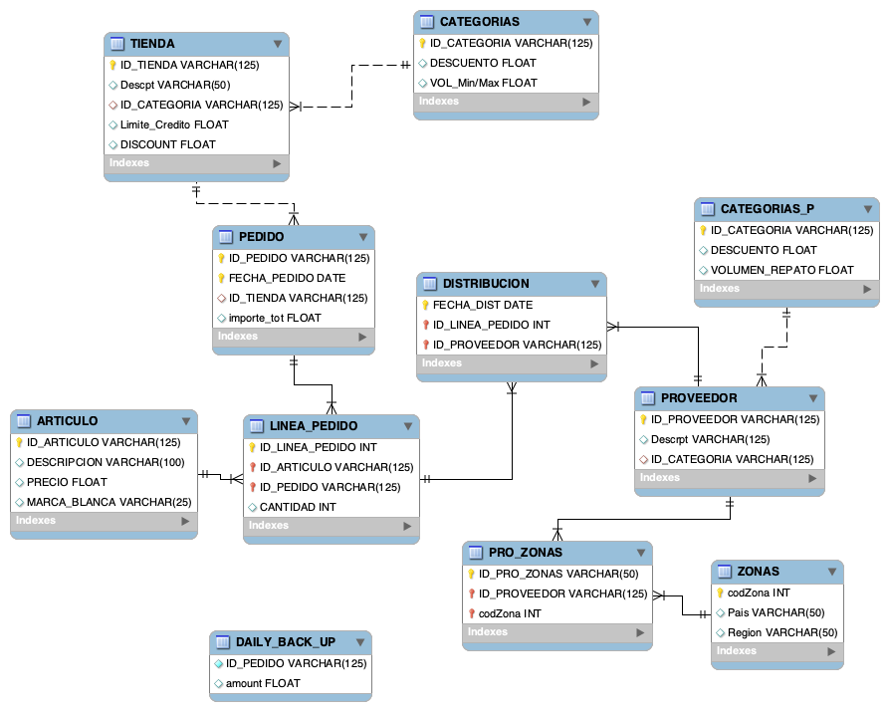
Relational model

Slide 5
Data Analysis in SQL
Before going into the specific questions, I will first update the total amounts of each invoice into the order spreadsheet (PEDIDO).
ID_PEDIDO | FECHA_PEDIDO | ID_TIENDA | IMPORTE_TOT
1 | 2022-10-01 | ZARA01 | 635.6
2 | 2022-10-02 | ZARA01 | 20760.8
3 | 2022-10-03 | ZARA01 | 4612.58
4 | 2022-10-04 | ZARA01 | 4661
5 | 2022-10-01 | ZARA01 | 5388.48
6 | 2022-10-06 | MG01 | 910
7 | 2021-10-01 | ECI01 | 2550
8 | 2021-10-02 | ECI01 | 9660
9 | 2021-06-03 | ECI02 | 11900
10 | 2021-07-04 | ECI02 | 322
11 | 2020-03-01 | ECI03 | 5100
12 | 2024-10-06 | ECI03 | 5796
13 | 2022-07-04 | ECI02 | 6800
14 | 2022-03-01 | ECI03 | 724.5
15 | 2022-10-25 | ECI03 | 17161
16 | 2022-10-26 | EL01 | NULL
ALTER TABLE table_name ADD column_name datatype;
UPDATE table_name SET column1 = value1, column2 = value2, ... WHERE condition;

Slide 6
Q3. In the same way, the table lists out all necessary information: name, ID, direction, contact, etc. Each store has its own category (VIP1,VIP2,VIP3), which results in different types of discounts (20%, 10%, 5%). We can also see that some stores are category NULL, which means that during many years or in 2022 those stores did not have any order.
ID_TIENDA | NOMBRE | direction | TEL | EMAIL | CATEGORIA | VOLUMEN_TOTAL | VOLUMEN_22 | A.DISCOUNT | LIMITE_CREDITO
ECI01 | EL CORTE INGLES | N. MINISTERIO, 79, MADRID, MADRID | 91234569 | ECI01NM@GMAIL.COM | NULL | 12210 | NULL | NULL | 29000
ECI02 | EL CORTE INGLES | CALLAO, 36, MADRID, MADRID | 91357907 | ECI02CL@GMAIL.COM | NULL | 19022 | NULL | NULL | 20500
ECI03 | EL CORTE INGLES | ARGUELLES, 110, MADRID, MADRID | 623456759 | ECI02AL@GMAIL.COM | VIP2 | 28781.5 | 17161 | 1716.1 | 12900
MG01 | MANGO | ARGUELLES, 23, MADRID, MADRID | 623456789 | MANGO01ARGUELLES@GMAIL.COM | VIP3 | 910 | 910 | 45.5 | 10900
ZARA01 | ZARA | GRAN VIA, 10, MADRID, MADRID | 91234567 | ZARA01GRANVIA@GMAIL.COM | VIP1 | 36058.5 | 36058.5 | 7211.69 | 25500
ZARA02 | ZARA | PRECIADO, 30, MADRID, MADRID | 91357901 | ZARA02PRECIADO@GMAIL.COM | NULL | NULL | NULL | NULL | 20500

Slide 7
Q4. The following table shows the orders of all stores in 2022. Each order is defined by its Id and organized by order date.
ID_TIENDA | ID_PEDIDO | FECHA_PEDIDO | direction | IMPORTE
ZARA01 | 1 | 2022-10-01 | GRAN VIA, 10, MADRID, MADRID | 635.6
ZARA01 | 2 | 2022-10-02 | GRAN VIA, 10, MADRID, MADRID | 20760.8
ZARA01 | 3 | 2022-10-03 | GRAN VIA, 10, MADRID, MADRID | 4612.58
ZARA01 | 4 | 2022-10-04 | GRAN VIA, 10, MADRID, MADRID | 4661
ZARA01 | 5 | 2022-10-01 | GRAN VIA, 10, MADRID, MADRID | 5388.48
MG01 | 6 | 2022-10-06 | ARGUELLES, 23, MADRID, MADRID | 910
ECI02 | 13 | 2022-07-04 | CALLAO, 36, MADRID, MADRID | 6800
ECI03 | 14 | 2022-03-01 | ARGUELLES, 110, MADRID, MADRID | 724.5
ECI03 | 15 | 2022-10-25 | ARGUELLES, 110, MADRID, MADRID | 17161

Slide 8
Q5. The following table shows the number of packages delivered by the different shipping companies.
ID_PROVEEDOR | nombre | direccion proveedor | cantidad
C_EXPRESS | CORREOS EXPRESS | PROSPERIDAD, 94, MADRID, MADRID | 262
DHL01 | DHL | LA PESETA, 1, MADRID, MADRID | 17
SEUR01 | SEUR | LUSIA, 110, MADRID, MADRID | 79

Slide 9
Q6. These two tables show the total products deliveried each year by different distributors and also points out how many packages each distribution company delivered in 2022.
year | tot(und)
2027 | 75
2025 | 240
2023 | 255
2022 | 2025
2021 | 930
2026 | 1800
2020 | 45
ID_PROVEEDOR | cantidad_2022
SEUR01 | 375
DHL01 | 255
C_EXPRESS | 1395
Year 2022

Slide 10
Q7. Similar to the stores, shipping companies are also categorized by the number of delivered products and enjoy some corresponding benefits.
ID_PROVEEDOR | NOMBRE | CALLE | NO | poblacion | ciudad | Tel | Email | CATEGORIA | VOLUMEN
C_EXPRESS | CORREOS EXPRESS | PROSPERIDAD | 94 | MADRID | MADRID | 630335589 | CORREOSEXPRESS@GMAIL.COM | A | 1395
DHL01 | DHL | LA PESETA | 1 | MADRID | MADRID | 630390499 | DHL01@HOTMAIL.COM | C | 255
SEUR01 | SEUR | LUSIA | 110 | MADRID | MADRID | 630390589 | SEUR01@HOTMAIL.COM | B | 375
ID_CATEGORIA | DESCUENTO | VOL_MIN | VOL_MAX
A | 0.2 | 501 | 10000
B | 0.1 | 301 | 500
C | 0.05 | 100 | 300

Slide 11
Q8: Create a new caracter for product.
ALTER TABLE ARTICULO
ADD COLUMN MARCA_BLANCA VARCHAR(25);
ID_ARTICULO | DESCRIPCION | PRECIO | MARCA_BLANCA
1 | Pantalones | 29.5 | NULL
10 | Silla | 45.5 | NULL
11 | Raton | 22.95 | NULL
12 | Cama Infantil | 1500 | NULL
13 | Conchon | 850 | NULL
14 | Cojin | 53.99 | NULL
15 | Zapatos | 80.5 | NULL
2 | Camiseta | 15.2 | NULL
3 | Mesa de escritorio | 120.5 | NULL
4 | TV Sony | 650.9 | NULL
5 | Sofa | 1025.99 | NULL
6 | Libreria | 550.2 | NULL
7 | movil | 995.5 | NULL
8 | Ipad 9 | 1200.99 | NULL
9 | Aire Condicionador | 690.5 | NULL

Slide 12
Q10. The following lines show the code and an example of the summary table that backs up the sales every day
CREATE TABLE DAILY_BACK_UP AS
SELECT p.ID_PEDIDO,(sum(lp.CANTIDAD*a.precio))as 'amount' FROM LINEA_PEDIDO lp, ARTICULO a, PEDIDO p
WHERE lp.ID_ARTICULO=a.ID_ARTICULO and lp.ID_PEDIDO=p.ID_PEDIDO and p.FECHA_PEDIDO=current_date()
GROUP BY p.ID_PEDIDO ;
ALTER TABLE DAILY_BACK_UP MODIFY amount FLOAT(2);
ID_PEDIDO | curdate() | amount
16 | 2022-10-27 | 26995

Slide 13
Conclusions
This exercise consists in a traditional model of supply-purchase-distribution, which shows real-world challenges and how we can use capabilities of SQL to provide new efficient solutions to conventional problems.
MySQL is an open-source relational database management system with easier operations enabling us to carry out data analysis on a database. We can use MySQL for collecting, Cleaning and visualizing the data.
Based on business data and logical models I created a database and used SQL to select, process and present data to help the client carry out business decisions, such as how to allocate store discounts and control distribution companies.

