Slide 1
COFFEE MANAGEMENT SYSTEM
GROUP 7 – ADVANCED PROGRAMMING WITH PYTHON

Slide 2
Content
01
Group
Coffee Management System
STRUCTURE OF CODE
02
Classes
Modules and Packages
Database Diagram
CONCLUSION
03
Demo
Conclusion

Slide 3
Introduction Group
BI10-031
ICT
BI10-156
ICT
Nguyễn Quốc Hùng
Nguyễn Hoàng Nam
Nguyễn Tiến Đạt
Nguyễn Minh Đức
Lương Nguyễn Việt Sơn
Your Text
BI10-072
ICT
BI10-123
ICT
Example Text :
Get a modern PowerPoint Presentation that is beautifully designed.
BI10-028
ICT

Slide 4
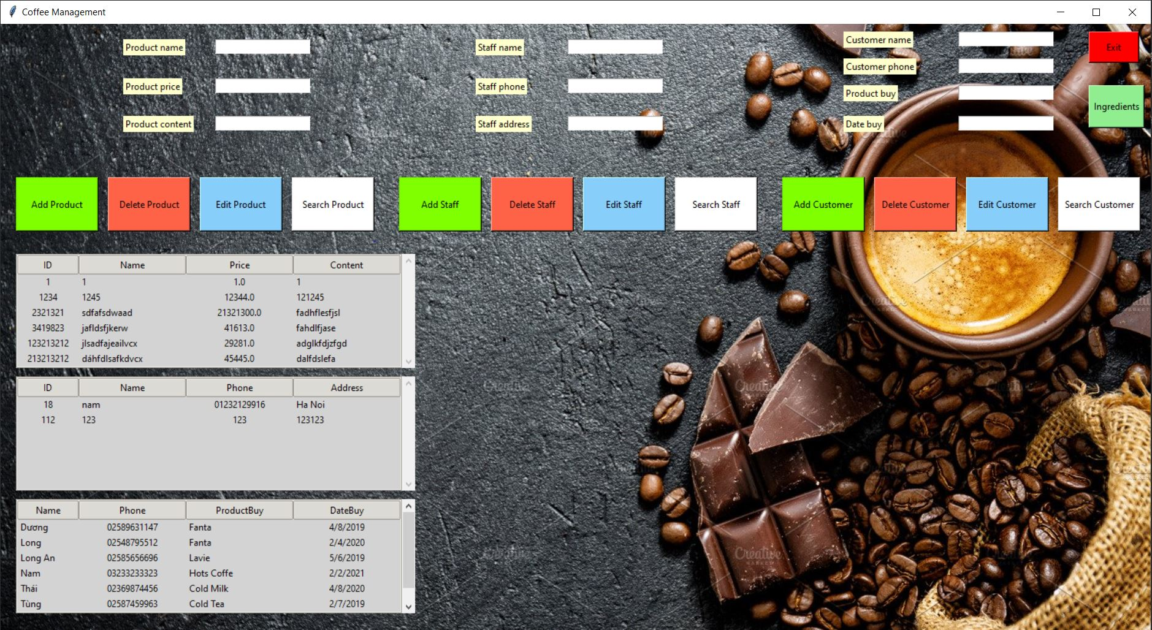
COFFEE MANAGEMENT SYSTEM

Slide 5
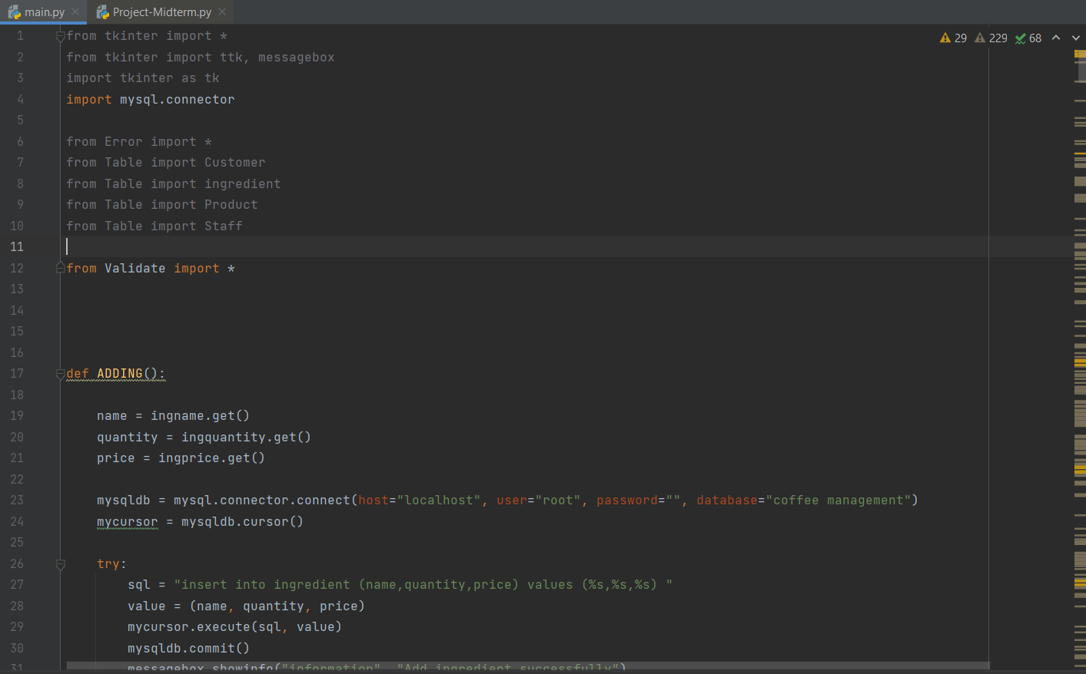
Structure
1.CLASSES
In our code , we create 1 class called ‘Main’ . It has a mission : run all the functions in other modules , packages and display it on the screen

Slide 6

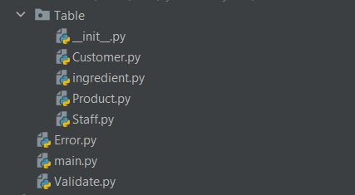

Structure
2. Module and Package
We divide our code into many modules to easy to access each part we want and each module have its own mission to do .
Also we import some packages in the library of python like tkinter , mysql or Pillow

Slide 7
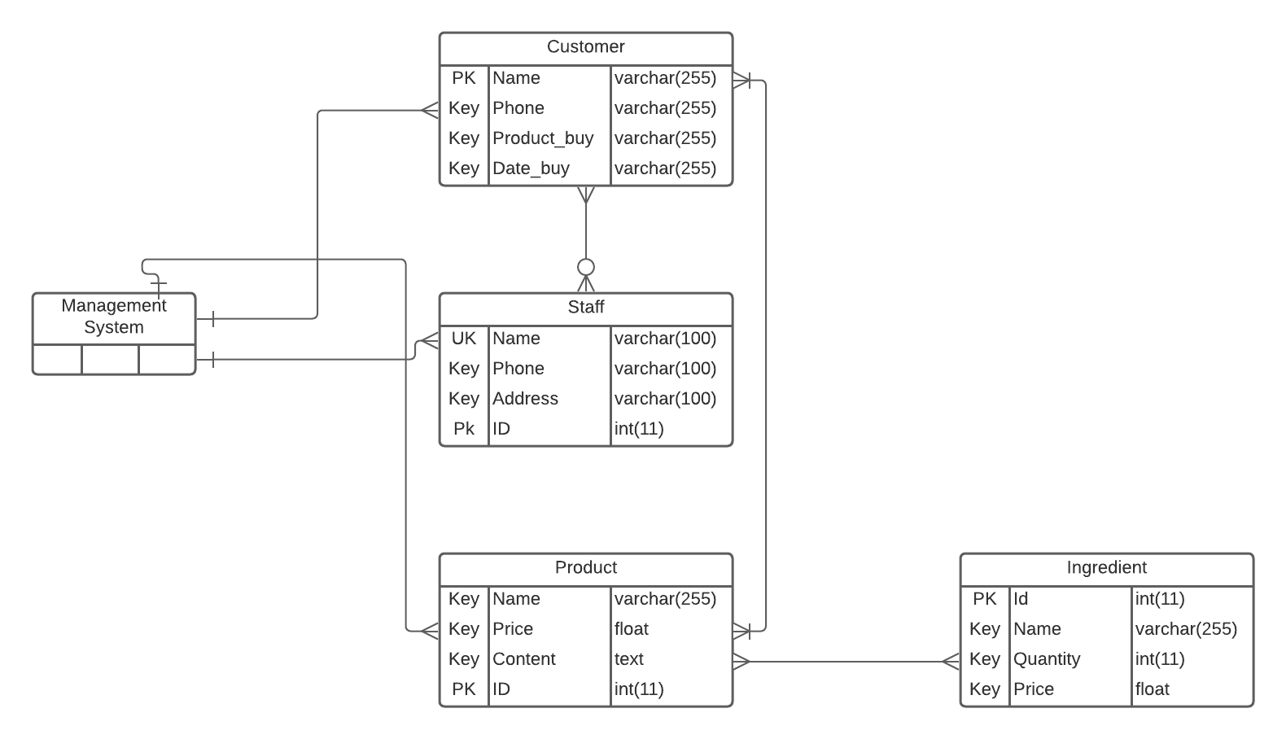
Structure
3. Database Diagram
With A Management System , Database Diagram is very important . This database show us the relationship between all the objects in the management system . In our system we have 4 objects which is Customer , Staff , Product and Ingredient

Slide 8
DEMO
Coffee Management System

Slide 9
THANK YOU
For listening our presentation

