Slide 1
COFFEE MANAGEMENT SYSTEM
GROUP 7 – ADVANCED PROGRAMMING WITH PYTHON

Slide 2
Content
01
Group
Coffee Management System
STRUCTURE OF CODE
02
Classes
Modules and Packages
Database Diagram
CONCLUSION
03
Demo
Conclusion

Slide 3
Introduction Group
BI10-031
ICT
BI10-156
ICT
Nguyễn Quốc Hùng
Nguyễn Hoàng Nam
Nguyễn Tiến Đạt
Nguyễn Minh Đức
Lương Nguyễn Việt Sơn
Your Text
BI10-072
ICT
BI10-123
ICT
Example Text :
Get a modern PowerPoint Presentation that is beautifully designed.
BI10-028
ICT

Slide 4
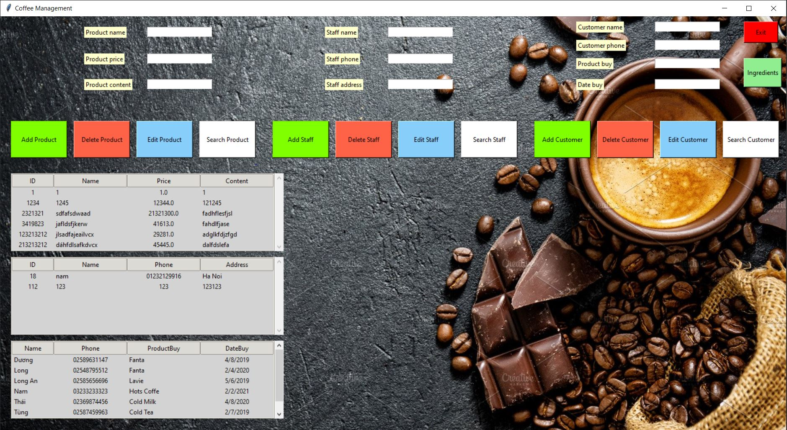
COFFEE MANAGEMENT SYSTEM

Slide 5
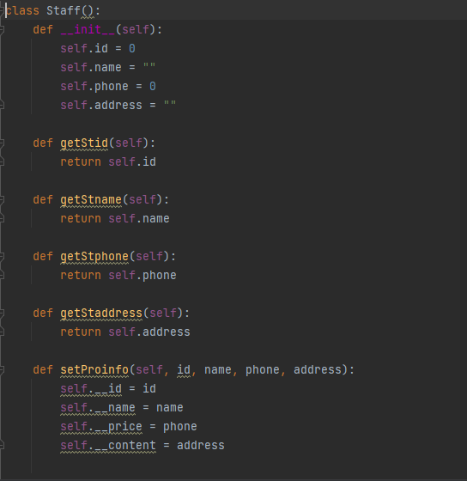
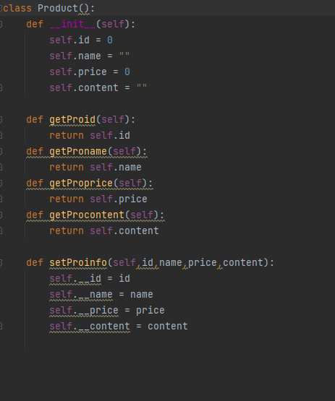
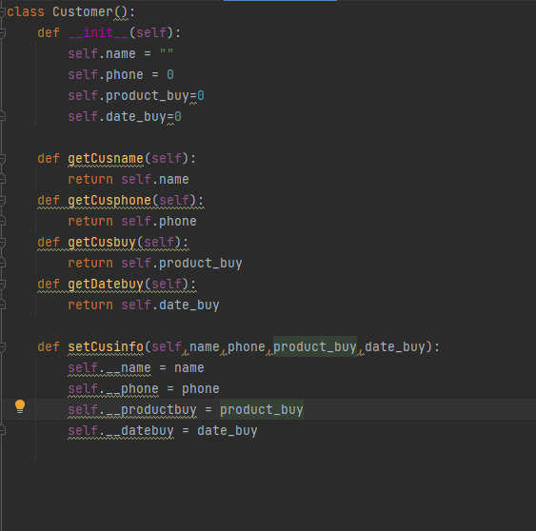
Structure
1.CLASSES
In our code , we create 3 classes called ‘Customer’ , ‘Product’ and ‘Staff . Each one has a mission : to hold all value of variables and help other functions to run the code

Slide 6

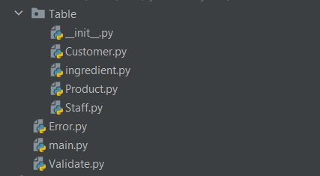

Structure
2. Module and Package
We divide our code into many modules and packages to easy to access each part we want and each module has its own mission to do .
Also we import some packages in the library of python like tkinter , mysql or Pillow

Slide 7
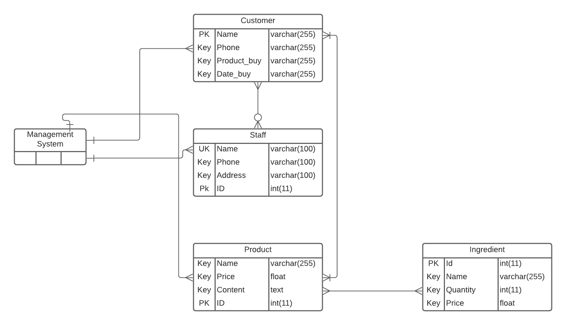
Structure
3. Database Diagram
With A Management System , Database Diagram is very important . This database show us the relationship between all the objects in the management system . In our system we have 3 main tables which are Customer, Staff , Product and for Product we have a subtable called Ingredient

Slide 8
DEMO
Coffee Management System

Slide 9
THANK YOU
For listening our presentation

