Slide 1


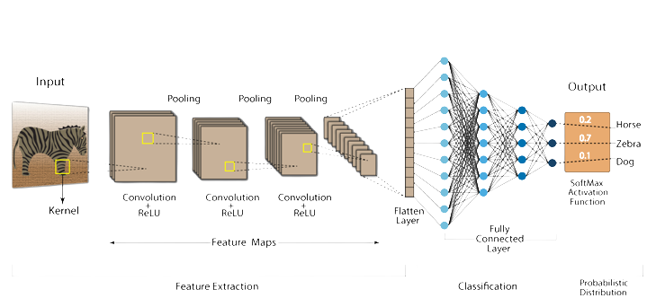




CLASSIFICATION AND GRADING SYSTEM FOR KOI FISH IN REAL TIME
PROJECT INTRODUCTION
PROBLEM
The topic is studied to build a model that can recognize and classify Koi fish in real time, through the neural layer of convolutional neural network CNN.
- Sorting Koi fish in real time
- Collect data from internet
- Building classification model
- Good data preprocessing
CNN network structure
MODEL EXECUTION PROCESS
RESULT
Data Collection
Data preprocessing
Model Training
Model Building
Evaluate model quality
Student: Tran Dinh Nam ID:19134079

