Slide 1
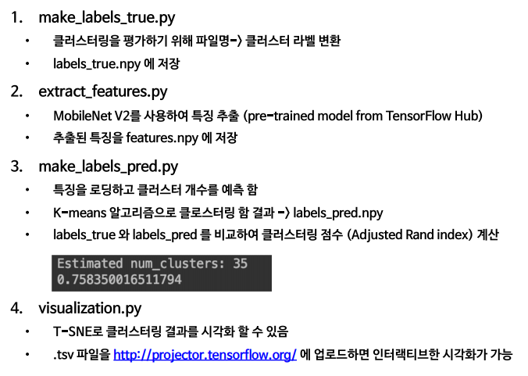

Slide 2
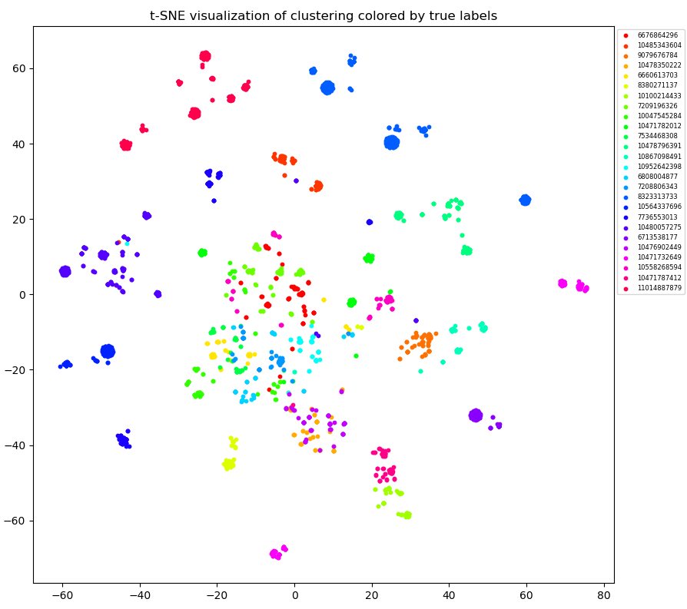
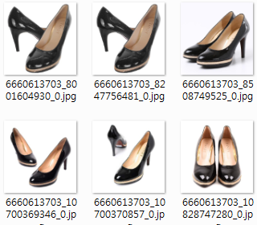
make_labels_true.py
Target image들의 true label 생성
extract_features.py
Target image → Feature vector
(using MobileNet2)
… | … | …
0.123456 | -0.123456 | …
0.123456 | -0.123456 | …
… | … | …
make_labels_pred.py
Feature vectors clustering
(using K-Means)
evaluation.py
Using adjusted rand index
visualization.py
t-SNE

Slide 3
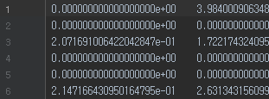
make_labels_true.py
향후 평가를 위해 Target image들의 true label 생성
make_labels_true.py
향후 평가를 위해 Target image들의 true label 생성
extract_features.py
Target image → Feature vector
(using MobileNet2)
(추가)
feature_network_fine_tunig .py
Another network + Image aug. + Fine Tuning
extract_features.py
Target image → Feature vector
(using fine-tunned another network)
(변경)
make_labels_pred.py
Feature vectors clustering
(using K-Means)
(변경)
evaluation.py
Adjusted rand index
make_labels_pred.py
Feature vectors clustering
(using another cluster algorithm)
visualization.py
t-SNE
evaluation.py
Adjusted rand index
visualization.py
t-SNE

Slide 4
10,628개 이미지 중 2,087개만 sampling / True number of cluster = 26
 | BL Code | Img P + BL Code
Predicted number of Cluster | 29 | 29
Random Index | 0.62347 | 0.64430
BL Code = Base Line Code (MobileNet V2 + K-Means)
Img P= Image Preprocessing

