Slide 1
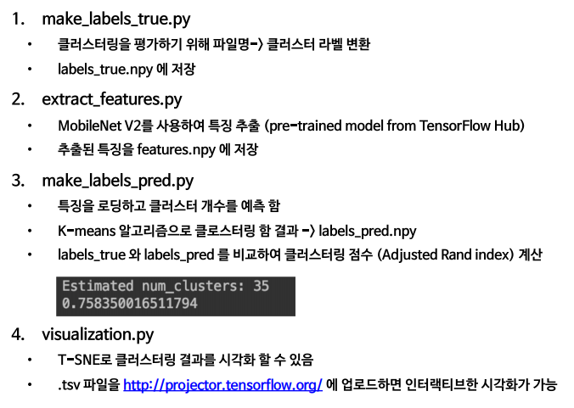

Slide 2

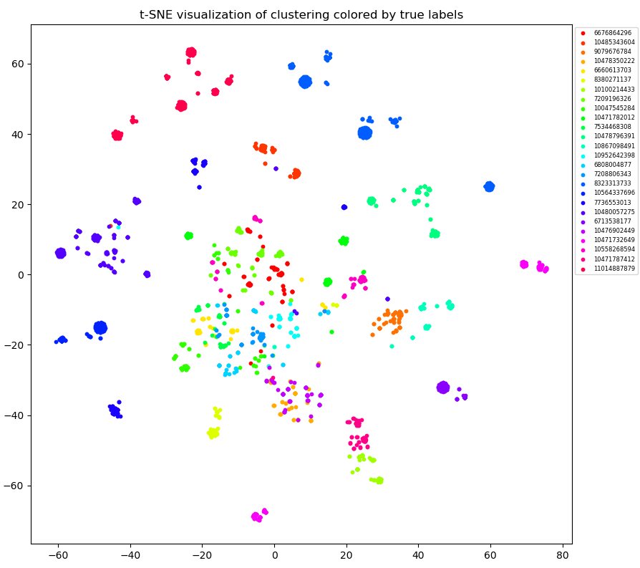
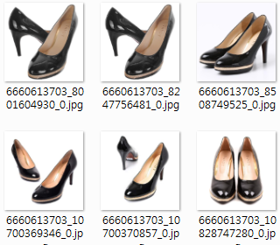
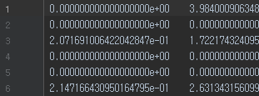
make_labels_true.py
향후 평가를 위해 Target image들의 true label 생성
10,628개 이미지 중 2,087개만 sampling
extract_features.py
Target image → Feature vector
(using MobileNet2)
make_labels_pred.py
Feature vectors clustering
(using K-Means)
evaluation.py
Adjusted rand index
visualization.py
t-SNE

Slide 3
make_labels_true.py
향후 평가를 위해 Target image들의 true label 생성
make_labels_true.py
향후 평가를 위해 Target image들의 true label 생성
extract_features.py
Target image → Feature vector
(using MobileNet2)
(추가)
Image_preprocessing.py
extract_features.py
Target image → Feature vector
(using another network)
+
Image augmentation + Fine Tuning
make_labels_pred.py
Feature vectors clustering
(using K-Means)
evaluation.py
Adjusted rand index
make_labels_pred.py
Feature vectors clustering
(using another cluster algorithm)
visualization.py
t-SNE
evaluation.py
Adjusted rand index
visualization.py
t-SNE

