Slide 1
국내 학회 일정 정리
한국인공지능학회 - 하계학술대회 (24년 기준)
1차 6월 16일 / 2차 6월 30일
https://aiassociation.kr/
한국지능시스템학회 ?? 핏이 안 맞는 거 같음
한국정보과학회 - 한국컴퓨터종합학술대회 (24년 기준)
4월 19일 (밀려서 5월 3일)
https://www.kiise.or.kr/conference/kcc/2025/
Notes:
대충 분야 맞고 상반기 마감인 학회만 정리

Slide 2


WISE
2025. 02. 25.

Slide 3
CONTENTS
1
2
3
Introduction
Related Works
Preliminary
4
5
6
Method
Experiments
Conclusion

Slide 4

1. Introduction
배경
기존 long term memory editing – parameter를 직접 바꿔버려서 기존에 pretrain했던 지식을 잃어버림
Locality가 안좋아짐
Working memory – 메모리에다가 지식 업데이트
Paraphrase된 query generalization이 잘 안됨
$⇒$ WISE: Reliability, Generalization, Locality 세 가지를 동시에 다 충족시키는 것이 목표

Slide 5
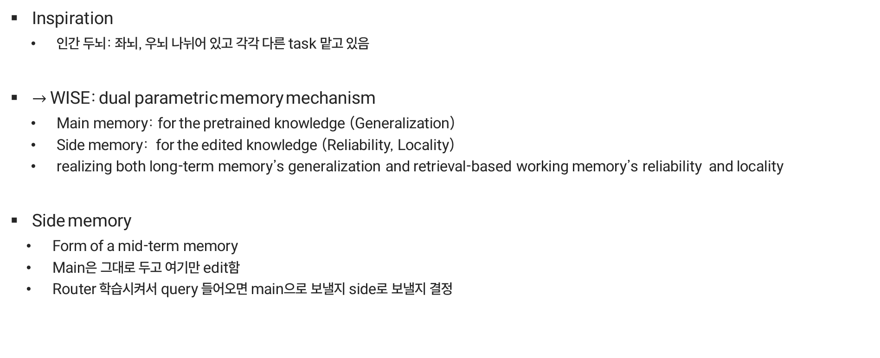
1. Introduction
배경
Inspiration
인간 두뇌: 좌뇌, 우뇌 나뉘어 있고 각각 다른 task 맡고 있음
$→$ WISE: dual parametric memory mechanism
Main memory: for the pretrained knowledge (Generalization)
Side memory: for the edited knowledge (Reliability, Locality)
realizing both long-term memory’s generalization and retrieval-based working memory’s reliability and locality
Side memory
Form of a mid-term memory
Main은 그대로 두고 여기만 edit함
Router 학습시켜서 query 들어오면 main으로 보낼지 side로 보낼지 결정

Slide 6
1. Introduction
배경
For continual editing
Knowledge-sharding mechanism
Edit한 게 안 겹치게 parameter 상에서 서로 다른 orthogonal subspace에 저장…
일단 다른 subspace에 먼저 저장해두고, 나중에 merge (충돌 없이)
요약
111
2
33

Slide 7
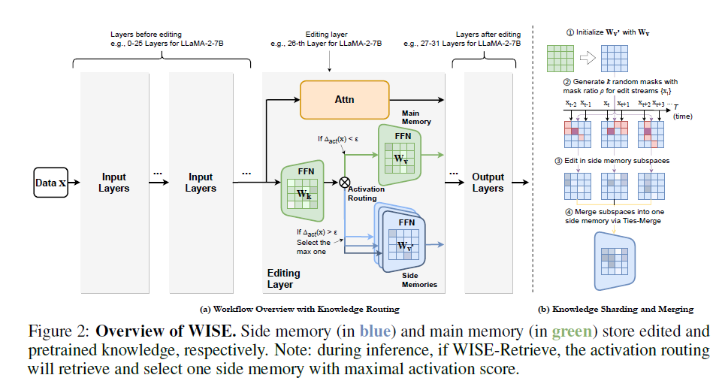
2. Method
Overview

Slide 8
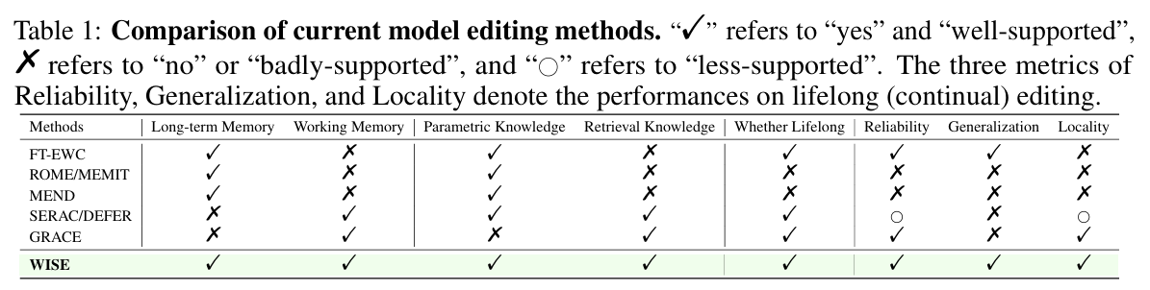
2. Methodology
2.2 Rethinking the Memory Design of Lifelong Model Editing
다른 거랑 비교
FT-EWC, ROME, MEMIT, MEND – long term memory 수정
Sequential setting 지원하지 않거나 locality가 떨어진다는 문제점
GRACE – working memory 활용
Query를 그냥 기억하기만 해서 generality기 떨어진다는 문제점
SERAC/DEFER – working memory를 scope classifier 사용 및 counterfactual model에 저장하는 방식 사용
설명설명

Slide 9
2. Methodology
2.3 WISE:Side Memory with Knowledge Sharding, Merging, and Routing
WISE key component
Side memory design
Side memory: llm 특정 ffn layer 복사, 복사된 layer edit해서 지식 저장
Memory routing mechanism: retrieval이랑 비슷하게 routing 해서 main or side 정해줌
Knowledge sharding and merging
Knowledge in random memory subspaces: side memory를 random한 subspace로 쪼개서 적정 density 맞춰줌 & forgetting 방지
Knowledge merging: model merging 테크닉 써서 다른 memory shard들을 loss 없이 하나의 side memory로 합침
Notes:
To enable effective lifelong model editing, the method should take advantage of both LLM parameters’ long-term memory and retrieval-based working memory. Therefore, we propose WISE as follows.

Slide 10


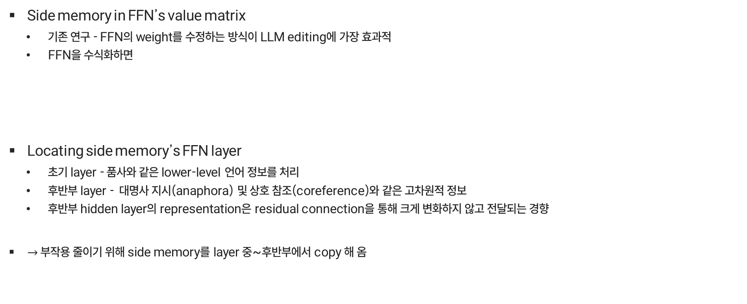
2. Methodology
2.3.1 Side Memory Design
Side memory in FFN’s value matrix
기존 연구 - FFN의 weight를 수정하는 방식이 LLM editing에 가장 효과적
FFN을 수식화하면
Locating side memory’s FFN layer
초기 layer - 품사와 같은 lower-level 언어 정보를 처리
후반부 layer - 대명사 지시(anaphora) 및 상호 참조(coreference)와 같은 고차원적 정보
후반부 hidden layer의 representation은 residual connection을 통해 크게 변화하지 않고 전달되는 경향
$→$ 부작용 줄이기 위해 side memory를 layer 중~후반부에서 copy 해 옴
Main memory
Side memory
*side memory update 방식은 뒤에서 자세히
Notes:
여기는 별로 안 중요한 거 같음

Slide 11
2. Methodology
2.3.1 Side Memory Design

Slide 12

2. Methodology
2.3.1 Side Memory Design
Routing between side memories and main memory
Query가 이전 edit scope 내에 있으면 side로 보내고 아니면 main memory로 보냄
Routing activation indicator 써서 main으로 갈지 side로 갈지 결정
We want the activation indicators of editing queries to be larger than the ones of irrelevant queries by a large margin, which is:
(관련 있으면 activation 크게, 없으면 작게)
$A(·) = a$, side memory의 activation
Notes:
A(·) = a is the activation of the side memory’s corresponding FFN layer in Equation 2

Slide 13
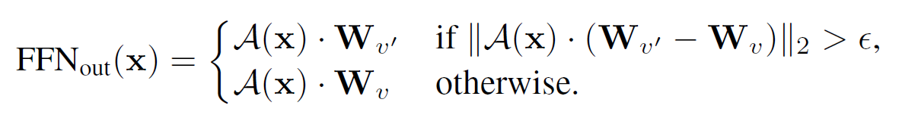
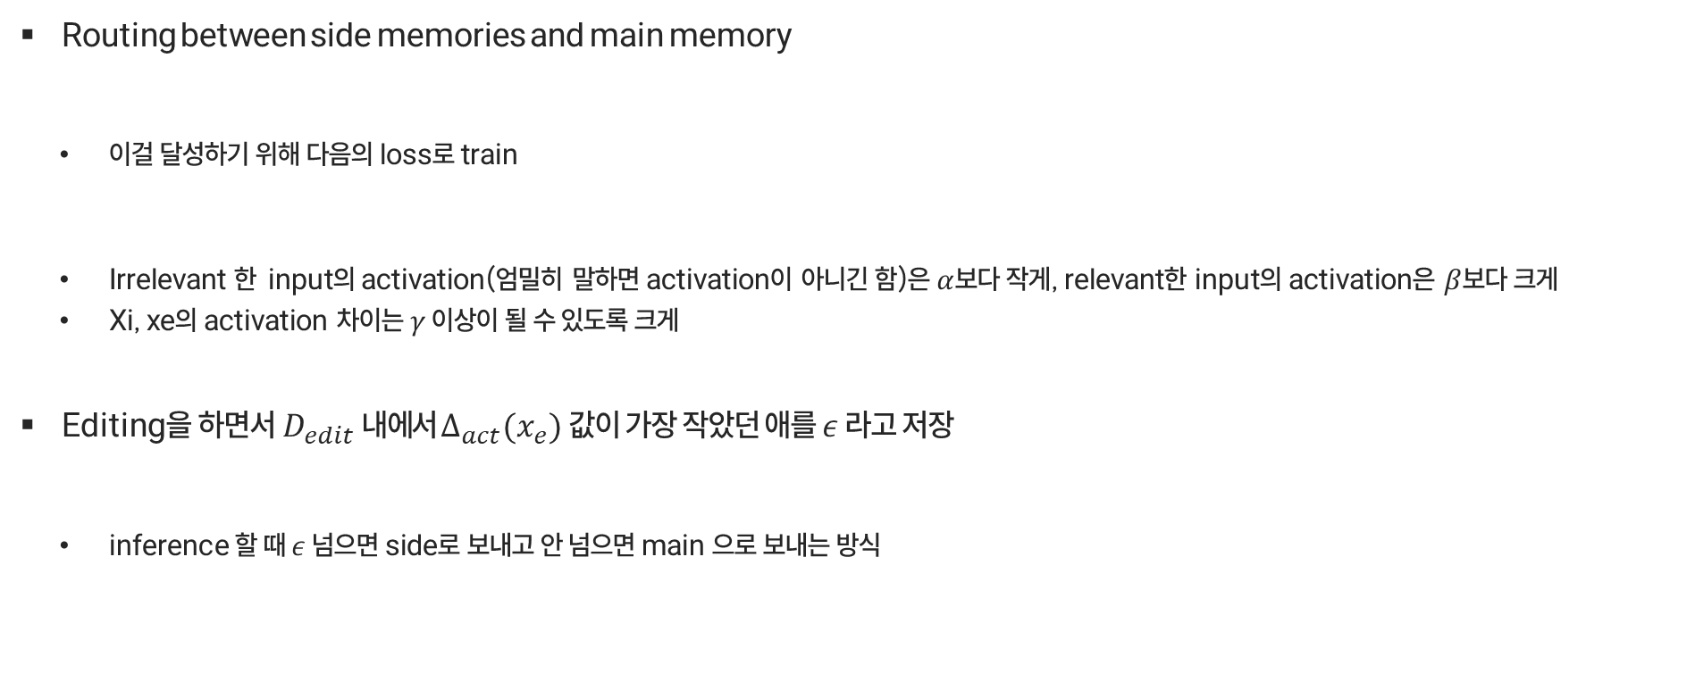
2. Methodology
2.3.1 Side Memory Design
Routing between side memories and main memory
이걸 달성하기 위해 다음의 loss로 train
Irrelevant 한 input의 activation(엄밀히 말하면 activation이 아니긴 함)은 $α$보다 작게, relevant한 input의 activation은 $β$보다 크게
Xi, xe의 activation 차이는 $γ$ 이상이 될 수 있도록 크게
Editing을$하면서 D_{edit} 내에$서 $∆_{act}(x_{e})$ 값이 가장 작았던 애를 $ε$ 라고 저장
inference 할 때 $ε$ 넘으면 side로 보내고 안 넘으면 main 으로 보내는 방식
Notes:
A(·) = a is the activation of the side memory’s corresponding FFN layer in Equation 2

Slide 14
2. Methodology
2.3.2 Knowledge Sharding and Merging
Knowledge Density 라는 개념을 처음 제안함 (knowledge capacity랑 비슷)
how many pieces of knowledge are stored per parameter on average
Editing dilemma
If only a few edits are made for full fine-tuning or editing the entire memory, the knowledge density is low, which may lead to overfitting [edit을 적게 하면 knowledge density가 낮아서 overfitting 위험]
If numerous edits are made within a common and limited parameter space, the knowledge density is high, resulting in conflicts within the edited knowledge and potentially causing catastrophic forgetting. [많이 하면 density 높아져서 충돌 생기거나 까먹음]
딜레마 해결방안
propose a knowledge sharding and merging mechanism to divide the edits into several shards, store them in different parameter subspaces, and merge them into a common side memory.
Notes:
이게 맞나??

Slide 15

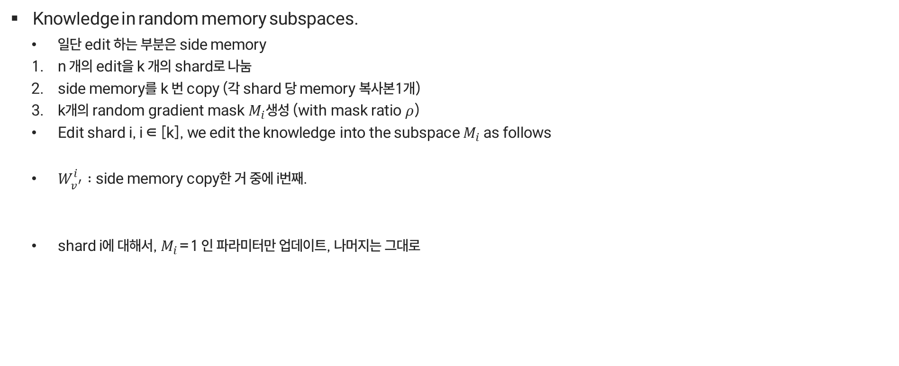
2. Methodology
2.3.2 Knowledge Sharding and Merging
Knowledge in random memory subspaces.
일단 edit 하는 부분은 side memory
n 개의 edit을 k 개의 shard로 나눔
side memory를 k 번 copy (각 shard 당 memory 복사본1개)
k개의 random gradient mask $M_{i}$생성 (with mask ratio $ρ$)
Edit shard i, i ∈ [k], we edit the knowledge into the subspace $M_{i}$ as follows
$W_{v^{′}}^{i} :$side memory copy한 거 중에 i번째.
shard i에 대해서, $M_{i}$=1 인 파라미터만 업데이트, 나머지는 그대로
Notes:
M = binary mask whose proportion of 1 is ρ
η is the learning rate, gi(·) is the gradient of the i-th
shard of edits, and the gradient is the autoregressive loss plus the routing activation loss La(Equation
5): Ledit = −log PWv′ (ye|xe) + La. ??

Slide 16


2. Methodology
2.3.2 Knowledge Sharding and Merging
Knowledge Merging
k개의 subspace를 하나로 합침
subspace mask를 random하게 만들었기 때문에 겹치는 부분이 있을 수도 ($ρ$ 커질수록 더 overlap)
anchor 역할해서 도움이 될 수도 있긴 한데 이 부분에서 충돌될 수도 있음
Ties-Merge 테크닉
Edit shift vector 계산:
strim: trim the redundant parameters for each task vector
elect the sign: elect the signs of each parameter
disjoint merge: compute the disjoint mean for each parameter which has the same and correct signs
$⇒$different subspaces of knowledge are integrated into one with fewer conflicts

Slide 17
2. Methodology
2.3.2 Knowledge Sharding and Merging
Routing and retrieving among several side memories.
One single side memory has its limited knowledge capacity
Notes:
MAPPO에서는 개별적인 Actor 네트워크(정책)는 존재하지만, Critic 네트워크(가치 평가)는 모든 에이전트가 공유하는 형태로 동작

Slide 18

3. Experiments
3.1 Experimental Settings and Evaluation Metrics
수백개~수천개의 sequential edit scenario
10개의 random token sequence를 생성해서 $x_{e}를$ augmentation
Enhance editing generalization/adaptation to diverse contexts
(다른 baseline들에도 augmentation 적용했음)

Slide 19
3. Experiments
3.1 Experimental Settings and Evaluation Metrics
LLM Models
Llama 2 – 7B, Mistral – 7B, GPT – J – 6B
Datasets

Slide 20
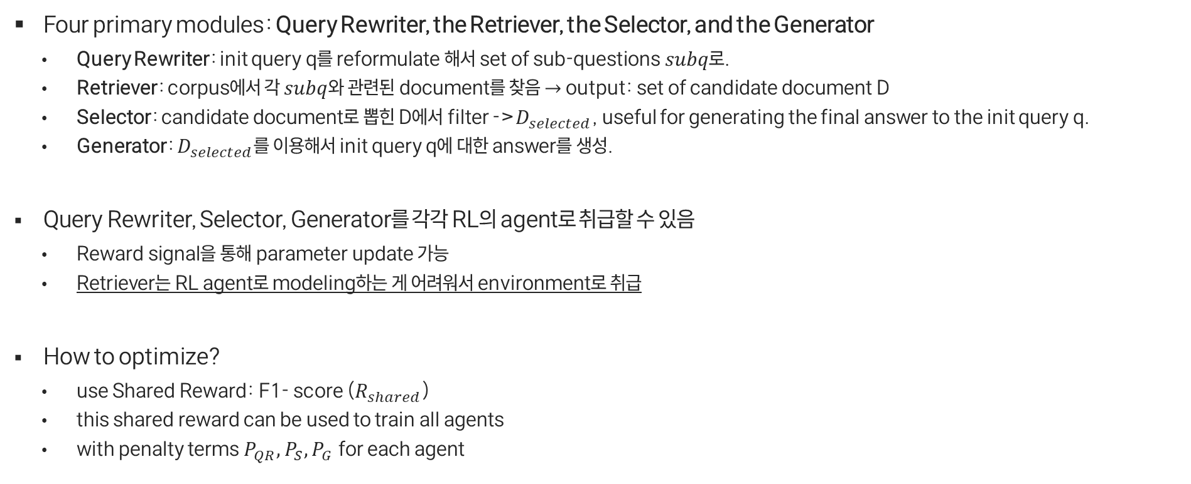
4. Methods
4.1. Overall of MMOA RAG
Four primary modules: Query Rewriter, the Retriever, the Selector, and the Generator
Query Rewriter: init query q를 reformulate 해서 set of sub-questions $subq로$.
Retriever: corpus에서 각 $subq$와 관련된 document를 찾음 $→$ output: set of candidate document D
Selector: candidate document로 뽑힌 D에서 filter ->$D_{selected}$, useful for generating the final answer to the init query q.
Generator: $D_{selected}$를 이용해서 init query q에 대한 answer를 생성.
Query Rewriter, Selector, Generator를 각각 RL의 agent로 취급할 수 있음
Reward signal을 통해 parameter update 가능
Retriever는 RL agent로 modeling하는 게 어려워서 environment로 취급
How to optimize?
use Shared Reward: F1- score ($R_{shared}$)
this shared reward can be used to train all agents
with penalty terms $P_{QR}, P_{S}, P_{G}$for each agent
Notes:
F1 Score는 Precision(정밀도)과 Recall(재현율)이 균형을 이루도록 조정한 성능 평가 지표.
한쪽으로 치우치는 것을 방지하고, Precision과 Recall의 조화로운 조합을 찾는 역할을 함! 즉, "잘못된 예측을 줄이면서도 놓치는 정답이 없도록 최적화하는 지표"라고 생각하면 됨!

Slide 21
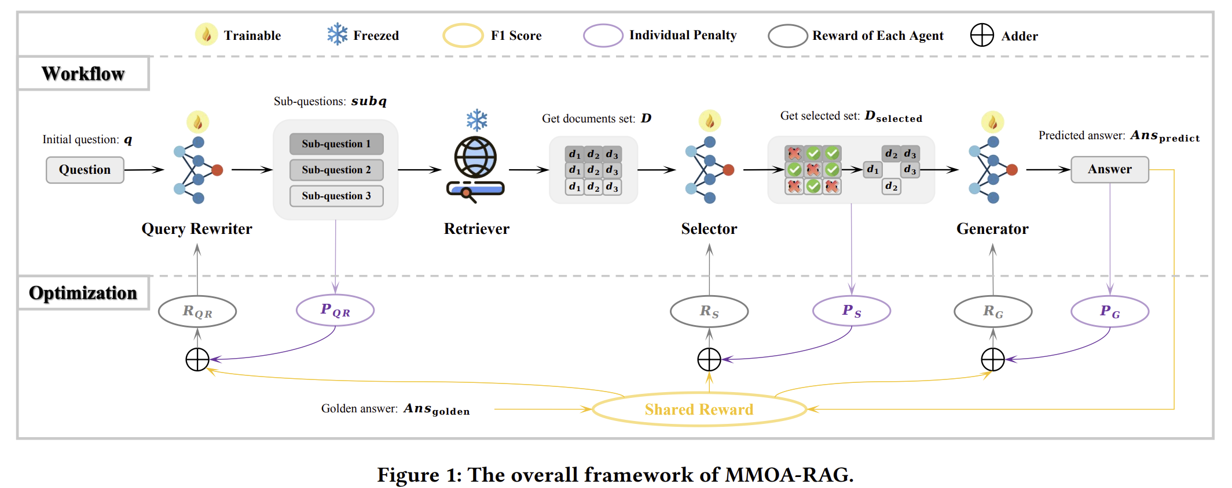



5. Limitations and Broader Impacts
Side memory retrieval has room for improvement to reach the oracle
Notes:
V = Vocab space of LLM

Slide 22


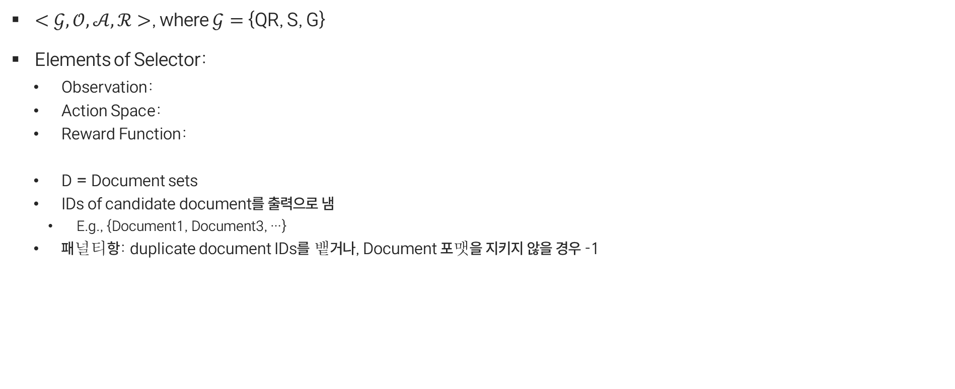
4. Methods
4.2. Detailed Configuration
$<𝒢,𝒪,𝒜,ℛ>$, where $𝒢=${QR, S, G}
Elements of Selector:
Observation:
Action Space:
Reward Function:
D = Document sets
IDs of candidate document를 출력으로 냄
E.g., {Document1, Document3, …}
패널티항: duplicate document IDs를 뱉거나, Document 포맷을 지키지 않을 경우 -1

Slide 23



4. Methods
4.2. Detailed Configuration
$<𝒢,𝒪,𝒜,ℛ>$, where $𝒢=${QR, S, G}
Elements of Generator:
Observation:
Action Space:
Reward Function:
패널티항 : Generated answer가 특정 length를 넘어가면 -0.5

Slide 24
4. Methods
4.3. Warm Start with SFT
3개의 모듈에 대해 RL을 진행하기 앞서, Warm-start로서 SFT를 적용시킴
Q. How to obtain training data?
Notes:
Three trainable modules: Query Rewriter, the Selector, and the Generator
Training data for the SFT of each corresponding task

Slide 25
4. Methods
4.3. Warm Start with SFT
Query Rewriter
public query rewriting data (Rewrite-Retrieve-Read) 로 SFT
Notes:
Three trainable modules: Query Rewriter, the Selector, and the Generator
Training data for the SFT of each corresponding task

Slide 26
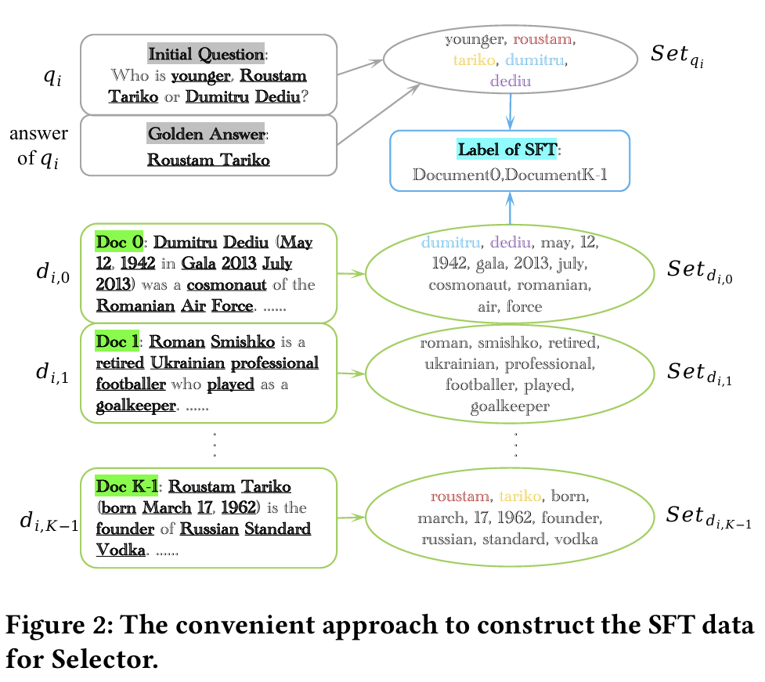
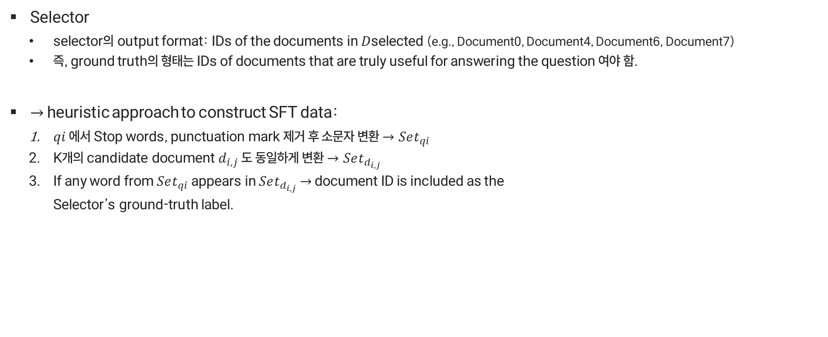
4. Methods
4.3. Warm Start with SFT
Selector
selector의 output format: IDs of the documents in 𝐷selected (e.g., Document0, Document4, Document6, Document7)
즉, ground truth의 형태는 IDs of documents that are truly useful for answering the question 여야 함.
$→$ heuristic approach to construct SFT data:
$qi$ 에서 Stop words, punctuation mark 제거 후 소문자 변환 $→Set_{qi}$
K개의 candidate document $d_{i,j}$ 도 동일하게 변환 $→Set_{d_{i,j}}$
If any word from $Set_{qi}$ appears in $Set_{d_{i,j}}$ $→$ document ID is included as the
Selector’s ground-truth label.

Slide 27

4. Methods
4.3. Warm Start with SFT
Generator SFT
Generator의 task: D_selected로부터 최종 답변인 Ans_predict 생성
GT의 형태: Golden answer Ans_golden
Loss Function (For all module)
Notes:
sft data는 각각 다 정해졌고, 거기다가 같은 loss function 써줄 수 있음
After undergoing SFT, the LLM demonstrates an improved ability
to follow instructions while executing the functions of Query
Rewriter, Selector, and Generator. The RAG system also achieves
relatively satisfactory warm-start performance.

Slide 28

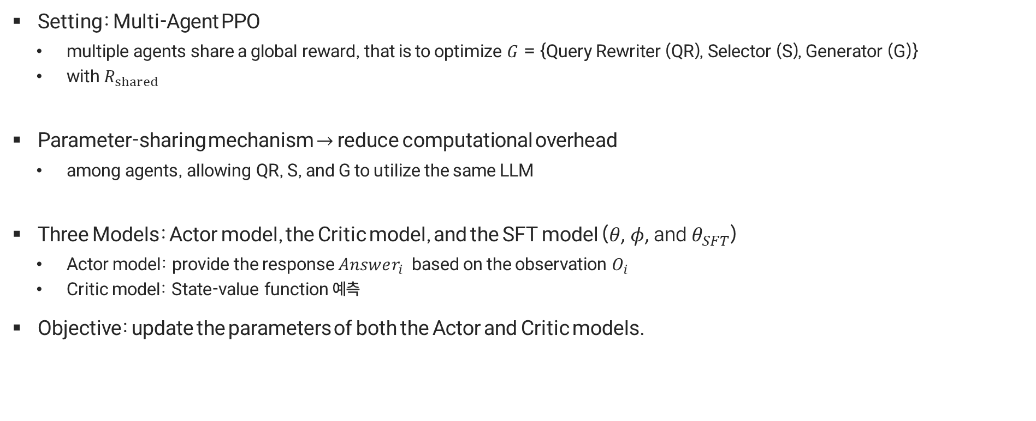
4. Methods
4.4. Multi-Agent Optimization
Setting: Multi-Agent PPO
multiple agents share a global reward, that is to optimize $G$ = {Query Rewriter (QR), Selector (S), Generator (G)}
with $R_{shared}$
Parameter-sharing mechanism $→$ reduce computational overhead
among agents, allowing QR, S, and G to utilize the same LLM
Three Models: Actor model, the Critic model, and the SFT model (𝜃, 𝜙, and $θ_{SFT}$)
Actor model: provide the response $Answer_{i}$ based on the observation $O_{i}$
Critic model: State-value function 예측
Objective: update the parameters of both the Actor and Critic models.
Actor model의 loss + Critic model의 loss
Notes:
sft하고 나면 instruction을 좀 더 잘 따르겟지요..

Slide 29
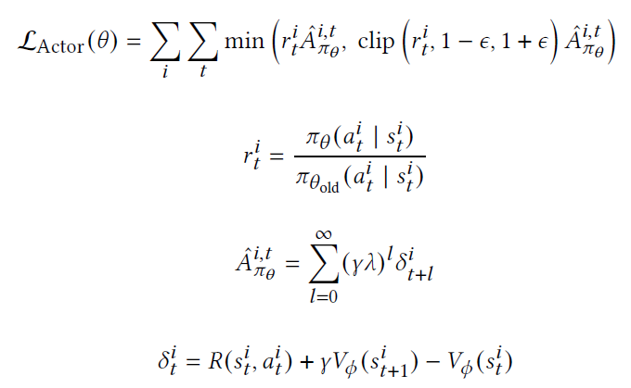
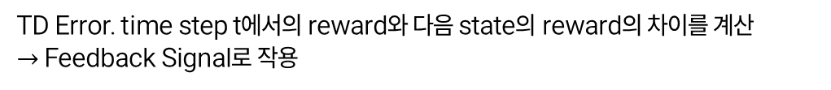
4. Methods
4.4. Multi-Agent Optimization
Actor loss function
New policy가 old policy보다 얼마나 더 나은지 평가 & clipping 적용해 급격한 update 방지
모듈별로 계산해서 sum
Old policy와 new policy의 차이
GAE를 사용하여 계산된 advantage. 특정 state 에서 특정 action을 했을 때 얼마나 좋은지 평가
TD Error. time step t에서의 reward와 다음 state의 reward의 차이를 계산
$→$ Feedback Signal로 작용
Notes:
no reward model.
we use f1 score as the shared reward for all agents.

Slide 30
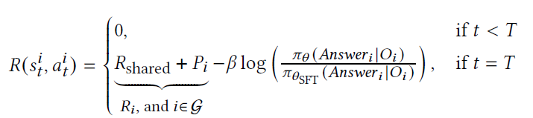
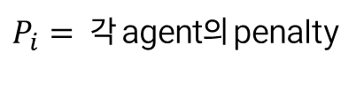

4. Methods
4.4. Multi-Agent Optimization
Reward
기존 SFT Model에서 크게 벗어나지 못하도록 제약
$R_{shared}=F1 score$
$P_{i}= 각$ agent의 penalty
최종 단계인 time step T일 때, 최적의 답변을 생성하고 기존 SFT 모델에서 크게 벗어나지 않도록 제약하는 방향으로 Reward를 줌
Notes:
마지막에 answer generation 하고 났을 때의 time step 을 T로 잡는 것 같음
Answer generation이 되어야 f1 score도 구할 수 있으니까.

Slide 31




4. Methods
4.4. Multi-Agent Optimization
Critic Model loss function
Estimation 값과 실제 return의 차이를 통해 loss 계산& clipping 적용해 급격한 update 방지
모듈별로 계산해서 sum
$V_{target}^{i,t}$: Cumulative return
최종적으로는 value function을 실제 return과 비슷하게 예측할 수 있도록 update
Notes:
여기 설명 추가

Slide 32
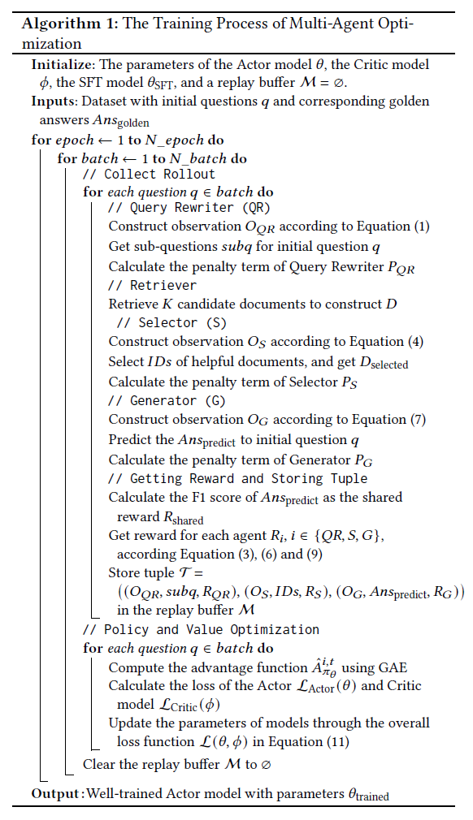

4. Methods
4.4. Multi-Agent Optimization
Full Algorithm
Collect Rollout (for batch)
QR이 subq 생성
R이 document 검색
S가 document 선택
G가 최종 answer 생성
Tuple $(O_{QR}, subq, R_{QR} ), (O_{S}, ID_{s}, R_{S} ), (O_{G},Ans_{predict}, R_{G} )$ 을 replay buffer에 저장
Policy & Value Optimization (for batch)
GAE로 advantage function 계산
Actor, Critic의 loss 계산
최종 loss를 통해 Actor model, Critic model update

Slide 33
5. Experiments
RQ1. How does our MMOA-RAG perform compared to existing RAG optimization methods?
RQ2. What are the results of the ablation study on MMOA-RAG, specifically, is joint optimization of multiple modules more effective?
RQ3. Does the joint optimization method of MMOA-RAG exhibit generalizability across different RAG systems?
RQ4. How does the MMOA-RAG method perform in out-of domain scenarios, i.e., what is its generalization capability?

Slide 34
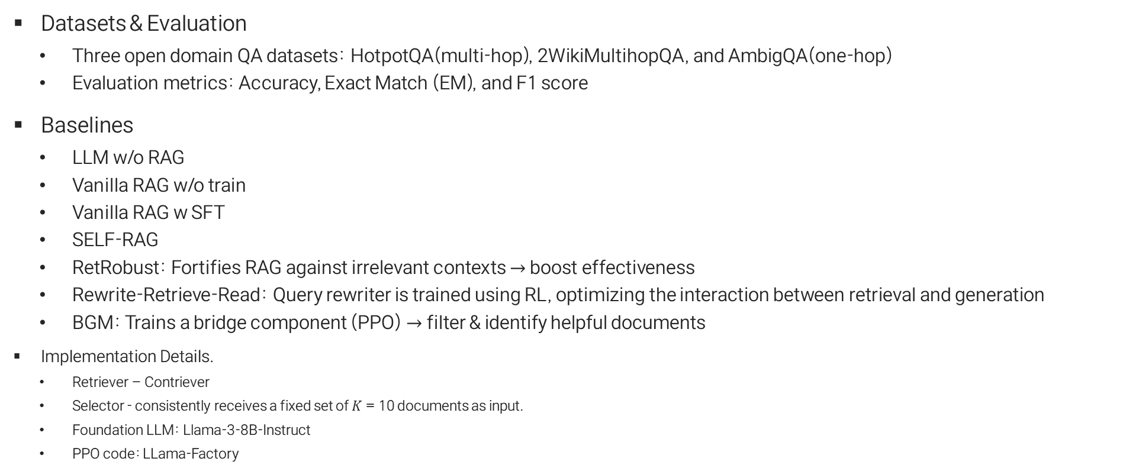
5. Experiments
Experimental Settings
Datasets & Evaluation
Three open domain QA datasets: HotpotQA(multi-hop), 2WikiMultihopQA, and AmbigQA(one-hop)
Evaluation metrics: Accuracy, Exact Match (EM), and F1 score
Baselines
LLM w/o RAG
Vanilla RAG w/o train
Vanilla RAG w SFT
SELF-RAG
RetRobust: Fortifies RAG against irrelevant contexts $→$ boost effectiveness
Rewrite-Retrieve-Read: Query rewriter is trained using RL, optimizing the interaction between retrieval and generation
BGM: Trains a bridge component (PPO) $→$ filter & identify helpful documents
Implementation Details.
Retriever – Contriever
Selector - consistently receives a fixed set of 𝐾 = 10 documents as input.
Foundation LLM: Llama-3-8B-Instruct
PPO code: LLama-Factory

Slide 35
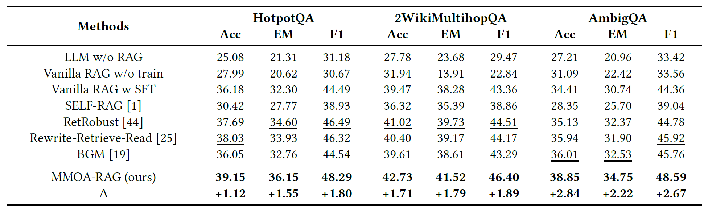
5. Experiments
RQ1. How does our MMOA-RAG perform compared to existing RAG optimization methods?
모든 dataset, metric에서 MMOA-RAG이 가장 좋은 성능을 보임

Slide 36
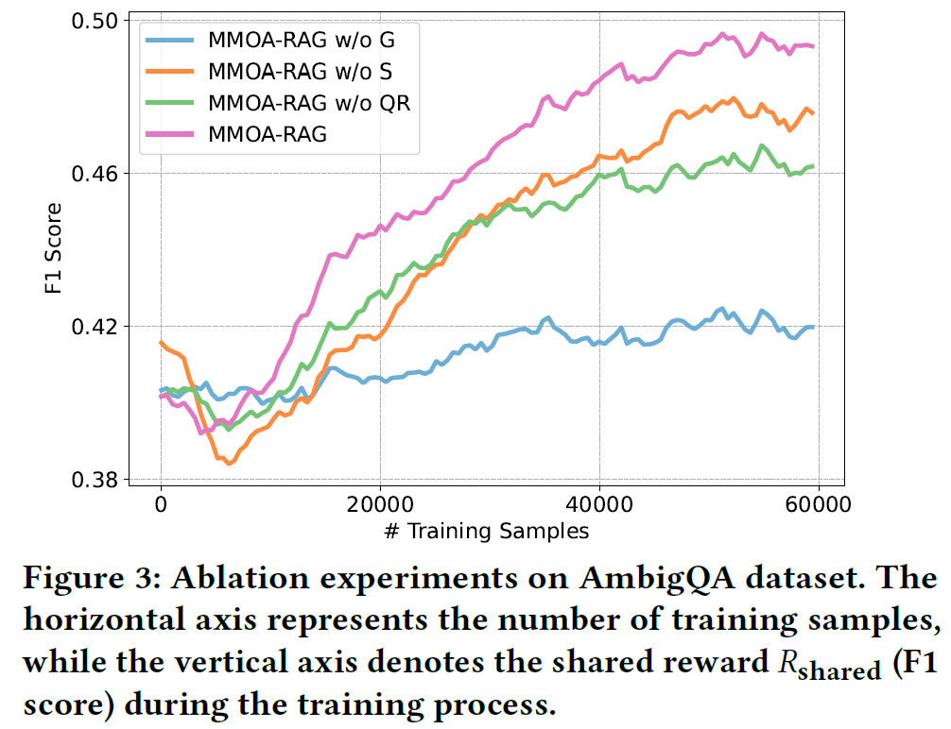
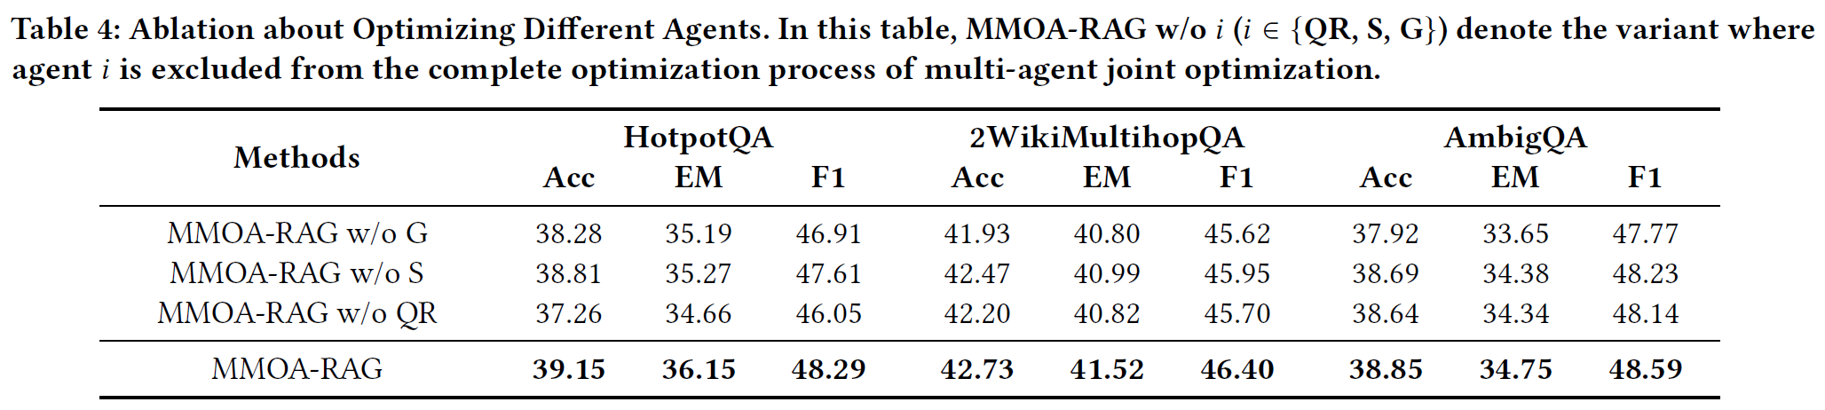
5. Experiments
RQ2. What are the results of the ablation study on MMOA-RAG, specifically, is joint optimization of multiple modules more effective?
Ablation experiments on AmbigQA dataset
- traning 과정 중 F1 score 상승 추세
- 모든 module 다같이 optimize 했을 때 가장 성능이 좋음

Slide 37
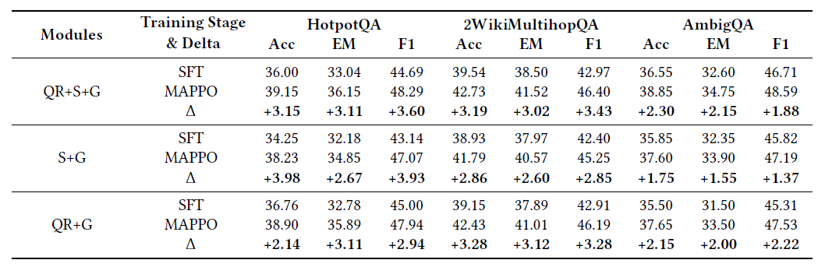
5. Experiments
RQ3. Does the joint optimization method of MMOA-RAG exhibit generalizability across different RAG systems?
Module을 하나씩 빼고 RAG 구축했을 때도 SFT보다 MAPPO가 더 성능이 좋음

Slide 38
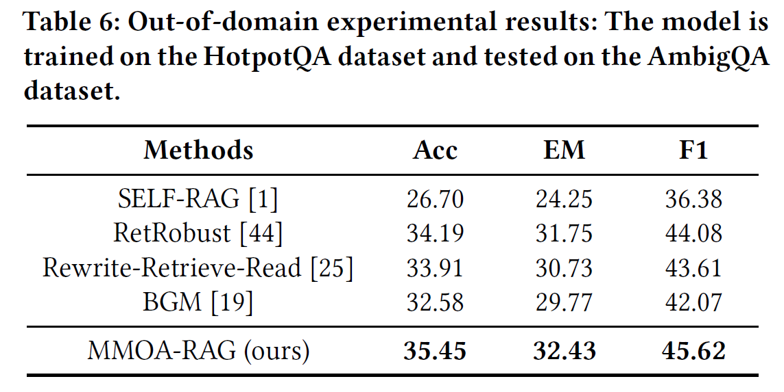
5. Experiments
RQ4. How does the MMOA-RAG method perform in out-of domain scenarios, i.e., what is its generalization capability?
Trained LLM on HotpotQA dataset and evaluated on the AmbigQA dataset

Slide 39
6. Conclusions
Models the RAG pipeline from a multi-agent perspective, treating Query Rewriter, Selector, and Generator as learnable RL agents.
Uses a multi-agent RL approach to jointly optimize these modules, aligning their objectives toward producing high-quality answers.
Comprehensive experiments and ablation studies show that multi-module joint optimization is both necessary and effective, making MMOA-RAG a strong method for optimizing RAG.

