Slide 1
Network Analysis
1. Jason 00000013271
2. Lyndon 00000008803
3. Steven 00000011580

Slide 2
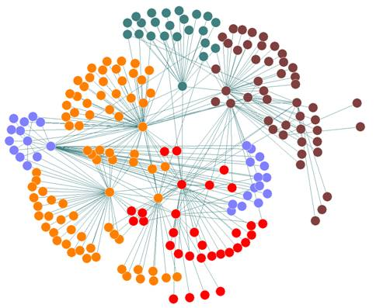
About Network Analysis
Notes:
Network Analysis
Working procedures in terms of a network of related activities

Slide 3
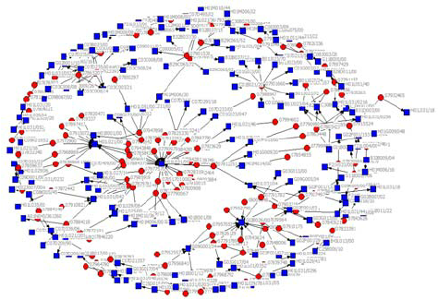
About Network Analysis
Notes:
Social Network Analysis
Mapping and measuring of relationships and flows between people, groups, organizations
Facebook, twitter, etc

Slide 4

RStudio
Notes:
R is Popular
R is designed to operate the way that problems are thought about
R is both flexible and powerful
For data analysist

Slide 5

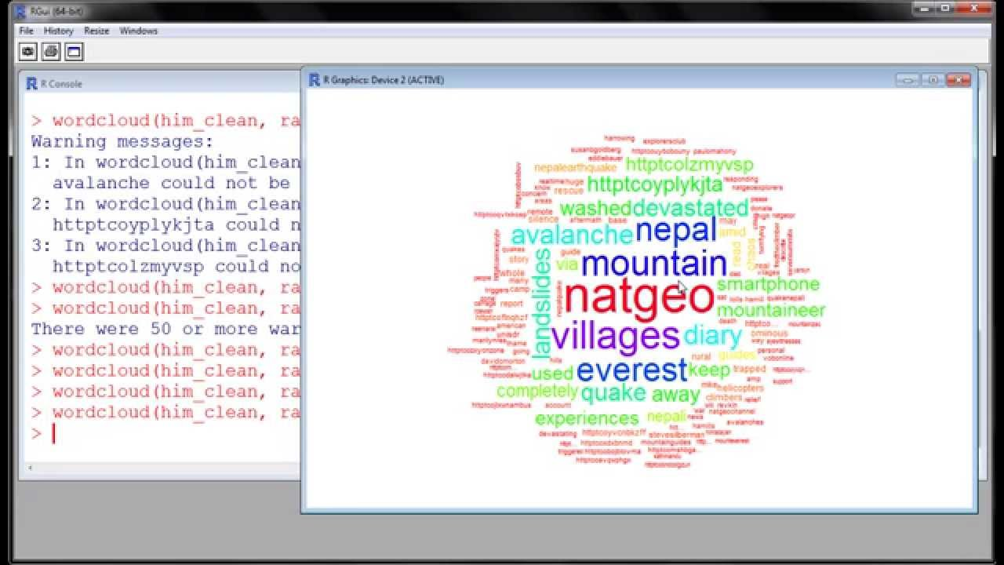
The Problem
Notes:
Semantic Analysis

Slide 6
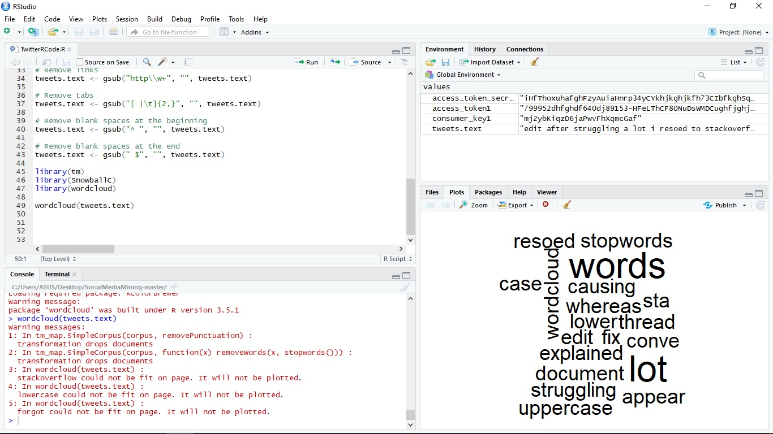
The Problem

Slide 7
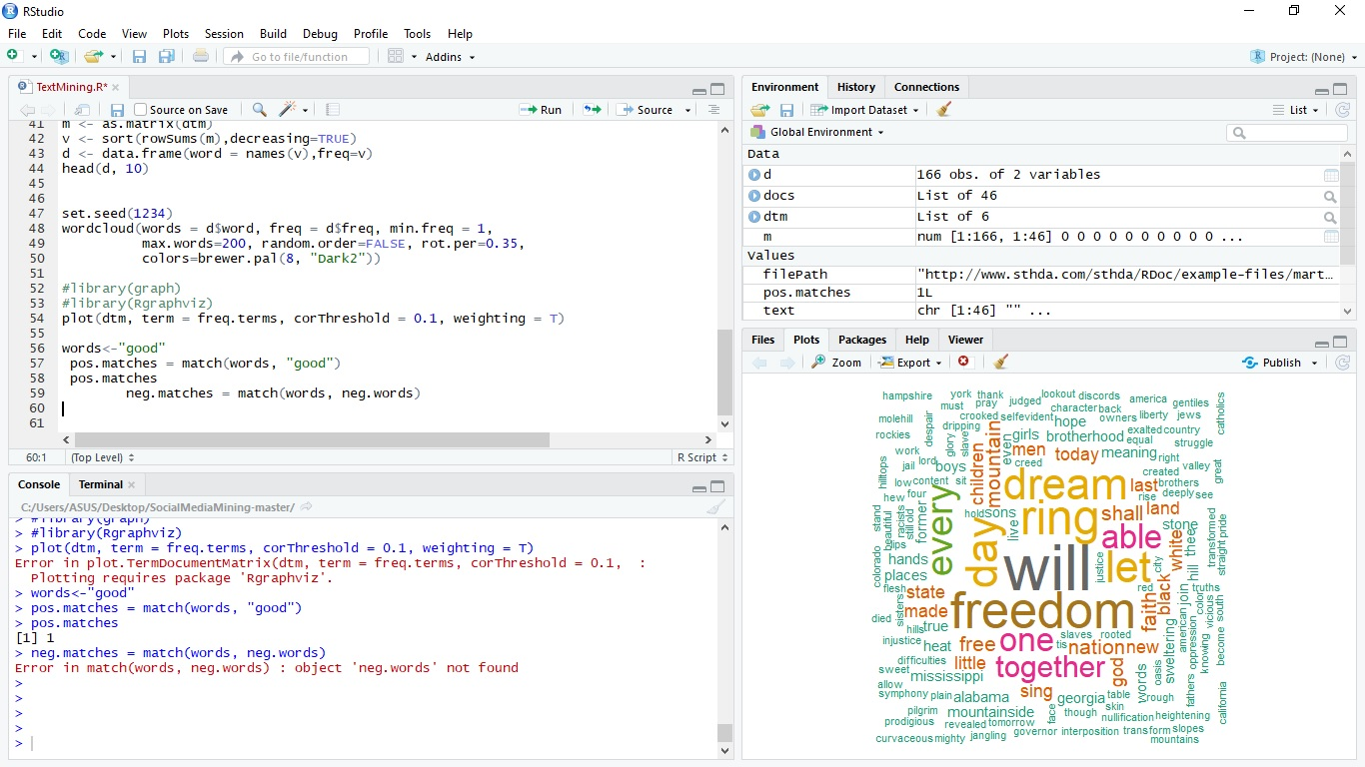
The Problem

Slide 8
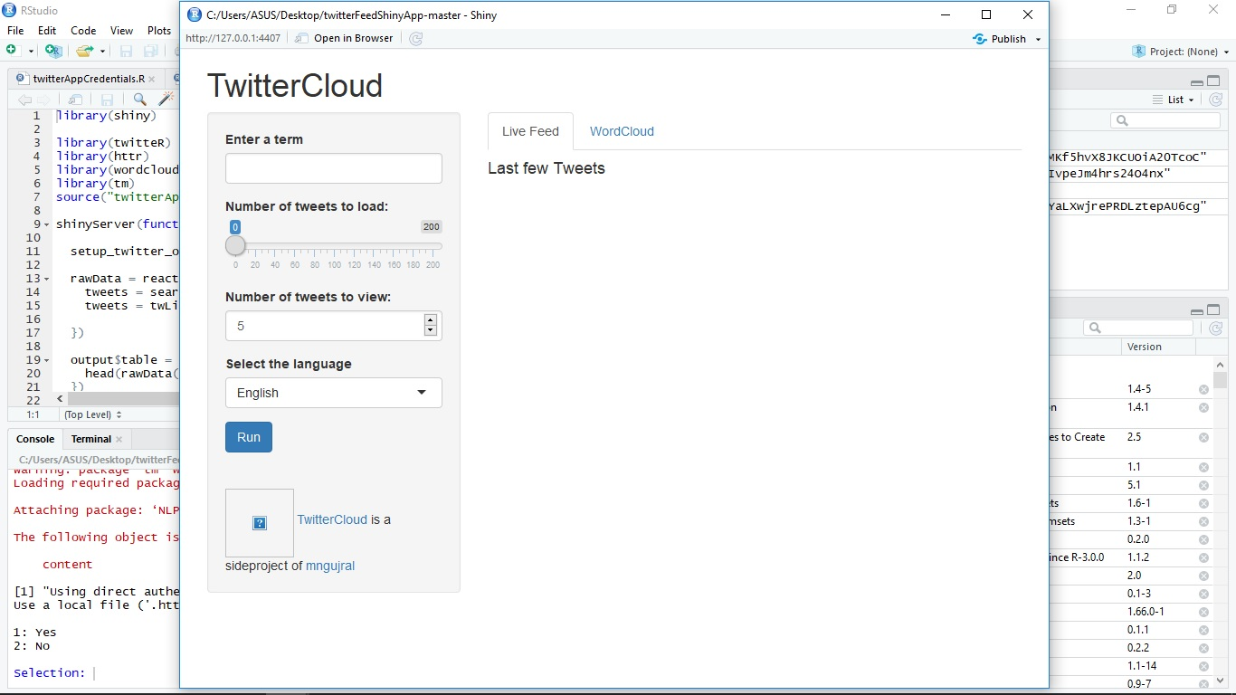
The Problem

Slide 9
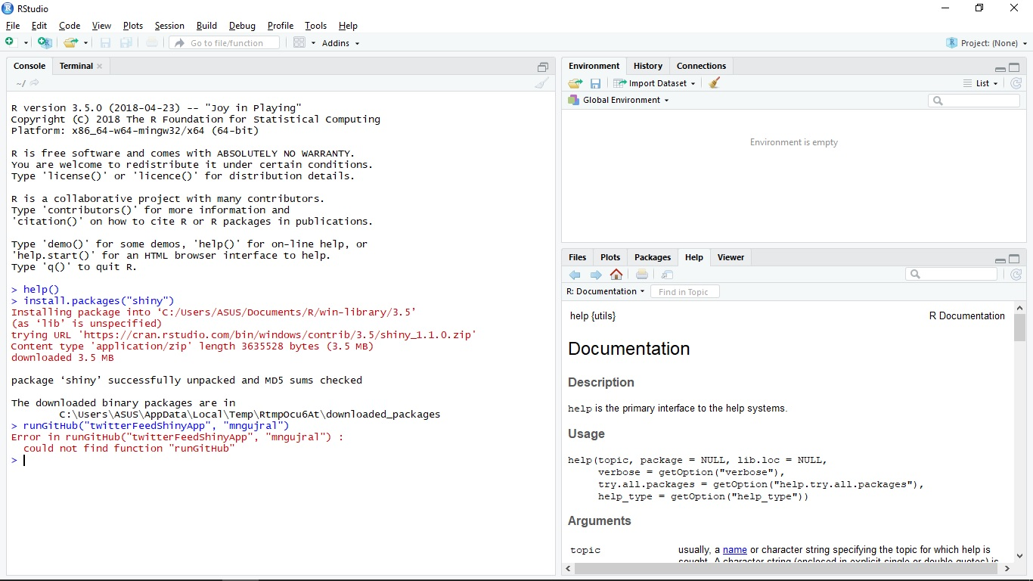
Error
Notes:
We want to export the GitHub repositories to our RStudio, but cannot; so we just download the GitHub repositories manually

Slide 10
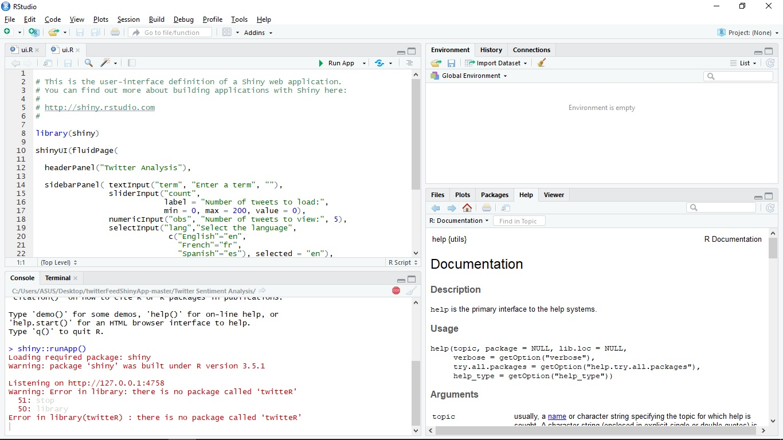
Error
Notes:
For this error, we already install shiny, but the app didn’t run

Slide 11
Process
Install R
Install RStudio
Run RStudio
Install the packages/library
Run the code

Slide 12
Process
library(twitteR)
library(ROAuth)
library(RCurl)
library(httr)
library(magrittr)
library(igraph)
Notes:
Twitter API
Interface
Generate HTTP
HTTP Tools (GET, POST, etc)
Forward pipe operator >
Create graph

Slide 13
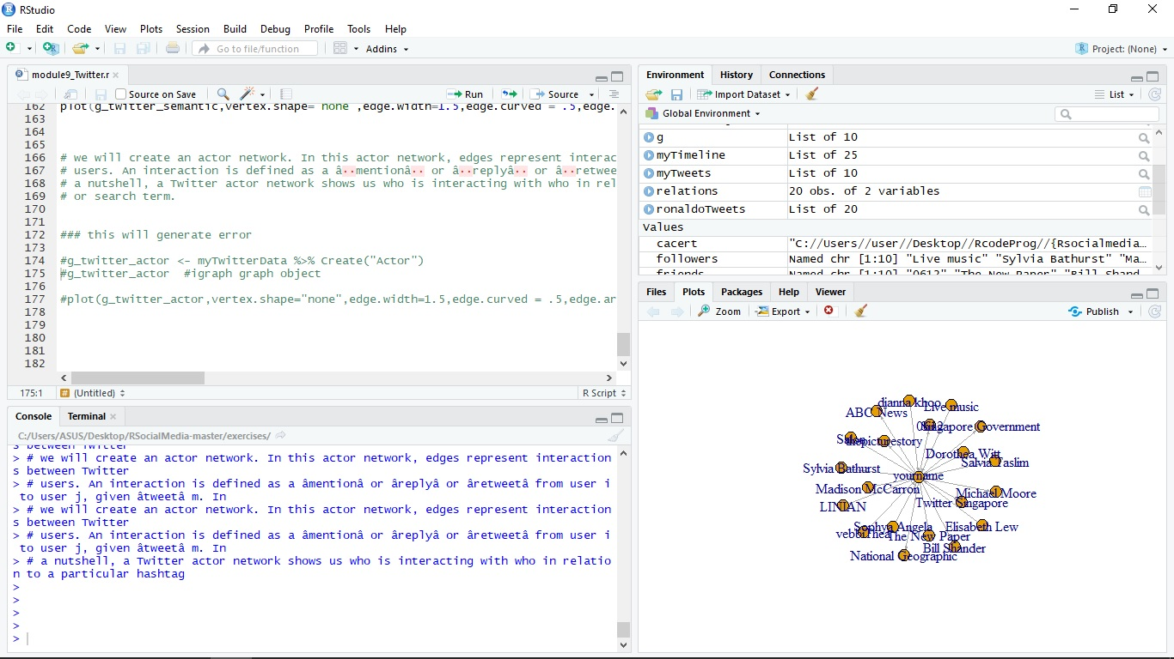
Output
Notes:
More can be explained in the documentation

Slide 14


