Slide 1
PANOPTES
Biometric Entrance Monitoring — Working Prototype
“The many-eyed giant of Greek myth, always watching.”
Iris-based access control • Live entry/exit logging • Anomaly detection

Slide 2
THE PROBLEM
Badge-based security fails the moment a badge changes hands
1
Fraud & fake IDs
Traditional badge/ID systems are easy to copy, borrow, or forge — the check is on the card, not the person.
WHAT PROMPTED THIS PROJECT
During an internship, outsiders bypassed the building's ID-badge checkpoints — despite multiple security personnel on site — and gained access to a restricted building, where they attempted to set a fire.
2
Insider risk
A staff member can hand their badge to someone who was never authorized to be inside.
3
No accountability trail
The fire was caught and stopped before anyone was hurt — but it exposed exactly how little a badge check actually verifies.
Once someone's past the door, most systems can't tell you who's actually inside right now.
PANOPTES — PROTOTYPE
2

Slide 3
THE SOLUTION
Authenticate the person, not the badge they're carrying
1
Iris-based authentication at every gate
You can copy a badge. You can't hand someone your eyes — each gate scans and verifies identity directly, in seconds.
2
Continuous entry/exit logging
Every scan is logged with a timestamp, gate, and confidence score — a live record of who's inside, not a guess.
3
Pattern-based anomaly detection
Rapid re-entries, low-confidence matches, and irregular movement automatically raise an alert for review.
Panoptes — named for the hundred-eyed giant of Greek myth. Built to always be watching.
PANOPTES — PROTOTYPE
3

Slide 4
SYSTEM ARCHITECTURE
Three parts, one clean contract between them
1
2
3
Frontend
Backend API
Iris Pipeline
HTML / CSS / JS
Flask + TinyDB
Python + OpenCV
Live dashboard, polls every 1.5s
Gates A–F, live access log
Anomaly alert feed
REST endpoints for gates/state/logs
Rule-based anomaly detection
NoSQL document storage
Segmentation → normalization
Gabor encoding → matching
Tested on real iris images
Gate configuration (A–F, entrance / exit / both) lives once in the backend — the frontend fetches it, rather than duplicating the layout.
PANOPTES — PROTOTYPE
4

Slide 5
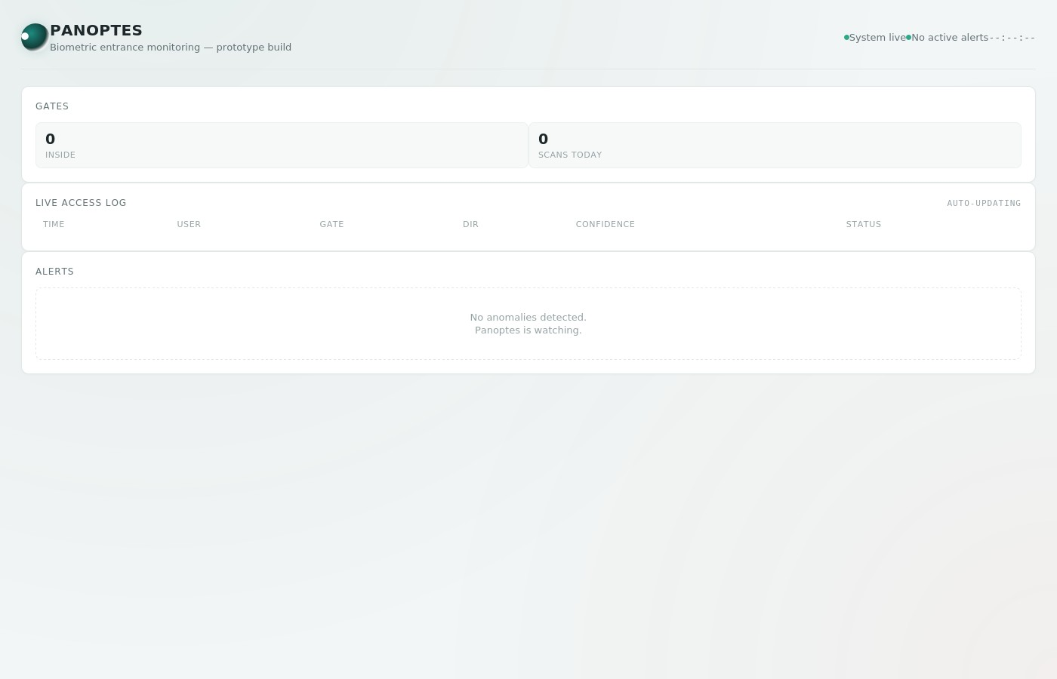
LIVE DASHBOARD
What the security desk actually sees
Gate status
Six lettered gates (A–F), each entrance / exit / both — live-pulses on every scan.
Access log
Timestamped entries: user, gate, direction, confidence, verified/flagged.
Alerts panel
Rapid re-entry and low-confidence matches surface automatically.
Live stats
Real-time count of who's inside and total scans, updated every 1.5s.
PANOPTES — PROTOTYPE
5

Slide 6
BIOMETRIC MATCHING
How a scan becomes a match, in four steps
1
2
3
4
Segment
Normalize
Encode
Match
Locate the pupil and iris boundary via Hough circle detection.
Unwrap the iris ring into a fixed grid (Daugman's rubber-sheet model).
Gabor filter bank + contrast normalization → a binary iris code.
Hamming distance vs. enrolled templates, tolerant to head tilt.
Built and tested against 56 real iris images (CASIA-IrisV1, 8 subjects) — not just assumed to work.
PANOPTES — PROTOTYPE
6

Slide 7
RESULTS
Real accuracy, honestly measured
58.3%
12.5%
4.7x
Top-1 identification accuracy
across 8 enrolled subjects
Random-chance baseline
(1 in 8 enrolled subjects)
better than chance — real biometric
signal, not a coin flip
Genuine vs. impostor match distance (lower = more similar)
READ HONESTLY
The two distributions overlap a lot. This is a simplified single-scale encoder with no eyelid/eyelash masking — real signal, not production-grade precision. Documented in full in the README.
PANOPTES — PROTOTYPE
7

Slide 8
KNOWN LIMITATIONS
What this prototype deliberately doesn't do yet
1
No liveness detection
2
No occlusion masking
A photo or prosthetic could fool the matcher — out of scope for a demo prototype.
Eyelids and eyelashes aren't masked out, which caps matching accuracy.
3
Live demo uses simulated matching
4
Not deployed
The polling dashboard shows a random-match mock — the real pipeline runs standalone until a camera exists to feed it.
Built and evaluated for demonstration, per the original project scope — not a production access-control system.
PANOPTES — PROTOTYPE
8

Slide 9
WHAT'S NEXT
Working today vs. what's next
WORKING TODAY
NEXT UP
Live frontend dashboard, polling a real backend
Wire the real iris pipeline into the live API
Flask API + TinyDB, tested end-to-end
Migrate the frontend to a JS framework
Rule-based anomaly detection
AutoCAD entrance/camera placement simulation
Real OpenCV iris pipeline, evaluated on real images
Version controlled on GitHub
Occlusion masking + multi-scale encoding
Scale storage to MongoDB if needed
PANOPTES — PROTOTYPE
9

Slide 10
Always watching. Always accountable.
Panoptes — a working biometric security prototype
Questions welcome.

