Slide 1
RECRUITNEST
A hiring and recruitment platform

Slide 2
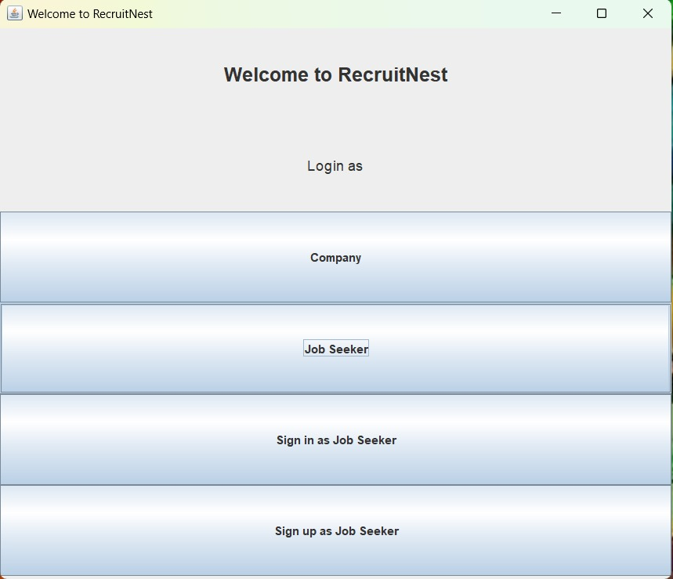
Login Page
In the login page, the
user can either login
as a company or a
Job seeker.

Slide 3
JOB SEEKER

Slide 4
Login Page
The job seeker will login into the
webpage using his login ID and password
The job seeker ID will be unique for every
job seeker
Once he/she is logged in, the job seeker
will be lead to the dashboard

Slide 5
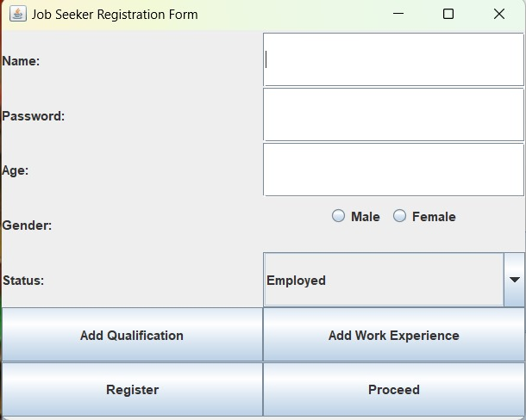
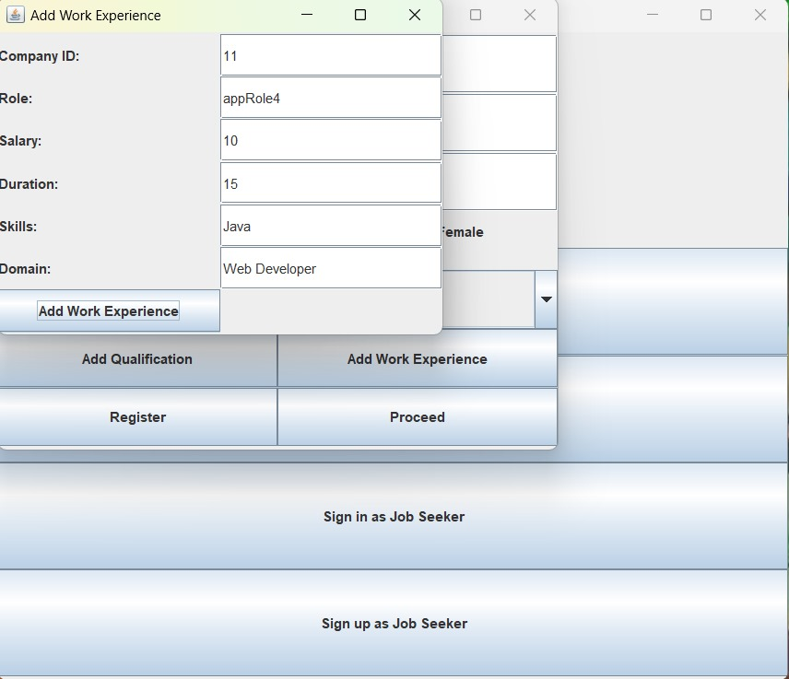
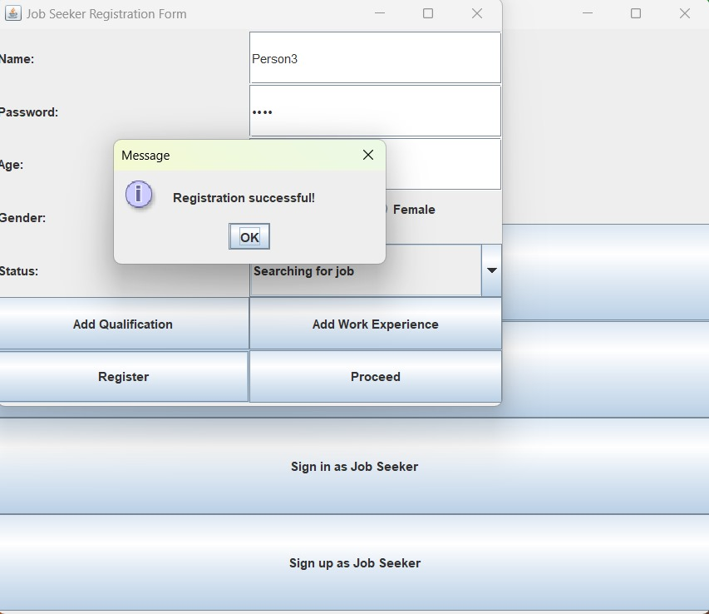
Registering a new user
In this page a new job seeker can add his details. Or else he can proceed to the dashboard.

Slide 6
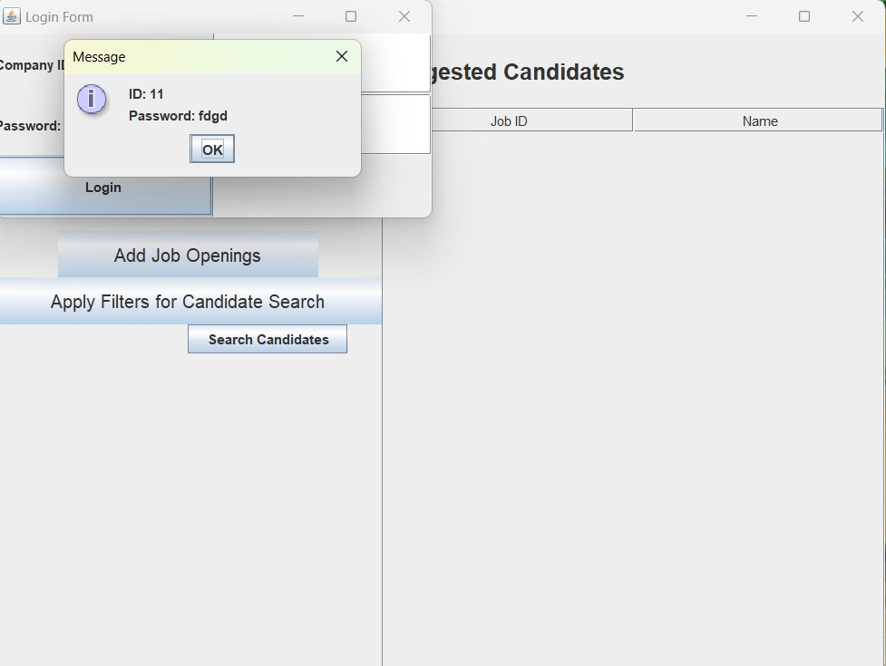
Dashboard Page
Once the user is logged in, the dashboard page
appears which consists of the following:
The user profile including the user info
and his current status
The button leading to trends and analytics of
the companies and industry
Suggested jobs which are tailored to the
specific skills of the job seeker

Slide 7
Dashboard-User info
The dashboard begins with the user info which
consists of the job seeker’s name, age, gender
and his current status.

Slide 8
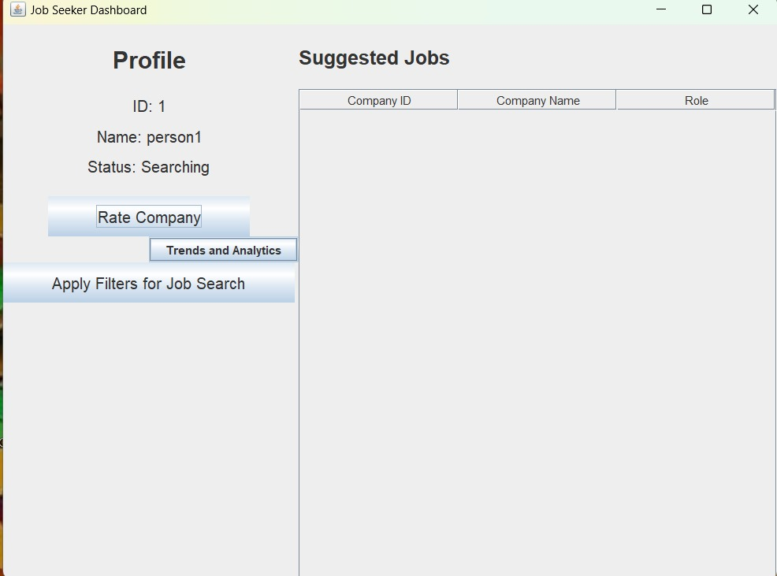
Dashboard-Job Suggestions
The job seeker is provided with specific suggestions
which are specific to the job seeker based on his
particular skills.
The job seeker can filter the companies based on
the jobs’ location and salary.

Slide 9
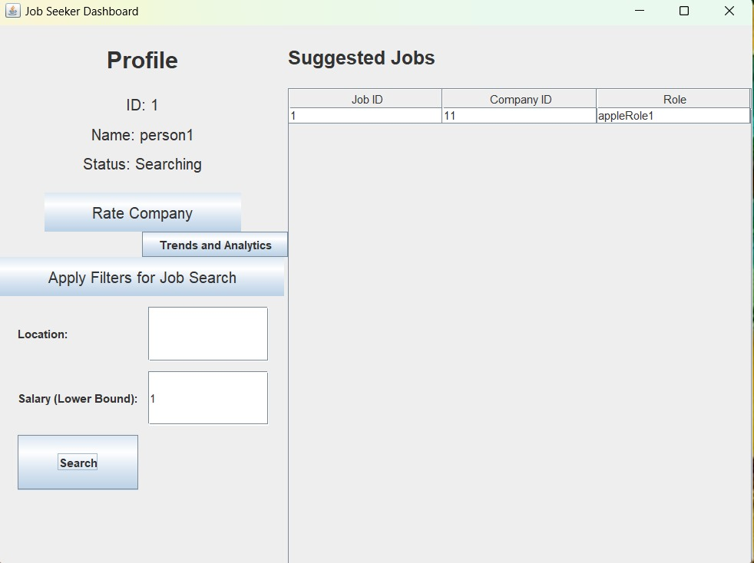
Dashboard-Job Suggestions
The job seeker can filter the suggestions based
on the company's location or salary.

Slide 10
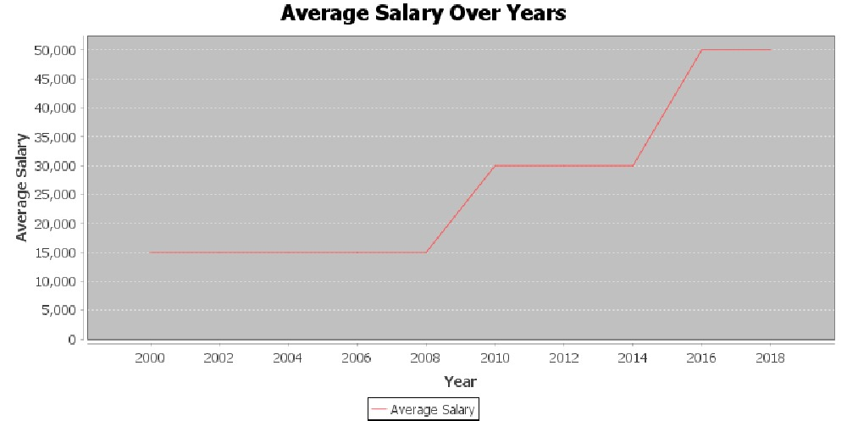
Trends and Analytics Page
The trends and analytics consists of the
trends of specific companies and the
trends in the industry.
Trends in industry: It shows the number
of employees for different roles which
lets the job seeker know which job roles
are considered more popular and how
much does each of those roles pay
on average

Slide 11
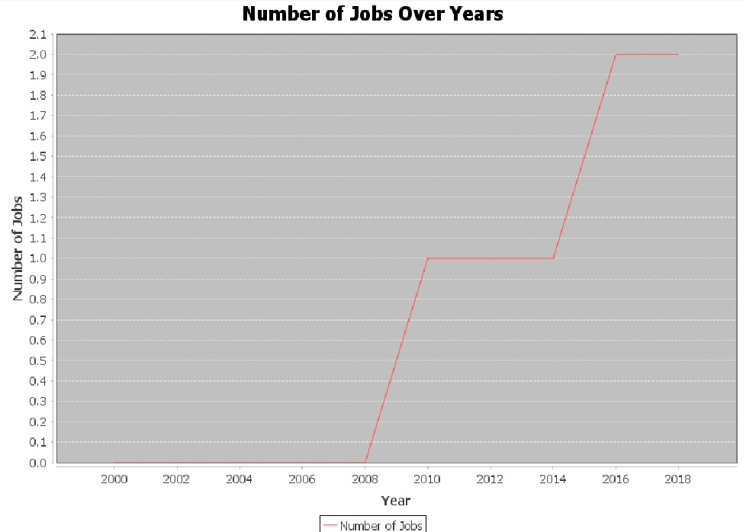
Trends and Analytics Page
Trends in company: It shows which companies
are hiring how many employees and the average salaries in
different companies

Slide 12
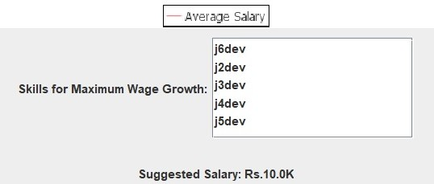
Suggested skills and expected incomes
Based on candidate profile suggest what additional or correlated skills a job seeker can learn based upon past candidate hirings to get the highest salary growth
The platform with analyze you with similarly skilled and experienced people to know what should be the ideal salary that you deserve

Slide 13
COMPANY

Slide 14
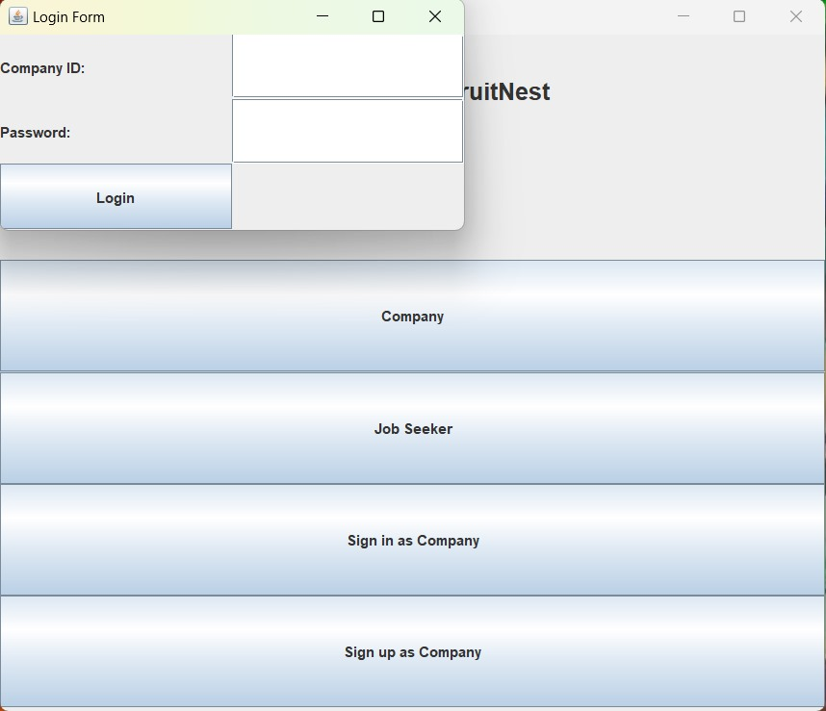
Login Page
The company can log into the webpage
using the company ID and its password
The ID will be uniquely identified for each
Company
Next the company will be lead to the
dashboard page

Slide 15
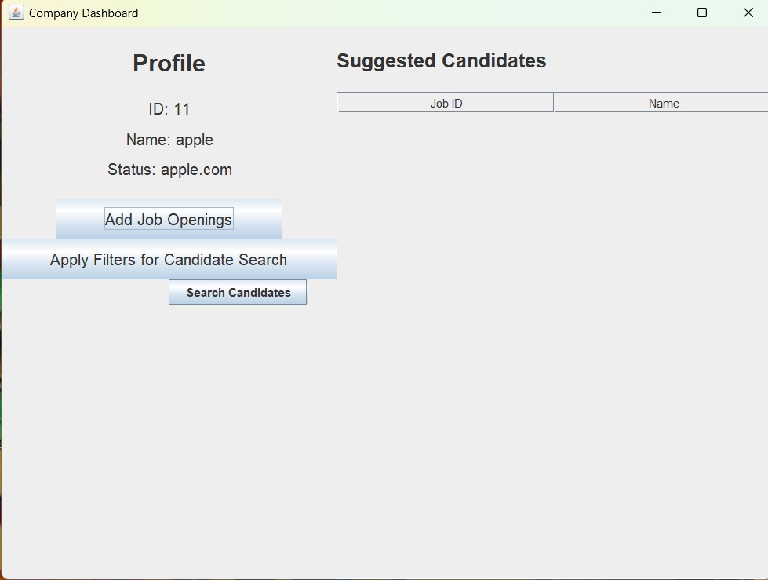
Dashboard Page
Once the user is logged in, the dashboard page
appears which consists of the following:
The company’s profile including the company
info and the jobs that the company has
The button which leads to a page in which the
company can add new job openings
Suggested candidates tailored to the specific
interests of the company based on it’s open job
Positions and their required skill sets.

Slide 16
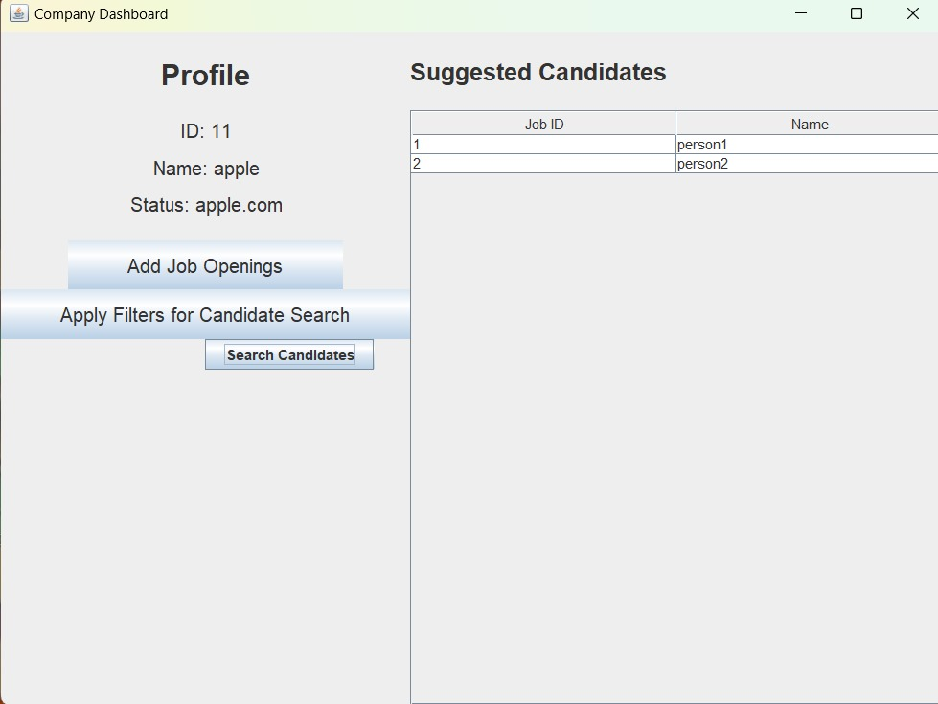
Dashboard-Company Info
The dashboard is initiated with the company’s
info which consists of the company ID,
Company name, sector, rating and its
official website. Followed by its status.

Slide 17
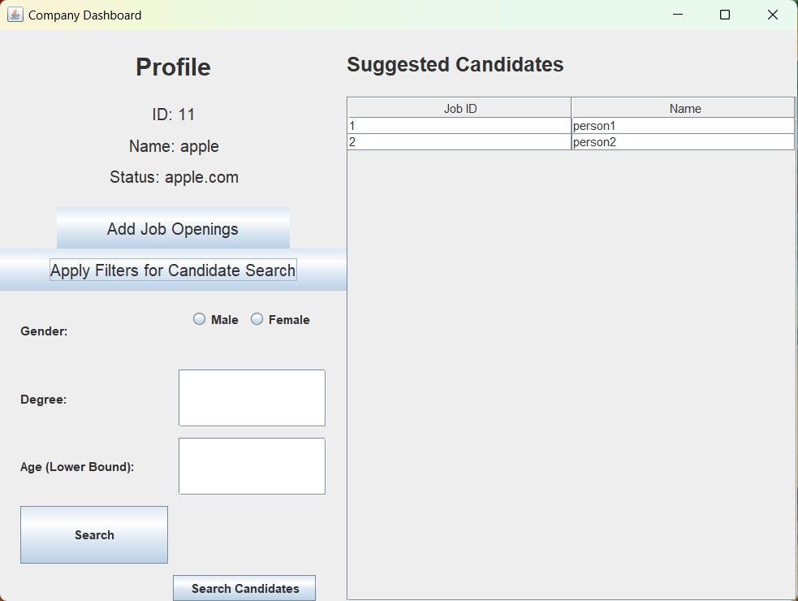
Dashboard-Suggested Candidates
The company is provided with specific suggestions
which are specific to the company based on its
required skills.
The company can filter the job seekers based on
The job seeker’s gender, age and degree.
In the image in the right, there are no filters applied
and the candidates suggested are on basis of
their skill required.

Slide 18
Dashboard-Suggested Candidates
The company can filter the job seekers based on
The job seeker’s gender, age and degree.

Slide 19
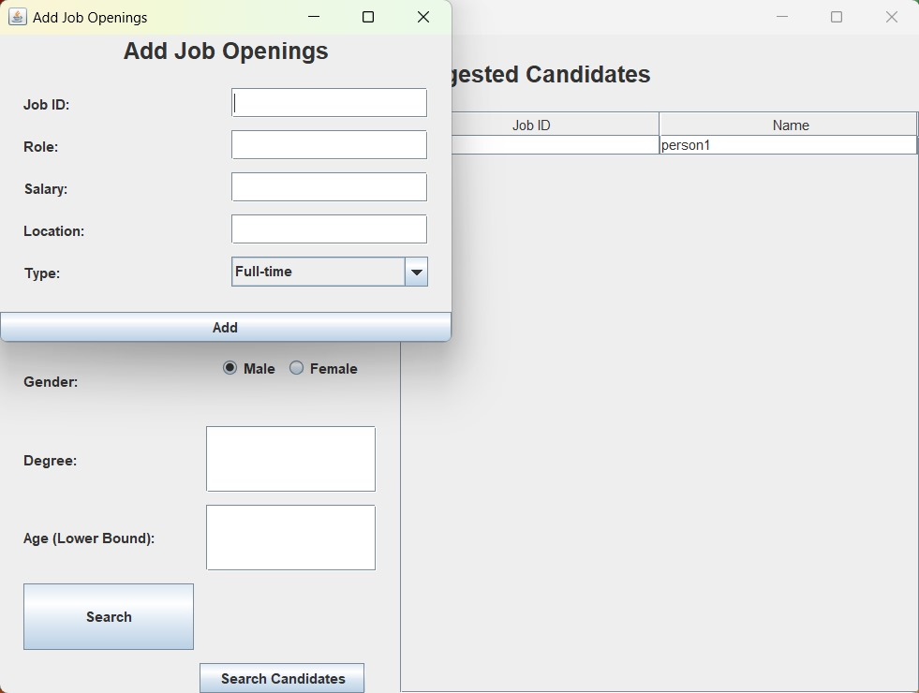
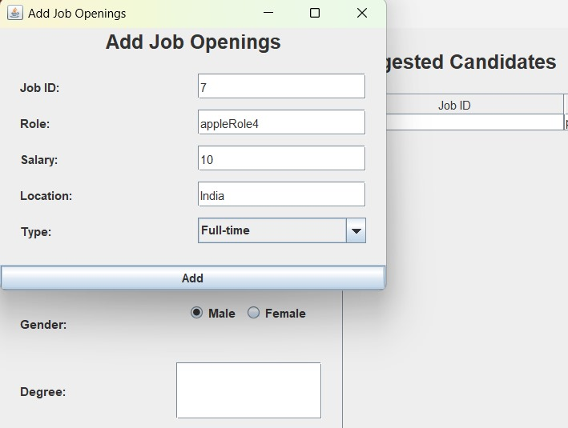
New job openings Page
The company can open new jobs in this page by mentioning the job name, salary, location and type.

Slide 20
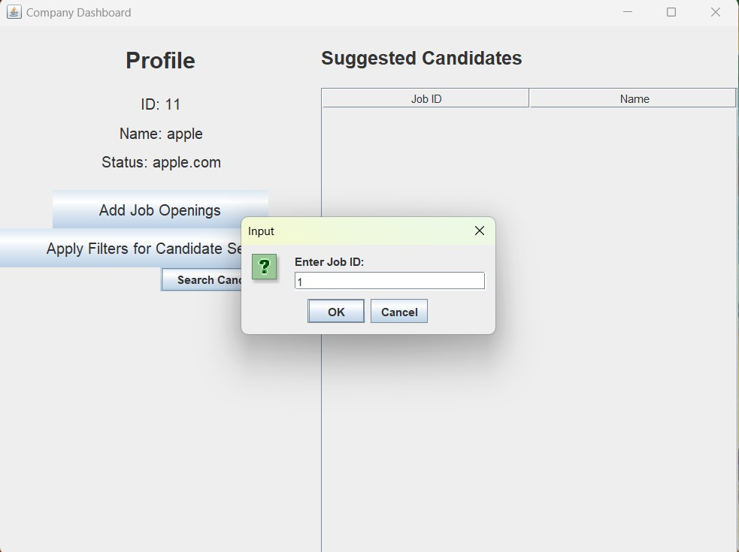
Searching for candidates
A company can also search for a job seeker with his job seeker ID.

