Slide 1
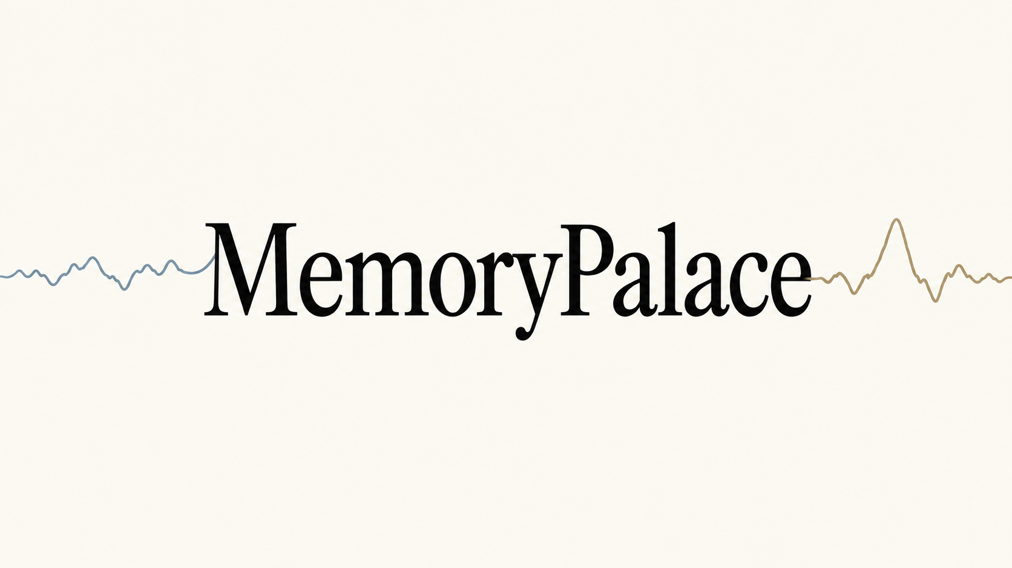
Revisit the moments you almost forgot.
HackMIT 2026
Notes:
Memorypalace. Revisit the moments you almost forgot. A personal memory companion that links changes in EEG activity with recorded context. Begin the 36-second film on the next slide.

Slide 2
Ever walked into a room…
and forgotten what you came to say?
Our objective
Revisit recorded moments, reflect on your day,
and share selected experiences with someone close.
Notes:
Open with an everyday lapse in recall, not a medical claim. This is a relatable motivation, not evidence that an EEG detector identifies forgetting. Transition to the concept film.

Slide 3
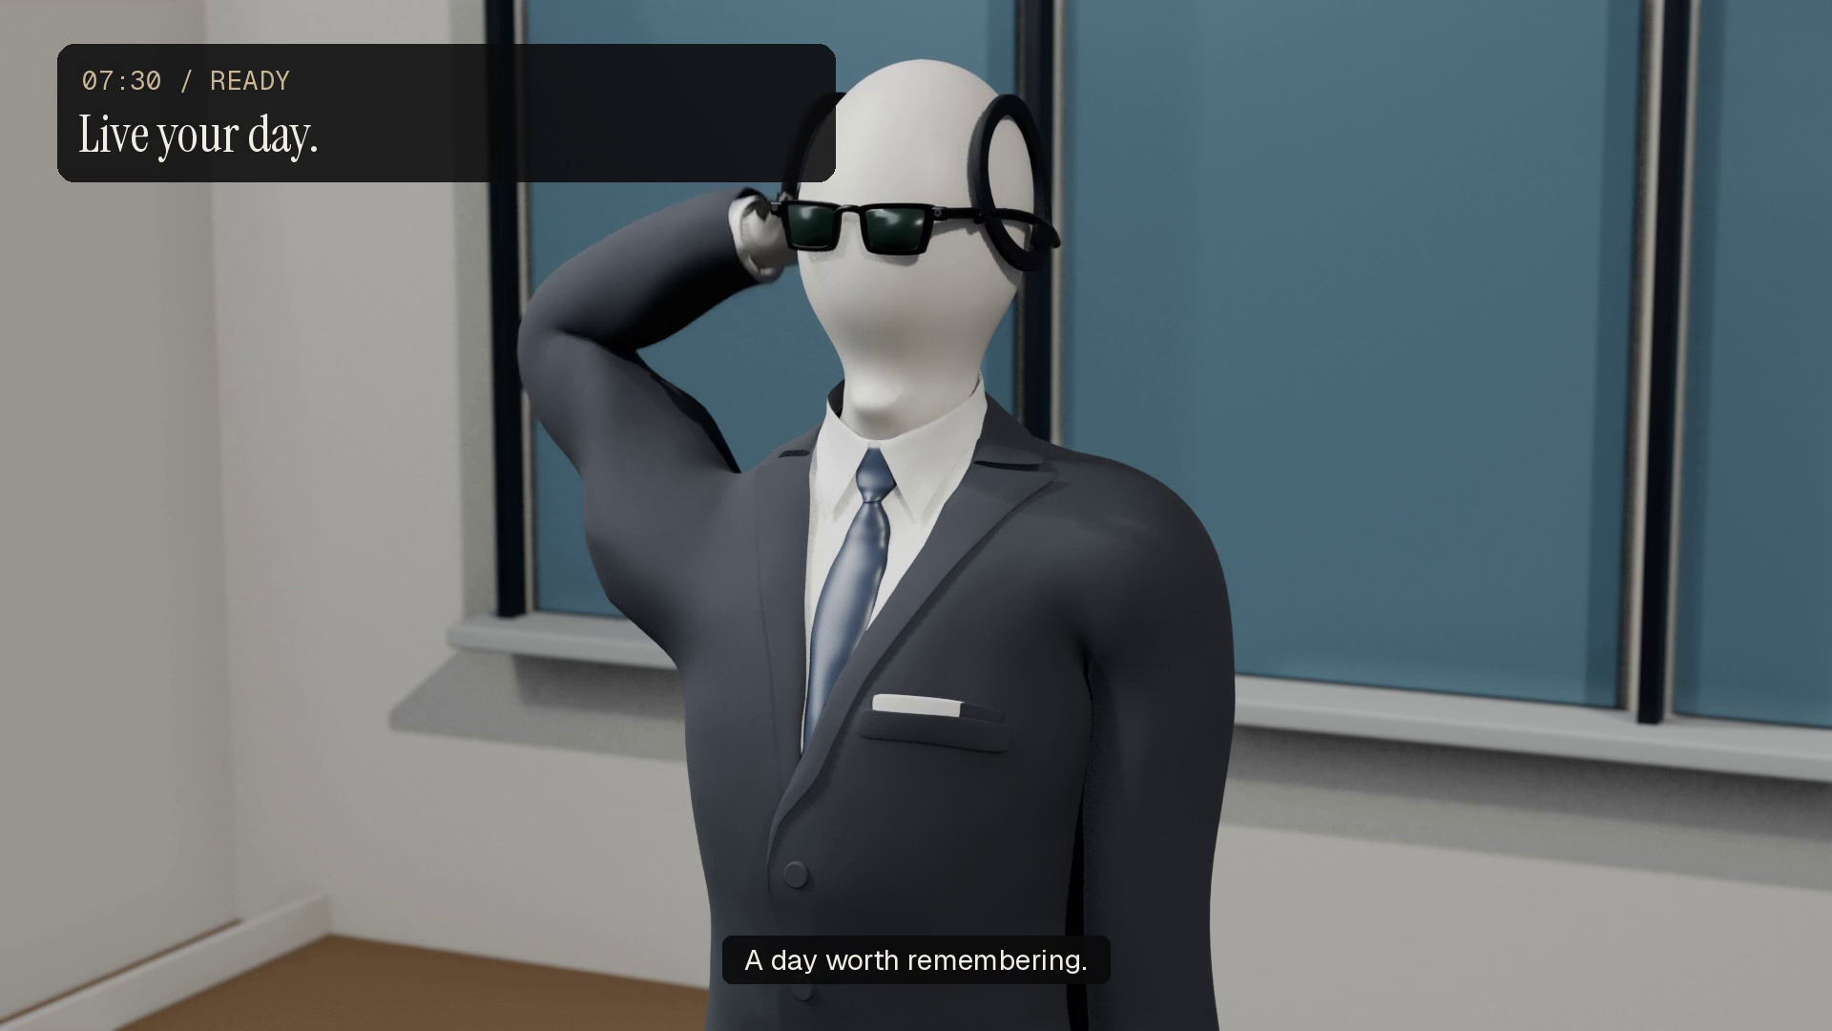
Notes:
Play the embedded 36-second concept film with sound. It illustrates the intended wearable experience, using the approved mannequin and revised desk reaction. The neural strengths shown in the film are illustrative story values. The running prototype uses the phone camera and supports synthetic EEG replay plus a Crown adapter.

Slide 4
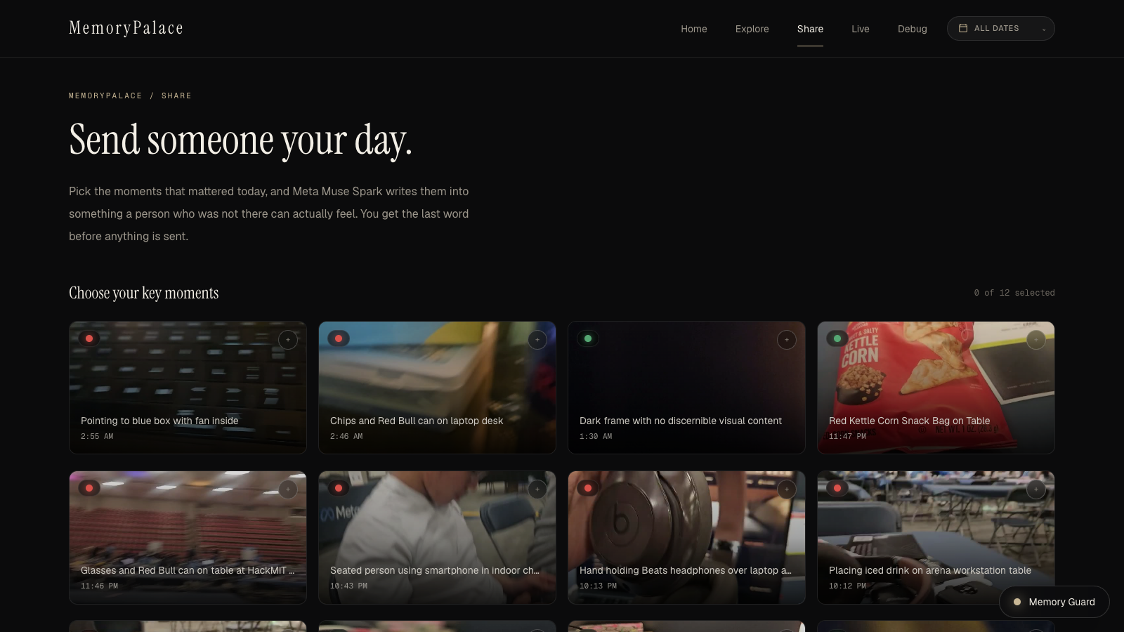
Come back to your day
Revisit what happened. Learn from it. Let someone close understand.
Reflect
What happened?
What do I want to learn?
Share with someone close
Help them understand what
stayed with you.
Deeply personal context. You choose what to share.
Notes:
At the end of the day, revisit selected recordings and their context. Reflection is a user activity, not a clinical assessment. The implemented Share flow drafts a personal note from selected moments; the user chooses the recipient, reviews the draft and shares it. Do not assert end-to-end encryption or a privacy guarantee that is not implemented. Source: app/components/share/SharePage.tsx.

Slide 5
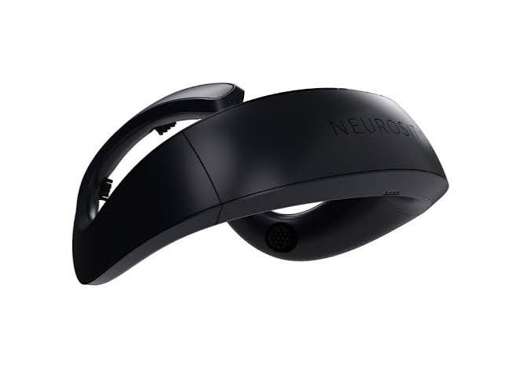
A personal memory companion
EEG identifies a change. Recorded context makes it useful.
Sense
EEG compared with your personal baseline
Capture context
Ray-Ban Meta glasses: the wearable camera concept
Revisit
Search, reflect, and share in Memorypalace
Neurosity Crown
Notes:
Hardware concept: Neurosity Crown for sensing EEG and Ray-Ban Meta glasses for first-person context, supported by the Memorypalace app. Crown is an EEG sensor, not a neurostimulation device; Ray-Ban Meta glasses are not Meta Quest. The current working recorder is an Android phone camera, with a Crown stream adapter. Twenty minutes is the requested onboarding target, not a measured result; code baseline currently uses 120 seconds. Sources: hardware-demo/eegdemo/pipeline.py; hardware-demo/README.md; https://neurosity.co/crown ; https://wearables.developer.meta.com/docs/develop/dat/build-integration-android/

Slide 6
Two checks before a moment is flagged
A change from your baseline, followed by a sustained elevation.
01
Change from your normal
Compare theta/alpha activity with your own resting baseline.
02
Sustained burst confirmation
Keep the event only after four fresh windows stay elevated.
Notes:
Current implementation: clean frontal EEG, theta (4–8 Hz) over alpha (8–13 Hz) band power, four-second non-overlapping windows, per-wearer z-score, threshold 2.0, four consecutive elevated windows. It measures a sustained load proxy. Phase-shift detection is not present in the inspected implementation; avoid describing this method as phase-shift inference or as a state-of-the-art benchmark. Source: confusion-detector/src/config.py; confusion-detector/src/cognitive_load.py; hardware-demo/eegdemo/pipeline.py.

Slide 7

Start by learning your normal
First-time calibration gives each wearer a personal reference.
20 µV peak-to-peak
40 µV peak-to-peak
70 µV peak-to-peak
Different ranges. A baseline that belongs to you.
Illustrative raw EEG • peak-to-peak = highest minus lowest • trigger uses normalized theta/alpha activity
Notes:
The three raw EEG traces and 20 / 40 / 70 microvolt ranges are synthetic illustrations, not measured people or diagnostic norms. Peak-to-peak means maximum minus minimum; raw amplitude also depends on recording conditions. The live prototype calibrates theta/alpha mean and spread over 120 seconds, then uses a z-score. It does not trigger from raw peak-to-peak amplitude. Person icon: Lucide user-round, https://github.com/lucide-icons/lucide/blob/main/icons/user-round.svg (ISC).

Slide 8
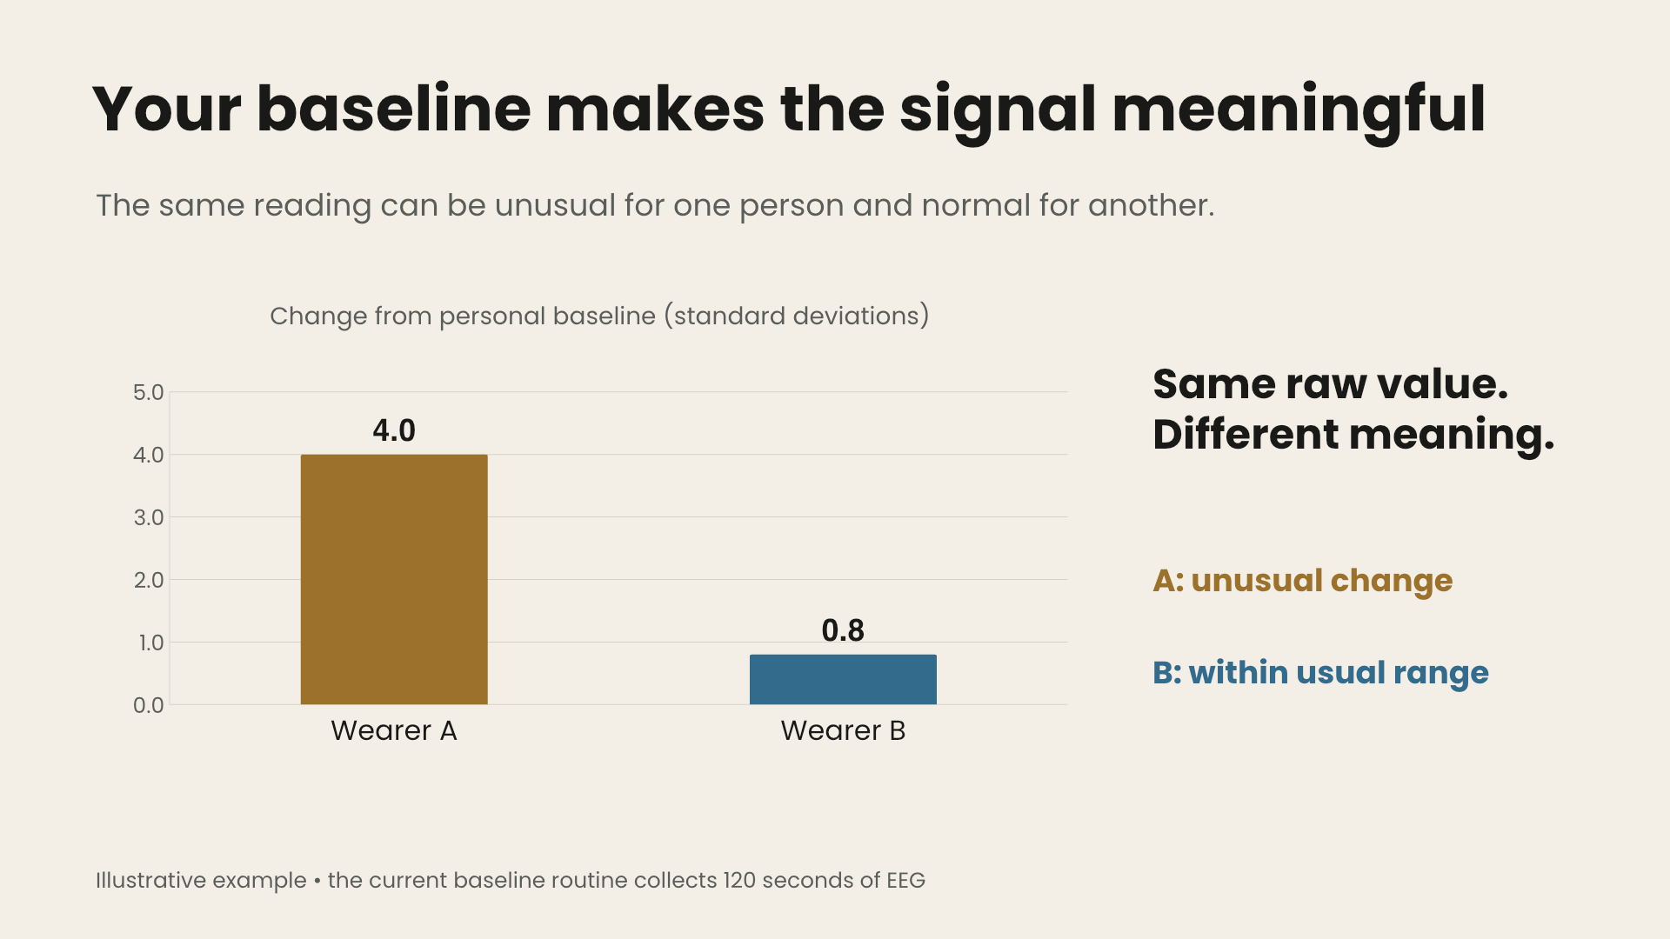
Your baseline makes the signal meaningful
The same reading can be unusual for one person and normal for another.
Same raw value.
Different meaning.
A: unusual change
B: within usual range
Illustrative example • the current baseline routine collects 120 seconds of EEG
Notes:
Illustrative arithmetic: raw theta/alpha index 3.0; A mean 1.0 and standard deviation 0.5 gives z=4.0; B mean 2.6 and standard deviation 0.5 gives z=0.8. These are explanatory values, not measured people or clinical thresholds. The implemented trigger threshold is z=2.0. Source: confusion-detector/src/detector.py and config.py. The chart remains editable beneath its animated video overlay.

Slide 9
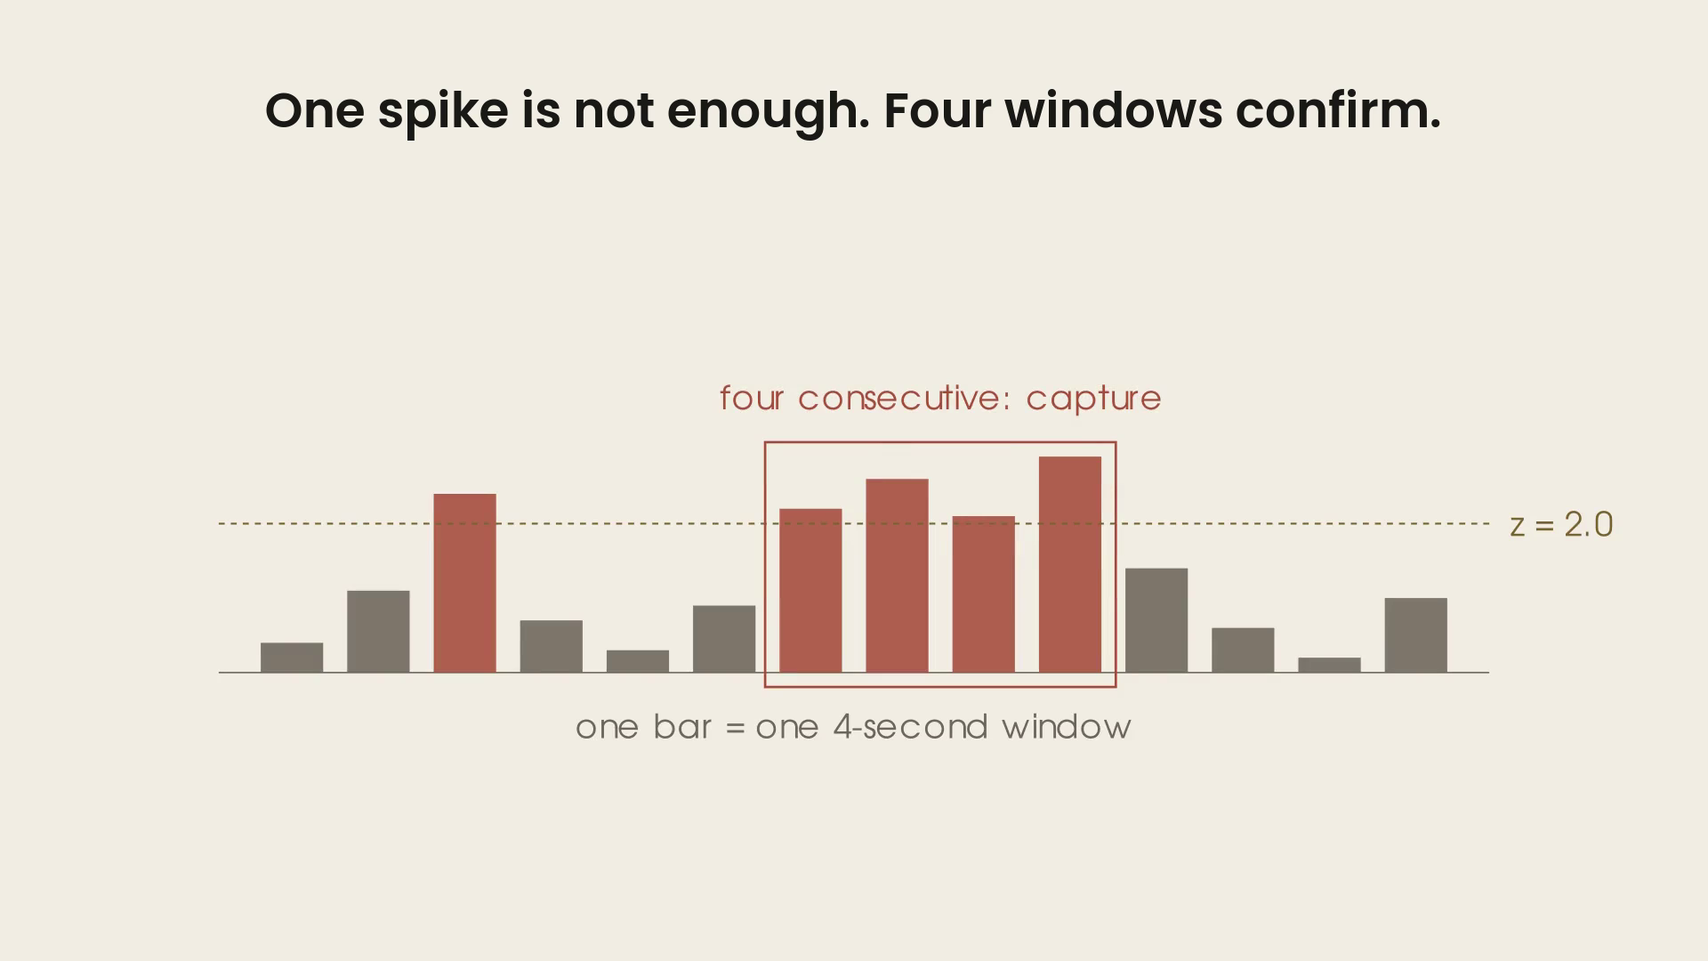
Four fresh windows confirm one event
Each window uses new EEG samples. A dip below the threshold resets the count.
0–4 s
4–8 s
8–12 s
12–16 s
Elevated
Elevated
Elevated
Elevated
4 / 4 confirmed
Flag the moment
Current detector: 4-second non-overlapping windows • illustrative signal sequence
Notes:
Four consecutive windows above z=2.0 are required. No overlap means samples are not reused; it does not prove statistical independence of brain activity. The active backend finalizes an ongoing recording on this trigger, attaches the signal context, and saves it. The concept film illustrates the broader event-capture vision. Sources: confusion-detector/src/config.py; hardware-demo/eegdemo/server.py Runtime.trigger.

Slide 10
Fresh samples reduced false alarms
Changing the overlap changed the result—even with the same threshold.
Controlled synthetic fixture • same data and threshold • source: confusion-detector/README.md
Notes:
Controlled comparison reported in confusion-detector/README.md, The one result that matters: 4-second windows, 75% overlap (hop 1s) 30.3 false alarms/hour; 50% overlap (hop 2s) 18.9; no overlap (hop 4s) 1.3. Same stationary synthetic fixture and threshold. Do not generalize the absolute rate to people or drifting baselines; the drifting fixture reported 7.2/hour at the default setting. This chart is engineering evidence for avoiding repeated samples, not a clinical performance claim.

Slide 11
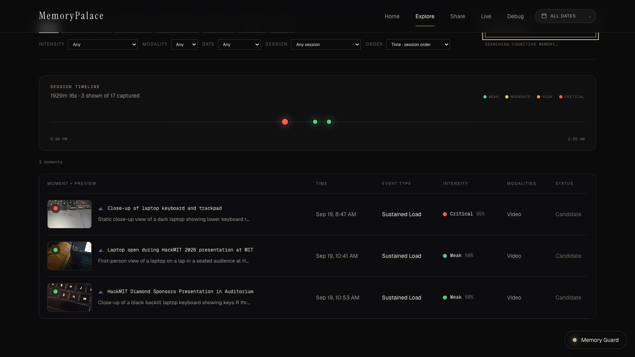
Find the moment again
Search what you remember. Open the original clip.
“laptop keyboard”
Search by a detail
you still remember.
Open live demo →
Notes:
Live demo at http://localhost:3000/explore. Query: laptop keyboard. The screenshot is captured from the running project, not a fabricated interface. Elastic combines keyword and vector retrieval, with timeline and intensity filters. Sources: app/components/explore; hardware-demo/eegdemo/elastic_store.py. Keep the standalone app running when using the demo link.

Slide 12

Elastic for memory search
Sponsor challenge: turn messy data into insights, answers or actions.
Recorded moment
Jina v5 Omni
Hybrid search
Video + time + EEG context
A shared space for clips
and search questions
Keywords + meaning
BM25 + kNN → RRF
A question becomes a replayable memory.
Implemented with Elastic Cloud Serverless and Elastic Inference Service
Notes:
Challenge source: DOCS_sponsor/elastic. Implementation: Elastic Cloud Serverless, Jina v5 Omni via Elastic Inference, semantic metadata, BM25 + dense kNN with RRF, date and EEG-intensity filters. The persisted video is linked from the retrieved moment. Sources: hardware-demo/eegdemo/elastic_store.py; FULFILLMENT_SPONSORS.md. Logo source: https://www.apmdigest.com/sites/default/files/2024-09/logo_elastic.png ; brand owner https://www.elastic.co/ . Official method references: https://www.elastic.co/docs/solutions/search/multimodal-search ; https://www.elastic.co/docs/reference/elasticsearch/rest-apis/reciprocal-rank-fusion .

Slide 13

Meta connects your moments
Understand a moment, ask about it, then share what matters.
Describe the moment
Muse Spark
Turns a recorded clip into a searchable description.
Talk to Memory Guard
Muse Voice Transcribe + Muse Spark
Transcribes your question, then reasons over retrieved moments.
Share with someone close
Muse Spark
Drafts a personal note from moments you select and review.
Personal context becomes a way to connect.
Notes:
Sponsor prompt: Bringing People Closer Together with AI. Muse Spark (muse-spark-1.3) is used in vision.py for recorded-video descriptions and in agent.py for Memory Guard reasoning/tool use and share_note generation. Muse Voice Transcribe (muse-voice-transcribe-1.0) transcribes push-to-talk input in voice.py; playback speech uses device speech synthesis. Muse Image and a Muse personal-agent connector are not implemented and are not claimed. Sources: hardware-demo/eegdemo/vision.py; agent.py; voice.py; app/components/share/SharePage.tsx. Sponsor links: https://developer.meta.com/ai/models/muse-spark/ and https://developer.meta.com/ai/models/muse-voice-transcribe/ .

Slide 14

84 numbers and a logistic regression
Voloridge • extracting sustained state changes from public EEG data
The pipeline
More complexity did not win
28 EEG channels, 200 Hz
Riemannian tangent space
1,218 features
Shin et al. 2018 • five people, 15 sessions
26-bin Fourier spectrum
728 features
Regress out eye channels
Zigzag topology
108 features
Fit before task; freeze before scoring
Bayesian state-space
Latent state
Theta / alpha / beta log power
Three more alternatives
Lost or tied
84 features • 2-second windows, every 0.25 s
Logistic regression → moving average
Band power + logistic
Task versus rest • one smoothing parameter
84 features + one smoothing parameter
Paired comparisons against each method’s own baseline • source: eeg-state-detection/README.md
Notes:
Voloridge asked for signal out of public data. Ours is EEG: 28 channels, five people, fifteen sessions from Shin et al. 2018 dataset A. Regress out eye-channel contributions, measure three band powers, logistic regression, one moving average. Alternatives were paired against their own baselines on the same recordings, windows and calibration folds. They lost or tied; these rows are not a cross-participant leaderboard. The one retained addition is a smoothing half-life. Source: presentation/SLIDES-VOLORIDGE.md and eeg-state-detection/README.md. Public-data research, distinct from the running four-window prototype detector.

Slide 15
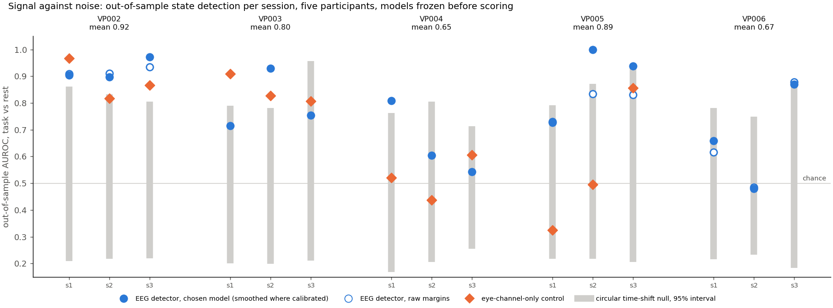
Does the signal survive a harder test?
Voloridge • models frozen before scoring held-out task blocks
Grey: random alignment of the same signal. 8 of 15 sessions beat it at p ≤ 0.05.
Brief-event detector: 3× its baseline, but p = 0.13 against random flags — rejected.
Notes:
Models were frozen and SHA-256 hashed before held-out blocks. Per session: first six blocks calibrate, last three score. The circular time-shift null preserves autocorrelation; shuffled windows would break it. 2,000 shifts per session. Eight of 15 sessions beat that null at nominal p ≤ 0.05 (session-wise, not multiplicity corrected). Orange diamonds are the identical pipeline on eye channels; two participants show substantial ocular contribution. The same null discipline rejected the brief-event zigzag result: 6/36 versus a 2/36 baseline, p=0.13 against random flags. Sources: eeg-state-detection/README.md; outputs/backtest_state/report.json; outputs/burst_diagnostic_dev/report.json. This is offline task/rest detection, not real-world forgetting or emotion accuracy.

Slide 16
System architecture
A signal and its recorded context become one searchable moment.
Meta
Crown EEG
Describe the moment
Signal packets
Python backend
Elastic
Detect • finalize • store
Index + retrieve
Camera client
Video + capture commands
Web app
Search • replay • share
Notes:
Actual wiring: Crown publisher sends EEG to Python backend. Android camera client polls authenticated commands and uploads video to the backend. Backend persists the catalog, calls Meta enrichment and Elastic indexing. Next.js browser accesses backend through server routes. Source: hardware-demo/eegdemo/server.py; pipeline.py; library.py; elastic_store.py; app/lib/backend.ts. The native diagram is editable.

Slide 17
Memorypalace
Your day has more to tell you.
Keep the context. Revisit it when you have time.
Try the live demo →
Notes:
Close: Memorypalace turns a fleeting reaction into a moment you can revisit, understand, and choose to share. Invite the judges to try the running retrieval demo. The film describes the wearable concept; the charts and sponsor slides show the implemented work.

