Slide 1
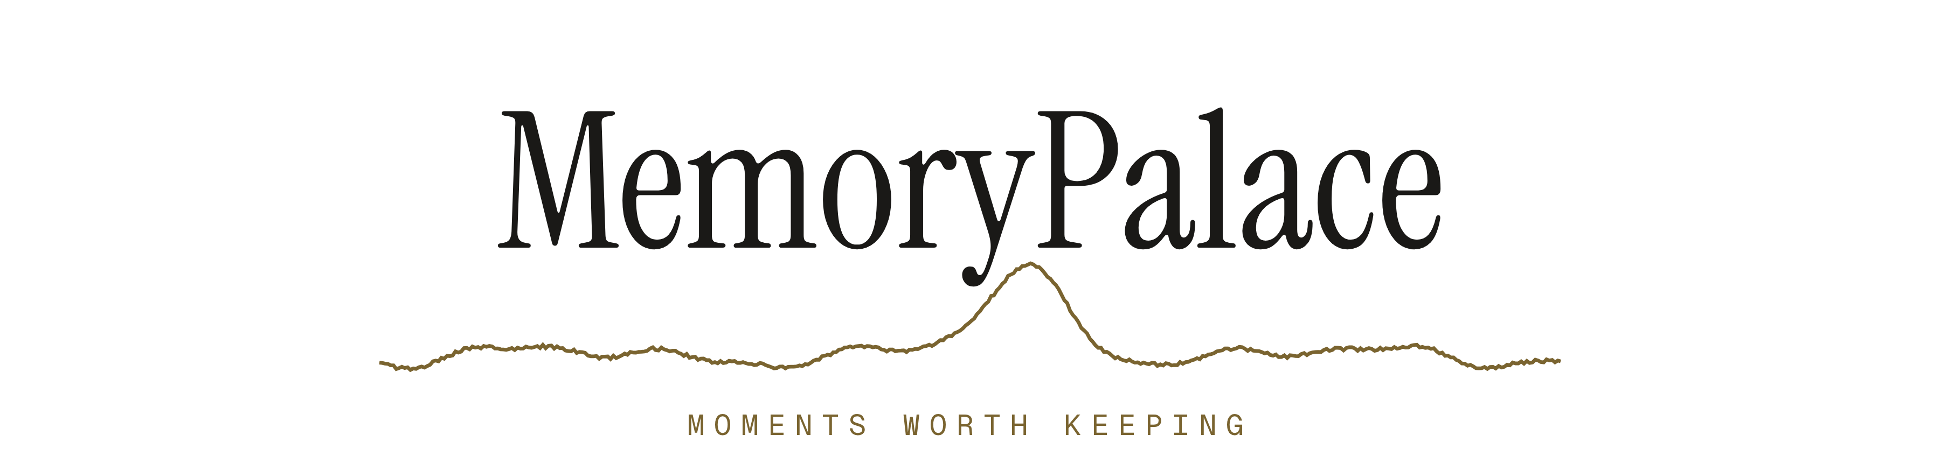
Your brain already flags the moments that mattered.
We wired that flag to a camera.
HACKMIT 2026 HEALTHCARE TRACK
Notes:
Say it in one breath and stop. "Your brain already flags the moments that mattered. Nobody has ever wired that flag to a camera." Do not introduce the team or the stack yet. Go straight to the problem.

Slide 2
THE PROBLEM
You cannot know which ten
seconds will matter.
RECORD IT ALL?
KEEP IT ALL?
WHAT WORKED
30 to 45 min
0 hours
1 still/30 s
Measured battery life of continuous wearable video.
Nobody ever scrubs ten hours of their own footage.
SenseCam helped dementia patients. No video at all.
Capture is solved. Deciding what is worth capturing is the product.
Notes:
Land the number, not the sentiment. 30 to 45 minutes is measured, and it kills every "just record everything" answer a judge will reach for. The SenseCam line is what earns the healthcare track: the wearable camera research that actually helped dementia patients never recorded video at all.

Slide 3
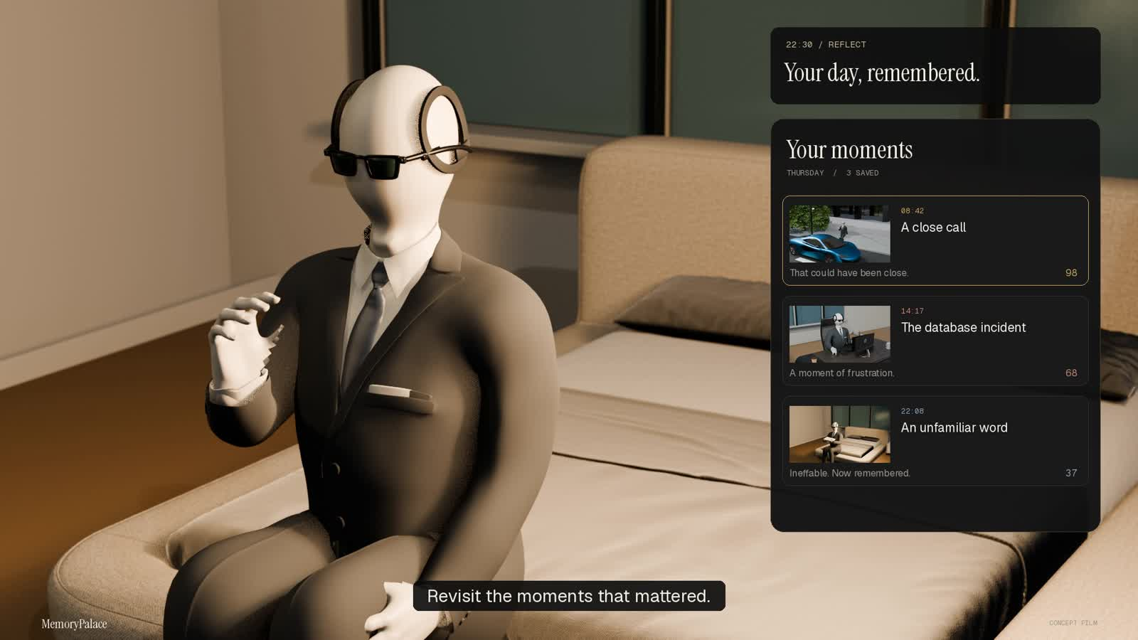
MEMORYPALACE 36 SECONDS PLAY WITH SOUND
Notes:
SAY NOTHING OVER THE FILM. Click once, step back, let it run 36 seconds, and watch the judges rather than the screen. The moment it ends, advance immediately and open with: "Every moment you just saw was chosen by a signal, not by a button."

Slide 4
HOW A MOMENT IS CHOSEN
The camera stays off until
your own baseline breaks.
EEG headset
4 s windows
z vs baseline
Four in a row
2 to 4 electrodes
no overlap, theta / alpha
mu and sigma are yours
persistence filter
Only when the fourth window comes back elevated does the phone wake up.
Notes:
Trace the row with your hand and stop on the highlighted box. "Four consecutive elevated windows." That is the whole trick, and it is what separates this from a noise detector. If anyone asks why four, jump to the trigger slide.

Slide 5
WHAT HAPPENS TO THE CLIP
Committed locally first.
Everything after is enrichment.
Records 10 s
Local catalog
Muse Spark
Elastic
phone opens, saves, closes
atomic write plus backup
grounded title and text
BM25 plus kNN, by RRF
A sponsor service outage degrades search. It can never lose a memory.
Notes:
The load bearing point is order: the clip is committed to a local atomic catalog BEFORE anything touches the network. The camera closes again immediately. Nothing runs continuously except the detector.

Slide 6
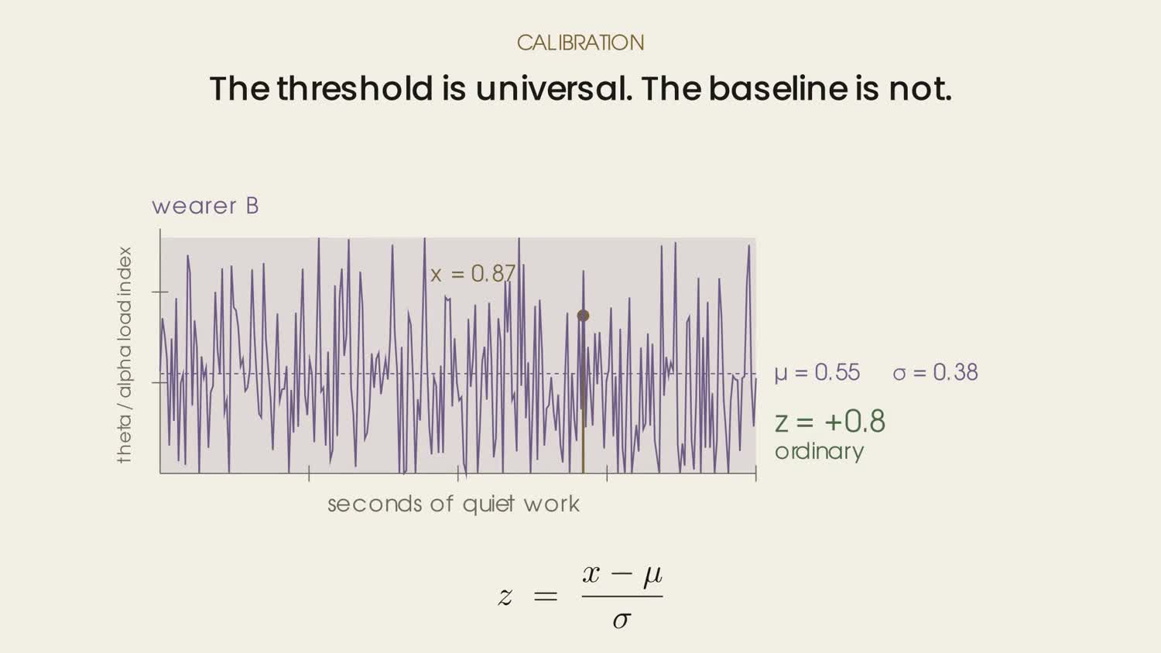
Why the baseline has to be yours
Notes:
Play it, then say the one line that matters: "Same amplitude, opposite conclusion." This is the answer to "why calibrate at all" and to "why can you not ship a pre-trained model".

Slide 7
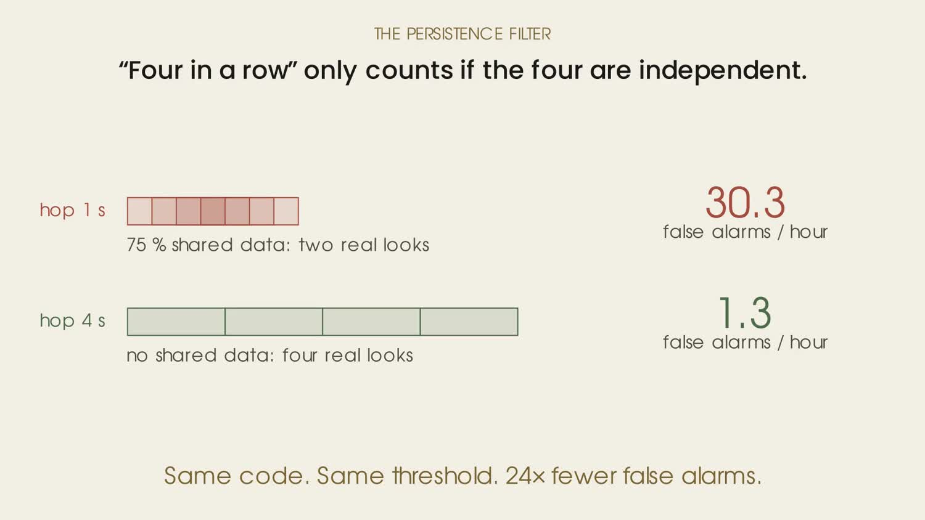
Four in a row, and why they must not overlap
Notes:
This is the slide that wins technical judges. We ported a parameter without porting its assumption, measured it, and it cost an order of magnitude in false alarms. Volunteering your own bug is worth more than any accuracy number.

Slide 8
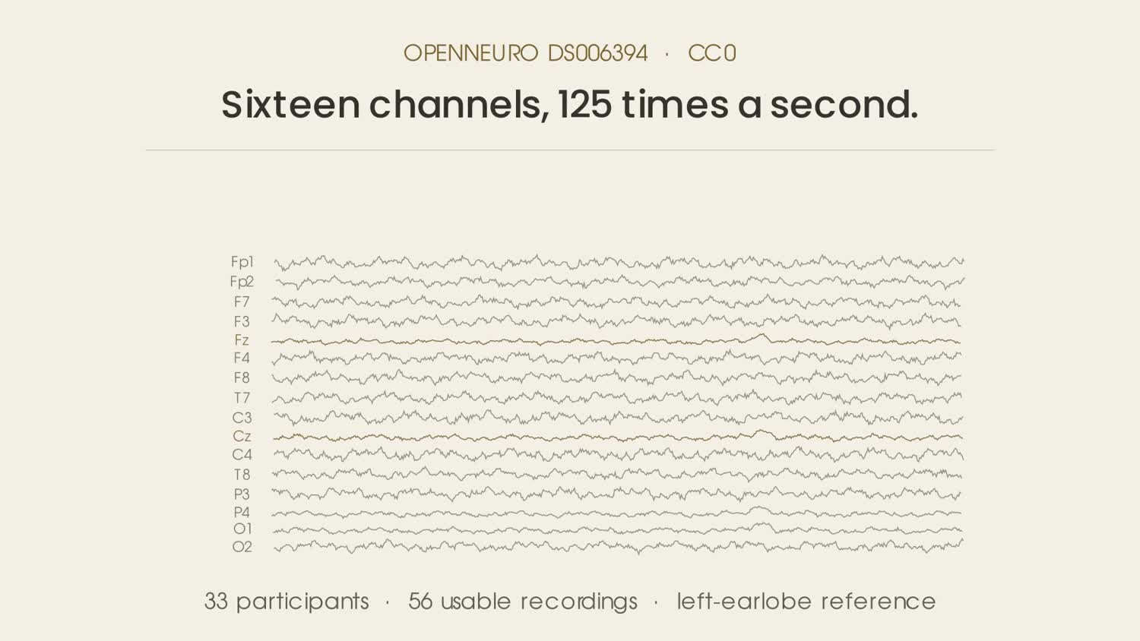
What is frozen before any model is fit
Notes:
Use this when someone asks where the numbers come from, or asks about peak to peak. Peak to peak appears exactly once in this pipeline: a plus or minus 150 microvolt artifact rejection threshold. It throws an epoch away. It is not how the detector fires.

Slide 9
SPONSOR TRACK
Elastic
The retrieval layer: two kinds of remembering, fused.
WHAT WE BUILT
WHAT WE HAVE NOT BUILT
Every moment indexed as one document on Elastic Cloud.
Jina v5 Omni puts clips and queries in one vector space.
BM25 and dense kNN merged by reciprocal rank fusion.
EEG intensity and date bounds applied in both branches.
Workflows and Agent Builder are future work, not done.
No relevance tuning. RRF ranking is out of the box.
Without credentials it falls back to local text search.
Notes:
Read the right hand column out loud. Most teams skip it, which is exactly why doing it works. Do not round anything up: if it is not built, say it is not built.

Slide 10
SPONSOR TRACK
Meta
Understanding and the agent: a clip becomes language.
WHAT WE BUILT
WHAT WE HAVE NOT BUILT
Muse Spark 1.3 writes a grounded title per clip.
Clips over 6 MB use the poster frame, and we log which.
A web grounding pass resolves names, never the clip.
Muse Voice Transcribe turns speech into the query.
No Meta text to speech. Output is the browser voice.
No physical glasses. The phone camera stands in.
No emotion inference. Scene metadata only.
Notes:
Read the right hand column out loud. Most teams skip it, which is exactly why doing it works. Do not round anything up: if it is not built, say it is not built.

Slide 11
SPONSOR TRACK
VoloRidge
Public data, frozen before the test. Failures included.
WHAT WE BUILT
WHAT WE HAVE NOT BUILT
Public CC0 EEG only. Every skipped recording is logged.
Preprocessing and features locked before any model fit.
Leave one out. The held out person picks no threshold.
Three negative controls and an electrode ablation.
No submission framing yet. The evidence exists.
No live human validation. Synthetic EEG throughout.
Our first continuous detector failed. We published it.
Notes:
Read the right hand column out loud. Most teams skip it, which is exactly why doing it works. Do not round anything up: if it is not built, say it is not built.

Slide 12
WHAT WE DO NOT CLAIM
Said first, before anyone asks.
NO HUMAN DETECTION
Every end to end run used synthetic EEG.
NOT A PROBABILITY
A workload proxy, not a likelihood.
NOT A DETECTION
We rank moments. We do not threshold.
NO EMOTION
An EEG spike does not name a feeling.
NO GLASSES
A phone camera stands in, marked as a demo.
Notes:
Do not rush this and do not apologise through it. Delivered flatly it is the most persuasive thirty seconds in the deck, because every judge has already sat through four teams claiming a live EEG demo. Read three of the five.

Slide 13
WHAT IS NEXT
EEG is non stationary.
So the model has to keep learning.
Spatial filters are tied to electrode positions, so weights never transfer between people. Retraining on the wearer is mandatory, which is why per user adaptation is the product and not a setup step. Every moment you confirm or dismiss is a label.
Connect the Crown
Rolling pre spike buffer
MongoDB metadata layer
Learning curve vs data
Notes:
Finish on the last line, then stop talking and let them ask.

Slide 14
APPENDIX WHAT ACTUALLY RUNS
Three processes, and no direct
phone to browser link.
MemoryPalace web
Python backend
Android client
Next.js 16, React 19
laptop, on the LAN
camera off when idle
The phone and the web app never talk to each other. Either half can crash without taking the other down.
EEG stream
synthetic today, Crown not connected
Notes:
Use this when a judge asks what actually runs. The load bearing choice: the phone never talks to the web app. Both are clients of the same LAN backend, so either half can crash without taking the other down, and the backend starts the stop timer only after the phone confirms recording, so leaving the page never leaves a camera running. If they ask to see it: hardware-demo/run.py demo --recorder phone runs the whole thing with no hardware.

Slide 15
APPENDIX DEMO RUN OF SHOW
The order, and what to say when it breaks.
THE ORDER
IF IT BREAKS
Pair the phone.
Open /live, simulate a spike.
Camera records ten seconds.
The moment appears in the gallery.
Search /explore for a phrase.
Click the dot to replay the clip.
Nothing responds: you are on next dev. Use the build.
Gallery empty: honest, nothing is seeded. Capture one.
Elastic down: search falls back to local text, and says so.
No wifi: run the backend in demo mode, no hardware.
Notes:
Rehearse the failure rows out loud. Each has an honest answer that beats fumbling, and two of them are designed behaviour rather than bugs.

