Slide 1
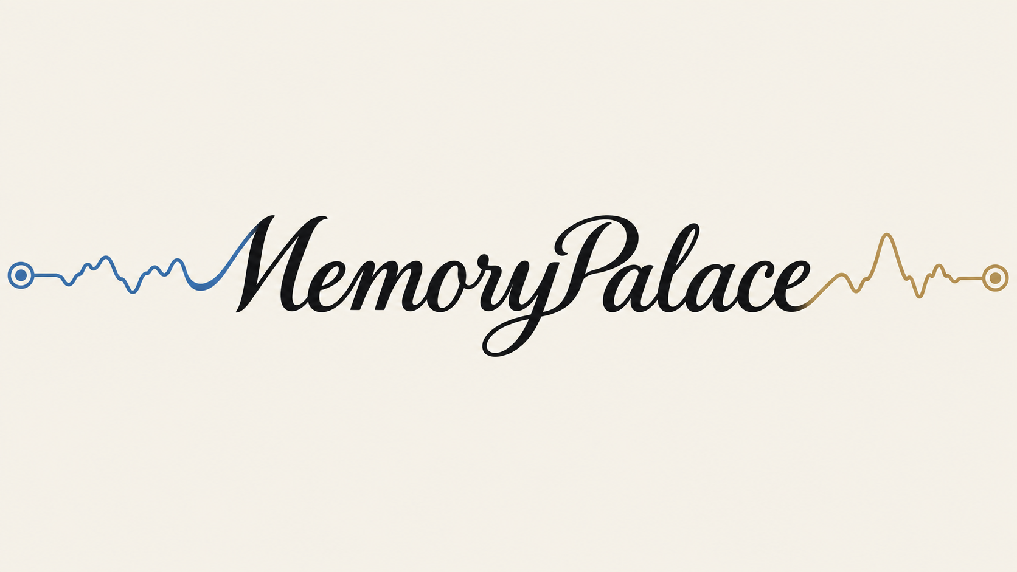
Revisit the moments you almost forgot.
HackMIT 2026
Notes:
Memorypalace. Revisit the moments you almost forgot. A personal memory companion that links changes in EEG activity with recorded context. Begin the 36-second film on the next slide.

Slide 2
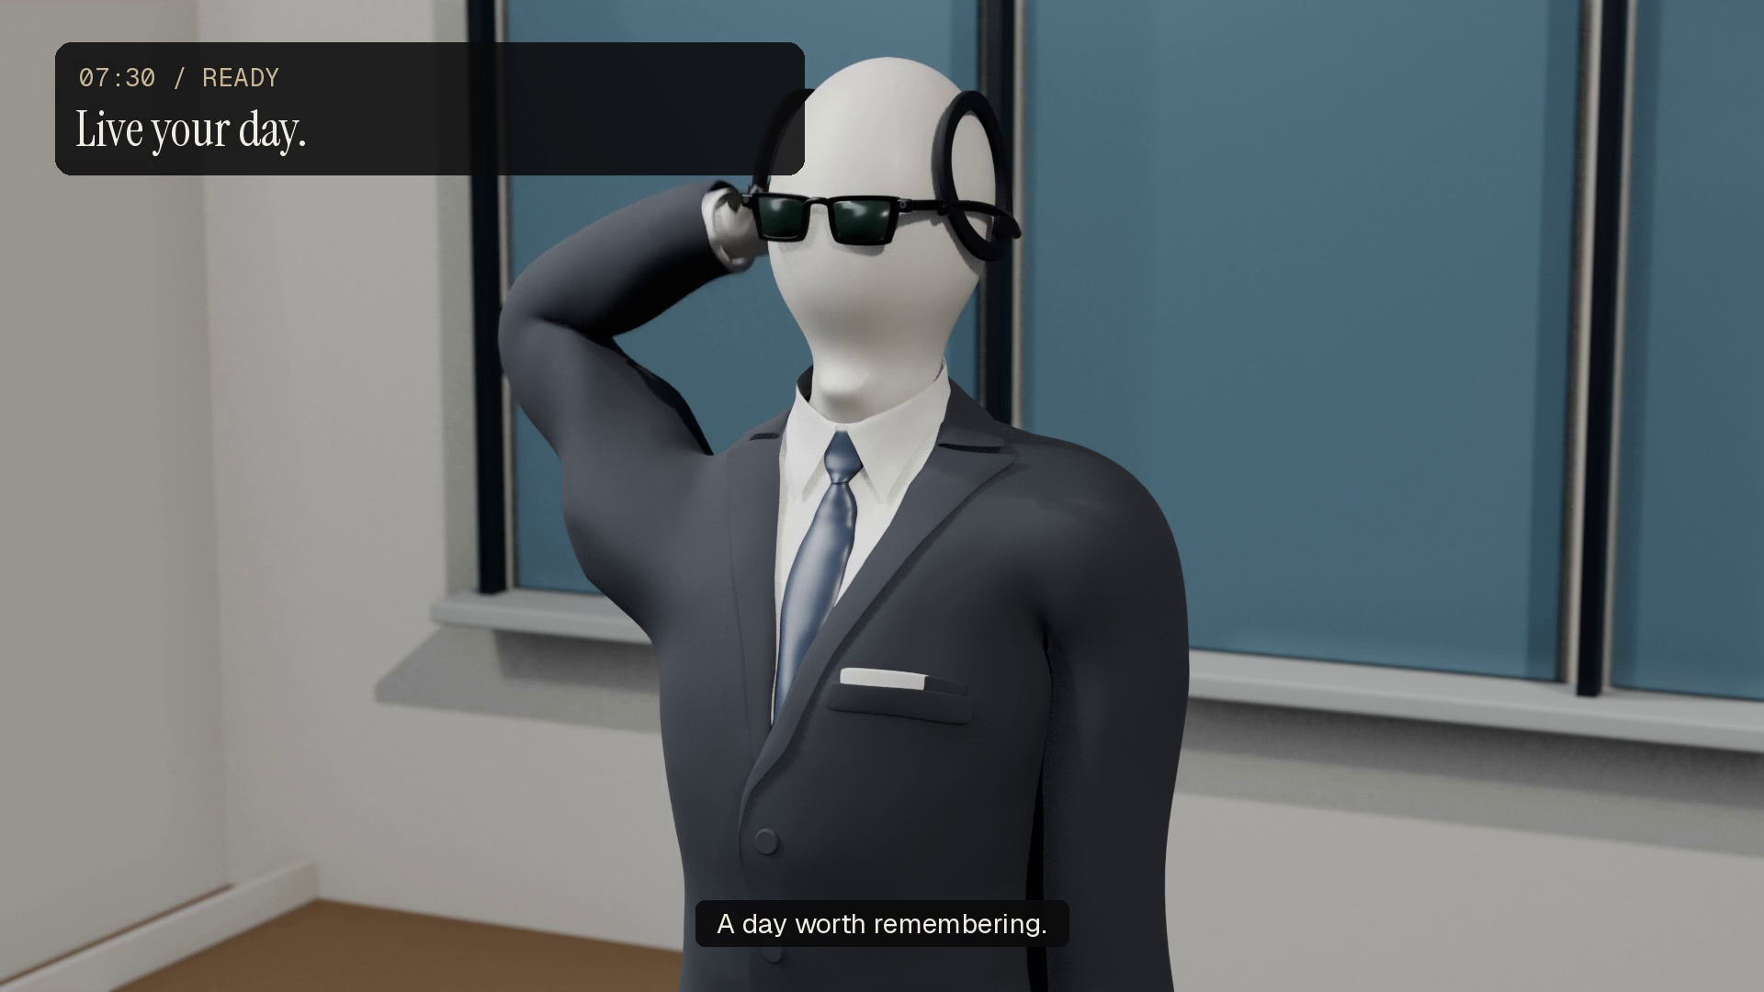
Notes:
Play the embedded 36-second concept film with sound. It illustrates the intended wearable experience, using the approved mannequin and revised desk reaction. The neural strengths shown in the film are illustrative story values. The running prototype uses the phone camera and supports synthetic EEG replay plus a Crown adapter.

Slide 3
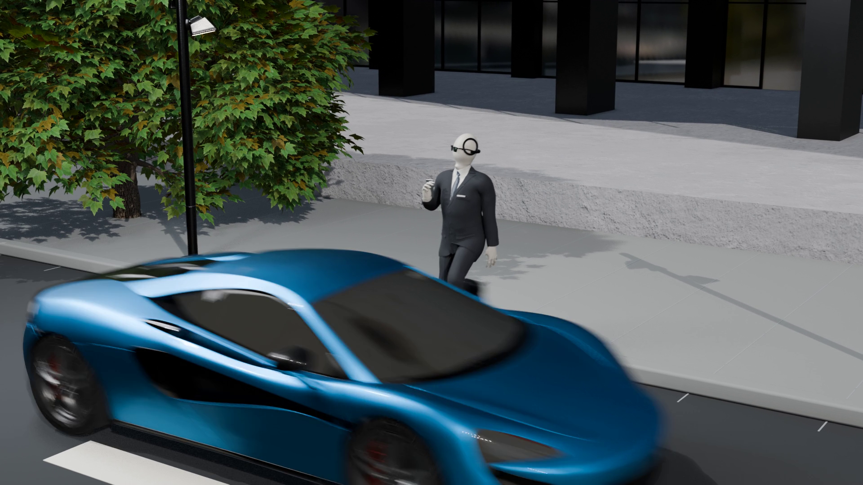
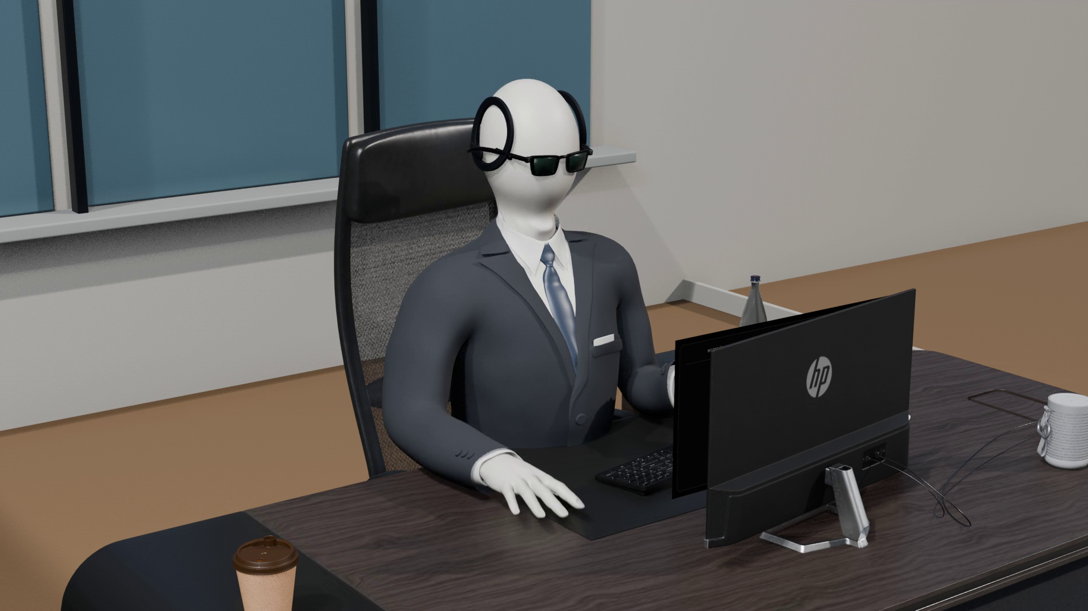
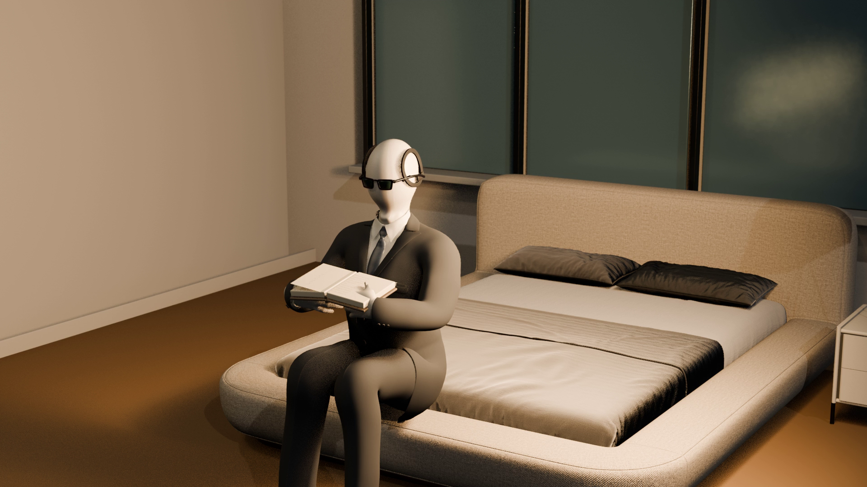
Your day moves faster than your memory
You remember the reaction. The context is harder to recover.
A close call
A frustrating task
An unfamiliar idea
What caught my attention?
What went wrong?
What did I want to learn?
A moment is useful when you can return to its context.
Notes:
The near miss, the database incident and the unfamiliar word are narrative examples, not clinical detections. The problem is the lost context and the effort of reviewing a whole day. Memorypalace aims to make a small collection of meaningful moments easy to revisit.

Slide 4
A personal memory companion
EEG identifies a change. Recorded context makes it useful.
Sense
Capture context
Revisit
Neurosity Crown
Personal EEG baseline
Ray-Ban Meta glasses
Wearable camera concept
Memorypalace
Search, reflect and share
20 min
Onboarding target
Fit the sensors, establish your baseline, try a guided capture.
Notes:
Hardware concept: Neurosity Crown for sensing EEG and Ray-Ban Meta glasses for first-person context, supported by the Memorypalace app. Crown is an EEG sensor, not a neurostimulation device; Ray-Ban Meta glasses are not Meta Quest. The current working recorder is an Android phone camera, with a Crown stream adapter. Twenty minutes is the requested onboarding target, not a measured result; code baseline currently uses 120 seconds. Sources: hardware-demo/eegdemo/pipeline.py; hardware-demo/README.md; https://neurosity.co/crown ; https://wearables.developer.meta.com/docs/develop/dat/build-integration-android/

Slide 5
Two checks before a moment is flagged
A change from your baseline, followed by a sustained elevation.
01
Change from your normal
Compare theta/alpha activity with your own resting baseline.
02
Sustained burst confirmation
Keep the event only after four fresh windows stay elevated.
Notes:
Current implementation: clean frontal EEG, theta (4–8 Hz) over alpha (8–13 Hz) band power, four-second non-overlapping windows, per-wearer z-score, threshold 2.0, four consecutive elevated windows. It measures a sustained load proxy. Phase-shift detection is not present in the inspected implementation; avoid describing this method as phase-shift inference or as a state-of-the-art benchmark. Source: confusion-detector/src/config.py; confusion-detector/src/cognitive_load.py; hardware-demo/eegdemo/pipeline.py.

Slide 6
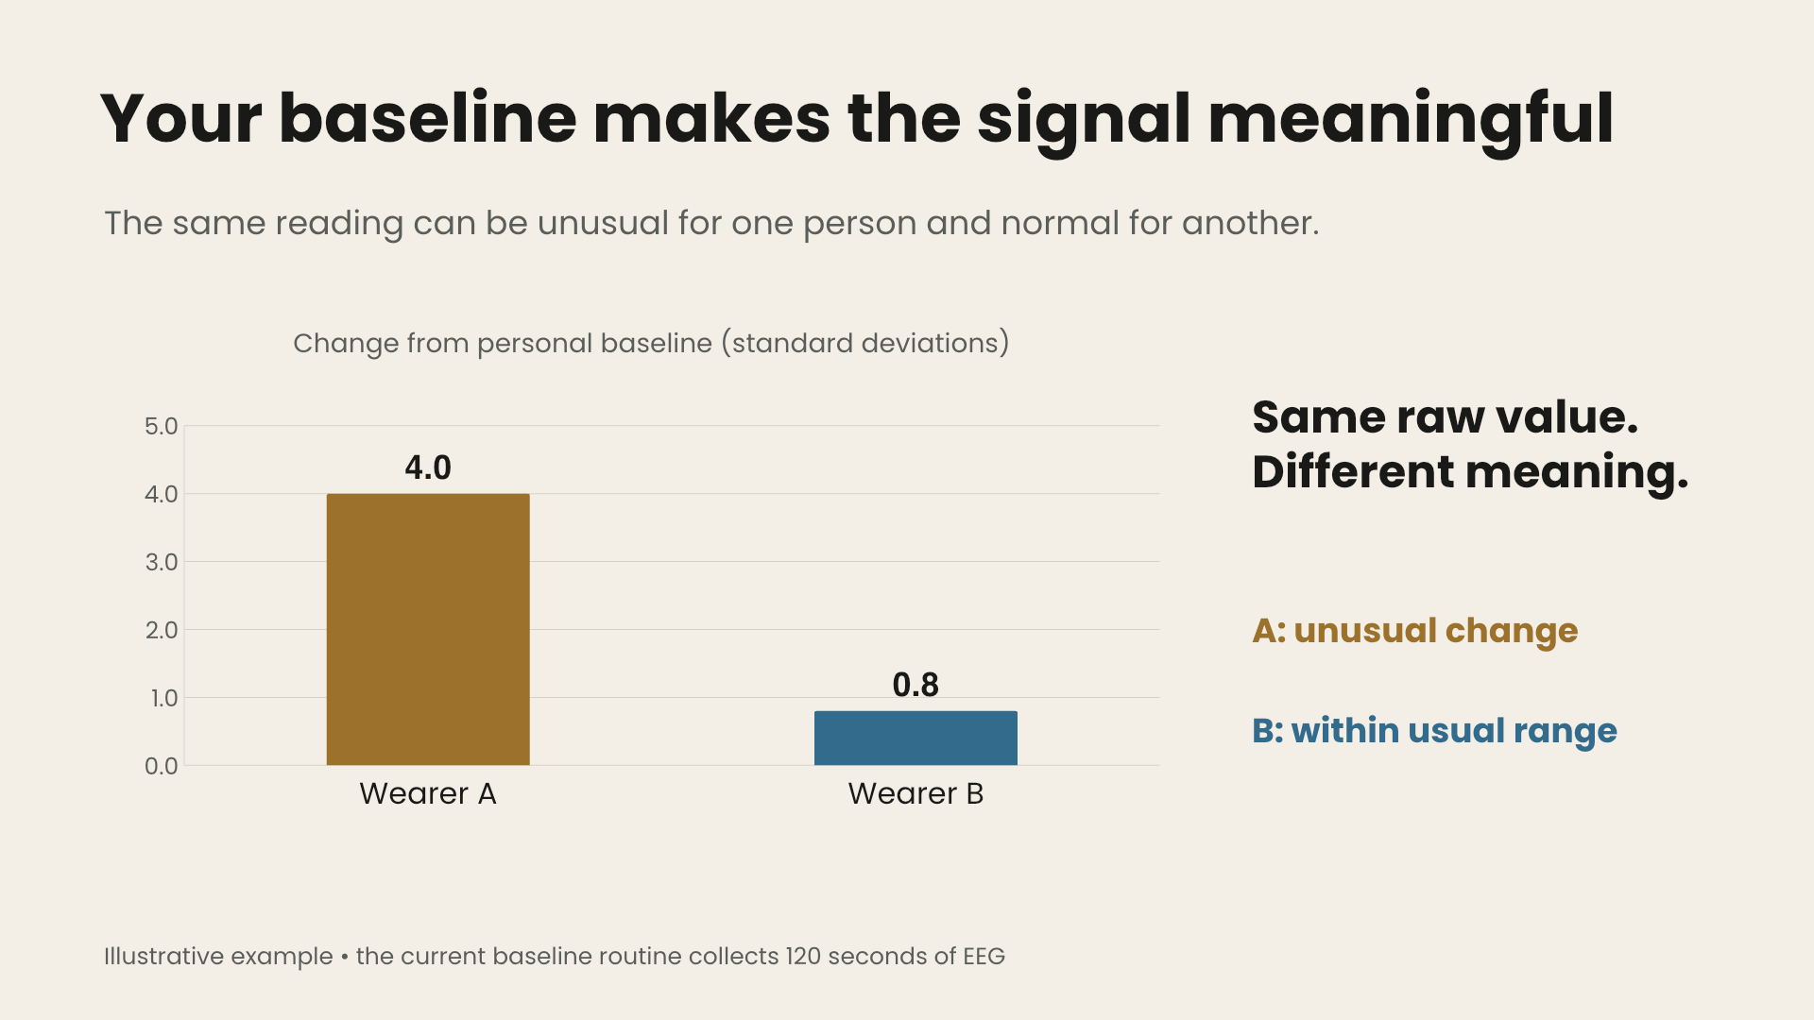
Your baseline makes the signal meaningful
The same reading can be unusual for one person and normal for another.
Same raw value.
Different meaning.
A: unusual change
B: within usual range
Illustrative example • the current baseline routine collects 120 seconds of EEG
Notes:
Illustrative arithmetic: raw theta/alpha index 3.0; A mean 1.0 and standard deviation 0.5 gives z=4.0; B mean 2.6 and standard deviation 0.5 gives z=0.8. These are explanatory values, not measured people or clinical thresholds. The implemented trigger threshold is z=2.0. Source: confusion-detector/src/detector.py and config.py. The chart remains editable beneath its animated video overlay.

Slide 7
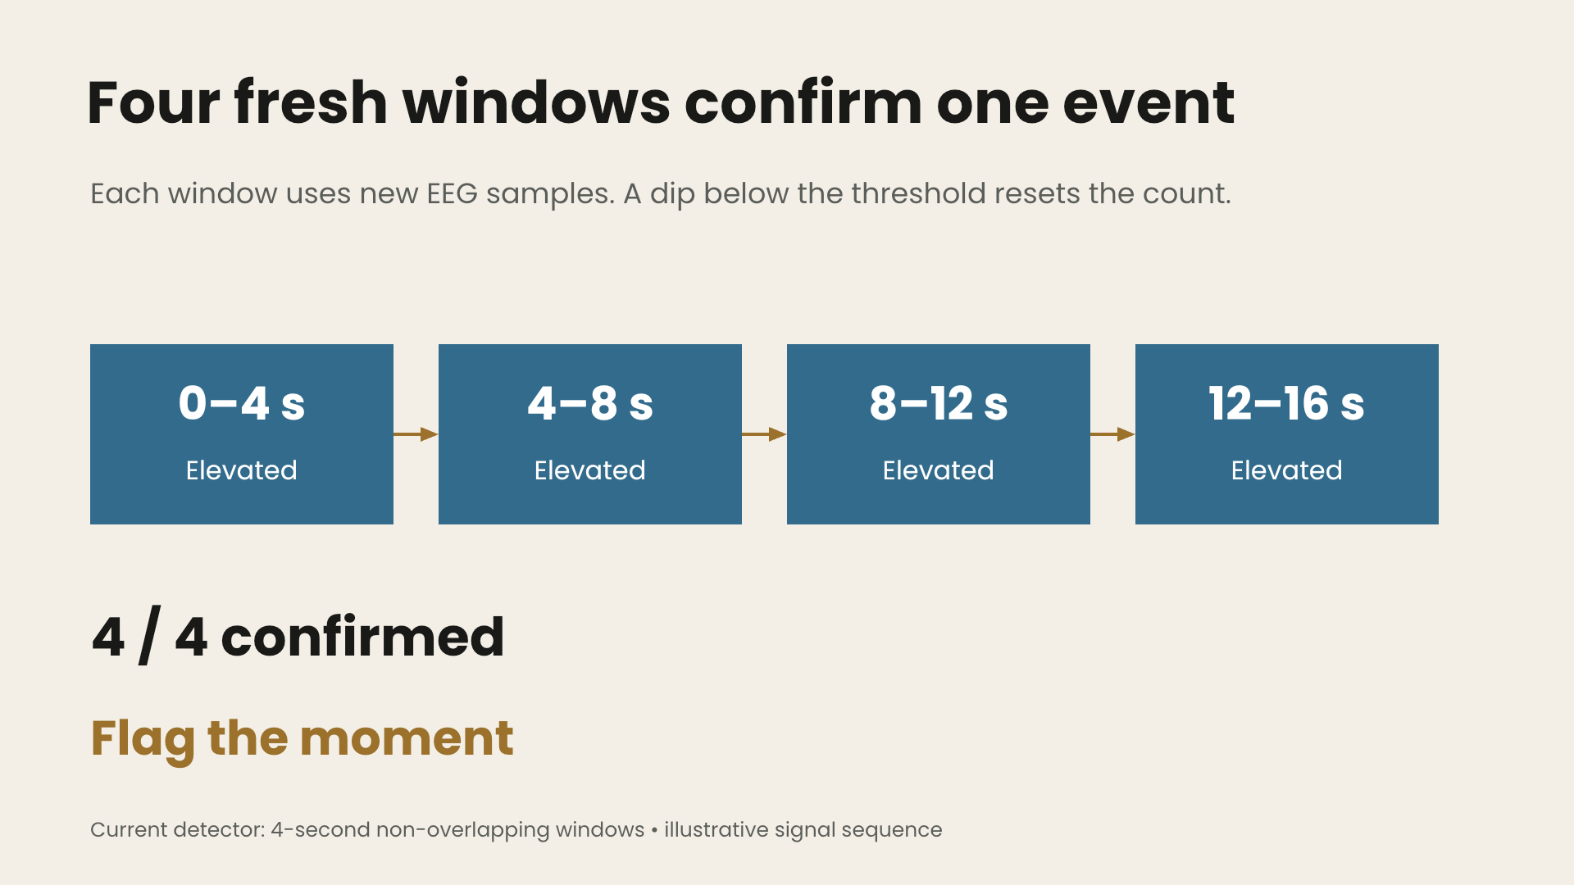
Four fresh windows confirm one event
Each window uses new EEG samples. A dip below the threshold resets the count.
0–4 s
4–8 s
8–12 s
12–16 s
Elevated
Elevated
Elevated
Elevated
4 / 4 confirmed
Flag the moment
Current detector: 4-second non-overlapping windows • illustrative signal sequence
Notes:
Four consecutive windows above z=2.0 are required. No overlap means samples are not reused; it does not prove statistical independence of brain activity. The active backend finalizes an ongoing recording on this trigger, attaches the signal context, and saves it. The concept film illustrates the broader event-capture vision. Sources: confusion-detector/src/config.py; hardware-demo/eegdemo/server.py Runtime.trigger.

Slide 8
Fresh samples reduced false alarms
Changing the overlap changed the result—even with the same threshold.
Controlled synthetic fixture • same data and threshold • source: confusion-detector/README.md
Notes:
Controlled comparison reported in confusion-detector/README.md, The one result that matters: 4-second windows, 75% overlap (hop 1s) 30.3 false alarms/hour; 50% overlap (hop 2s) 18.9; no overlap (hop 4s) 1.3. Same stationary synthetic fixture and threshold. Do not generalize the absolute rate to people or drifting baselines; the drifting fixture reported 7.2/hour at the default setting. This chart is engineering evidence for avoiding repeated samples, not a clinical performance claim.

Slide 9
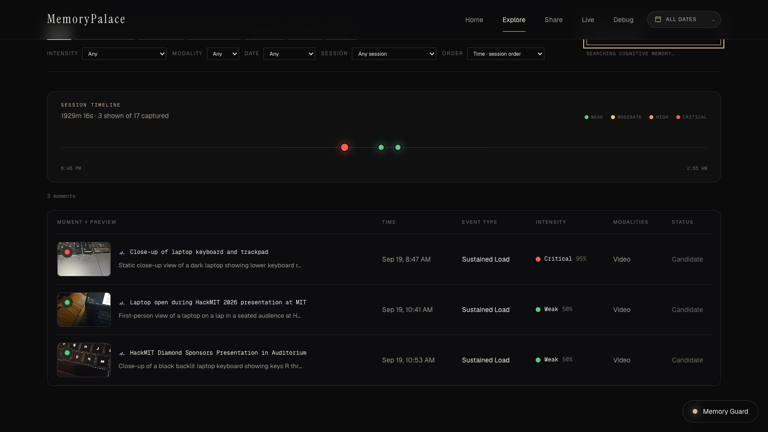
Find the moment again
Search what you remember. Open the original clip.
“laptop keyboard”
Search by a detail
you still remember.
Open live demo →
Notes:
Live demo at http://localhost:3000/explore. Query: laptop keyboard. The screenshot is captured from the running project, not a fabricated interface. Elastic combines keyword and vector retrieval, with timeline and intensity filters. Sources: app/components/explore; hardware-demo/eegdemo/elastic_store.py. Keep the standalone app running when using the demo link.

Slide 10

Elastic for memory search
Sponsor challenge: turn messy data into insights, answers or actions.
Recorded moment
Jina v5 Omni
Hybrid search
Video + time + EEG context
A shared space for clips
and search questions
Keywords + meaning
BM25 + kNN → RRF
A question becomes a replayable memory.
Implemented with Elastic Cloud Serverless and Elastic Inference Service
Notes:
Challenge source: DOCS_sponsor/elastic. Implementation: Elastic Cloud Serverless, Jina v5 Omni via Elastic Inference, semantic metadata, BM25 + dense kNN with RRF, date and EEG-intensity filters. The persisted video is linked from the retrieved moment. Sources: hardware-demo/eegdemo/elastic_store.py; FULFILLMENT_SPONSORS.md. Logo source: https://www.apmdigest.com/sites/default/files/2024-09/logo_elastic.png ; brand owner https://www.elastic.co/ . Official method references: https://www.elastic.co/docs/solutions/search/multimodal-search ; https://www.elastic.co/docs/reference/elasticsearch/rest-apis/reciprocal-rank-fusion .

Slide 11

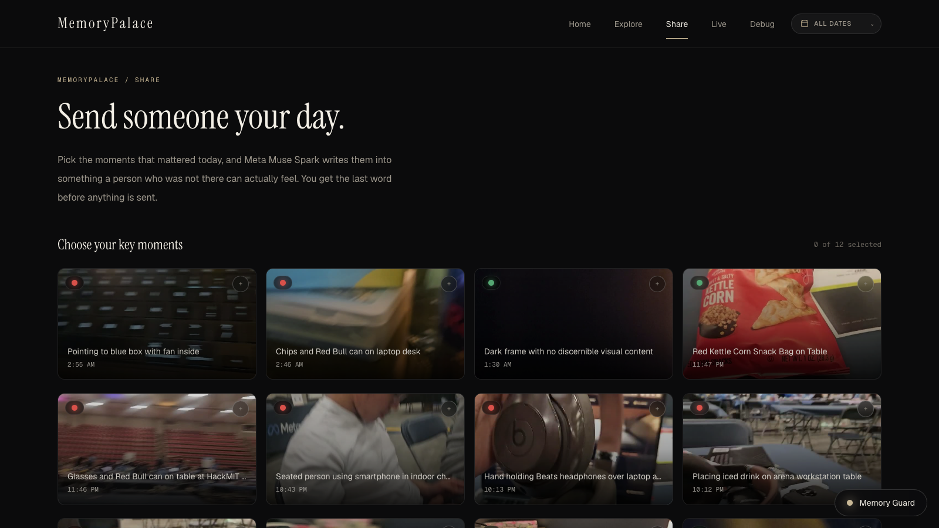
Meta for meaningful sharing
Sponsor challenge: bring people closer together with AI.
Choose the moments
You decide what to include
and who it is for.
Let Muse Spark draft
Review a personal note,
then share it yourself.
Notes:
Sponsor challenge is quoted from DOCS_sponsor/meta: Bringing People Closer Together with AI. Implemented Share flow: user selects moments and recipient, Muse Spark writes a grounded first-person note, user reviews and edits, then invokes native Share or Copy. This deck does not send anything. Meta also powers scene descriptions, voice transcription and Memory Guard when selected. Sources: app/components/share/SharePage.tsx; hardware-demo/eegdemo/agent.py share_note; hardware-demo/eegdemo/server.py compose_share. Logo: official Meta logo via Wikimedia Commons, https://upload.wikimedia.org/wikipedia/commons/a/ab/Meta-Logo.png ; brand source https://www.meta.com/brand/resources/meta/company-brand/ .

Slide 12

Voloridge: data to design
Voloridge challenge: build something interesting using public datasets.
56
usable recordings
Placement matters
A frontocentral montage
retained more event signal.
OpenNeuro ds006394 • offline LOSO logistic regression • channel configurations differ in placement
Notes:
Challenge source: DOCS_sponsor/VoloRidge. Dataset: OpenNeuro ds006394 / NEMAR on006394, surprise-related visual and auditory events, CC0; 33 participants listed, 56 usable recordings. This is offline leave-one-subject-out logistic regression, not a live Memorypalace accuracy claim. Values from xueqi-validation/results/electrode_ablation_table.csv: 16 channels AUC .712, 8 .705, 4 .697, 2 temple .599. Channel positions differ across configurations, so the chart does not isolate channel count alone. Source: xueqi-validation/RESULTS.md. https://openneuro.org/datasets/ds006394 ; logo from https://www.voloridge.com/themes/custom/voloridge/logo.svg .

Slide 13
System architecture
A signal and its recorded context become one searchable moment.
Meta
Crown EEG
Describe the moment
Signal packets
Python backend
Elastic
Detect • finalize • store
Index + retrieve
Camera client
Video + capture commands
Web app
Search • replay • share
Notes:
Actual wiring: Crown publisher sends EEG to Python backend. Android camera client polls authenticated commands and uploads video to the backend. Backend persists the catalog, calls Meta enrichment and Elastic indexing. Next.js browser accesses backend through server routes. Source: hardware-demo/eegdemo/server.py; pipeline.py; library.py; elastic_store.py; app/lib/backend.ts. The native diagram is editable.

Slide 14
Memorypalace
Your day has more to tell you.
Keep the context. Revisit it when you have time.
Try the live demo →
Notes:
Close: Memorypalace turns a fleeting reaction into a moment you can revisit, understand, and choose to share. Invite the judges to try the running retrieval demo. The film describes the wearable concept; the charts and sponsor slides show the implemented work.

