Slide 2
Secure Food Delivery Management System Project id- 8 Submitted by:- Harshpreet Singh Sandhu (Enroll No. R134218065) Neelesh Kumar (Enroll. No. R134218102) Naman Sharma (Enroll. No. R134218099) Karan Bhandari (Enroll. No. R134218076) Under the guidance of Mr. Keshav Kaushik Department of Systemics

Slide 3
PROBLEM STATEMENT
Insecure handling of “customer details” in food delivery system and optimising delivery time for faster deliveries.

Slide 4
OBJECTIVES
Provide customer options for Sign-up and Login
Get customer details and encrypt it in file
Authenticate the customer
Display the menu and calculate customer’s bill
Calculate distance for delivery using shortest path and display it

Slide 5
ABSTRACT
The project aims to implement security features like encryption/decryption in a food delivery system while also providing the shortest path for the delivery and displaying it simultaneously.

Slide 6
Encryption and Decryption
Encryption is a process of translating a plain text into something that appears to be random and meaningless and is difficult to decipher.
Decryption is a process of transforming encrypted information back into original data.
It’s Need
Provides security of data at all times.
Maintains integrity
Ensures privacy
Protects data across devices

Slide 7
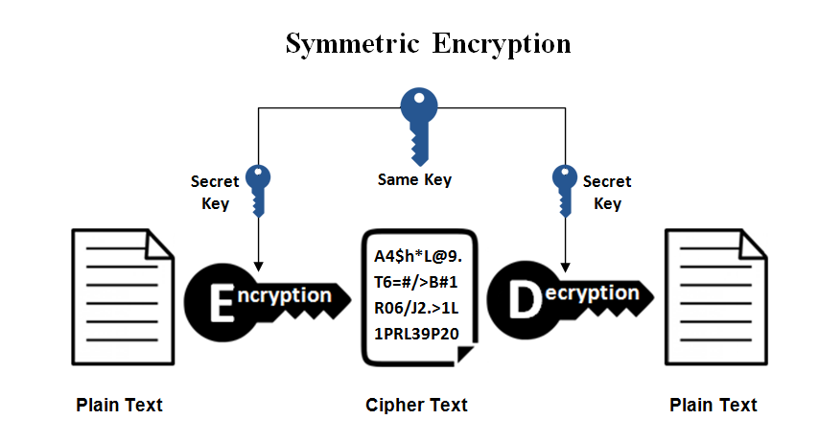
Algorithms used
(AES) Advance Encryption Standard Algorithm:
It involves only one secret key to cipher and decipher information. The secret key that can either be a number, a word or a string of random letters. The sender and the recipient should know the secret key that is used to encrypt and decrypt all the files.

Slide 8
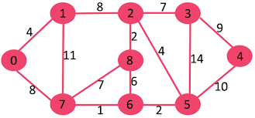
Dijkstra's algorithm (or Dijkstra's Shortest Path First algorithm) an algorithm for finding the shortest paths between nodes in a graph, which may represent, for example, road networks. It fixes a single node as the source node and finds shortest paths from the source to all other nodes in the graph, producing a shortest-path tree.

Slide 9
Workflow of Programme
Provide option for Sign-up/Login
After Login, encrypt these details in file and go to Menu
Get food items and their quantities from the menu displayed
Display bill and get delivery address
Calculate the shortest path and hence the optimize time for delivery
Visual depiction of the path, source to destination

Slide 10
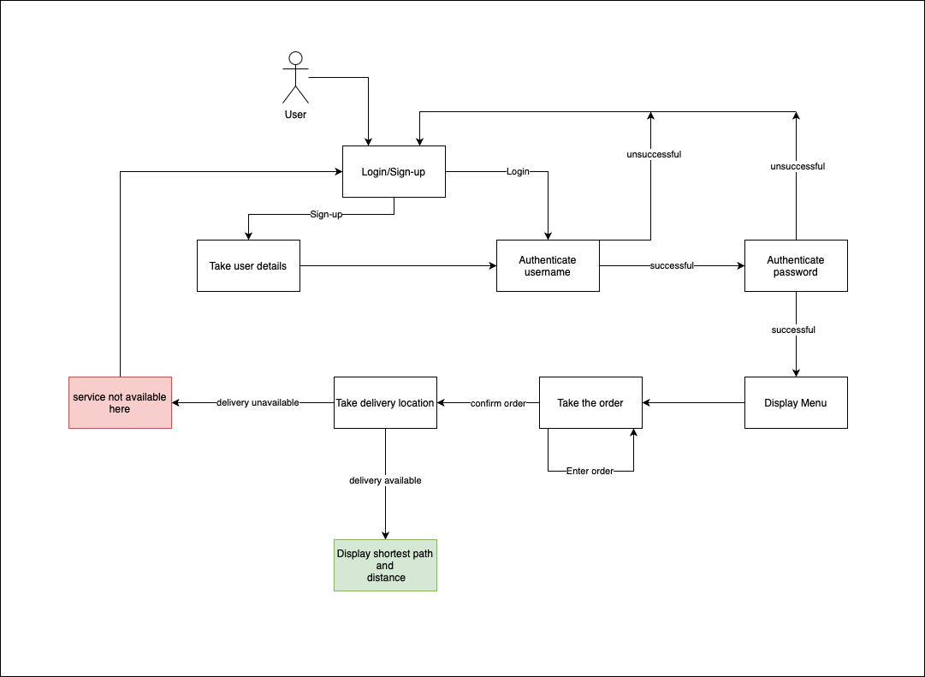

Slide 11
Modules
User information (File handling)
Encryption and Decryption
Food information (Menu)
Bill generation
Optimise Delivery path

Slide 12
Files created
Customer information (userinfo) – includes all the data related to the customer in the encrypted form
Order summary (order_review) – contains all the details related to the food ordered by the customer including the order number

Slide 13
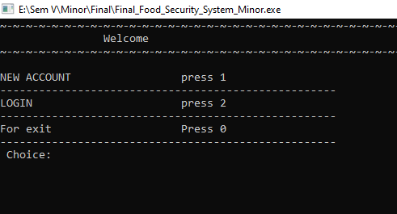
Output-Welcome page

Slide 14
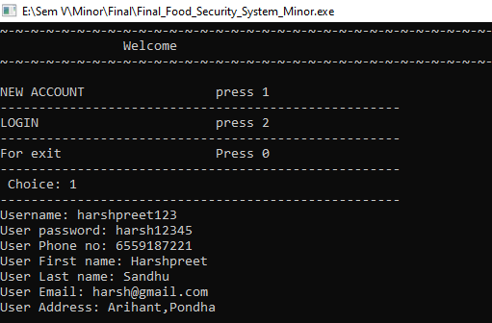
Output-Create account

Slide 15
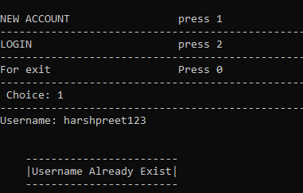
Output- Username already exist

Slide 16
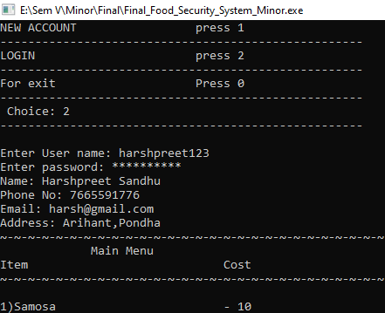
Output-Successful login

Slide 17
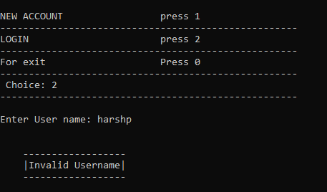
Output- Invalid Username

Slide 18
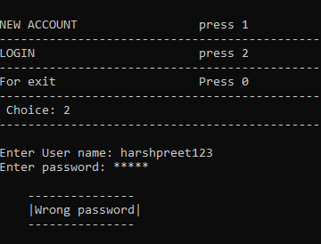
Output- Wrong Password

Slide 19
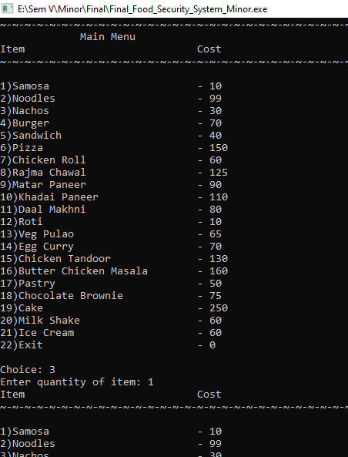
Output-Menu

Slide 20
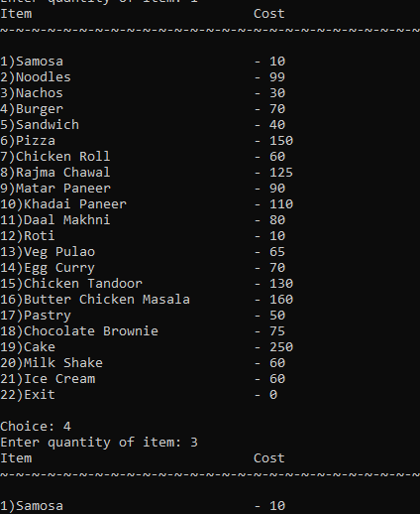
Output-Menu continued

Slide 21
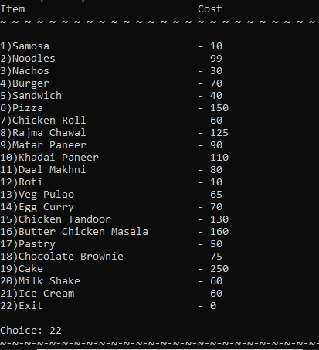
Output-Menu continued

Slide 22
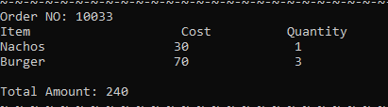
Output- Bill

Slide 23
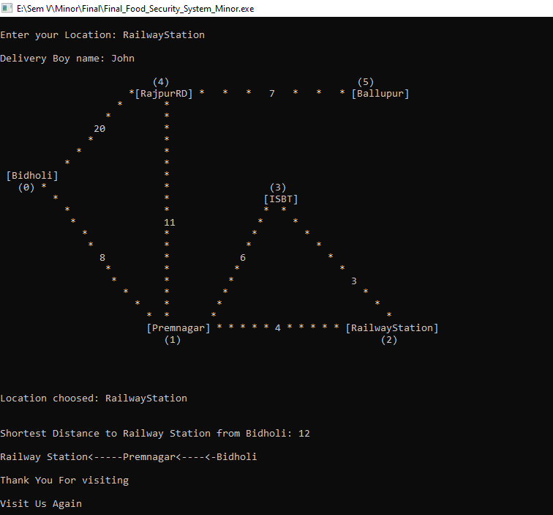
Output- Enter location

Slide 24
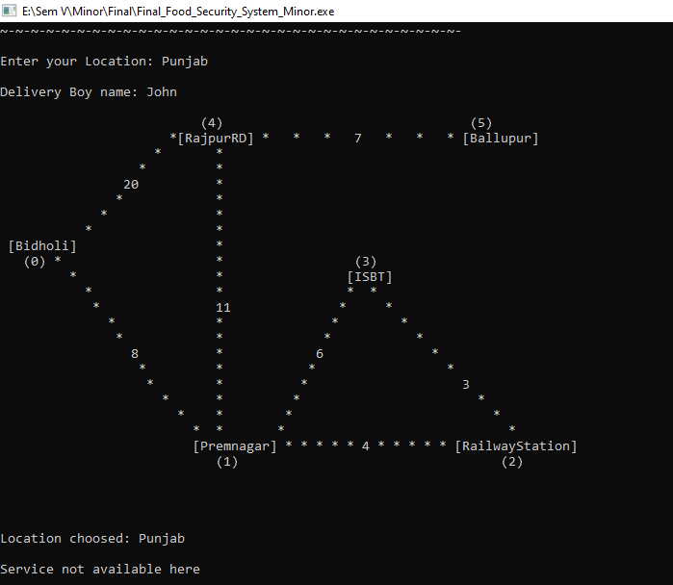
Output- Service not available

