Slide 1
OPEN SOURCE DEVELOPMENT PROJECT-BASED LEARNING
E-Voting System (C++): An Open Source Case Study
Practicing Git Collaboration, Branching Strategy, Code Review & Open Source Governance in a 5-Person Team
GitHub Repository: https://github.com/Naman-2513/evoting-system-cpp
Naman Rana
Project Structure & Voter Module
Mudit Chaudhary
Admin Panel & XOR Encryption
Ritvik Garg
Admin Panel & Security
Veer Saksham Singh
Documentation Lead & Changelog
Harshit Agarwal
Documentation & Architecture

Slide 2
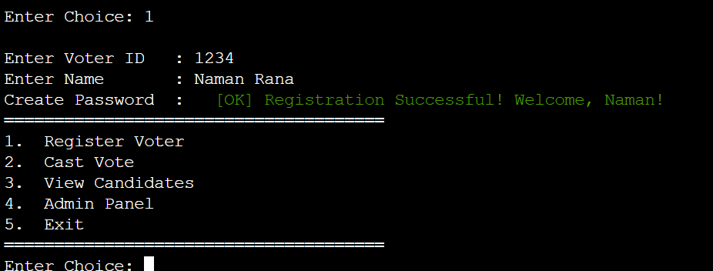
OPEN SOURCE DEVELOPMENT PBL
What We Built — System Architecture & Context
Core Software Specifications
• Core Functionality: Console-based C++ E-Voting system enabling voter registration, password login, encrypted ballot casting, and real-time admin tallying.
• Persistence Layer: Flat-file data storage (`voters.txt`, `candidates.txt`, `votes.txt`) avoiding heavyweight database dependencies for lightweight distribution.
• Security Mechanism: Symmetric XOR encryption layer for vote anonymity and anti-tampering during storage.
• PBL Objective: The C++ application serves as the vehicle — the primary focus is establishing open-source software (OSS) development practices.
Console CLI UI Demonstration
Featuring ANSI color formatting, animated loading spinners, structured input validation, and password-protected admin actions.
E-Voting System C++ | GitHub: github.com/Naman-2513/evoting-system-cpp | PBL Presentation

Slide 3
OPEN SOURCE DEVELOPMENT PBL
Project Objectives — OSS Development Practices
Collaborative Workflow Goals
Quality & Governance Goals
• Git-First Development: Shift from traditional file-sharing or single-developer habits to a disciplined, version-controlled Git workflow.
• Feature-Branch Isolation: Ensure every team member develops inside dedicated topic branches to avoid breaking `main`.
• Pull Request Enforcement: Mandate peer code reviews for all merges to ensure quality, visibility, and shared code ownership.
• Task & Issue Visibility: Use GitHub Issues & Discussions for transparent task distribution rather than informal chat apps.
• Documentation as First-Class Code: Maintain complete standard documentation (`README`, `ARCHITECTURE`, `CONTRIBUTING`, `CHANGELOG`, `CONTRIBUTORS`) alongside source code.
• Equitable Contribution: Trace individual labor cleanly via commit history and dedicated branches.
• Public Release Management: Manage formal releases (v1.0) with clean semantic tagging and reproducible build steps.
E-Voting System C++ | GitHub: github.com/Naman-2513/evoting-system-cpp | PBL Presentation

Slide 4
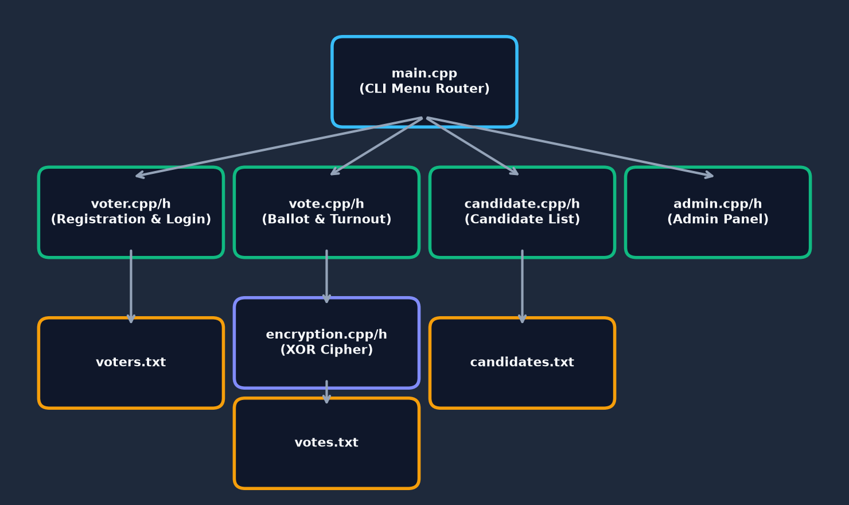
OPEN SOURCE DEVELOPMENT PBL
Repository Structure & Module Layout
Repository Layout (`evoting-system-cpp`)
• Header/Source Separation: `include/` for headers (`.h`), `src/` for implementations (`.cpp`) adhering to standard C++ library layout.
• Main Entry Point: `main.cpp` handles menu routing and delegates logic to modular components.
• Flat File Persistence: `voters.txt`, `candidates.txt`, `votes.txt` store state cleanly without external binary DBs.
• Root Governance Files: `README.md`, `ARCHITECTURE.md`, `CONTRIBUTING.md`, `CHANGELOG.md`, `CONTRIBUTORS.md`, `LICENSE`.
E-Voting System C++ | GitHub: github.com/Naman-2513/evoting-system-cpp | PBL Presentation

Slide 5
OPEN SOURCE DEVELOPMENT PBL
Git Workflow Lifecycle — From Issue to Release
1. Issue Assignment
2. Branch Creation
3. Local Commit & Test
• Task created on GitHub Issues & assigned to team member.
• Member branches off latest `main` (`git checkout -b feature/name`).
• Granular commits written locally with clear messages.
4. Pull Request Opened
5. Peer Code Review
6. Merge & Tagging
• PR opened against `main` with detailed description.
• At least 1 teammate inspects diffs and approves change.
• PR merged into `main`; tagged as `v1.0` at milestone completion.
E-Voting System C++ | GitHub: github.com/Naman-2513/evoting-system-cpp | PBL Presentation

Slide 6
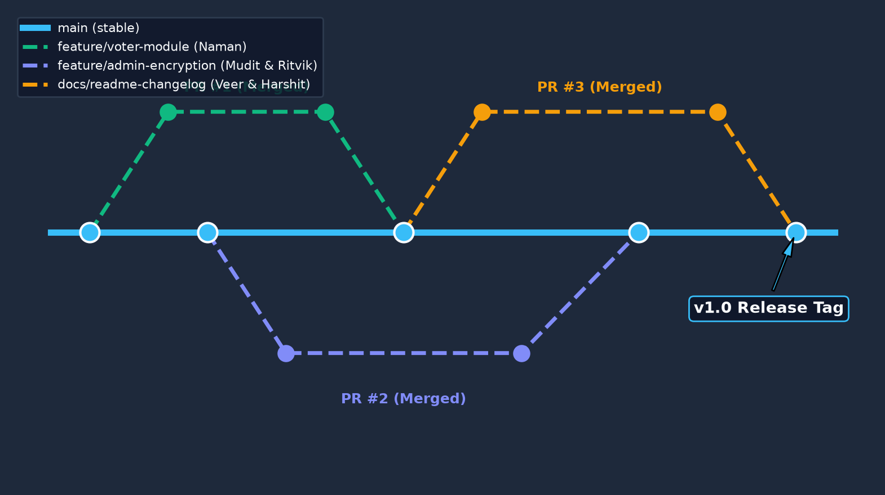
OPEN SOURCE DEVELOPMENT PBL
Branching Strategy — Protecting Main Source of Truth
Branching Principles
• Single Source of Truth: `main` branch is always clean, compiled, and demo-ready at all times.
• No Direct Commits: Direct pushes to `main` prohibited; all updates flow through verified Pull Requests.
• Granular Topic Branches: Branches named by scope (e.g. `feature/voter-module`, `feature/admin-panel`, `docs/readme`).
• Divergence Prevention: Frequent rebasing/merging of `main` into topic branches prevented conflict lockups.
E-Voting System C++ | GitHub: github.com/Naman-2513/evoting-system-cpp | PBL Presentation

Slide 7
OPEN SOURCE DEVELOPMENT PBL
Pull Requests & Code Review Protocol
Code Review Workflow
Review Checklist Applied
• Peer Verification Gate: Every PR required approval from at least one non-author team member before merging.
• Knowledge Sharing: Reviews ensured every student understood code outside their assigned module.
• Bug Prevention: Caught space-delimiter parsing bugs and missing include paths before reaching `main`.
• Traceable History: GitHub PR conversations provided a complete audit trail of design discussions.
• Build Verification: Does the code compile cleanly using `g++ -std=c++17` without compiler warnings?
• Modular Boundaries: Are function declarations isolated to header files and implementations in `.cpp`?
• File Storage Safety: Does the change respect space-encoding (`encodeName`) in text persistence files?
• Documentation Sync: Are API changes updated in `ARCHITECTURE.md` or `README.md`?
E-Voting System C++ | GitHub: github.com/Naman-2513/evoting-system-cpp | PBL Presentation

Slide 8
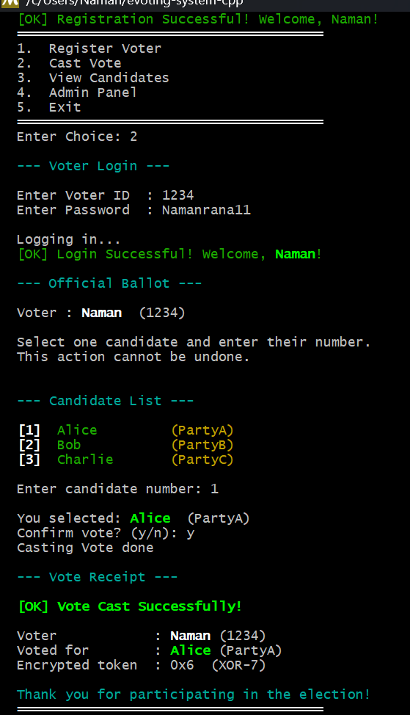
OPEN SOURCE DEVELOPMENT PBL
Task Tracking & Release Management
GitHub Governance Tools
• GitHub Issues: Used to track bug reports (e.g. voter name parsing bug), feature requests, and refactoring items.
• GitHub Discussions: Platform for async architectural consensus (XOR encryption vs flat-file schema).
• CHANGELOG.md: Maintained chronologically to record notable updates, fixes, and release milestones.
• Release Tag v1.0: Formal release tagged on June 30, 2026, marking complete feature set and stable build.
E-Voting System C++ | GitHub: github.com/Naman-2513/evoting-system-cpp | PBL Presentation

Slide 9
OPEN SOURCE DEVELOPMENT PBL
Documentation as a First-Class Deliverable
README.md
ARCHITECTURE.md
• Project overview, feature breakdown, build/run commands for Windows & Linux, tech stack.
• Detailed system diagrams, data flow specifications, module descriptions, and ADR design records.
CONTRIBUTING.md
CONTRIBUTORS.md
• Step-by-step developer guide: branching conventions, commit styling, PR review process.
• Explicit labor distribution matrix detailing specific feature ownership for every team member.
CHANGELOG.md
E-Voting System C++ | GitHub: github.com/Naman-2513/evoting-system-cpp | PBL Presentation
• Release history documenting incremental improvements from initial setup to v1.0 release.

Slide 10
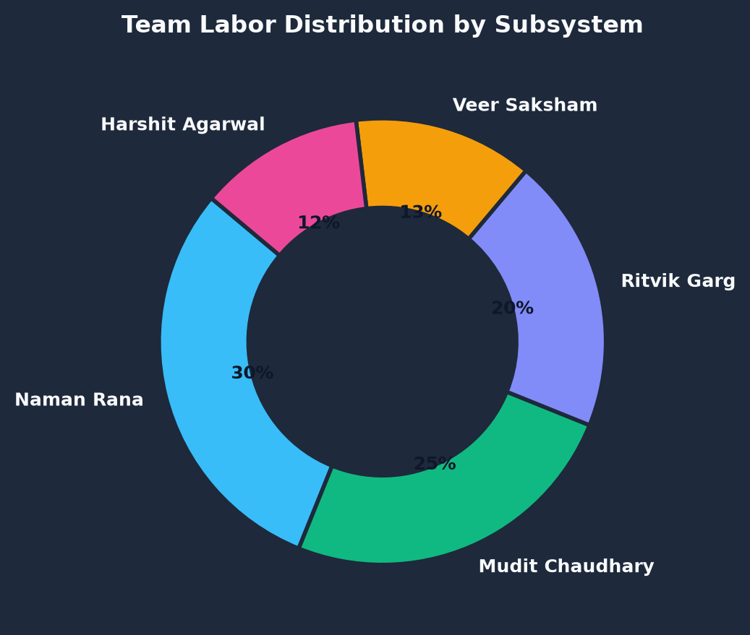
OPEN SOURCE DEVELOPMENT PBL
Team Contribution Matrix & Labor Division
Individual Feature Ownership
• Naman Rana: Project structure (`src/`, `include/`), `.gitignore`, `LICENSE`, `voter.cpp/h` module.
• Mudit Chaudhary: Admin panel (`admin.cpp`), XOR encryption (`encryption.cpp`), `ARCHITECTURE.md` design.
• Ritvik Garg: Admin panel results tallying, ballot security, vote validation logic.
• Veer Saksham Singh: Documentation lead (`README.md`, `CONTRIBUTING.md`, `CHANGELOG.md`).
• Harshit Agarwal: Documentation co-lead, system overview diagrams, repository metadata maintenance.
E-Voting System C++ | GitHub: github.com/Naman-2513/evoting-system-cpp | PBL Presentation

Slide 11
OPEN SOURCE DEVELOPMENT PBL
Collaboration & Technical Challenges Resolved
Git & Merge Order Challenges
Flat-File Persistence Parsing Bug
• Branch Drift Prevention: Challenge: 5 parallel branches drifting from `main`. Solution: Enforced frequent PR merges and rebasing.
• Review Turnaround: Challenge: Review bottlenecks delaying urgent merges. Solution: Assigned secondary reviewers for every module.
• Platform Differences: Challenge: PowerShell wildcard expansion issues on Windows. Solution: Configured `tasks.json` and documented Git Bash execution.
• Multi-word Name Collision: Issue: `cin >> name` broke multi-word names ('John Smith') when reading space-delimited text files.
• Data Corruption: Impact: Spaces shifted password and boolean fields, causing voter lookup failures.
• Architectural Fix: Implemented `encodeName()` (space -> `_`) on file write and `decodeName()` (`_` -> space) on display, keeping storage parsed safely.
E-Voting System C++ | GitHub: github.com/Naman-2513/evoting-system-cpp | PBL Presentation

Slide 12
OPEN SOURCE DEVELOPMENT PBL
Governance & Best Practices Adopted
Open Source Governance Principles
Process Discipline Metrics
• Single Source of Truth: `main` branch represents production state; no unstable code ever merged without approval.
• Architectural Decision Records: Design choices (flat file vs SQL database, XOR obfuscation) documented explicitly in `ARCHITECTURE.md`.
• Standard Licensing: Included MIT License enabling open educational reuse and code transparency.
• Traceability: 100% of codebase changes linked to specific Git commits and Pull Requests.
• Reproducible Build: Single-command build instructions tested on GCC/MinGW platforms.
• Zero Obsolete Artifacts: Clean `.gitignore` configured to exclude binary executables (`evoting.exe`) and object files.
E-Voting System C++ | GitHub: github.com/Naman-2513/evoting-system-cpp | PBL Presentation

Slide 13
OPEN SOURCE DEVELOPMENT PBL
Key Takeaways & Educational Learnings
Technical & Process Mastery
Soft Skills & Team Dynamics
• Real-World Git Experience: Transitioned from basic individual Git commands to industrial team collaboration workflows.
• Peer Code Review Mindset: Learned to write clean, self-documenting code built for peer inspection and review.
• Modular Software Design: Understood header/implementation separation in C++ for large-scale maintainability.
• Asynchronous Communication: Effective collaboration via GitHub PR comments and issue descriptions.
• Conflict Resolution: Resolving merge conflicts systematically without losing member contributions.
• Documentation Hygiene: Appreciating that comprehensive documentation is vital for software longevity.
E-Voting System C++ | GitHub: github.com/Naman-2513/evoting-system-cpp | PBL Presentation

Slide 14
OPEN SOURCE DEVELOPMENT PBL
Future Scope — Engineering & Process Roadmap
CI/CD & Automation Roadmap
Software Feature Roadmap
• GitHub Actions Integration: Automate compilation checking on every PR across Linux and Windows runners.
• Automated Testing Framework: Integrate GoogleTest (gtest) to validate voter registration and vote tallying automatically.
• Static Analysis Checks: Incorporate `clang-tidy` and linter checks during automated PR builds.
• Cryptographic Upgrade: Replace simple XOR cipher with AES-256 / RSA public-key encryption for cryptographic vote secrecy.
• Relational Database: Migrate flat text files to SQLite/PostgreSQL for ACID compliance and multi-threaded safety.
• GUI / Web Interface: Transition CLI to a modern Web/React interface while keeping C++ backend logic intact.
E-Voting System C++ | GitHub: github.com/Naman-2513/evoting-system-cpp | PBL Presentation

Slide 15
OPEN SOURCE DEVELOPMENT PBL
Conclusion & Project Summary
Summary of Achievements
• Successful Delivery: Delivered a fully functional, console-based C++ E-Voting System with persistent file storage and vote encryption.
• Open Source Rigor: Demonstrated exemplary GitHub practices: branch isolation, mandatory peer PR reviews, changelogs, and standard docs.
• Team Synergy: Equitable, transparent labor distribution across all 5 team members with 100% traceable Git history.
Thank You! Questions & Discussion
Explore the complete source code, documentation & commit history:
https://github.com/Naman-2513/evoting-system-cpp
E-Voting System C++ | GitHub: github.com/Naman-2513/evoting-system-cpp | PBL Presentation

