Slide 1
Improving Customer Engagement and Product Demand in Fashion Retail Store
Naman Bhargava (namanb)

Slide 2
Business Idea
Dataset contains information about Customer, Product and Transactions in a Fashion Retail Store based in New York for Jan 2023.
Business Ideas:
i. Promote top-performing Masculine Suits and boost
underperforming Children’s clothing.
ii. There is need to revamp the discount strategy to protect profit
margin.
namanb

Slide 3
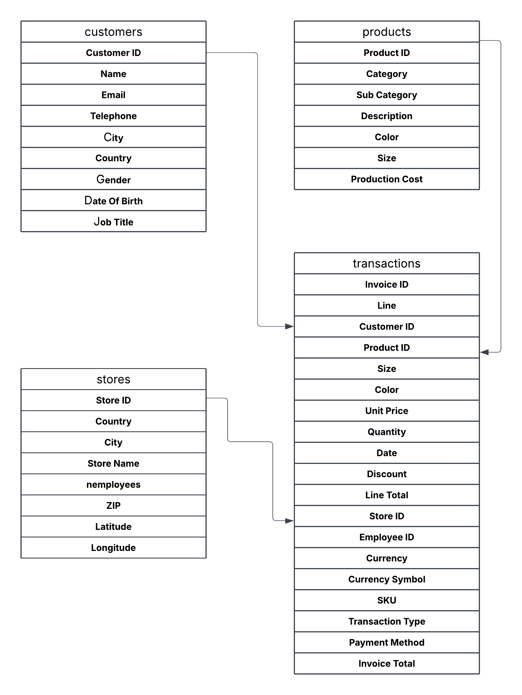
ERD
namanb

Slide 4
Analyzing Product Categories and Sub-Categories by Profit
Masculine and Feminine category clothes had almost same revenue, while Children have lower revenue.
Children revenue is approx. 20% of Feminine clothing revenue.
Among subcategories, Masculine Suits and Blazer is most profitable for brand, generating 36% more revenue than second most profitable.
namanb

Slide 5
Discount Strategy
We have examined the discount strategy of store as well.
From the outlook, it looks like a misfire.
Discounted products make only 40% of the sale and generate 72% less profit than Non-Discounted products.
namanb

Slide 6
Thank You

