Slide 1
Business Case: Target SQL

Slide 2
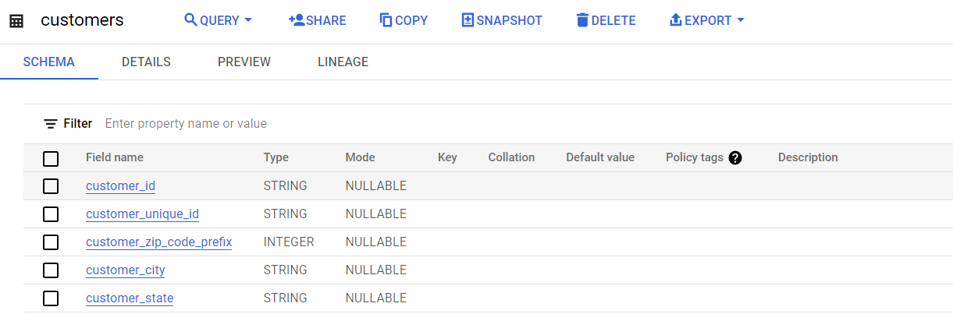
Import the dataset and do usual exploratory analysis steps like checking the structure & characteristics of the dataset:
Data type of all columns in the "customers" table.

Slide 3
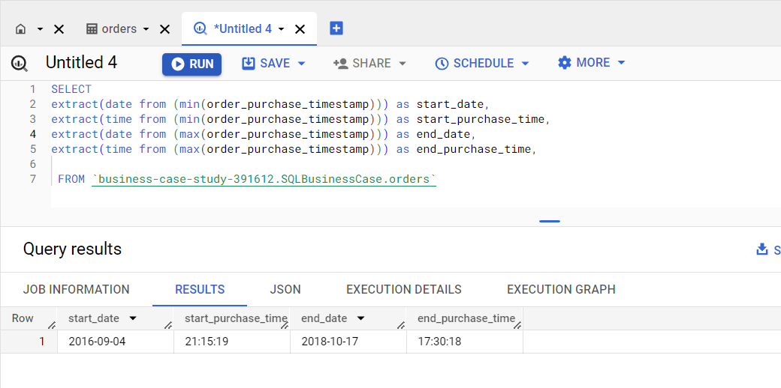
Get the time range between which the orders were placed.
SELECT
extract(date from (min(order_purchase_timestamp))) as start_date,
extract(time from (min(order_purchase_timestamp))) as start_purchase_time,
extract(date from (max(order_purchase_timestamp))) as end_date,
extract(time from (max(order_purchase_timestamp))) as end_purchase_time,
FROM `business-case-study-391612.SQLBusinessCase.orders`

Slide 4
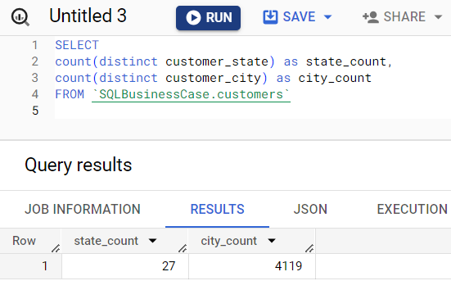
Count the Cities & States of customers who ordered during the given period.
SELECT
count(distinct customer_state) as state_count,
count(distinct customer_city) as city_count
FROM `SQLBusinessCase.customers`

Slide 5
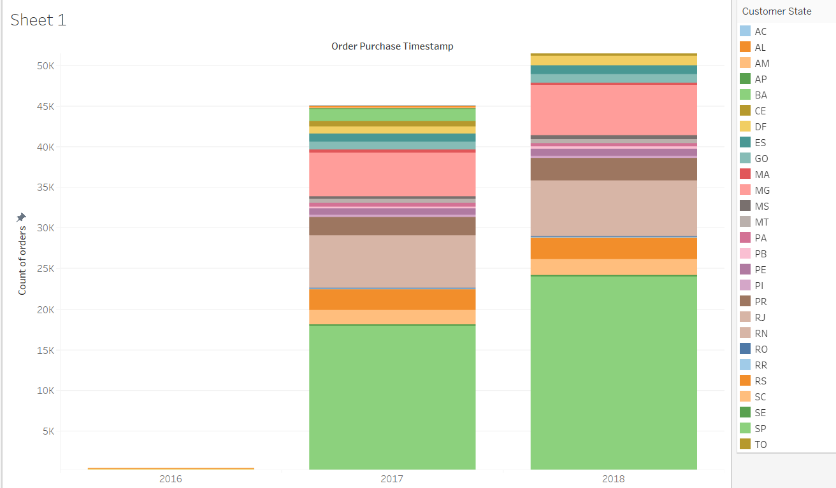
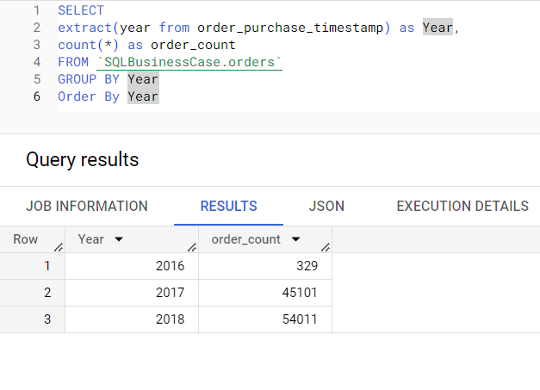
2.In-depth Exploration:
Is there a growing trend in the no. of orders placed over the past years?
SELECT
extract(year from order_purchase_timestamp) as Year,
count(*) as order_count
FROM `SQLBusinessCase.orders`
GROUP BY Year
Order By Year
ANALYSIS – Yes there is a growing trend in the numbers of orders being places over the given years
SATE – SP was the most active contributor to the no. of orders being placed

Slide 6
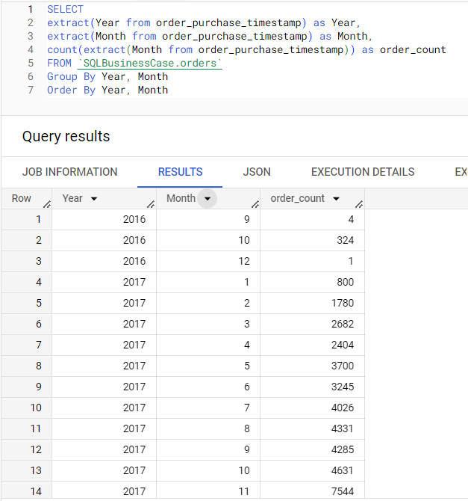
Can we see some kind of monthly seasonality in terms of the no. of orders being placed?
SELECT
extract(Year from order_purchase_timestamp) as Year,
extract(Month from order_purchase_timestamp) as Month,
count(extract(Month from order_purchase_timestamp)) as order_count
FROM `SQLBusinessCase.orders`
Group By Year, Month
Order By Year, Month

Slide 7
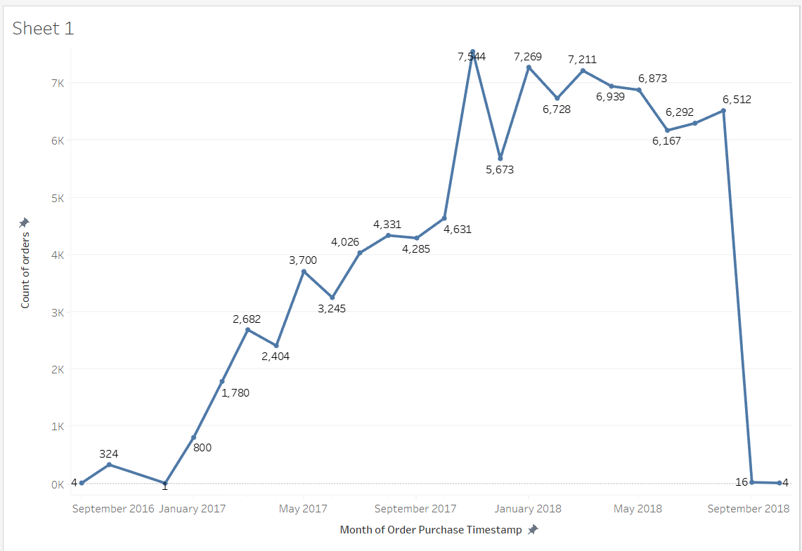
ANALYSIS – In the year 2017 the order_count in November were on BOOM!!!! Which was continued till MAY 2018 and got dropped from 2018 August onwards
Recommendation – we can introduce new products in the market during this time with a nice discount to increase the overall sales

Slide 8
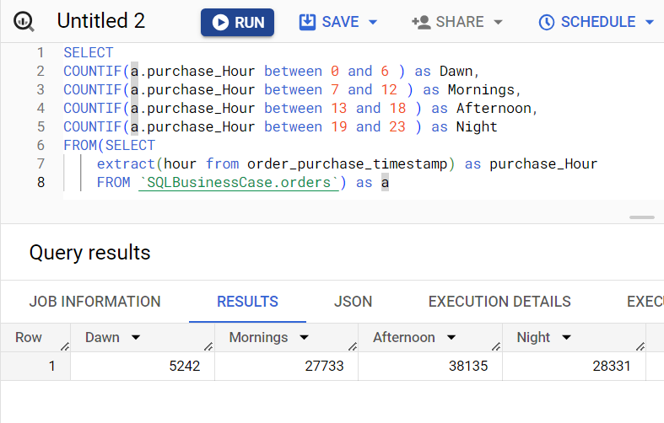
During what time of the day, do the Brazilian customers mostly place their orders? (Dawn, Morning, Afternoon or Night)
0-6 hrs : Dawn
7-12 hrs : Mornings
13-18 hrs : Afternoon
19-23 hrs : Night
SELECT
COUNTIF(a.purchase_Hour between 0 and 6 ) as Dawn,
COUNTIF(a.purchase_Hour between 7 and 12 ) as Mornings,
COUNTIF(a.purchase_Hour between 13 and 18 ) as Afternoon,
COUNTIF(a.purchase_Hour between 19 and 23 ) as Night
FROM(SELECT
extract(hour from order_purchase_timestamp) as purchase_Hour
FROM `SQLBusinessCase.orders`) as a
ANALYSIS – Afternoons > Night time > Mornings > Dawn are the time zones in which customers order most
Recommendation – moreover we can launch deals during this time to attract more customers and by taking data from the question, we can target the market at a particular month frame to BOOM!!! the sales
Recommendation – The quantity of product or the product_stock must be available for the customers

Slide 9
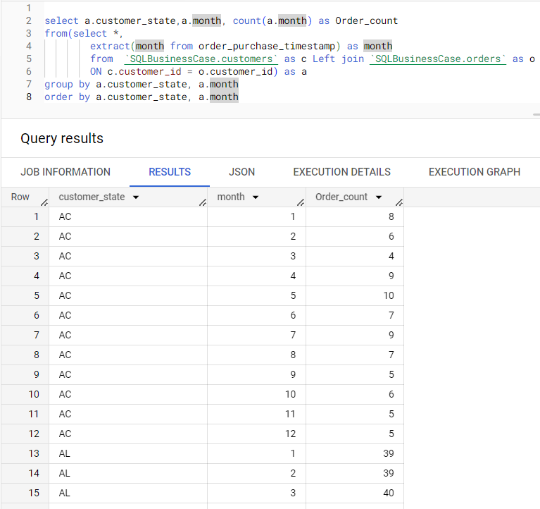
3.Evolution of E-commerce orders in the Brazil region:
Get the month on month no. of orders placed in each state.
select a.customer_state,a.month, count(a.month) as Order_count
from(select *,
extract(month from order_purchase_timestamp) as month
from `SQLBusinessCase.customers` as c Left join `SQLBusinessCase.orders` as o
ON c.customer_id = o.customer_id) as a
group by a.customer_state, a.month
order by a.customer_state, a.month
Analysis – Based on the aggregation firstly done on state then on month, as it is giving clear idea about difference in order_count for each month,
We can figure out the state and the month range which contribute most in order_count

Slide 10
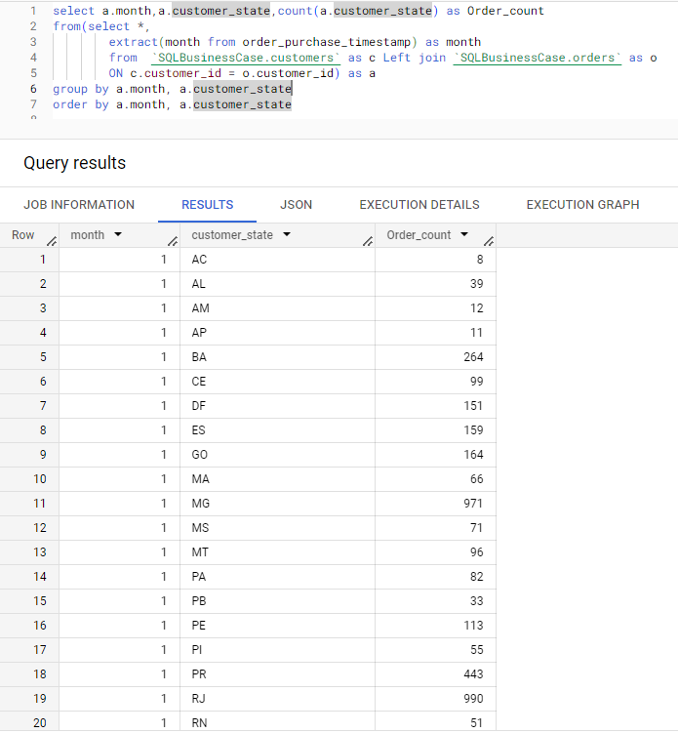
3.Evolution of E-commerce orders in the Brazil region:
Get the month on month no. of orders placed in each state.
select a.month,a.customer_state,count(a.customer_state) as Order_count
from(select *,
extract(month from order_purchase_timestamp) as month
from `SQLBusinessCase.customers` as c Left join `SQLBusinessCase.orders` as o
ON c.customer_id = o.customer_id) as a
group by a.month, a.customer_state
order by a.month, a.customer_state
Analysis – Based on the aggregation firstly done on month then on state

Slide 11
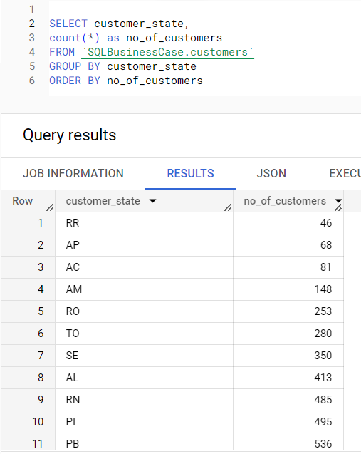
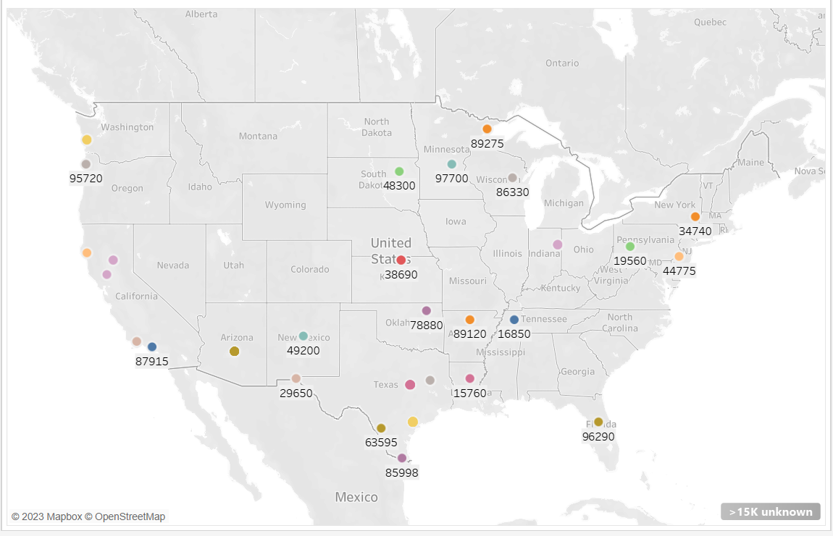
How are the customers distributed across all the states?
SELECT customer_state,
count(*) as no_of_customers
FROM `SQLBusinessCase.customers`
GROUP BY customer_state
ORDER BY no_of_customers

Slide 12
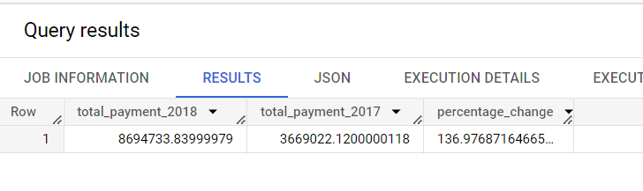
4. Impact on Economy: Analyze the money movement by e-commerce by looking at order prices, freight and others.
Get the % increase in the cost of orders from year 2017 to 2018 (include months between Jan to Aug only). You can use the "payment_value" column in the payments table to get the cost of orders.
select x.total_payment_2018, y.total_payment_2017,
((x.total_payment_2018 - y.total_payment_2017)/y.total_payment_2017)*100 as percentage_change
from
(select SUM(a.payment_value) as total_payment_2018,
row_number() over(order by SUM(a.payment_value)) as id1
from(SELECT *,
extract(Year from o.order_purchase_timestamp) as Year
FROM `SQLBusinessCase.payments` as p inner join `SQLBusinessCase.orders` as o
ON p.order_id = o.order_id
WHERE extract(Year from o.order_purchase_timestamp) IN (2017, 2018)
and extract(Month from o.order_purchase_timestamp) between 1 and 8 ) as a
Group by a.Year
order by a.Year desc
LIMIT 1) as x join
(select SUM(a.payment_value) as total_payment_2017,
ROW_Number() over(order by SUM(a.payment_value)) as id2
from(SELECT *,
extract(Year from o.order_purchase_timestamp) as Year
FROM `SQLBusinessCase.payments` as p inner join `SQLBusinessCase.orders` as o
ON p.order_id = o.order_id
WHERE extract(Year from o.order_purchase_timestamp) IN (2017, 2018)
and extract(Month from o.order_purchase_timestamp) between 1 and 8 ) as a
Group by a.Year
order by a.Year desc
LIMIT 1 offset 1) as y
ON x.id1 != y.id2

Slide 13
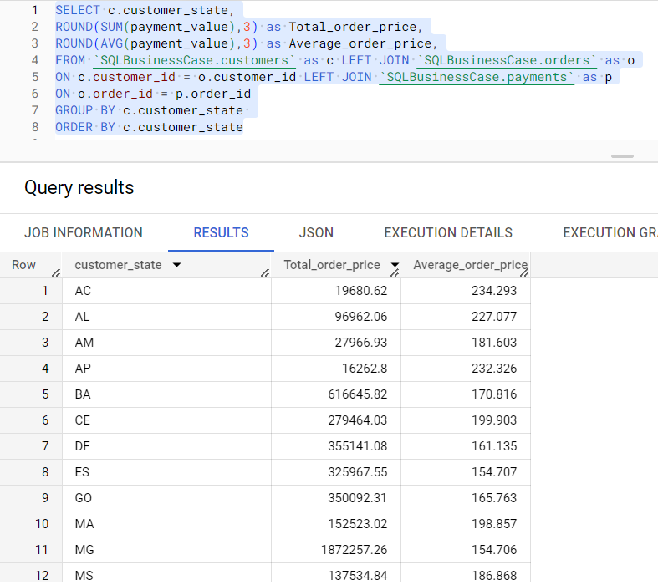
Calculate the Total & Average value of order price for each state.
SELECT c.customer_state,
ROUND(SUM(payment_value),3) as Total_order_price,
ROUND(AVG(payment_value),3) as Average_order_price,
FROM `SQLBusinessCase.customers` as c LEFT JOIN `SQLBusinessCase.orders` as o
ON c.customer_id = o.customer_id LEFT JOIN `SQLBusinessCase.payments` as p
ON o.order_id = p.order_id
GROUP BY c.customer_state
ORDER BY c.customer_state

Slide 14
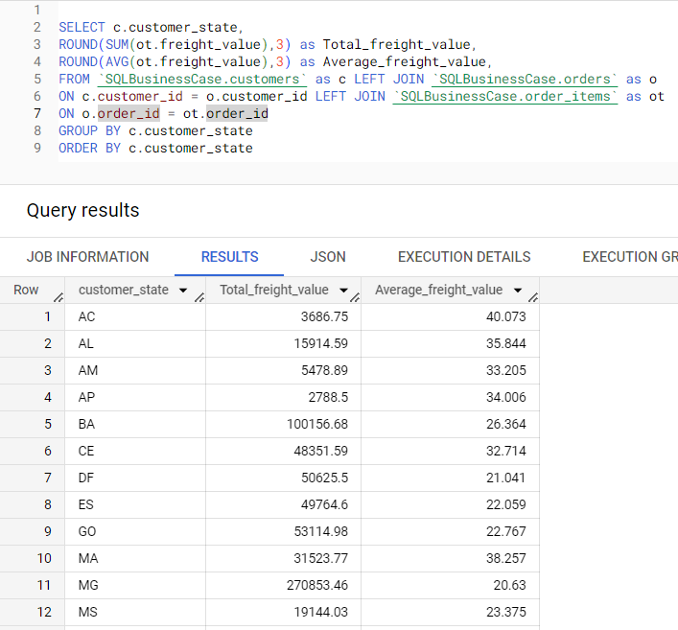
Calculate the Total & Average value of order freight for each state.
SELECT c.customer_state,
ROUND(SUM(ot.freight_value),3) as Total_freight_value,
ROUND(AVG(ot.freight_value),3) as Average_freight_value,
FROM `SQLBusinessCase.customers` as c LEFT JOIN `SQLBusinessCase.orders` as o
ON c.customer_id = o.customer_id LEFT JOIN `SQLBusinessCase.order_items` as ot
ON o.order_id = ot.order_id
GROUP BY c.customer_state
ORDER BY c.customer_state

Slide 15
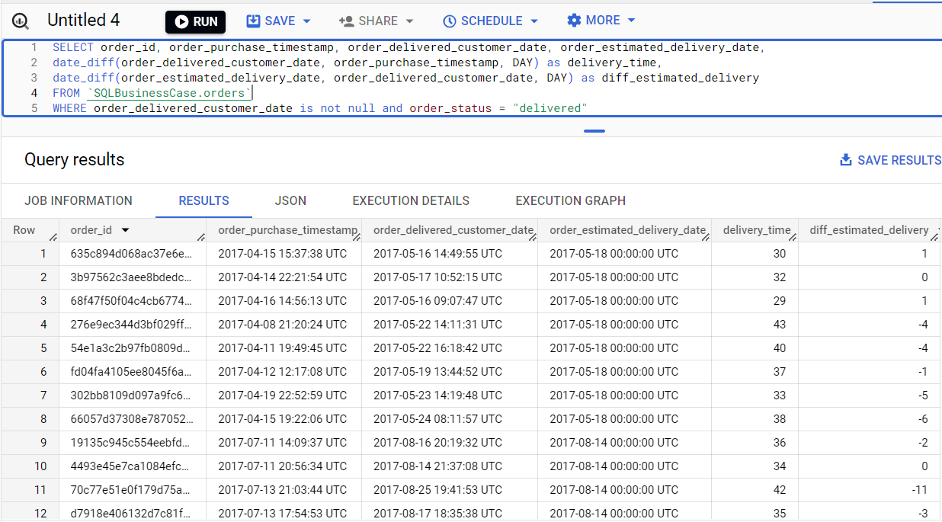
5. Analysis based on sales, freight and delivery time.
Find the no. of days taken to deliver each order from the order’s purchase date as delivery time. Also, calculate the difference (in days) between the estimated & actual delivery date of an order. Do this in a single query.
SELECT order_id, order_purchase_timestamp, order_delivered_customer_date, order_estimated_delivery_date,
date_diff(order_delivered_customer_date, order_purchase_timestamp, DAY) as delivery_time,
date_diff(order_estimated_delivery_date, order_delivered_customer_date, DAY) as diff_estimated_delivery
FROM `SQLBusinessCase.orders`
WHERE order_delivered_customer_date is not null and order_status = "delivered"

Slide 16
Find out the top 5 states with the highest & lowest average freight value.
WITH L as
(SELECT c.customer_state as Lowest_state,
ROUND(AVG(ot.freight_value),3) as Lowest_freight_value,
ROW_NUMBER() over(order by ROUND(AVG(ot.freight_value),3)) as id1,
FROM `SQLBusinessCase.customers` as c LEFT JOIN `SQLBusinessCase.orders` as o
ON c.customer_id = o.customer_id LEFT JOIN `SQLBusinessCase.order_items` as ot
ON o.order_id = ot.order_id
GROUP BY c.customer_state
LIMIT 5
),
H as
(SELECT c.customer_state as Highest_state,
ROUND(AVG(ot.freight_value),3) as Highest_freight_value,
ROW_NUMBER() over(order by ROUND(AVG(ot.freight_value),3) desc) as id2,
FROM `SQLBusinessCase.customers` as c LEFT JOIN `SQLBusinessCase.orders` as o
ON c.customer_id = o.customer_id LEFT JOIN `SQLBusinessCase.order_items` as ot
ON o.order_id = ot.order_id
GROUP BY c.customer_state
LIMIT 5
)
SELECT L.Lowest_state, L.Lowest_freight_value, H.Highest_state, H.Highest_freight_value
FROM L INNER JOIN H
ON L.id1 = H.id2

Slide 17
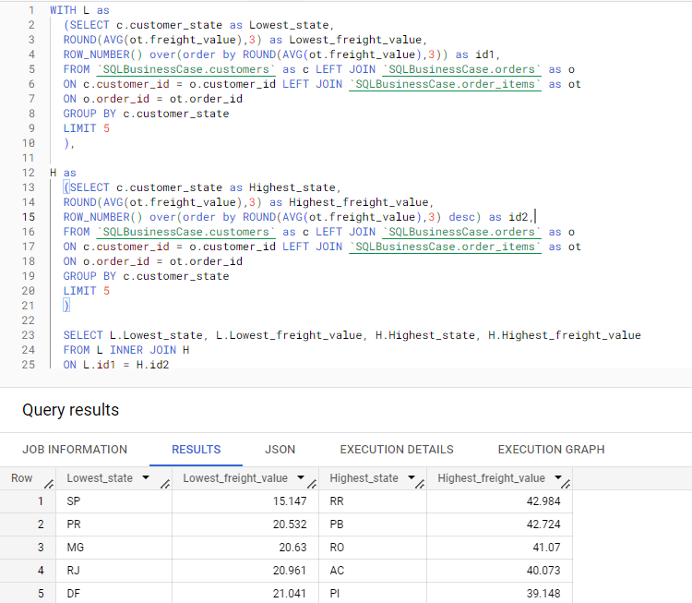

Slide 18
Find out the top 5 states with the highest & lowest average delivery time.
WITH L as
(SELECT c.customer_state as Low_state,
AVG(t.delivery_time) as Low_AVG_del_time,
ROW_NUMBER() over(order by AVG(t.delivery_time)) as id1
FROM `SQLBusinessCase.customers` as c RIGHT JOIN (SELECT order_id,customer_id,
date_diff(order_delivered_customer_date, order_purchase_timestamp, DAY) as delivery_time
FROM `SQLBusinessCase.orders`
WHERE order_delivered_customer_date is not null and order_status = "delivered") as t
ON c.customer_id = t.customer_id
GROUP BY c.customer_state
LIMIT 5
),
H as(
SELECT c.customer_state as High_state,
AVG(t.delivery_time) as High_AVG_del_time,
ROW_NUMBER() over(order by AVG(t.delivery_time) desc) as id2
FROM `SQLBusinessCase.customers` as c RIGHT JOIN (SELECT order_id,customer_id,
date_diff(order_delivered_customer_date, order_purchase_timestamp, DAY) as delivery_time
FROM `SQLBusinessCase.orders`
WHERE order_delivered_customer_date is not null and order_status = "delivered") as t
ON c.customer_id = t.customer_id
GROUP BY c.customer_state
LIMIT 5
)
SELECT L.Low_state, L.Low_AVG_del_time, H.High_state, H.High_AVG_del_time
FROM L INNER JOIN H
ON L.id1 = H.id2

Slide 19
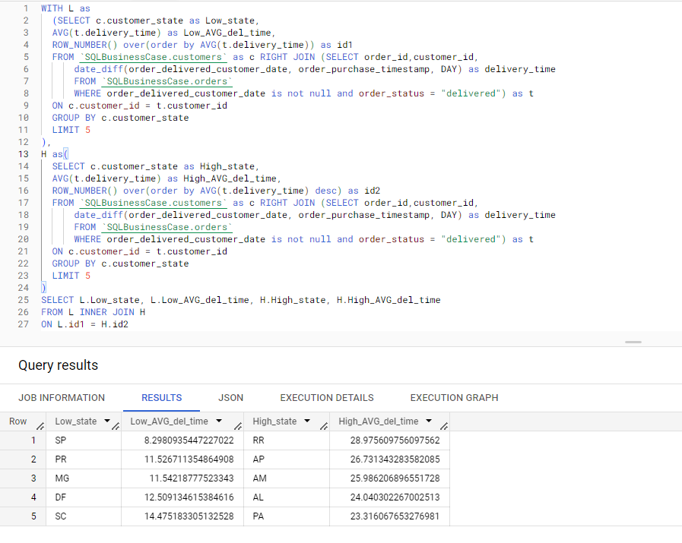

Slide 20
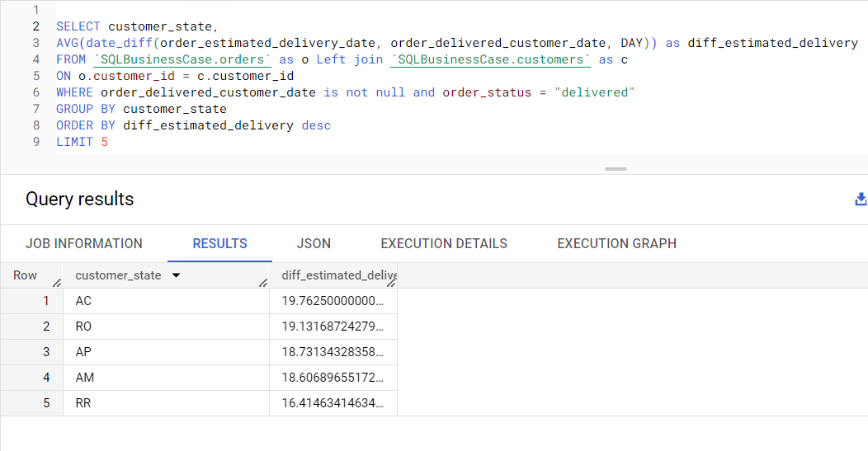
Find out the top 5 states where the order delivery is really fast as compared to the estimated date of delivery. You can use the difference between the averages of actual & estimated delivery date to figure out how fast the delivery was for each state.
SELECT customer_state,
AVG(date_diff(order_estimated_delivery_date, order_delivered_customer_date, DAY)) as diff_estimated_delivery
FROM `SQLBusinessCase.orders` as o Left join `SQLBusinessCase.customers` as c
ON o.customer_id = c.customer_id
WHERE order_delivered_customer_date is not null and order_status = "delivered"
GROUP BY customer_state
ORDER BY diff_estimated_delivery desc
LIMIT 5

Slide 21
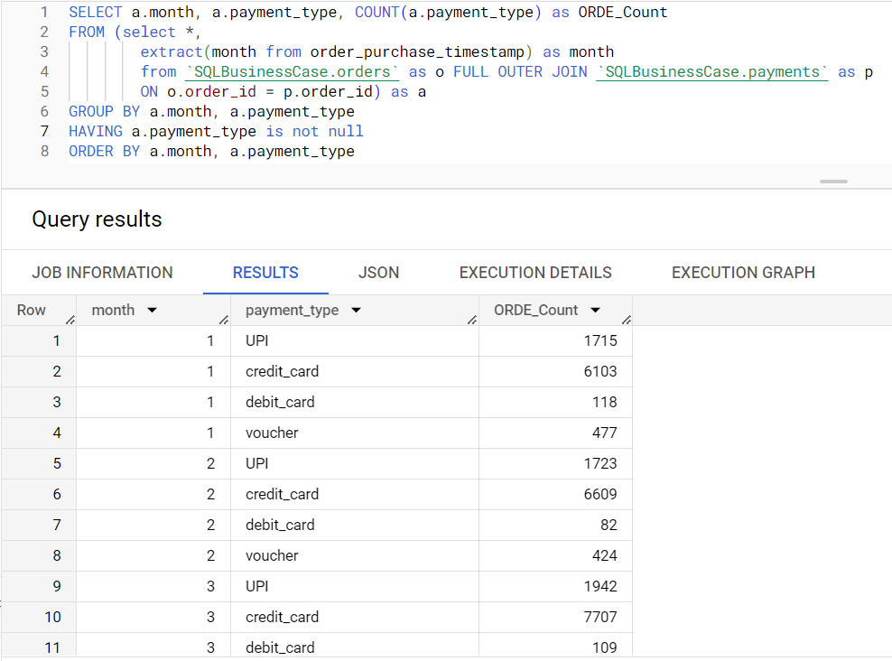
6. Analysis based on the payments:
Find the month on month no. of orders placed using different payment types.
SELECT a.month, a.payment_type, COUNT(a.payment_type) as ORDE_Count
FROM (select *,
extract(month from order_purchase_timestamp) as month
from `SQLBusinessCase.orders` as o FULL OUTER JOIN `SQLBusinessCase.payments` as p
ON o.order_id = p.order_id) as a
GROUP BY a.month, a.payment_type
HAVING a.payment_type is not null
ORDER BY a.month, a.payment_type

Slide 22
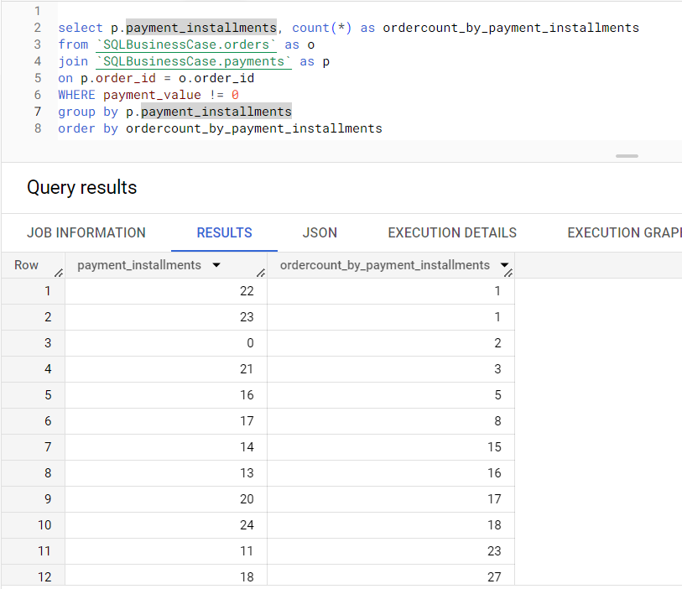
Find the no. of orders placed on the basis of the payment installments that have been paid.
select p.payment_installments, count(*) as ordercount_by_payment_installments
from `SQLBusinessCase.orders` as o
join `SQLBusinessCase.payments` as p
on p.order_id = o.order_id
WHERE payment_value != 0
group by p.payment_installments
order by ordercount_by_payment_installments

