Slide 1
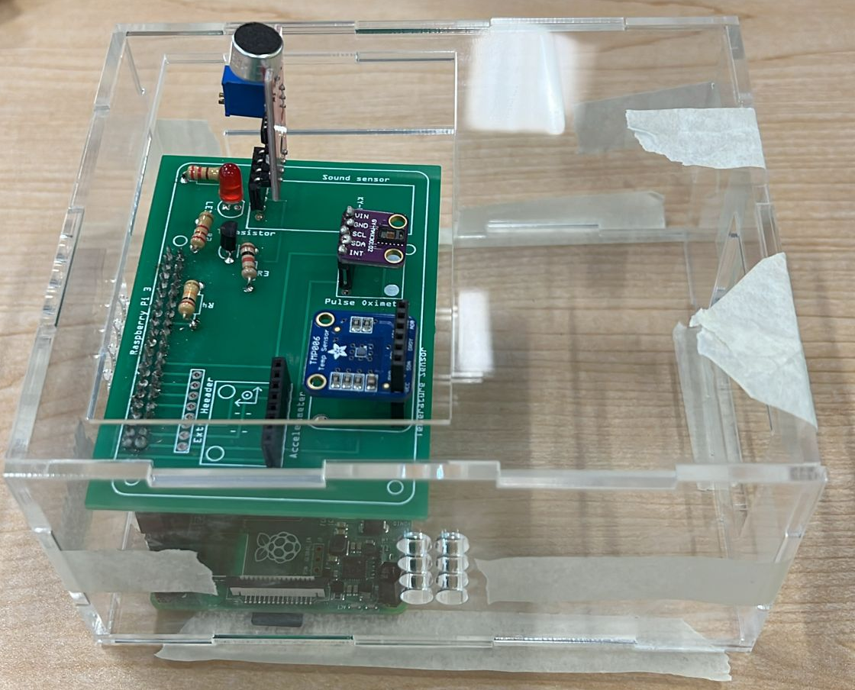
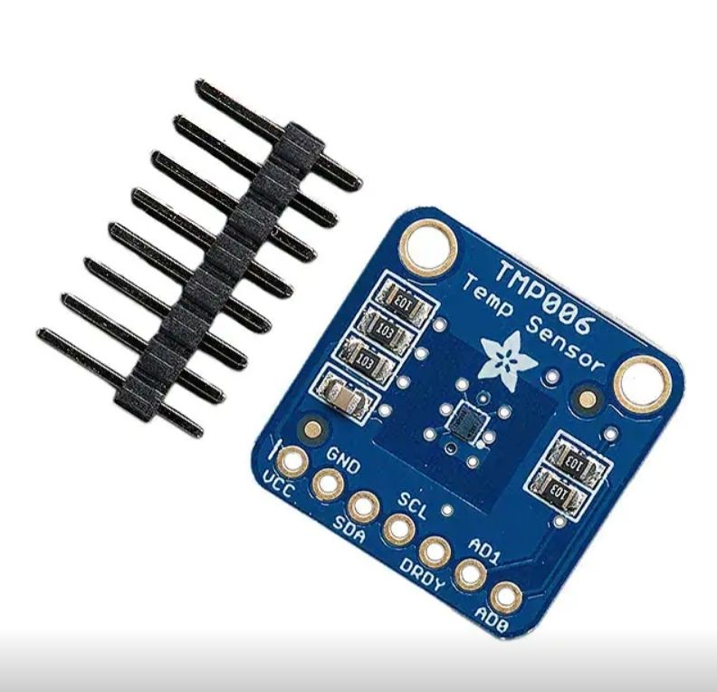
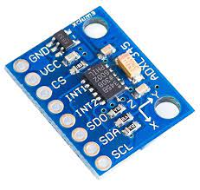
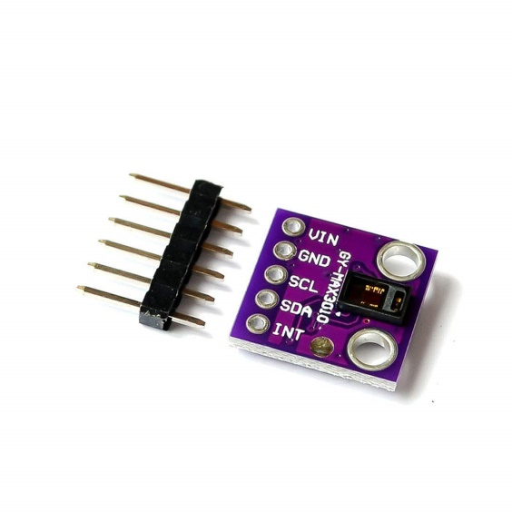
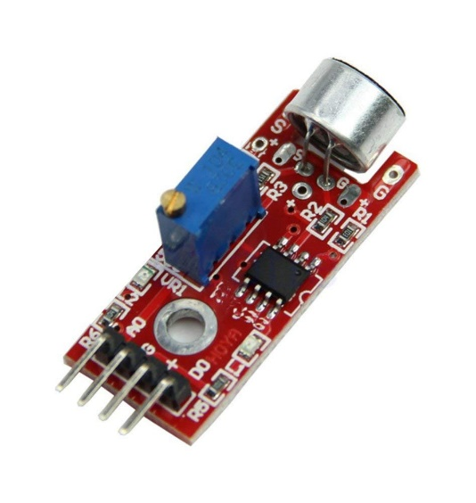
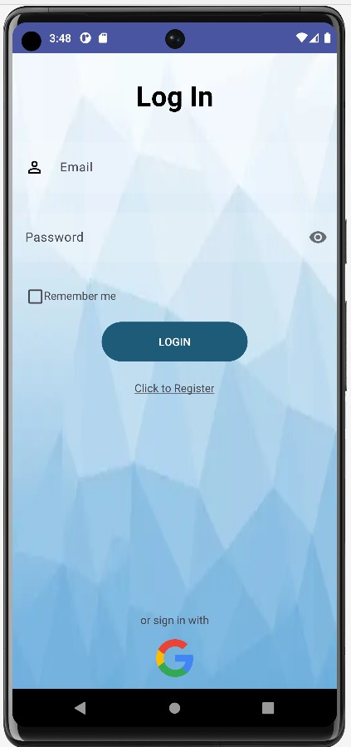
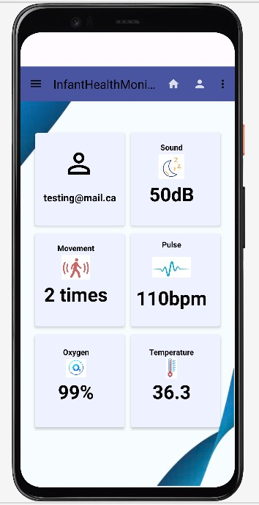
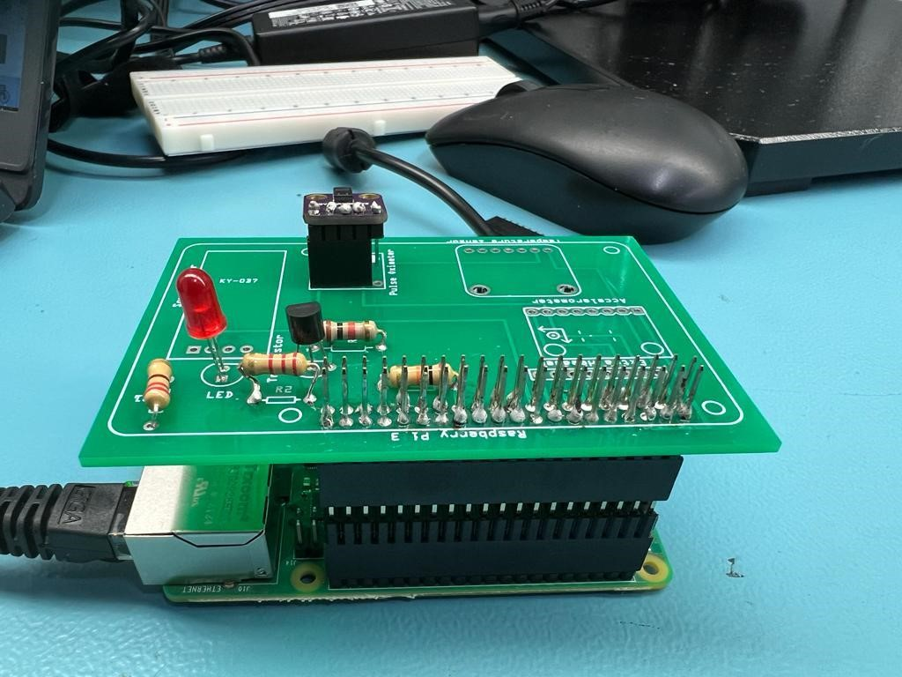
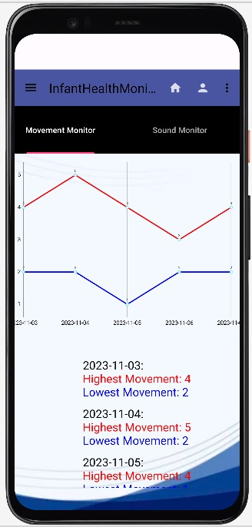
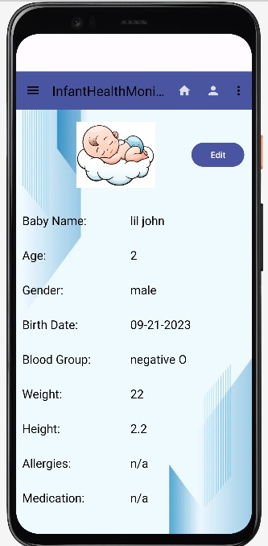
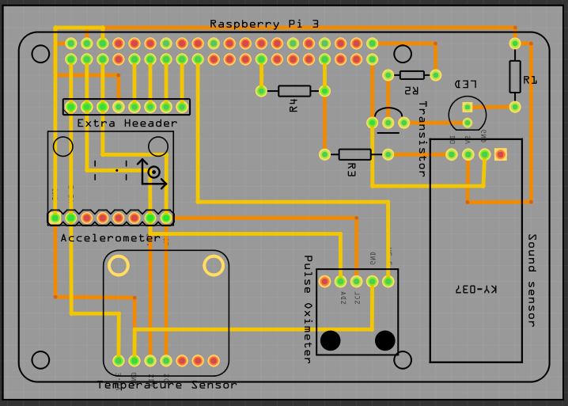
Infant Health Monitor
Naman Pal, Zoyeba Mahbub, Satinder Kaur, Eshan Salwan
Faculty of Applied Sciences and Technology, Humber College
INTRODUCTION
HARDWARE DEVELOPMENT
SOFTWARE DEVELOPMENT
PRINTING
Embark on the cutting edge of infant care with our capstone innovation –the Infant Health Monitor System. Powered by a Raspberry Pi-connected PCB board, it seamlessly integrates advanced sensors for real-time monitoring through a user-friendly app. This empowers both parents and healthcare providers to effortlessly nurture the well-being of our little ones. Welcome to a revolutionary era in caregiving.
Meet the components enhancing our system:
In the project's initial phase, we meticulously selected individual sensors aligned with our objectives and proceeded with their development and testing on a breadboard, ensuring optimal functionality. Following successful individual testing, we transitioned to the creation of PCB designs in a Fritzing file. Through collaborative planning, design approval, and file transfer to PDF, we engaged an online vendor for custom PCB production. Upon receiving the PCB, rigorous tests using a digital multimeter validated each section, confirming expected results. This paved the way for powering up the Raspberry Pi with the PCB, seamlessly integrating each sensor and conducting comprehensive tests that yielded anticipated results.
,
Our team is excited to present a live demonstration featuring an intricately designed acrylic box. Within this transparent showcase, you'll witness the seamless integration of our state-of-the-art sensors and central processing unit, meticulously crafted to emulate the functionality of a real-life health band.
Users can securely log in with existing email accounts or create new ones. Upon login, they are directed to the homepage, which features dynamic card views displaying real-time sensor data via Firebase. Users can navigate to view sensor readings for the past seven days, presented as maximum and minimum values in the graph. The Profile screen allows users to securely input and save infant details, instantly updating the mobile app.
CONCLUSION
Android studio. (2023) Screenshot of Login Page of Infant Health Monitor
The Infant Health Monitor is an advanced system for comprehensive child health monitoring, exceeding basic standards with tailored solutions and vital metric displays. Reflecting the latest healthcare advancements, it ensures precise monitoring. Committed to advancing child health monitoring, we focus on enhancing physical design durability, efficiency, and optimizing sensing technologies to introduce an innovative Infant Health Monitor, setting a new benchmark for precision in safeguarding infant well-being.
TMP006
ADXL345
MAX30102
LM393
TMP006: Continuous temperature tracking for timely response to variations.
ADXL345: Movement detection for monitoring infant activity levels.
MAX30102: Real-time monitoring for precise assessment of the infant's heart rate and oxygen level.
LM393: Cry detection to alert caregivers for prompt attention to the baby's needs.
Android studio. (2023) Screenshot of Home Screen of Infant Health Monitor
AIM
Testing of MAX30102 sensor, connected to the PCB Board, which is in turn linked to the Raspberry Pi for seamless integration and effective data transmission.
Android studio. (2023) Screenshot of Motion Screen of Infant Health Monitor
ACKNOWLEDGEMENTS
Our objective is to provide parents/caregivers, a convenient way to monitor their infant’s health in real-time. Parents can easily keep track of their baby's vital signs and receive alerts if anything seems unusual. Ultimately, the project aims to help parents ensure their baby's well-being.
We express my thanks to Professors Ali Maki, Kristian Medri, Meirion Williams, and Haki Sharifi for their crucial guidance in shaping the project. Special appreciation is extended to FAST for their substantial support in transforming the InfantHealthMonitor concept into a reality.
Android studio. (2023) Screenshot of Profile Screen of Infant Health Monitor
Layout of PCB Board comprises all the four sensors in the Fritzing

