Slide 1

Healthcare Diagnosis: Machine Learning Based Diabetes Risk Assessment
Submitted by:- Under the Guidance of :-
Naman Rana Dr.Meenakshi Memoria

Slide 2

Overview
Introduction
Objective and scope
Design of project model
Methodology
What contribution would the project make
Workflow till now
Testing
Conclusion
References

Slide 3
Introduction
Diabetes is a serious health condition that affects millon of people world-wide. According to the World Health Organization (WHO),the number of people with diabetes has nearly quadrupled since 1980.
Imagine if we could use technology to help doctors and healthcare professionals predict who might develop diabetes in future .This is what this project is all about!
We are using special math (called “machine learning ”) .It can analyze a persons’s health data and give a warning if it thinks they might get diabetes someday.

Slide 4

Objective and Scope
Develop a Predictive Model: The primary objective of this project is to develop a predictive model that can accurately identify individuals at risk of developing diabetes.
Early detection: Enable early detection of diabetes risk factors.By identifying individuals at risk early on,we aim to facilitate timely intervention and preventive measures to reduce the likelihood of diabetes development.
Enhance Healthcare Decision-Making: Provide healthcare professionals with a valuable tool to assist in their diagnostic and risk assessment processes.
Collaboration with Experts: Collaboration with healthcare professionals, researchers ,and relevant stakeholders maybe part of the project scope to ensure that the model aligns with clinical needs and best practices.
Future Scalability: While the primary scope is focused on diabetes prediction,the project mat suggest areas for future enhancements ,such as incorporating more data sources , expanding the model’s capabilities,or exploring related healthcare applications

Slide 5
Process Description
Data Collection
Data Preprocessing
Model Development
Model Selection
User Interface(UI)

Slide 6
Methodology
Firstly we will gather data from data sources(yahoo finance & Wikipedia feeds).
Then we will pre-process the data to keep the essential data we need.
Then after processing we will split the data into two parts(Training data and Testing data).
After this we will train our algorithm(Logistic regression) with our training data set.
After these steps we will test our data with testing techniques(Backtracking) and Test data sets.
After that we will improve our accuracy and then test that again.
If all the cases passes then we will give it a GUI interface for easy use.

Slide 7
What contribution would the project make
Informed Decision-Making.
Risk Management.
Disease Detection
Health Awareness
Alleviate Healthcare Burdens
Encouraging Sustainable Health Practices.

Slide 8
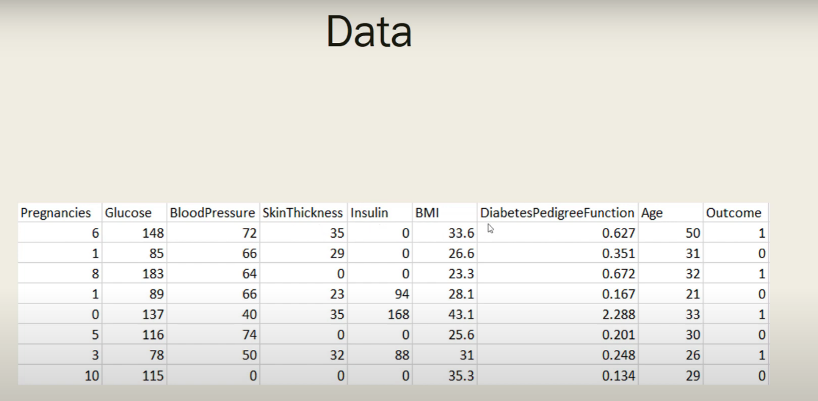
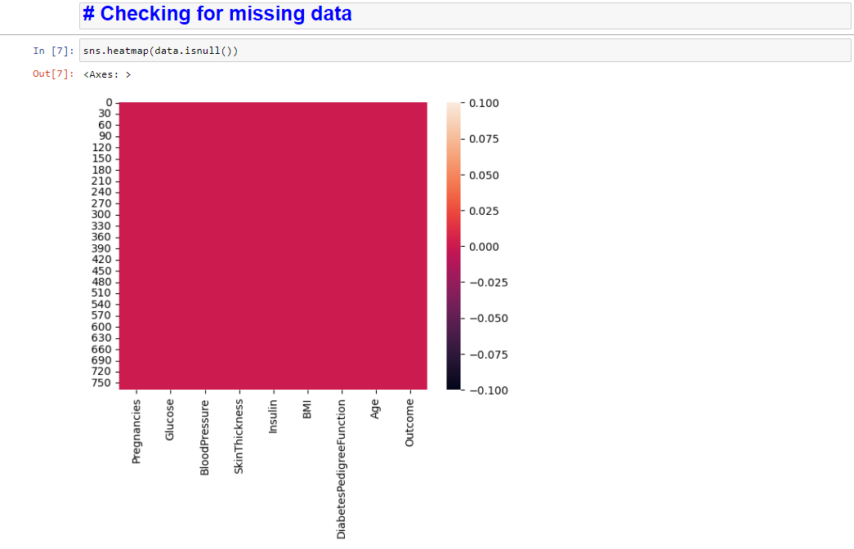

Slide 9
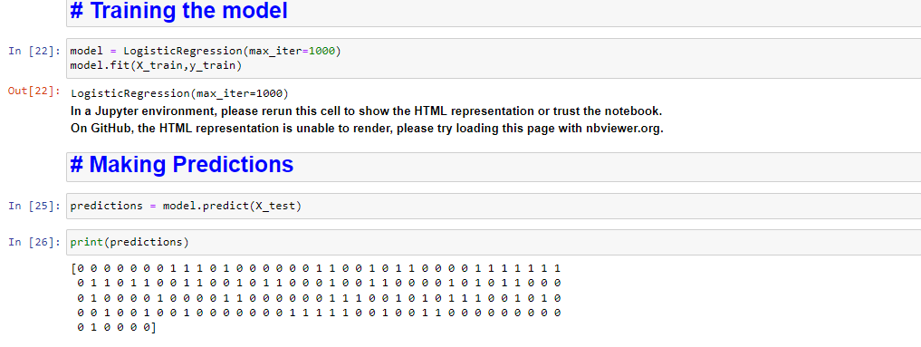

Slide 10
Testing Technologies used
Testing is done by the following methods :-
Back tracking – we test in the previous data our predictor is it working properly or not.
Providing different test cases.- we provide different time frames to test our model to check its accuracy.

Slide 11
Conclusion
In conclusion , this project represents a meaningful contribution to the healthcare domain, emphasizing the importance of data – driven approaches to disease risk assessment .While we acknowledge its limitations ,we remain committed to the ongoing pursuit of innovation, ethics ,and collaboration in our collective effort to combat the global challenge of diabetes and improve thew well-being of individuals.

Slide 12
References
Gauri D. Kalyankar, Shivananda R. Poojara and Nagaraj V. Dharwadkar,” Predictive Analysis of Diabetic Patient Data Using Machine Learning and Hadoop”, International Conference On I-SMAC,978-1-5090-3243-3,2017.
Ayush Anand and Divya Shakti,” Prediction of Diabetes Based on Personal Lifestyle Indicators”, 1st International Conference on Next Generation Computing Technologies, 978-1-4673-6809-4, September 2015.
Dr Saravana kumar N M, Eswari T, Sampath P and Lavanya S,” Predictive Methodology for Diabetic Data Analysis in Big Data”, 2nd International Symposium on Big Data and Cloud Computing,2015.

Slide 13
Thank you

