Slide 1


MINOR PROJECT · B.TECH MATHEMATICS AND COMPUTING
Punjab Engineering College (Deemed to be University), Chandigarh
Optimization-Based Resource Allocation for Public Bus Fleet Scheduling under Demand Variability
Case study: Chandigarh Transport Undertaking (CTU) · Final presentation
UNDER THE GUIDANCE OF
SUBMITTED BY
Dr. Sumati Mahajan
Department of Mathematics, PEC
Daksh Garg (24112005)
Piyush Aggarwal (24112006)
Abhay Chauhan (24112015)
Naman Vasudev (24112032)
Notes:
Introduce the team and the project: allocating CTU's existing bus fleet across routes and time periods when demand is uncertain.

Slide 2
Bus supply rarely matches passenger demand
INTRODUCTION
Fixed-route buses are the most accessible public transport mode for Indian commuters.
A transport undertaking must spread a finite fleet over many routes whose demand changes by place and time of day.
When departures do not follow demand, the network fails in two directions at once.
High-demand corridors
Overcrowding and long waits; passengers left behind by full buses
!
Low-demand corridors
Spare capacity and near-empty runs that still cost fuel and driver hours
↓
Notes:
Motivation: the same fleet is over-stretched on some corridors and under-used on others.

Slide 3
CTU: a fixed fleet, 68 routes, no public ridership data
INTRODUCTION · CASE STUDY AND PROBLEM
68
389
1,662 km
649
routes (Depots II, III, IV)
buses allocated
total route length
named stops
Given
Decide
So that
A fixed fleet (389 buses)
Routes with published headway ranges and lengths
Three periods: AM 07-10, Midday 10-16, PM 16-19
A headway for every route and period
The number of buses each route needs
Waiting and overcrowding fall
Vehicle-km stays within budget
No route waits beyond the equity cap
Fleet and cycle-time limits hold
Notes:
Data source: the CTU timetable as on 25.07.2026. Ridership is not public, so demand in this study is synthetic.

Slide 4
Frequency setting is a fleet-constrained planning step
LITERATURE REVIEW · TRANSIT PLANNING
Ceder (2016) [1]
Furth & Wilson (1981) [3]
Planning chain from network design to frequencies, timetables and crews.
Use here: frames our stage: frequencies and buses for fixed routes.
Allocates buses across routes and periods under fleet and loading limits.
Use here: the same structure as our fleet and capacity constraints.
Martínez et al. (2014) [5]
Verbas & Mahmassani (2015) [6]
MILP for frequency setting with a discrete set of frequencies.
Use here: justifies our headway menu with binary choices.
Frequency allocation over routes and time periods with explicit trade-offs.
Use here: supports period-wise allocation and trade-off analysis.
Notes:
Reviews of the field: Ibarra-Rojas et al. (2015) and Ceder & Wilson (1986) place frequency setting between network design and timetabling.

Slide 5
Multi-objective and uncertainty methods we build on
LITERATURE REVIEW · METHODS
Deb et al. (2002): NSGA-II [7]
Mavrotas (2009, 2013): AUGMECON [8, 9]
Elitist GA with non-dominated sorting and crowding distance.
Use here: heuristic Pareto front, benchmarked against an exact one.
Augmented ε-constraint: only strictly efficient points; exact for integer programs.
Use here: our exact Pareto front.
Zimmermann; Inuiguchi & Ramík [13, 14]
Charnes & Cooper; Jones & Tamiz [10, 11]
Fuzzy multi-objective LP (1978); possibilistic programming via α-level cuts (2000).
Use here: triangular fuzzy demand with an α-cut capacity rule.
Goal programming (1961): targets, deviations; preemptive vs weighted forms (2010).
Use here: priority scenarios for passengers, operator and equity.
Notes:
Stochastic alternatives exist (An & Lo 2016; Gkiotsalitis et al. 2022). We use fuzzy numbers because no data exist to fit probability distributions.

Slide 6
Standards, Indian evidence and the gap
LITERATURE REVIEW · STANDARDS AND GAP
Reliability standard: Excess Wait Time
TfL plans bus services against published guidelines [21]; Singapore's reliability framework rewards operators on Excess Wait Time [20]. We report EWT = (h/2)·CV².
Research gap
Our verified search (2014-2026) found no study applying goal programming to bus frequency or fleet allocation.
CTU publishes no ridership, so the method must work with fuzzy, synthetic demand and be ready for real data.
The synopsis model had four mathematical errors that had to be corrected first.
Indian bus speeds
GPS studies: Chennai buses average 17.8 km/h (peak) and 21.5 km/h (off-peak) [22]; speeds vary strongly across Ahmedabad [23]. This sets our 18-26 km/h test range.
Notes:
The gap statement is limited to what our search found; we do not claim no such study exists.

Slide 7
Project objectives
OBJECTIVES
1
Build a validated CTU baseline from the published timetable: routes, headways, buses, stops.
2
Formulate a corrected, linear multi-objective MILP for headways and bus allocation.
Aim
Less waiting and crowding using the existing fleet, without additional buses.
3
Represent uncertain demand with triangular fuzzy numbers and an α-cut capacity rule.
4
Balance waiting, operating effort, crowding and equity with goal programming; cross-check on an exact Pareto front (AUGMECON 20×20 grid).

Slide 8
Seven-stage pipeline, fully reproducible
METHODOLOGY · PIPELINE
1
Data audit
2
Calibration
3
Demand
4
MILP
Timetable → validated route table
Cycle time τ vs fleet
Synthetic, fuzzy (L, M, U)
Headway menu, Z1-Z3
5
Goal programming
6
Pareto
7
[FUTURE] Simulation
Priority scenarios
AUGMECON 2D and 3D
[FUTURE] 2,000 demand days, sensitivity
One command (python run_all.py) regenerates every table and figure; 100 automated tests check data, model, solvers.

Slide 9
A linear multi-objective MILP over a headway menu
METHODOLOGY · MATHEMATICAL MODEL
Objectives (minimise)
Constraints
Z₁ = Σ M_{rt} Σ_{k} (h_{k}/2) y_{rtk}
1
Σ_{r} x_{rt} ≤ B_{eff} = 357 fleet in every period
waiting (pax·min/h), linear in binaries y
2
τ_{r} f_{rt} ≤ x_{rt}, x integer buses needed to run a frequency
Z₂ = Σ d_{r}^{cyc} H_{rt} f_{rt}
3
o_{rt} ≥ D_{rt}^{α} − C f_{rt}, o ≥ 0 overflow above capacity C = 60
vehicle-km per day
Z₃ = Σ o_{rt} H_{rt}
4
f_{r}^{min} ≤ f_{rt} ≤ f_{r}^{max} published bounds, via the menu
passengers above capacity per day
5
|x_{rt} − x_{r}⁰| ≤ dev_{r}; headway cap practicality, equity
Notes:
Sizes: 191 active route-periods, 651 variables, 576 constraints. Menu 10, 12, 15, 20, 25, 30, 40, 45, 60, 90 min plus each route's published headways.

Slide 10
Fuzzy demand, priorities, Pareto check and simulation
METHODOLOGY · UNCERTAINTY AND SOLUTION
Fuzzy demand
Goal programming
Triangular (L, M, U) with L = 0.80M, U = 1.35M. Capacity planned for the upper α-cut Dα = U − α(U − M); α = 1 gives M, α = 0 gives U.
G1 waiting −4%, G2 overflow 0, G3 vehicle-km −3%, G4 headway caps 60/90 min. Preemptive (3 priority orders), weighted and Chebyshev forms.
Pareto cross-check
Simulation
Exact AUGMECON on a 20×20 grid → 46 strictly efficient points
[Future] Simulation: 2,000 synthetic demand days with gamma headways — Phase 8

Slide 11
Only the one-way reading of route length fits the fleet
RESULTS · DATA AND CALIBRATION
Data audit
68/68 routes match the PDF; totals 389 buses, 1,662 km; 17 rounded cells corrected.
Full-cycle reading fails
Only 44.2% of the fleet would be used, and 57 of 68 routes would hold more buses than their maximum frequency needs.
Chosen setting
One-way length, 22 km/h, 10% layover: 96.4% fleet use with spares. CTU must confirm the length convention.
Notes:
Implied speed that exactly fills the fleet: 19.3 km/h without spares, 21.2 km/h with 10% spares.

Slide 12
Priorities matter once frequency limits are relaxed
RESULTS · GOAL PROGRAMMING
Scenario | Priority | Waiting | Vehicle-km | Overflow | Above cap (min) | Goals met
P-PASSENGER | overflow > wait > equity > km | −4.0% | −2.5% | −29.6% | 100 | 0 of 4
P-OPERATOR | km > overflow > wait > equity | −3.8% | −3.0% | −29.6% | 100 | 1 of 4
P-EQUITY | equity > overflow > wait > km | −4.0% | −3.1% | −26.4% | 0 | 3 of 4
P-BALANCED | equal normalised weights | −4.1% | −3.1% | −26.4% | 0 | 3 of 4
CHEBYSHEV | min-max deviation | −3.8% | −3.0% | −29.6% | 100 | 0 of 4
Changes vs the published schedule; f_max relaxed by two menu levels, α = 0.5. With published f_max all five scenarios give the same schedule (waiting +0.8%, overflow −0.6%): nothing to prioritise. G2 (zero overflow) is unattainable by design; targets were set inside the attainable range after the ideal values were known.

Slide 13
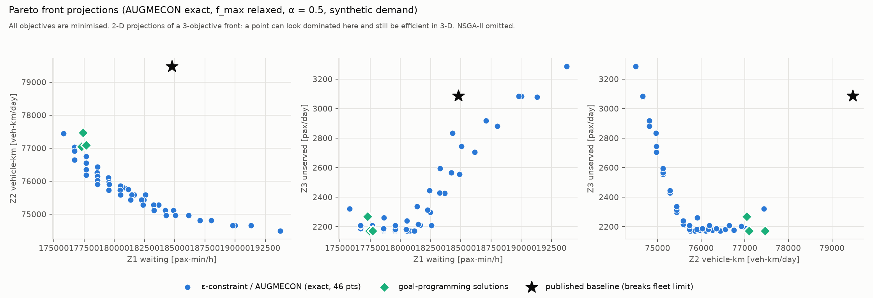
Exact Multi-Objective Pareto Front (2-D Trade-Offs)
RESULTS · PARETO CROSS-CHECK
46
0.946
0
59.7 s
exact efficient points (AUGMECON 20×20)
Hypervolume = 0.946: Front captures 94.6% of the multi-objective solution space
0 Dominated Points: Mathematically verifies all 46 schedules are strictly non-dominated
AUGMECON 20×20 grid solve time
Notes:
NSGA-II's higher hypervolume comes from its denser point set filling gaps between grid samples; it strictly dominates no exact point. Mean GD 0.049, IGD 0.032. P-PASSENGER lies exactly on the front; P-BALANCED is 0.068 away because it trades a little overflow for full equity.

Slide 14
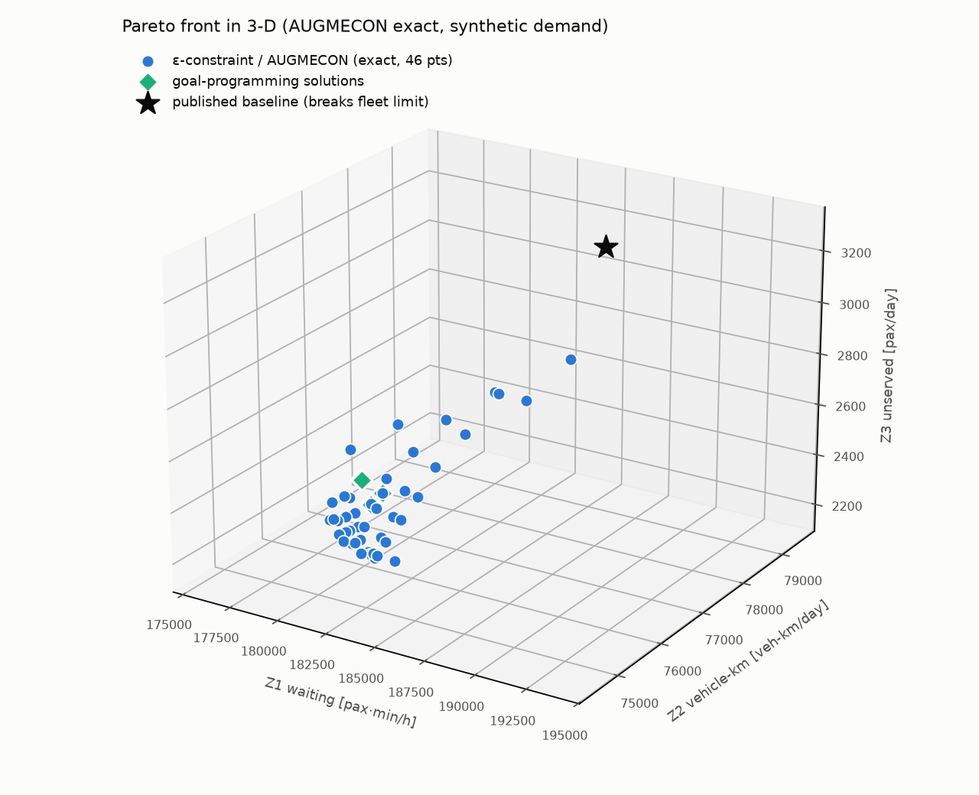
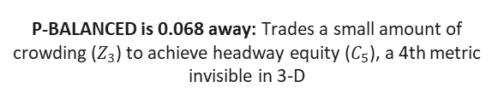
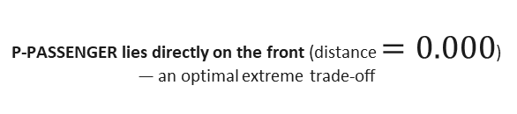

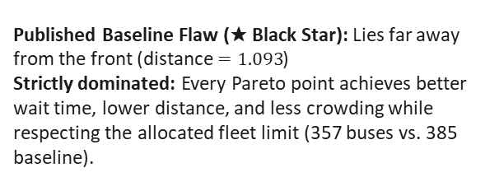
3-D Pareto Front vs. Goal Programming & Baseline
Objective Space: Minimising $Z_{1}$(Passenger Wait), $Z_{2}$(Vehicle-km), and $Z_{3}$(Unserved Demand)
P-PASSENGER lies directly on the front (distance $=0.000$) — an optimal extreme trade-off
P-BALANCED is 0.068 away: Trades a small amount of crowding ($Z_{3}$) to achieve headway equity ($C_{5}$), a 4th metric invisible in 3-D
Published Baseline Flaw (★ Black Star): Lies far away from the front (distance $=1.093$)
Strictly dominated: Every Pareto point achieves better wait time, lower distance, and less crowding while respecting the allocated fleet limit (357 buses vs. 385 baseline).

Slide 15
RESULTS · LIMITATIONS & CAVEATS
• Demand is synthetic and illustrative — not measured CTU ridership; gains concentrate on long infrequent routes partly by construction.
• Calibration uses a single assumed speed (22 km/h); route-specific running times are needed for greater precision.
• GP targets were set after best achievable values were known — goal achievement is conditional on target choice.
• Results are deterministic at α = 0.5; Monte Carlo stress-testing against day-to-day demand variation is planned (Phase 8).
• Waiting objective uses h/2 rule — overstates at long headways; no within-period peak factor; buses move freely across periods.
• Headline results use relaxed frequency limits (two levels shorter than published minimum); requires CTU approval.
• No depot, crew scheduling, stop-capacity, or transfer constraints modelled yet.
Notes:
2,000 simulated demand days, identical for every schedule. Waiting differences between optimised schedules are a few seconds and should not be used to rank them.

Slide 16
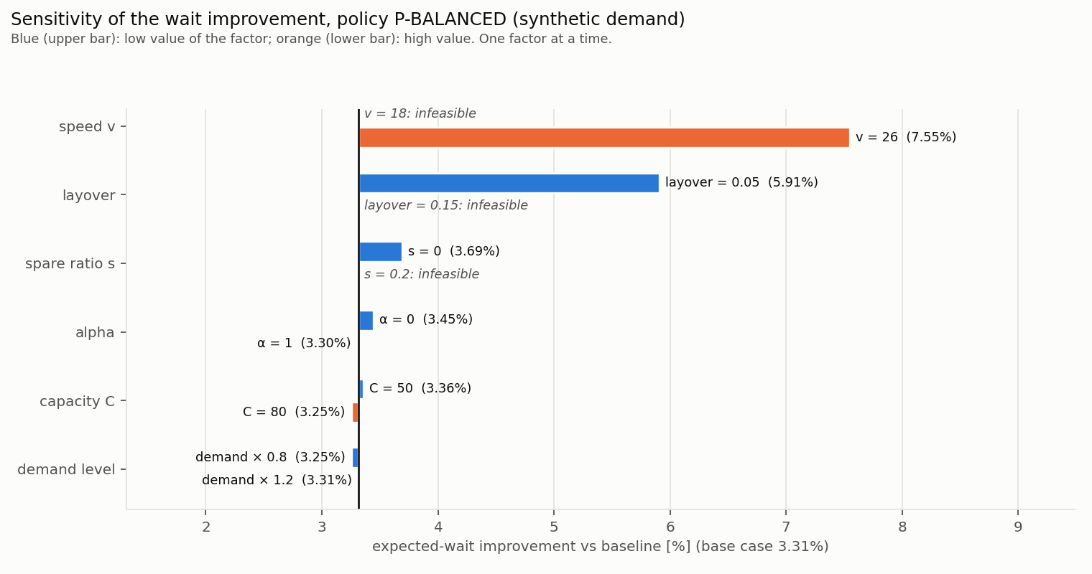
Honest scope: what is proven vs what is planned
RESULTS · WHAT THE MODEL CANNOT YET CLAIM
Results validated against demand (seed 42, anchor 81,326 boardings/day)
No out-of-sample test against real or held-out data
Stochastic robustness (overflow risk, day-to-day variation) is Phase 8 — Monte Carlo simulation
Sensitivity to speed, capacity, spares, layover, α and fleet size: planned as one-factor sweeps
Current AUGMECON front is the benchmark — NSGA-II will be judged against it by hypervolume and strict dominance (Phase 8)
Conference targets: CTRG 2027 / ORSI annual convention

Slide 17
What remains before the results can speak
PLANNED WORK
1
Real ridership
2
Fairer comparisons
3
Better waiting model
Request ETM ticket data from CTU; boarding counts at 5-10 hubs; L/M/U from 10th/50th/90th percentiles.
NSGA-II: approximate Pareto front; compare vs AUGMECON by hypervolume, GD, IGD, coverage. PSO / QPSO: alternative metaheuristics. Simple benchmark (proportional / square-root rule); route-specific running times; GP target sweep.
Arrival-timing model for long headways; within-period peak-hour factor.
4
CTU validation
5
Operations
6
Write-up
Confirm the route-length convention, what the 389 buses include, and the 22 km/h speed. Real ridership data from CTU (ETM / boarding counts); route-specific running times and within-period peak factors.
Depot and interlining constraints; driver-duty feasibility; stop capacity at shorter headways.
Monte Carlo simulation: 2,000 synthetic demand days; gamma-distributed headways; sensitivity sweeps. Final report, viva preparation, conference paper (CTRG 2027 / ORSI).

Slide 18
Plans and target venues
PLANNED WORK
Plan 1
Ridership request, hub counts
Plan 2
Benchmark, route speeds, waiting model
Conferences targeted
Conference of Transportation Research Group of India (CTRG): biennial; 8th edition held at IIT Guwahati, Dec 2025.
ORSI Annual Convention (Operational Research Society of India): usually held in December.
Plan 3
Re-run with real demand; validation
Plan 4
Phase 8: NSGA-II + Monte Carlo simulation; Report, paper submission (CTRG 2027 / ORSI)

Slide 19
References
REFERENCES
[1] A. Ceder, Public Transit Planning and Operation: Modeling, Practice and Behavior, 2nd ed. Boca Raton, FL: CRC Press, 2016, doi: 10.1201/b18689.
[2] A. Ceder and N. H. M. Wilson, “Bus network design,” Transportation Research Part B, vol. 20, no. 4, pp. 331–344, 1986, doi: 10.1016/0191-2615(86)90047-0.
[3] P. G. Furth and N. H. M. Wilson, “Setting frequencies on bus routes: theory and practice,” Transportation Research Record, no. 818, pp. 1–7, 1981.
[4] O. J. Ibarra-Rojas, F. Delgado, R. Giesen and J. C. Muñoz, “Planning, operation, and control of bus transport systems: A literature review,” Transportation Research Part B, vol. 77, pp. 38–75, 2015, doi: 10.1016/j.trb.2015.03.002.
[5] H. Martínez, A. Mauttone and M. E. Urquhart, “Frequency optimization in public transportation systems: Formulation and metaheuristic approach,” European Journal of Operational Research, vol. 236, no. 1, pp. 27–36, 2014, doi: 10.1016/j.ejor.2013.11.007.
[6] İ. Ö. Verbas and H. S. Mahmassani, “Exploring trade-offs in frequency allocation in a transit network using bus route patterns: Methodology and application to large-scale urban systems,” Transportation Research Part B, vol. 81, pp. 577–595, 2015, doi: 10.1016/j.trb.2015.06.018.
[7] K. Deb, A. Pratap, S. Agarwal and T. Meyarivan, “A fast and elitist multiobjective genetic algorithm: NSGA-II,” IEEE Transactions on Evolutionary Computation, vol. 6, no. 2, pp. 182–197, 2002, doi: 10.1109/4235.996017.
[8] G. Mavrotas, “Effective implementation of the ε-constraint method in multi-objective mathematical programming problems,” Applied Mathematics and Computation, vol. 213, no. 2, pp. 455–465, 2009, doi: 10.1016/j.amc.2009.03.037.
[9] G. Mavrotas and K. Florios, “An improved version of the augmented ε-constraint method (AUGMECON2) for finding the exact Pareto set in multi-objective integer programming problems,” Applied Mathematics and Computation, vol. 219, no. 18, pp. 9652–9669, 2013, doi: 10.1016/j.amc.2013.03.002.
[10] A. Charnes and W. W. Cooper, Management Models and Industrial Applications of Linear Programming, vols. 1–2. New York: Wiley, 1961.
[11] D. Jones and M. Tamiz, Practical Goal Programming. New York: Springer, 2010, doi: 10.1007/978-1-4419-5771-9.
[12] L. A. Zadeh, “Fuzzy sets,” Information and Control, vol. 8, no. 3, pp. 338–353, 1965, doi: 10.1016/S0019-9958(65)90241-X.
[13] H.-J. Zimmermann, “Fuzzy programming and linear programming with several objective functions,” Fuzzy Sets and Systems, vol. 1, no. 1, pp. 45–55, 1978, doi: 10.1016/0165-0114(78)90031-3.
[14] M. Inuiguchi and J. Ramík, “Possibilistic linear programming: a brief review of fuzzy mathematical programming and a comparison with stochastic programming in portfolio selection problem,” Fuzzy Sets and Systems, vol. 111, no. 1, pp. 3–28, 2000, doi: 10.1016/S0165-0114(98)00449-7.

Slide 20
References
REFERENCES
[15] K. An and H. K. Lo, “Two-phase stochastic program for transit network design under demand uncertainty,” Transportation Research Part B, vol. 84, pp. 157–181, 2016, doi: 10.1016/j.trb.2015.12.009.
[16] K. Gkiotsalitis, M. Schmidt and E. van der Hurk, “Subline frequency setting for autonomous minibusses under demand uncertainty,” Transportation Research Part C, vol. 135, art. 103492, 2022, doi: 10.1016/j.trc.2021.103492.
[17] R. O. Arbex and C. B. da Cunha, “Efficient transit network design and frequencies setting multi-objective optimization by alternating objective genetic algorithm,” Transportation Research Part B, vol. 81, pp. 355–376, 2015, doi: 10.1016/j.trb.2015.06.014.
[18] S. B. Jha, J. K. Jha and M. K. Tiwari, “A multi-objective meta-heuristic approach for transit network design and frequency setting problem in a bus transit system,” Computers & Industrial Engineering, vol. 130, pp. 166–186, 2019, doi: 10.1016/j.cie.2019.02.025.
[19] Z. Ahern, A. Paz and P. Corry, “Approximate multi-objective optimization for integrated bus route design and service frequency setting,” Transportation Research Part B, vol. 155, pp. 1–25, 2022, doi: 10.1016/j.trb.2021.10.007.
[20] W. Leong, K. Goh, S. Hess and P. Murphy, “Improving bus service reliability: The Singapore experience,” Research in Transportation Economics, vol. 59, pp. 40–49, 2016, doi: 10.1016/j.retrec.2016.07.025.
[21] Transport for London, Guidelines for Planning Bus Services. London: TfL, Aug. 2012. [Online]. Available: https://foi.tfl.gov.uk/FOI-2321-1617/bus-service-planning-guidelines.pdf
[22] S. Mahesh and G. Ramadurai, “Analysis of driving characteristics and estimation of pollutant emissions from intra-city buses,” Transportation Research Procedia, vol. 27, pp. 1211–1218, 2017, doi: 10.1016/j.trpro.2017.12.071.
[23] G. V. Jain, S. S. Jain and M. Parida, “Evaluation of travel speed of conventional buses and bus rapid transit service in Ahmedabad city, India using geo-informatics,” Journal of Public Transportation, vol. 24, art. 100034, 2022, doi: 10.1016/j.jpubtr.2022.100034.
[24] R. Fedujwar and A. Agarwal, “A systematic review on crowding valuation in public transport,” Public Transport, vol. 16, no. 3, pp. 743–773, 2024, doi: 10.1007/s12469-024-00363-w.
[25] Chandigarh Transport Undertaking, “Time Table of CTU Bus Services: Local and Tri-City Routes, Depot Nos. II, III and IV,” as on 25.07.2026. [Online]. Available: chdctu.gov.in

Slide 21
Thank you
Questions and discussion
Daksh Garg · Piyush Aggarwal · Abhay Chauhan · Naman Vasudev
Guide: Dr. Sumati Mahajan, Department of Mathematics, PEC Chandigarh

