Slide 1
Skeleton-Based Human Action Recognition
UCS761 Deep Learning Project
Submitted by:
Sahil Kumar (102316091) • Aashish Sharma (102316104)
Chaitanya Singh Chouhan (102316106) • Naman Jain (102316108)

Slide 2
Introduction
Human Action Recognition (HAR)
Automatically identifies human activities from visual data with applications in:
Surveillance systems
Healthcare monitoring
Human-computer interaction
Sports analytics
Why Skeleton-Based?
Robust to background noise and lighting variations
Reduced computational complexity
Invariant to environmental changes

Slide 3
Problem Statement & Challenges
Noisy Skeletal Data
Pose estimation errors lead to unstable joint trajectories
Similar Motion Patterns
Difficult to distinguish between actions with subtle differences
Execution Variability
Variations in speed, viewpoint, and individual differences
Real-World Deployment
Balancing accuracy with computational efficiency
Our Solution
Develop a 2-stream CTR-GCN ensemble leveraging Graph Convolutional Networks and Transformers to learn robust spatial-temporal features while handling noise effectively

Slide 4
Methodology: Model Architecture
CTR-GCN Architecture
Training Configuration
Type: Graph Convolutional Network with Channel-wise Topology Refinement
2-Stream Ensemble:
• Joint Stream: Raw coordinates
• Bone Stream: Vector differences between joints
Three-Stage Architecture:
Stage 1: 2-3 → 64 channels
Stage 2: 64 → 128 channels
Stage 3: 128 → 256 channels
Loss Function:
CrossEntropyLoss for multi-class classification
Optimizer:
SGD with Nesterov momentum (0.9)
Weight decay: 1e-4
Learning Rate:
CosineAnnealingLR: 0.1 → ~0
Activation:
ReLU throughout all layers

Slide 5
Methodology: Workflow
1
Data Collection
NTU RGB+D (NTU-60) dataset
~56k sequences, 60 action classes
2
Preprocessing
Temporal normalization (64 frames)
Skeleton centralization, noise augmentation
3
Training
Two separate streams (joint and bone)
60 epochs with best model selection
4
Testing
Late fusion with equal weighting
Combined logits from both streams
5
Evaluation
Top-1 accuracy, precision, recall, F1-score
Confusion matrix analysis
Cross-View Split: ~37k train samples, ~19k test samples

Slide 6
Implementation Details
Training Parameters
Data Parameters
Regularization
Epochs: 60
Batch size: 32
Initial LR: 0.1
LR Decay: Cosine
Momentum: 0.9
Weight decay: 1e-4
Input: 17 COCO joints
Frames: 64 (uniform)
Channels: 3 (x, y, score)
Augmentation:
- Gaussian noise
- Centralization
Dropout: 0.5
BatchNorm in GCN
Label smoothing
Data augmentation
Early stopping

Slide 7
Results: Performance Metrics
95.76%
Top-1 Accuracy
Metric | Score
Precision (Macro) | 95.85%
Recall (Macro) | 95.77%
F1-Score (Macro) | 95.77%
Metric
Score
Consistent and well-balanced classification across all 60 action classes

Slide 8
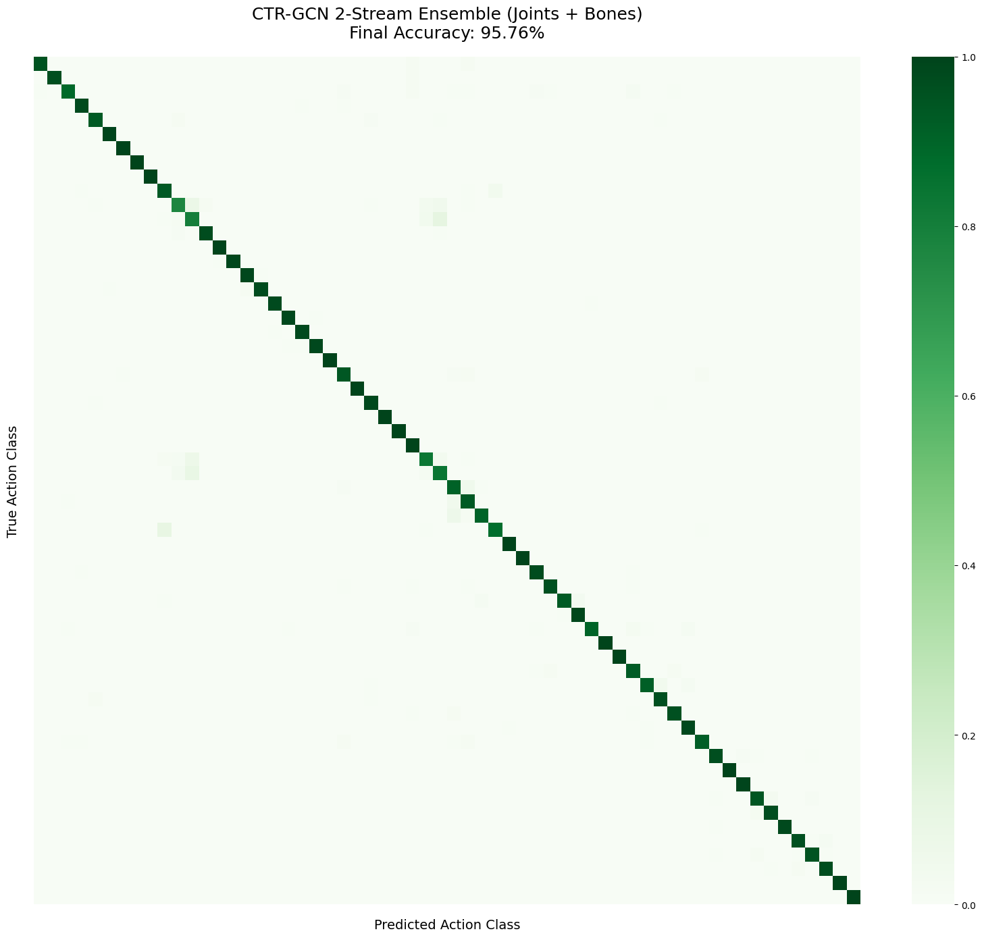
Results: Analysis
Confusion Matrix
Key Observations
✓ Dominant diagonal pattern
Strong class separability with minimal misclassification
✓ Stable convergence
Decreasing loss without overfitting indicators
✓ Effective regularization
Dropout and data augmentation prevent overfitting
⚠ Minor confusion in similar actions
Actions with similar motion patterns show slight overlap

Slide 9
Comparison with Baseline Models
Our model demonstrates ~20% improvement over baseline methods

Slide 10
Conclusion
Key Achievements
✓ Achieved 95.76% accuracy with balanced precision, recall, and F1-score
✓ Significant improvement (~20%) over baseline ST-GCN, MSG3D, and Transformers
✓ Robust feature learning through joint-bone dual-stream fusion
Future Directions
• Transformer-based temporal modeling for longer sequences
• Self-supervised learning to reduce annotation dependency
• Multimodal integration with object context and text alignment
Thank You

