Slide 1
Database Management System (DBMS)
DBMS( Data Base Management Systems)
DB- Data Base & MS - Management Systems
DB - is a Collection of data
ex. Text, numbers, images, audio, video, speech, etc.
MS - is a Management Systems – is a set of programs to store and retrieve those date(already stored data)
DBMS is a collection of data and set of programs to access and store those data in an easy and efficient manner.
DBMS is a software(mysql, sql, oracle) which is used to manage the database.
The end user access the database with help of DBMS s/w and application program(c,c++,java).
Notes:
1

Slide 2
Database Management System (DBMS)
DBMS
DATA
APPLICATION
PROGRAM
C, C++, JAVA
END USER OR
PROGRAMMER
s/w(mysql,sql, oracle)
Notes:
2

Slide 3
Database Management System (DBMS)
Database Applications:
Banking: transactions
Airlines: reservations, schedules
Universities: registration, grades
Sales: customers, products, purchases
Online retailers: order tracking, customized recommendations
Manufacturing: production, inventory, orders, supply chain
Human resources: employee records, salaries, tax deductions
Databases can be very large.
Databases touch all aspects of our lives
Notes:
3

Slide 4
Database Management System (DBMS)
PURPOSE OF DBMS
. Previously data is stored in files.
Draw back of using file systems to store
Data redundancy and consistency
duplication of information in different files
Difficulty in accessing data
need to write a new program to carry out each new task.
Data isolation
multiple files and formats
4. Data security
5. Transaction problems
Notes:
4

Slide 5
Database Management System (DBMS)
Database Users:
1. Native user:
who need not be aware of the presence of data base system. These are end users of data base who are work through menu driven application.
2. Application Programmer:
are responsible for developing application program or user interface application program will be written in high level language.
3. Sophisticated User
are interact with system without writing the programs. They request in query language.
4. Specialized User:
who works specialized data base application that do not fit into fractional data base processing frame work.
Notes:
5

Slide 6
Database Management System (DBMS)
5. Online User:
who may communicate with data base directly through online.
Data Base Administrator(DBA):
It is a person or group of in charge for implementing data base system in organization. The DBA has all privilage allowed by the DBMS and can assign or removes the privilages from the users.
Notes:
6

Slide 7
Database Management System (DBMS)
Data Independence:
Capacity of changing the schema at one level without effecting the other level.
. Data base system are designed in multilayer.
The over all design(description) of data base is called as schema.
Data independence two types.
Logical data independence/logical schema
2. Physical data independence/physical schema
First layer
Second layer
Third layer
Notes:
7

Slide 8
Database Management System (DBMS)
logical schema always follows the logical data independence.
Physical schema always follows the physical data independence
logical data independence(logical schema):
it stores information about how data is managed inside.
ability to change logical schema without changing the external or application program.
physical data independence(physical schema):
ability to change the physical data without impacting the logical data
Notes:
8

Slide 9
Database Management System (DBMS)
Layered architecture
// access by the
users
// relationships
//storage
Application programs
Logical schema
Physical schema
Notes:
9

Slide 10
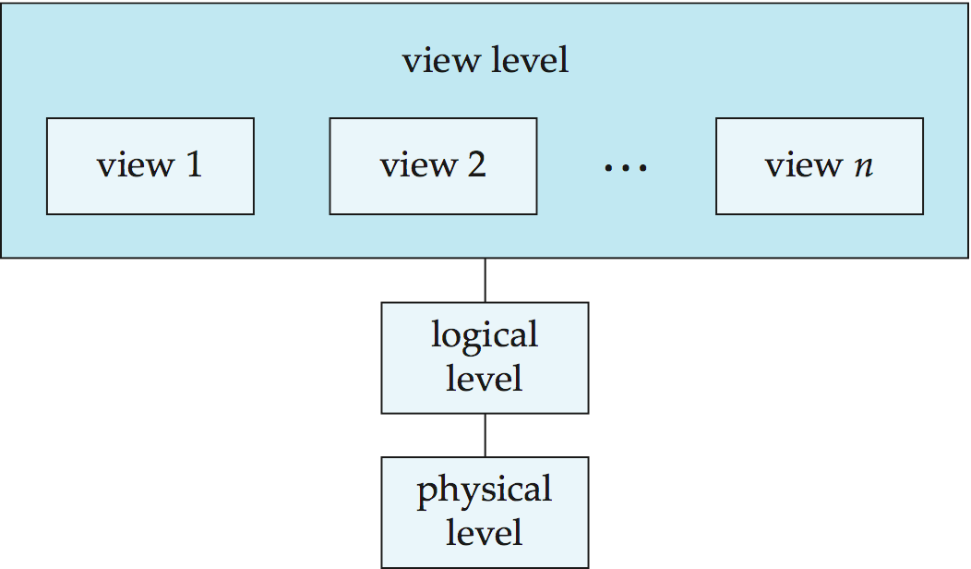
DATA ABSTRACTION
The Three levels of data abstraction
Notes:
10

Slide 11
Data abstraction
THREE LEVELS
1. EXTERNAL LEVEL(VIEW LEVEL)
2. CONCEPTUAL LEVEL(LOGICAL LEVEL)
3. INTERNAL LEVEL(STORAGE LEVEL)
. EXTERNAL LEVEL(VIEW LEVEL) :
This level describes that part of data base that is relevant to each user.
CONCEPTUAL LEVEL(LOGICAL LEVEL):
This level describes what data is stored in database and relationships among the data.
All entities, attributes and their relationships
Constraints on the data
c. Security and integrity information
Notes:
11

Slide 12
3. PHYSICAL LEVEL(STORAGE LEVEL)
It is physical representation of database. This level describes how the data is stored in database, it covers the data structures and file organization.
Notes:
12

Slide 13
Data Models
Data models uses collection of tools for describing
Data
Data relationships
Data semantics
Data constraints
Data models:
Structure of data base is called as data models
Object - based logical models
Record - based logical models
Physical models
Object - based logical models
the entity relationship model
the object – oriented model
the semantic data model
d. the functional data model
Notes:
13

Slide 14
ENTITY RELATIONSHIP MODEL – Database Modeling
The Entity relationship(E-R) data model is based on perception of a real world that consists of a set of basic objects called entities, and relationship among these objects.
Graphical representation of over all representation of database is called as entity relation ship diagram.
An entity is an thing or object in the real world that is distinguishable from all other objects.
Example: specific person, company, event, plant
An entity set is a set of entities of the same type that share the same properties or entities.
Example: set of all persons, companies, trees, holidays
An entity is represented by a set of attributes
Example:
instructor = (ID, name, street, city, salary ) course= (course_id, title, credits)

Slide 15
Entity Sets
Attributes: an entity is represented by a set of attributes
employee= ( employee_name, employee_number, salary)
Attribute types:
1. simple attributes:
the attributes that cannot be divided into subparts are known as simple attributes. Ex. Eno(Employee_number)
2. composite attributes: the attributes can be divided into subparts(i.e., other attributes) are known as composite attributes.
ex. Ename(employee_name) can be divided into first_name, middle_name and last_name.
3. single valued attributes: the attributes that have a single value for a particular entity is known as single valued attribute.

Slide 16
Ex. Eno (employee_number) can be only a single value for a particular employee.
Multivalued attributes: the attributes that have many values(a set of values) for a particular entity is known as multi-valued attributes.
Ex. Ename(employee_name) There can be more than one name for an employee.
Derived attributes: The value for this type of attribute can be derived from the values of other related attributes or entities.

Slide 17
ENTITY RELATIONSHIP DIAGRAM
Graphical representation of over all representation of database is called as entity relation ship diagram.
Components of E-R Diagram
. Rectangles, which represent entity sets
. Ellipses, which represent attributes
. Diamonds, which represent relationship set
. Lines, which link attributes to entity sets and entity sets to relationship sets.
. Double Ellipses, which represent multivalued attributes
. Dashed Ellipses, which denote derived attributes
. Double Lines, which indicate total participation of an entity in a relationship set.

Slide 18
ENTITY RELATIONSHIP DIAGRAM
E-R DIAGRAM FOR CUSTOMER AND LOAN relation borrower
Customer-name
Loan-number
borrower
customer
loan
Customer-city
Customer-street
amount
Social-security

Slide 19
ENTITY RELATIONSHIP DIAGRAM
E-R DIAGRAM FOR CUSTOMER AND ACCOUNT relation depositor
Customer-name
Account-number
DEPOSITOR
customer
account
Customer-city
Customer-street
balance
Social-security

Slide 20
RELATIONAL MODEL
Structure of Relational Databases
. RDB consists of collection of relations(tables), each of which is assigned a unique value.
each relation consists of no.of rows and no.of columns
. A row in table represents a relationship among a set of values.
.
.

Slide 21
RELATIONAL MODEL
BANKING ENTERPRISE
Account -schema=(branch-name, account-number, balance)
Branch-schema=(branch-name, branch-city, assets)
Customer-schema=(customer-name, customer-street, customer-city)
Depositor-schema=(customer-name, account-number)
Loan-schema=(branch-name, loan-number, amount)
Borrower-schema=(customer-name, loan-number)
.

Slide 22
RELATIONAL MODEL
QUERY LANGUAGES
a query language is a language in which a user requests information from the database. Query languages are considered as higher level languages than programming languages also.
Types of query languages
Procedural query languages
The user specify the procedure how to retrieves the information from the database.
ex. Relational algebra
2. Non-Procedural query languages
The user retrieves the information from the database without describing the specific procedure to retrieve it.
ex. Tuple relational calculus and domain relational calculus.

Slide 23
RELATIONAL MODEL
THE RELATIONAL ALGEBRA
The relational algebra is a procedural query language. It consists of operations that take one or two relations(tables) as input and produce a new relation(table) as output.
Fundamental Operations used in relational algebra
The select operation
The select operation selects tuples(rows) that satisfy a given predicate. Lower case greek letter sigma to denote selection. The predicate appears as a subscript to sigma.
Display all tuples branch name is perryridge
Sigma(branch-name=“perryridge” (loan)

Slide 24
RELATIONAL MODEL
2. Projection operation
projection operation that creates a new relation by deleting columns from existing relation i.e a new relation is created from another existing relation by selecting only those columns requested by the user from projection and is denoted by greek letter pi.
Write a query to display all loan numbers and amount of the loan
Pi loan-number, amount(loan)

Slide 25
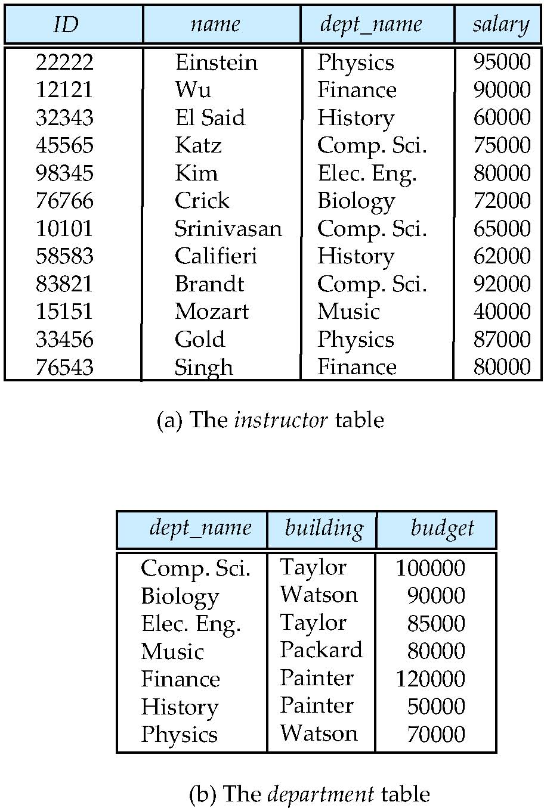
A Sample Relational Database
Notes:
25

Slide 26
Data Definition Language (DDL)
Specification notation for defining the database schema
Example: create table instructor ( ID char(5), name varchar(20), dept_name varchar(20), salary numeric(8,2))
DDL compiler generates a set of table templates stored in a data dictionary
Data dictionary contains metadata (i.e., data about data)
Database schema
Integrity constraints
Primary key (ID uniquely identifies instructors)
Authorization
Who can access what
Notes:
26

Slide 27
Data Manipulation Language (DML)
Language for accessing and manipulating the data organized by the appropriate data model
DML also known as query language
Two classes of languages
Pure – used for proving properties about computational power and for optimization
Relational Algebra
Tuple relational calculus
Domain relational calculus
Commercial – used in commercial systems
SQL is the most widely used commercial language
Notes:
27

Slide 28
SQL
The most widely used commercial language
SQL is NOT a Turing machine equivalent language
SQL is NOT a Turing machine equivalent language
To be able to compute complex functions SQL is usually embedded in some higher-level language
Application programs generally access databases through one of
Language extensions to allow embedded SQL
Application program interface (e.g., ODBC/JDBC) which allow SQL queries to be sent to a database
Notes:
28

Slide 29
Database Design
The process of designing the general structure of the database:
Logical Design – Deciding on the database schema. Database design requires that we find a “good” collection of relation schemas.
Business decision – What attributes should we record in the database?
Computer Science decision – What relation schemas should we have and how should the attributes be distributed among the various relation schemas?
Physical Design – Deciding on the physical layout of the database
Notes:
29

Slide 30
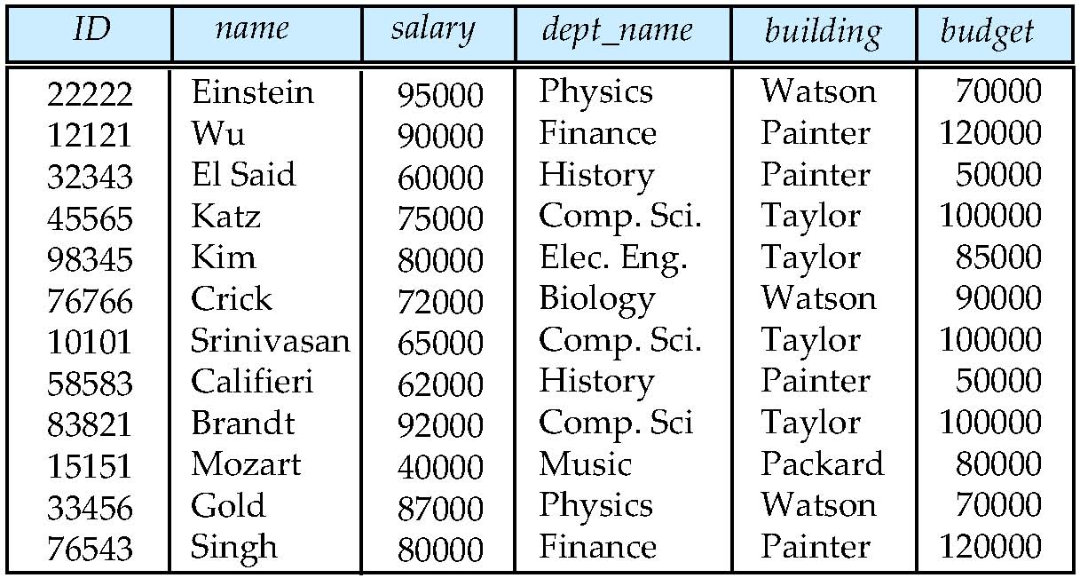
Database Design (Cont.)
Is there any problem with this relation?
Notes:
30

Slide 31
Design Approaches
Need to come up with a methodology to ensure that each of the relations in the database is “good”
Two ways of doing so:
Entity Relationship Model (Chapter 7)
Models an enterprise as a collection of entities and relationships
Represented diagrammatically by an entity-relationship diagram:
Normalization Theory (Chapter 8)
Formalize what designs are bad, and test for them
Notes:
31

Slide 32
Object-Relational Data Models
Relational model: flat, “atomic” values
Object Relational Data Models
Extend the relational data model by including object orientation and constructs to deal with added data types.
Allow attributes of tuples to have complex types, including non-atomic values such as nested relations.
Preserve relational foundations, in particular the declarative access to data, while extending modeling power.
Provide upward compatibility with existing relational languages.
Notes:
32

Slide 33
XML: Extensible Markup Language
Defined by the WWW Consortium (W3C)
Originally intended as a document markup language not a database language
The ability to specify new tags, and to create nested tag structures made XML a great way to exchange data, not just documents
XML has become the basis for all new generation data interchange formats.
A wide variety of tools is available for parsing, browsing and querying XML documents/data
Notes:
33

Slide 34
Database Engine
Storage manager
Query processing
Transaction manager
Notes:
34

Slide 35
Storage Management
Storage manager is a program module that provides the interface between the low-level data stored in the database and the application programs and queries submitted to the system.
The storage manager is responsible to the following tasks:
Interaction with the OS file manager
Efficient storing, retrieving and updating of data
Issues:
Storage access
File organization
Indexing and hashing
Notes:
35

Slide 36
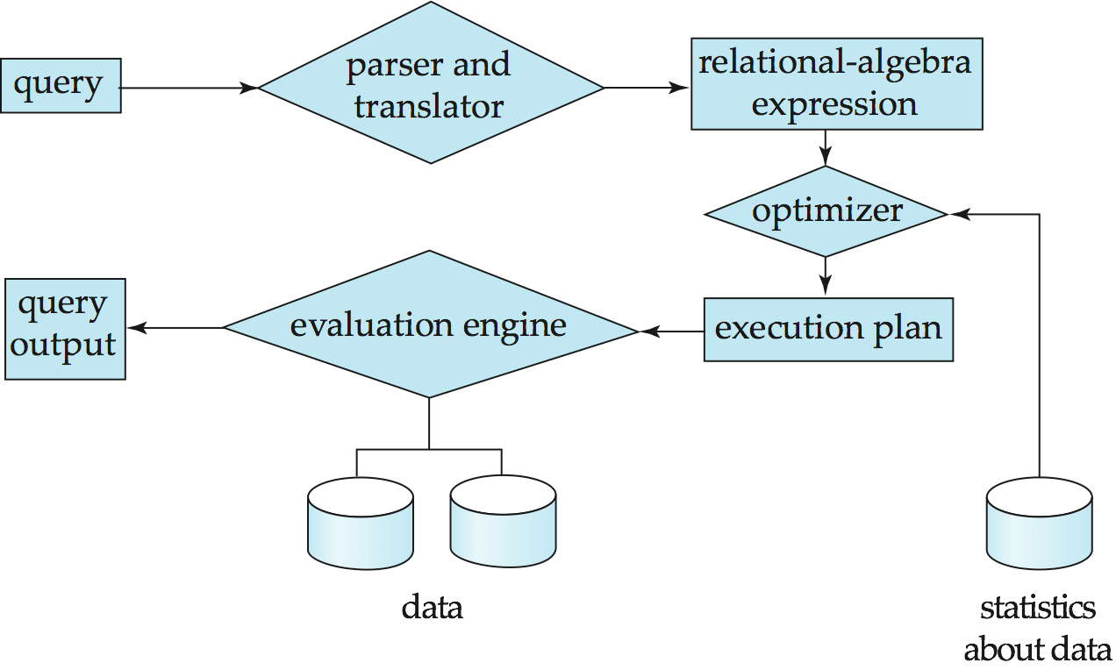
Query Processing
1. Parsing and translation
2. Optimization
3. Evaluation
Notes:
36

Slide 37
Query Processing (Cont.)
Alternative ways of evaluating a given query
Equivalent expressions
Different algorithms for each operation
Cost difference between a good and a bad way of evaluating a query can be enormous
Need to estimate the cost of operations
Depends critically on statistical information about relations which the database must maintain
Need to estimate statistics for intermediate results to compute cost of complex expressions
Notes:
37

Slide 38
Transaction Management
What if the system fails?
What if more than one user is concurrently updating the same data?
A transaction is a collection of operations that performs a single logical function in a database application
Transaction-management component ensures that the database remains in a consistent (correct) state despite system failures (e.g., power failures and operating system crashes) and transaction failures.
Concurrency-control manager controls the interaction among the concurrent transactions, to ensure the consistency of the database.
Notes:
38

Slide 39
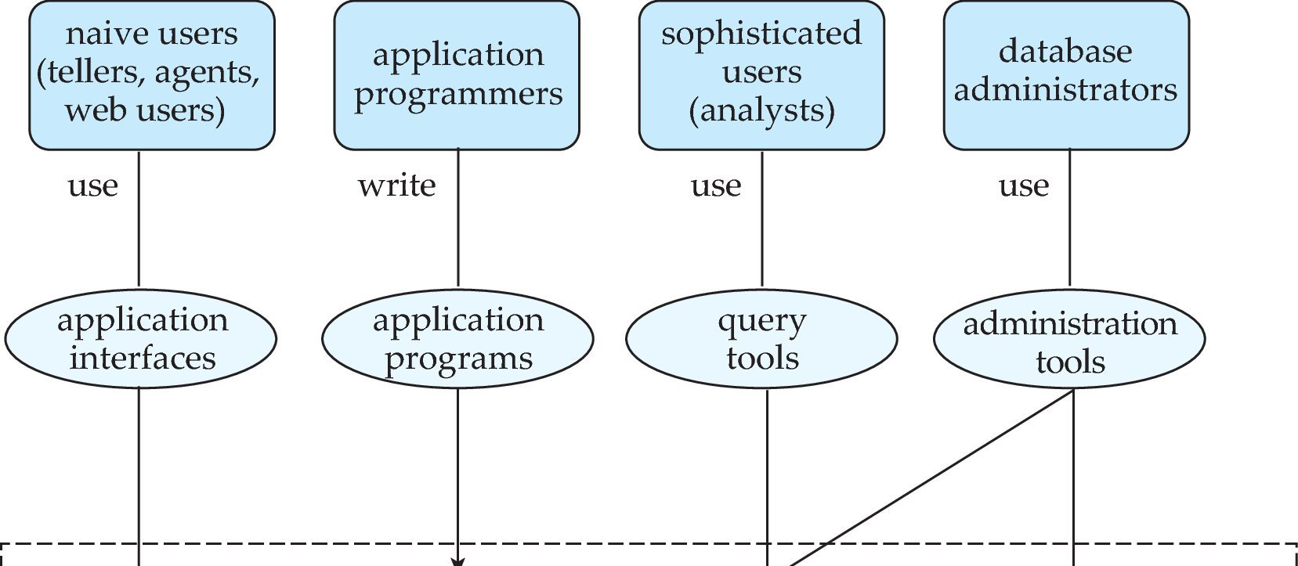
Database Users and Administrators
Database
Notes:
39

Slide 40
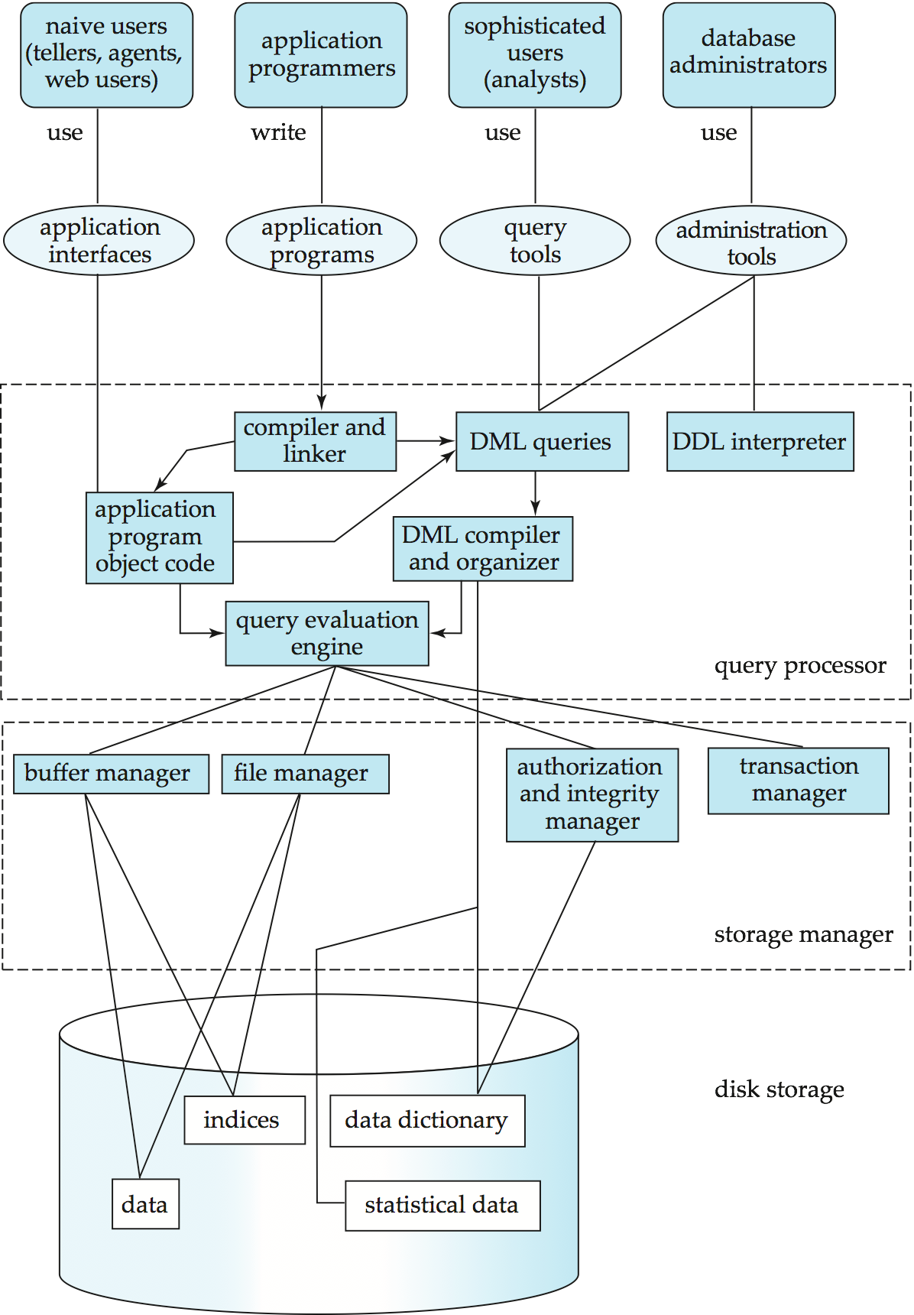
Database System Internals
Notes:
40

Slide 41
Database Architecture
The architecture of a database systems is greatly influenced by
the underlying computer system on which the database is running:
Centralized
Client-server
Parallel (multi-processor)
Distributed
Notes:
41

Slide 42
History of Database Systems
1950s and early 1960s:
Data processing using magnetic tapes for storage
Tapes provided only sequential access
Punched cards for input
Late 1960s and 1970s:
Hard disks allowed direct access to data
Network and hierarchical data models in widespread use
Ted Codd defines the relational data model
Would win the ACM Turing Award for this work
IBM Research begins System R prototype
UC Berkeley begins Ingres prototype
High-performance (for the era) transaction processing
Notes:
42

Slide 43
History (cont.)
1980s:
Research relational prototypes evolve into commercial systems
SQL becomes industrial standard
Parallel and distributed database systems
Object-oriented database systems
1990s:
Large decision support and data-mining applications
Large multi-terabyte data warehouses
Emergence of Web commerce
Early 2000s:
XML and XQuery standards
Automated database administration
Later 2000s:
Giant data storage systems
Google BigTable, Yahoo PNuts, Amazon, ..
Notes:
43

Slide 44
End of Chapter 1
Notes:
44

