Slide 1
THE Role of Performance
Alireza Pourghannad
Poorghanad@gmail.com

Slide 2
THE Role of Performance
Airplane | Passenger Capacity | Cruising range (miles) | Cruising speed (m.p.h.)
Boeing 777 | 375 | 4630 | 610
Boeing 747 | 470 | 4150 | 610
BAC/Sud Concorde | 132 | 4000 | 1350
Douglas DC-8-50 | 146 | 8720 | 544
Passenger throughput (Passenger X m.p.h.)
228,750
286,700
178,200
79,424

Slide 3
Measuring Performance
Number of CPU clock cycles for a Program
Clock cycle time
CPU Execution time for a program ?

Slide 4
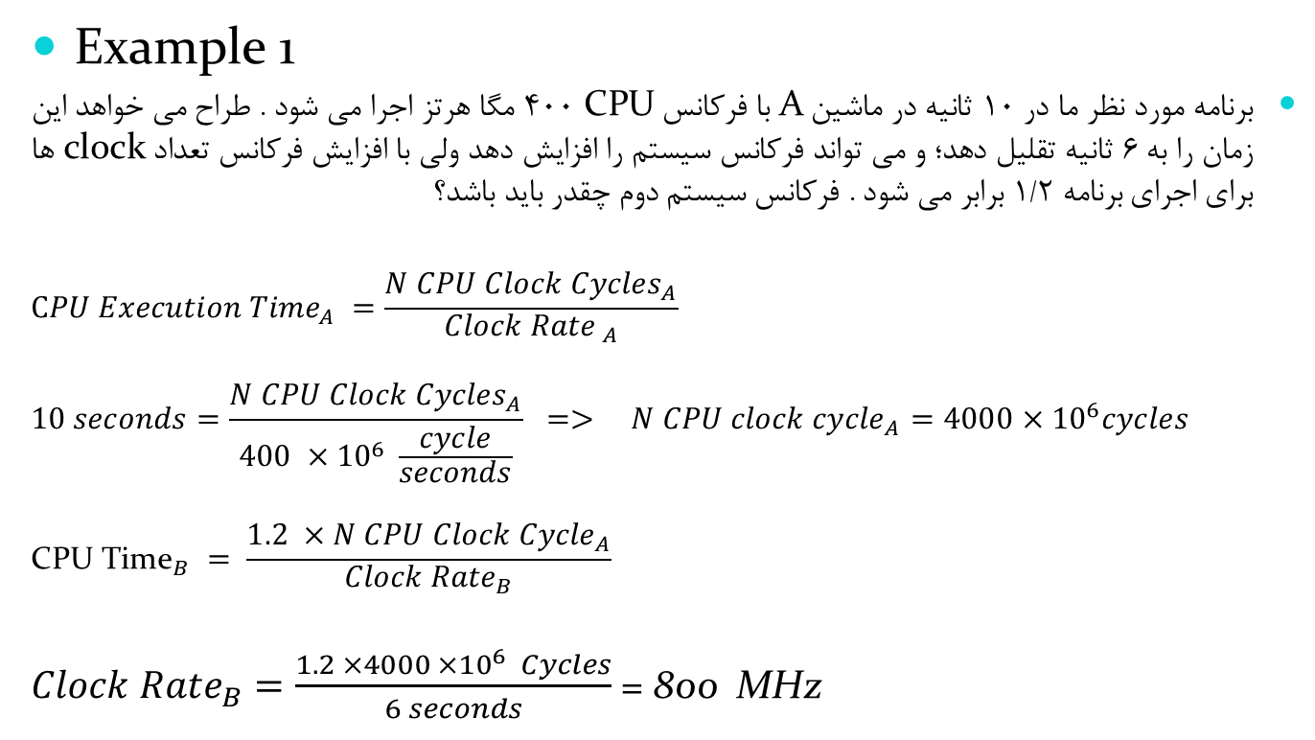
Measuring Performance

Slide 5
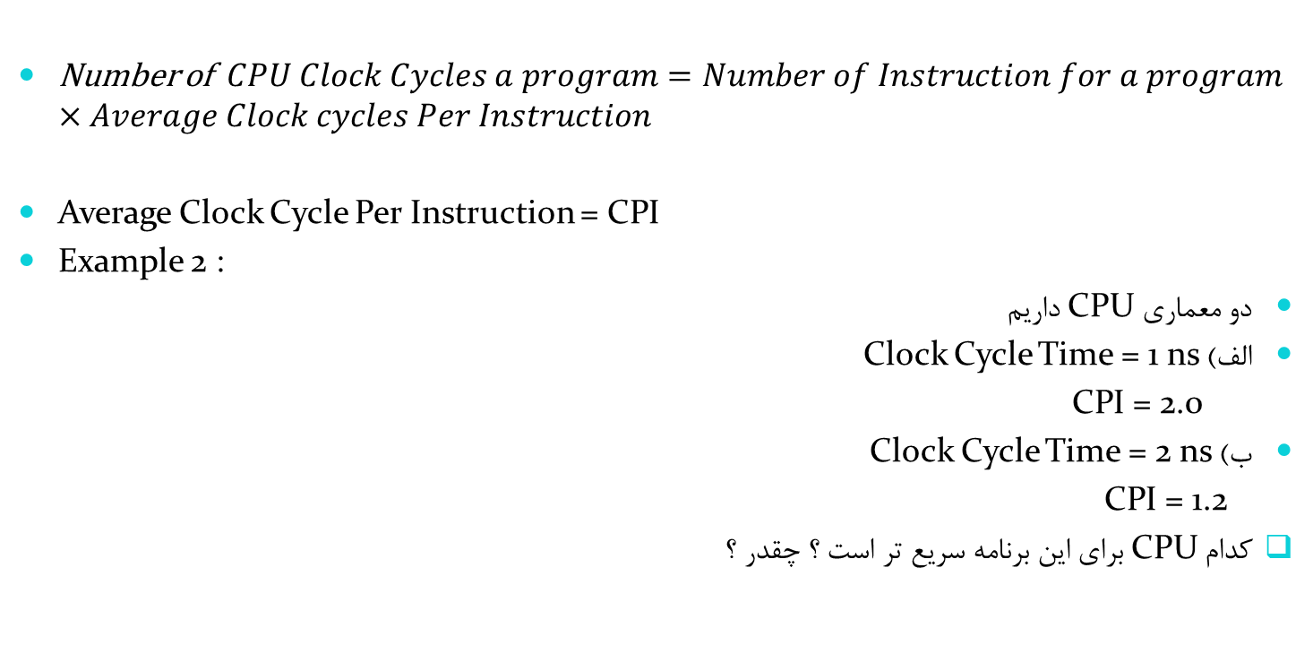

Slide 6
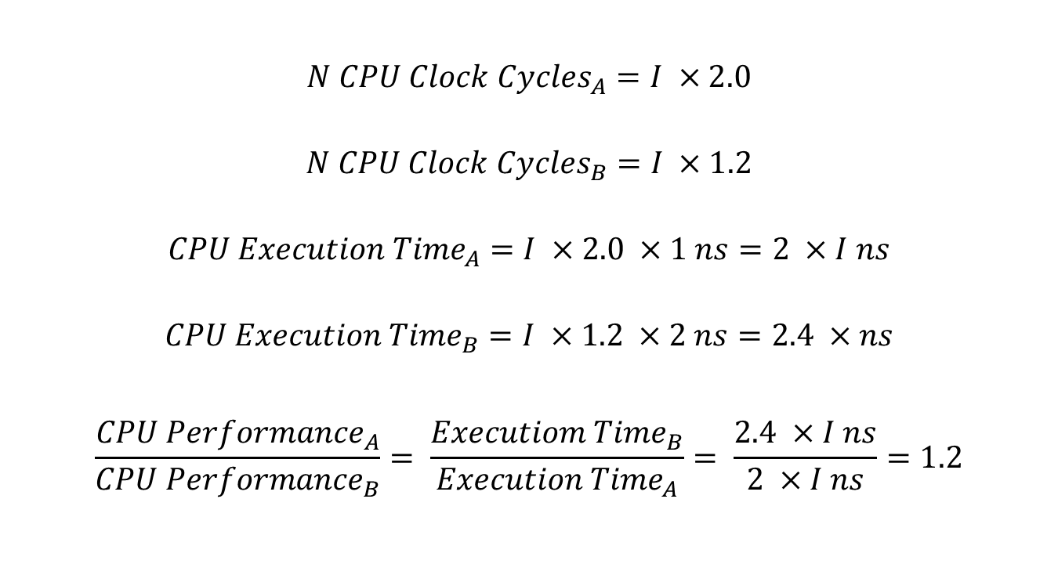

Slide 7
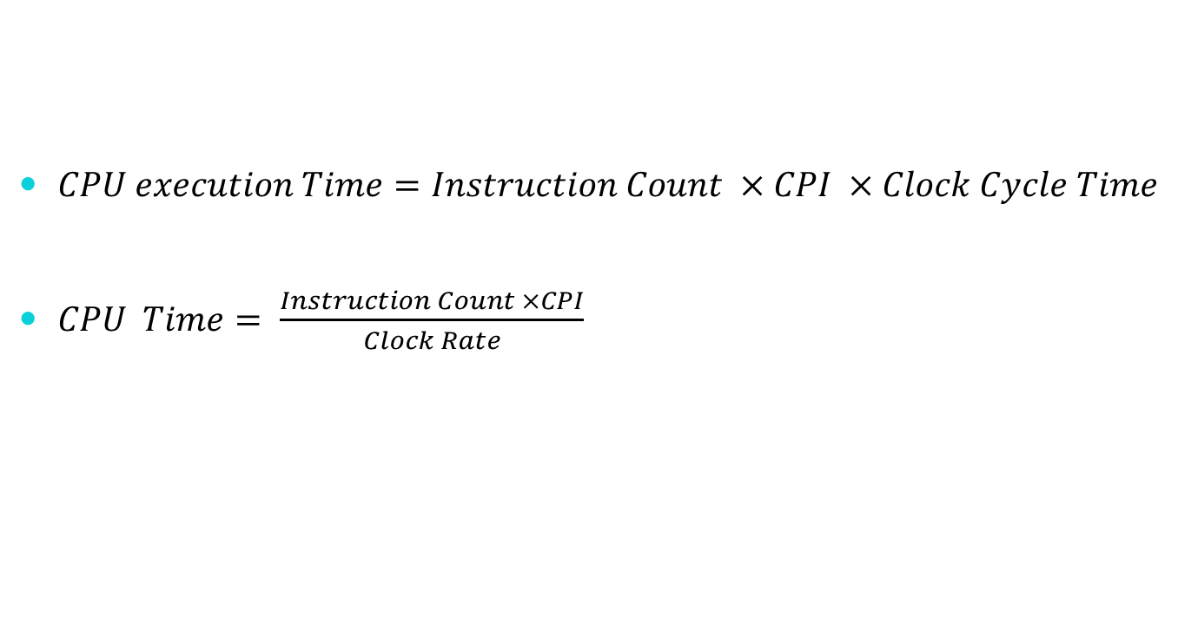

Slide 8
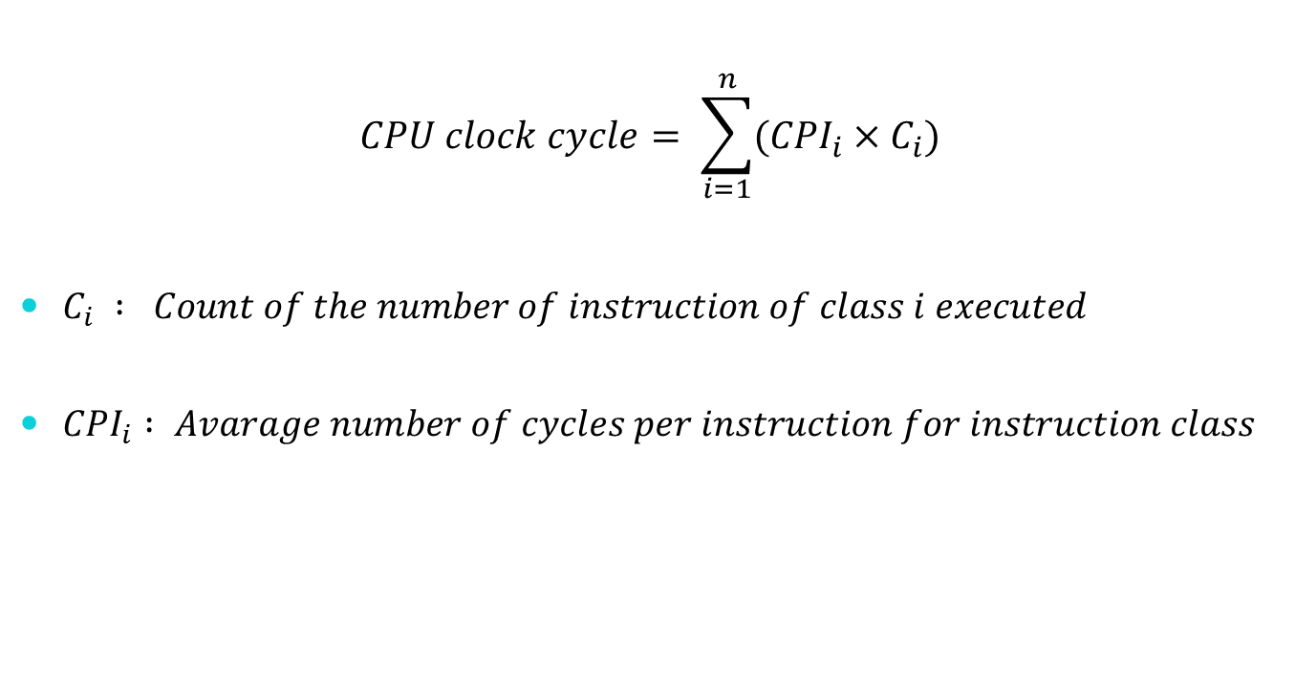

Slide 9
Example 3 :
A compiler designer is trying to decide between two code sequence for a particular machine. The hardware designers have supplied the following facts :
Instruction class | CPI for this instruction class
A | 1
B | 2
C | 3

Slide 10
For a particular high-level-language statement, the compiler writer is considering two code sequences that require the following instruction counts:
Which code sequence executes the most instruction? Which will be faster? What is the CPI for each sequence?
 | Instruction counts for instruction class
Code Sequence | A | B | C
1 | 2 | 1 | 2
2 | 4 | 1 | 1

Slide 11
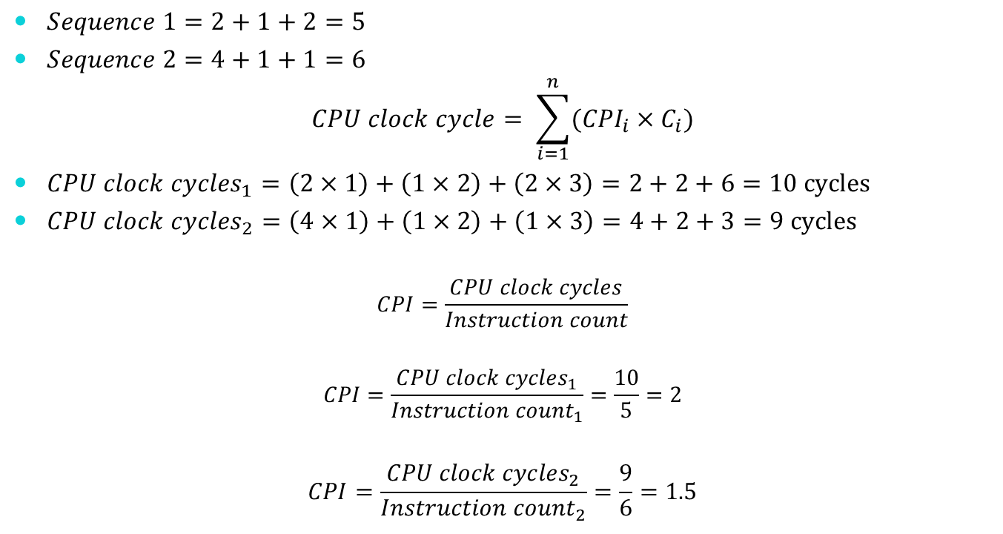

Slide 12
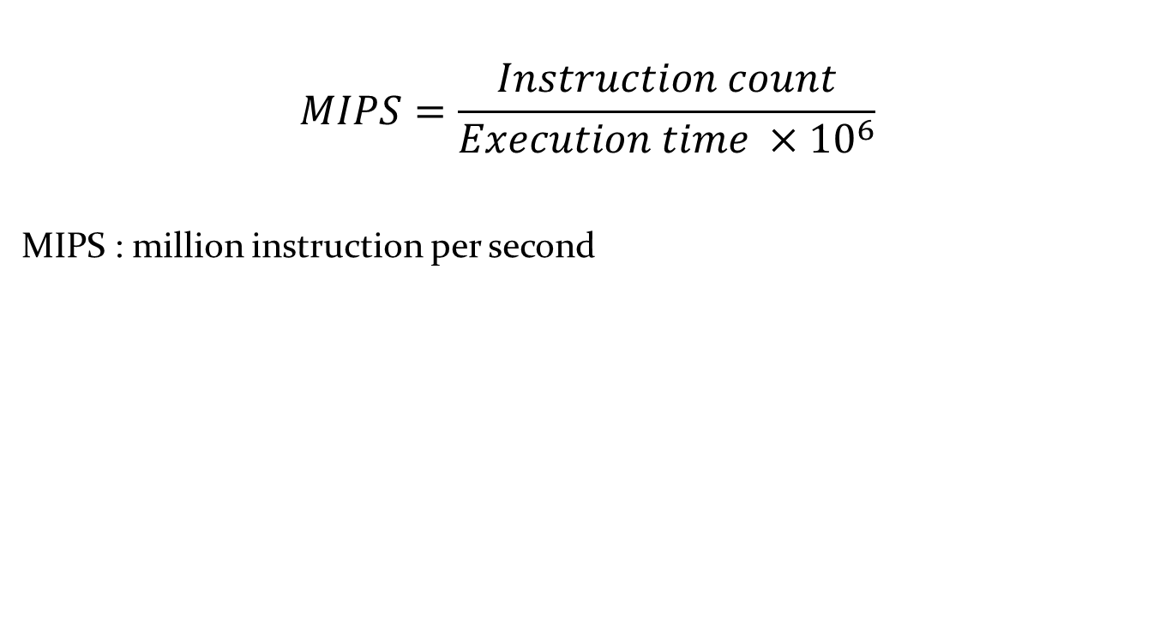
MIPS

Slide 13
Example 4 :
Consider the machine with three instruction classes and CPI measurements from the last example. Now suppose we measure the code for the same program from two different compilers and obtain the following data:
Assume that the Machine’s clock rate is 500 MHz. Which code sequence will execute faster according to MIPS? According to execution time?
 | Instruction counts (in Billion) for each instruction class
Code from | A | B | C
Compiler 1 | 5 | 1 | 1
Compiler 2 | 10 | 1 | 1

Slide 14
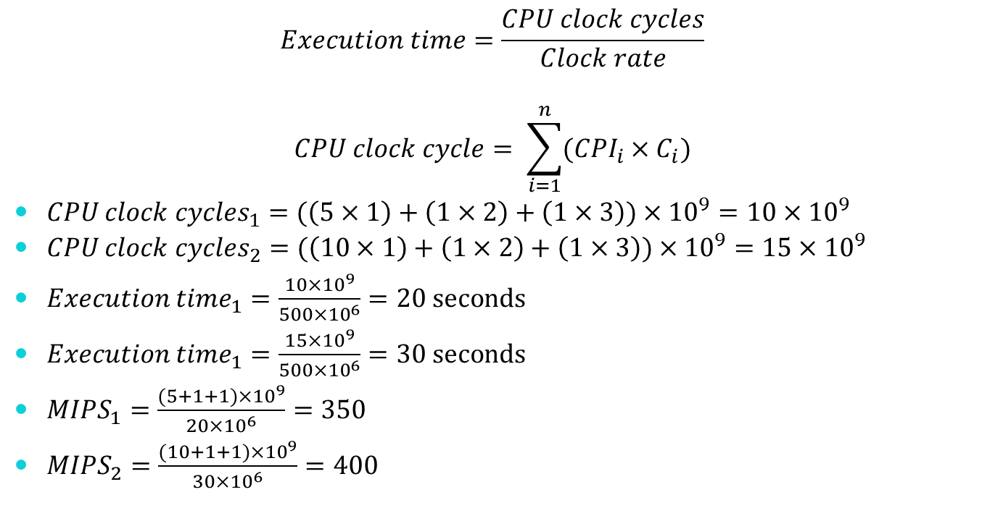

Slide 15
تمرین : دو پیاده سازی مختلف M1 و M2 با چهار کلاس دستور العمل مطابق جدول زیر وجود دارد. فرکانس کاری M1 و M2 به ترتیب برابر 500 MHz و 750 MHz می باشد.
M1
M2
Class | CPI for this class
A | 1
B | 2
C | 3
D | 4
Class | CPI for this class
A | 2
B | 2
C | 4
D | 4

