Slide 1


MY BOOKSHOP MANAGEMENT
Team:
19DCE032 Naman Ghevariya
19DCE074 Tirth Moradiya
19DCE112 Ridham Patel
19DCE116 Viren Patel

Slide 2
Current Scenario
In Current Scenario there is totally manually working in bookshop.
There need to continue remind in mind the stock of book.
There is no software for details keeping of books.
There is problem in finding book by author.

Slide 3
Introduction to System
This project is mainly based for automated Bookshop Management System.
This project allow owner to keep record of books and also give a total bill at selling books.
This project has Unique Features Of keeping notes in it for business or any other purpose.
This project can reduce work of searching Books in Shop whether the a book stock is over or not.

Slide 4
Technology Used
programming Language: Java
Database: java DB.
Software: Apache NetBeans 12.0
Hardware: A Set of PC or Laptop.

Slide 5
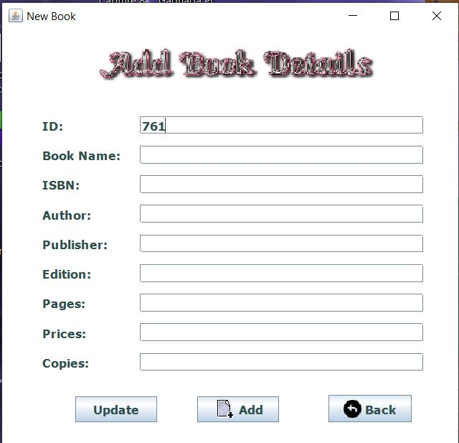
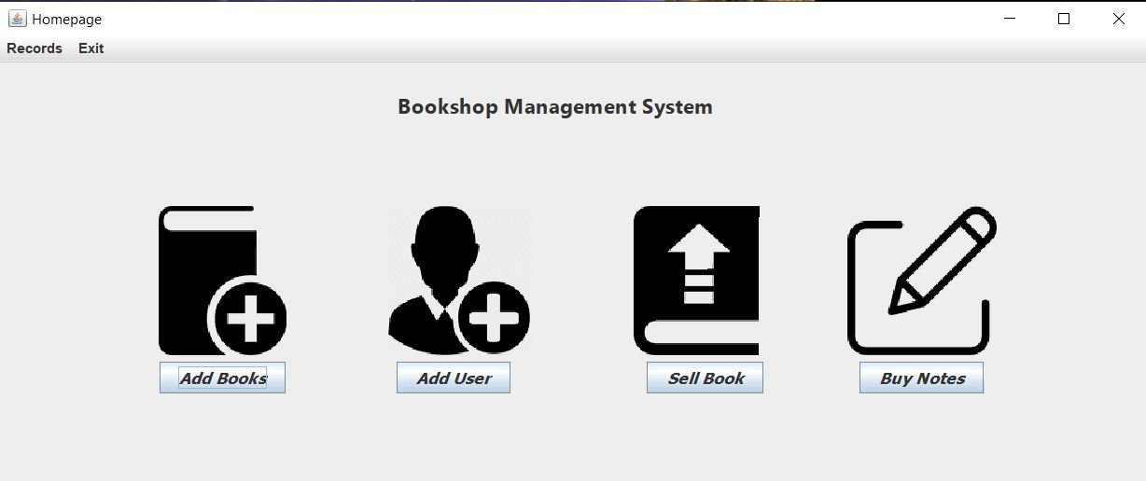
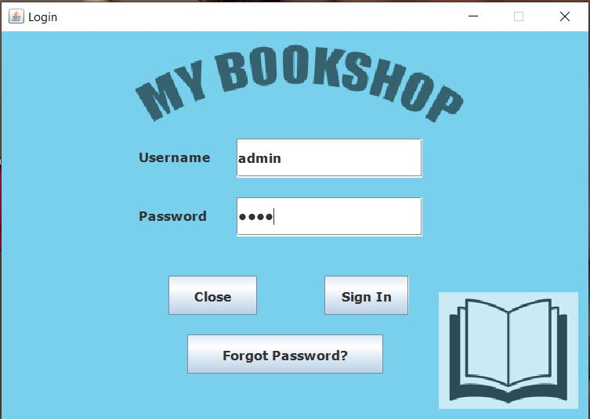
Implementation Screenshot

Slide 6
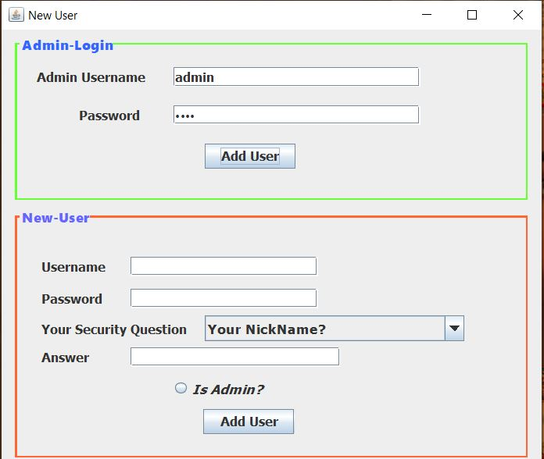
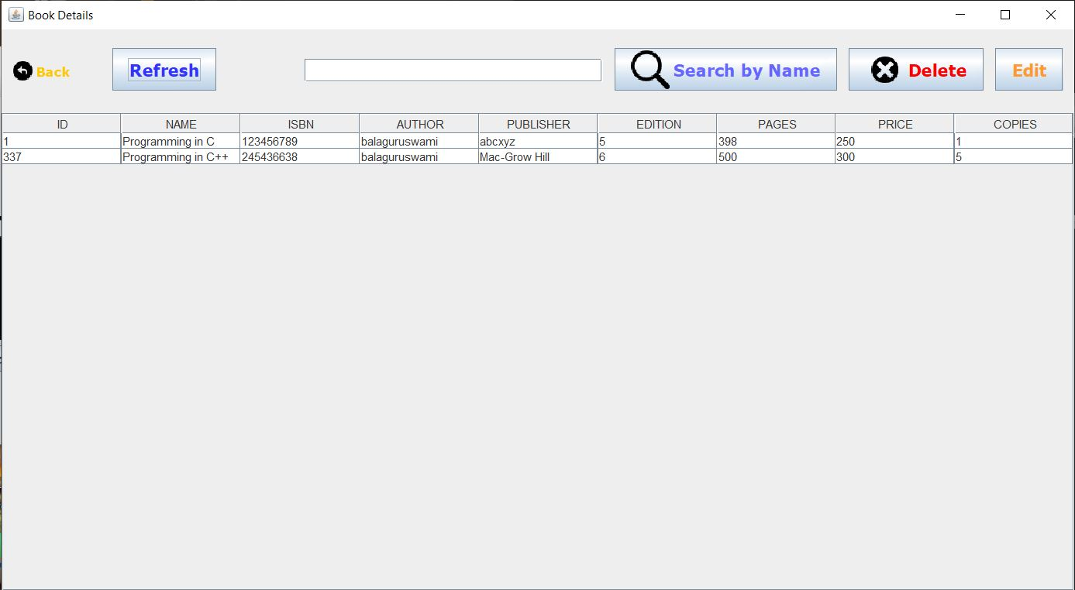
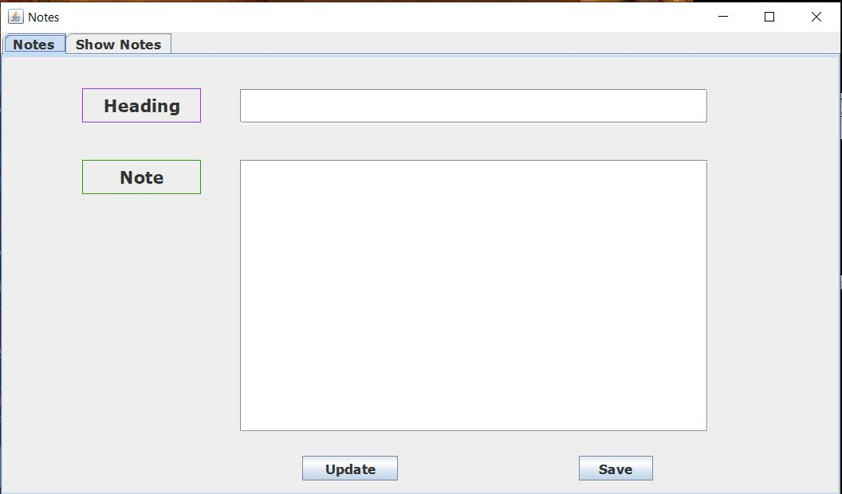
Implementation Screenshot

Slide 7
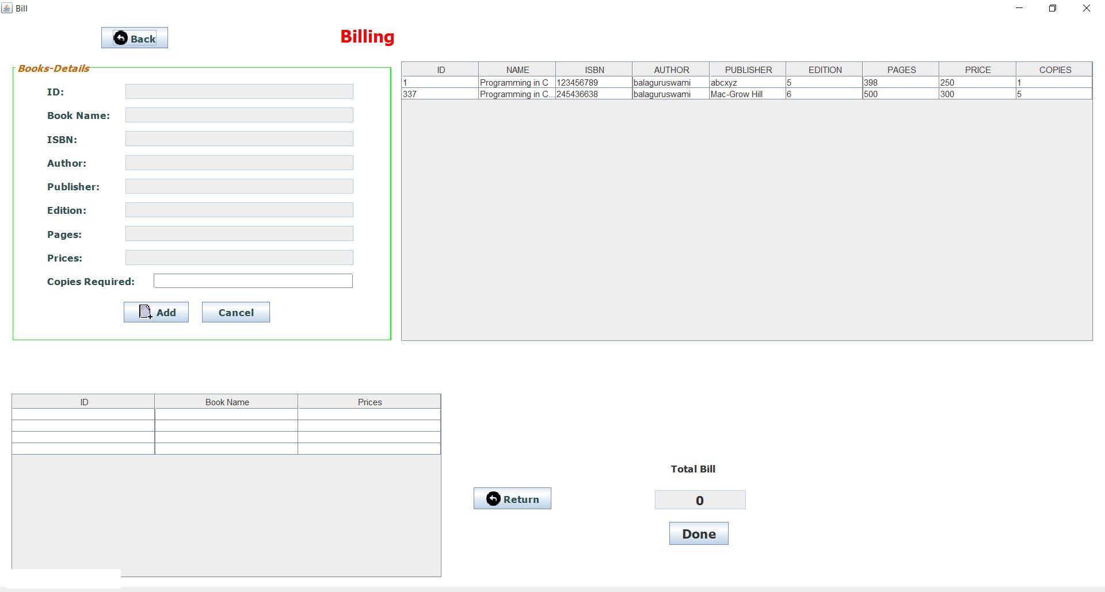
Implementation Screenshot

Slide 8
Expected Improvement In Future
In Current Develop System Report generating option is not available which can be Added.
We Can Add Billing System to Create bill Instead of getting Total Amount only.
We can have Customer Side application Also.

Slide 9
Reference
https://stackoverflow.com/questions/21135452/how-to-add-row-of-data-to-jtable-from-values-received-from-jtextfield-and-combob
https://stackoverflow.com/questions/29345792/java-jtable-getting-the-data-of-the-selectedrow/38981623#:~:text=You%20can%20use%20the%20following,selected%20row%20of%20your%20table.&text=(DefaultTableModel)%20jTable.,return%20the%20entire%20row%20data.
https://www.c-sharpcorner.com/UploadFile/fd0172/display-records-from-database-using-jtable-in-java/
http://www.herongyang.com/JDBC/Derby-Server-SELECT-FROM.html

