Slide 1
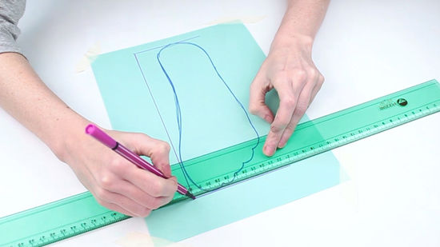
Foot wear size Detection using OpenCV
By
KEERTHI D L 181040007 [EWT]
CHANDAN YADAV N 181040015 [EWT]
Under the guidance of
Prof. Mohan Kumar. J

Slide 2
AGENDA
INTRODUCTION
HARDWARE AND SOFTWARE SPECIFICATION
METHODS
BLOCK DIAGRAM
FLOWCHART
RESULTS
CONCLUSION
SCOPE OF FUTURE WORK
REFERENCES

Slide 3
INTRODUCTION
Object identification has become one of the most important applications for industries to ease user, save time and to achieve parallelism.
The process of object identification analysis is to determine exact size of the object.
The project is based on the object identification in Open CV to find the size of foot.
The static image is processed in the raspberry pi and the corresponding size is detected based on the image from the standard table in database.
08-11-2018
3

Slide 4
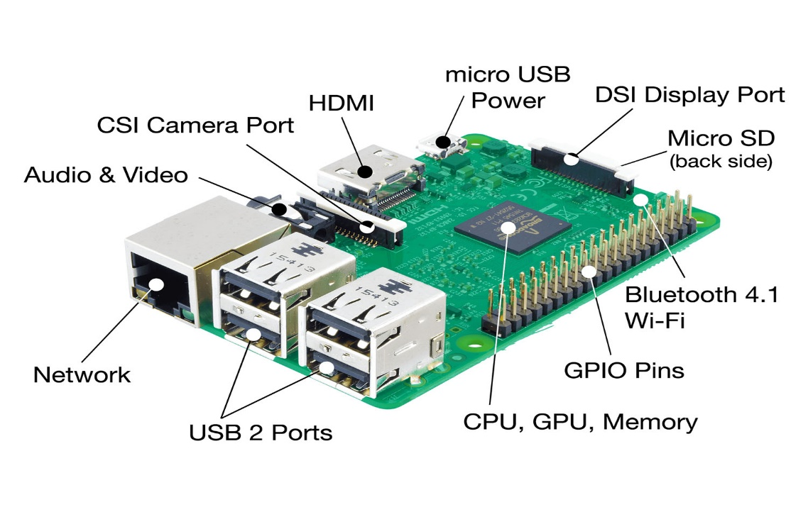
HARDWARE SPECIFICATION
RASPBERRY PI :
It is a minicomputer of a credit card size.
It has various tons of features.
The board not only has tons of features it also has terrific processing speed making it suitable for advanced applications.
It is of a very low price.
08-11-2018
4

Slide 5

SOFTWARE SPECIFICATION
Open CV :
Open source Computer vision is a library of programing Functions mainly aimed at real-time computer vision.
The library has more than 2500 optimized algorithms.
These algorithms can be used to detect and recognize faces, identify objects, extract 3D models of objects, find similar images from an image database, remove red eyes from images taken using flash and etc.
08-11-2018
5

Slide 6
COMPUTER VISION
Computer vision is an interdisciplinary field. It deals with how computer can made to high-level of understanding from the digital images or videos.
Computer vision task includes methods for acquiring, processing, analyzing, understanding digital images and extraction of high dimensional data.
Computer vision is also related in image processing, image analysis and machine vision. It also includes:-
Object Recognition:- one or several pre-specified or learned objects or object classes can be recognized.
Object identification :-it is instance of an object recognized. E.g.: identification of specific persons face or finger print.
Object Detection :-in this image data are scanned for the specific condition. E.g. detection of abnormal cells or tissues in medical images etc.
08-11-2018
6

Slide 7
COMPUTER VISION
Some important functions found in the computer vision systems are:
Image acquisition:- A digital image produces by one or several image sensors such as light sensitive cameras, tomography devices, ultra-sonic cameras etc.
Pre-Processing :-Before computer vision method is applied to Image in order to extract some information from it like re-sampling, noise reduction, contrast enhancement etc.
Feature Extraction :-Features at various level of complexity are extracted from the image such as Lines, edges, ridges, corners, blobs and more complex features like texture, shape or motion.
Detection / Segmentation:-In the processing, a decision is made about which image points or regions of the image are relevant for further processing.
Decision making:- The final step is the decision required for the application. for e.g., pass/fail, match/no-match.
08-11-2018
7

Slide 8
METHODS
There are 5 different methods namely :
SEGMENTATION
THRESHOLDING
CONTOURS
EXTEREME POINTS
EUCLIDEAN DISTANCE
08-11-2018
8

Slide 9
SEGMENTATION
The main Goal of segmentation is to simplify an image or change the representation of an image so that it would be easier to analyze.
It is the process of partitioning a digital image into multiple segments which is set of pixels, known as super pixel.
It is typically used to identify the objects and boundaries like lines, curves.
08-11-2018
9

Slide 10
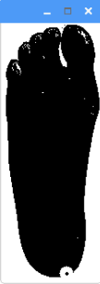
THRESHOLDING
It is based on a clip-level to turn a gray-scale image into binary image. (balanced histogram Thresholding)
In this method each color pixel from an image is replaced with black pixel if the Image intensity is lesser than the constant or to white pixel if the image intensity is greater than constant.
The advantage of this can be quicker execution with less clear boundary between background and foreground.
08-11-2018
10

Slide 11
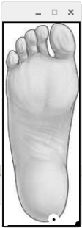
CONTOURS
Contours are useful tool for shape analysis and object detection and recognition.
Contour tracing is one of the preprocessing techniques which is applied on the digital image to extract information about their general shape.
The correct extraction of the contour will produce more accurate features which will increase the chances of correctly classifying a given pattern.
08-11-2018
11

Slide 12
EXTREME POINTS
Extreme points denote the extreme north, south, east and west (x-y) coordinates along the contours.
Steps involved in finding the extreme points are:-
Loading the image from the disk.
Converting to grayscale.
Perform Thresholding.
In order to detect the outlines we use function “cv2.findcontours”.
The contour is simply a NumPy array of (x, y)-coordinates. Therefore, we can leverage the NumPy functions to find the extreme coordinates.
08-11-2018
12

Slide 13
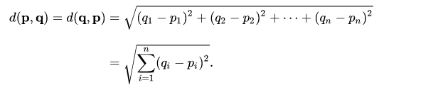
EUCLIDEAN DISTANCE
In mathematics, the Euclidean distance is the ordinary straight-line distance between two points in Euclidean space.
In Cartesian coordinates if p = (p1, p2...) and q= (q1, q2...) are points in Euclidian space then distance from p to q or from q to p is given by the Pythagorean formula as follows
By using Euclidian distance formula, we would be able to get the coordinates of the extreme points. Which would be considered as the distance between those extreme points.
08-11-2018
13

Slide 14
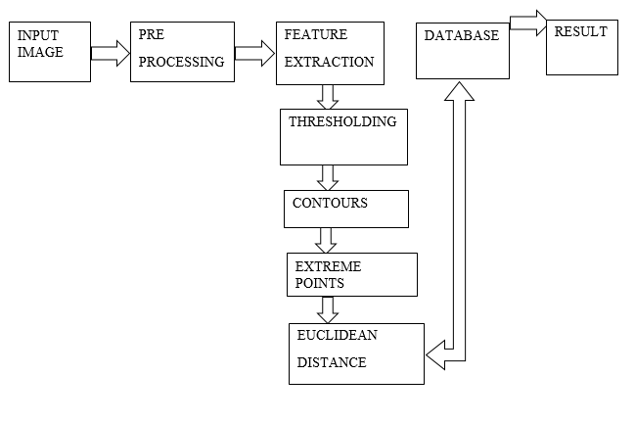
BLOCK DIAGRAM
08-11-2018
14

Slide 15
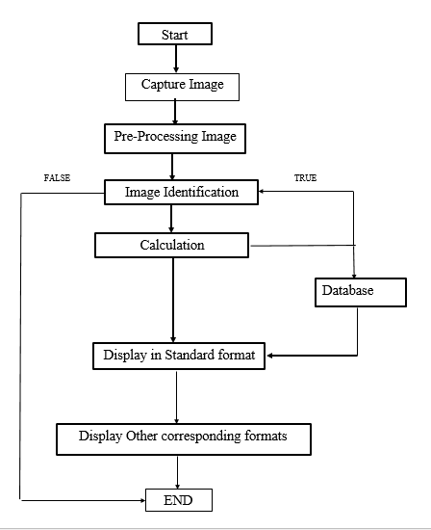
FLOWCHART
08-11-2018
15

Slide 16
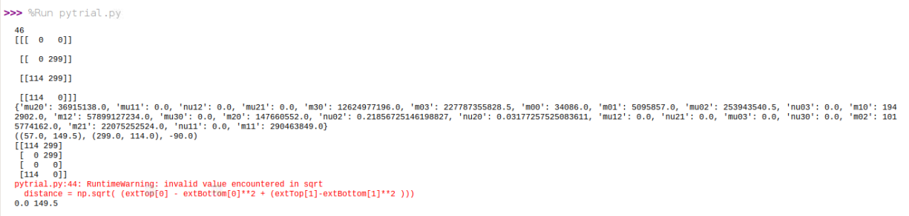
RESULTS
08-11-2018
16

Slide 17
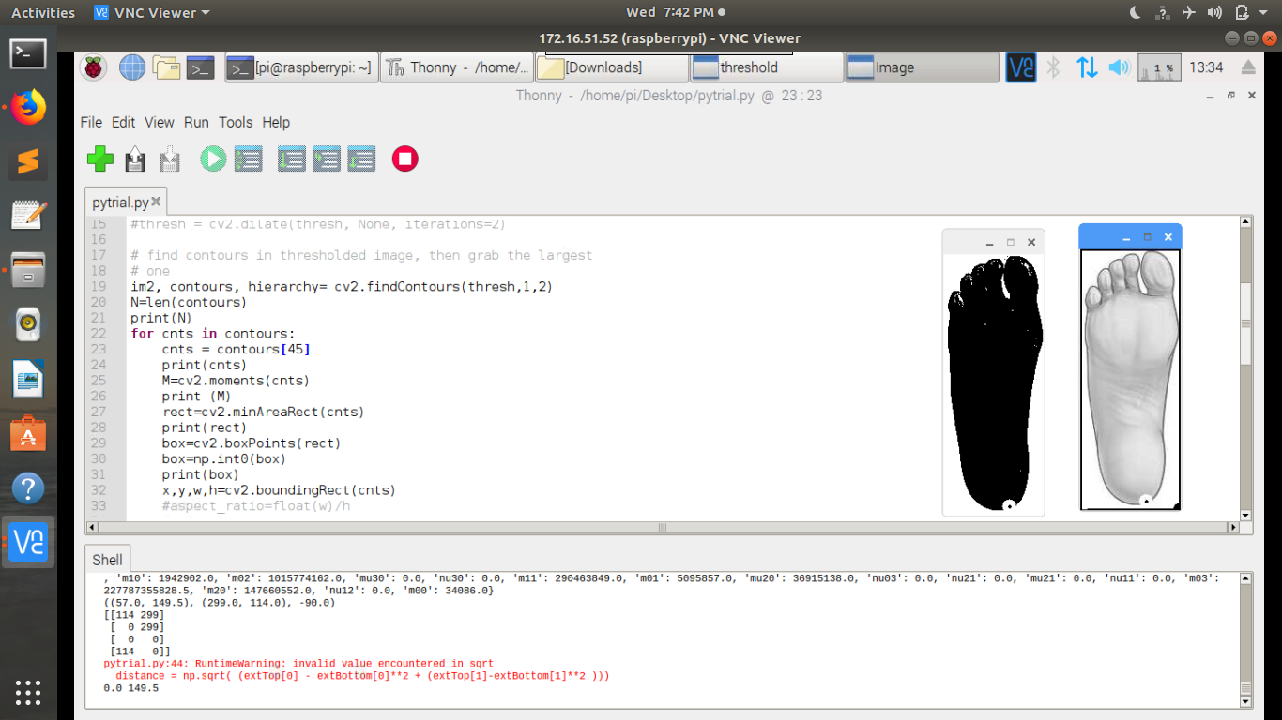
RESULTS
08-11-2018
17

Slide 18
CONCLUSION
The static image is passed as the input to the system and it calculates the length of foot using the Euclidean distance formula.
The obtained data is stored in the database and corresponding data like standard sizes of 3 different units like UK, US, Euro sized was displayed.
The major disadvantage or problem encountering in our project is we are unable to achieve the automation in pre-processing of the image.
08-11-2018
18

Slide 19
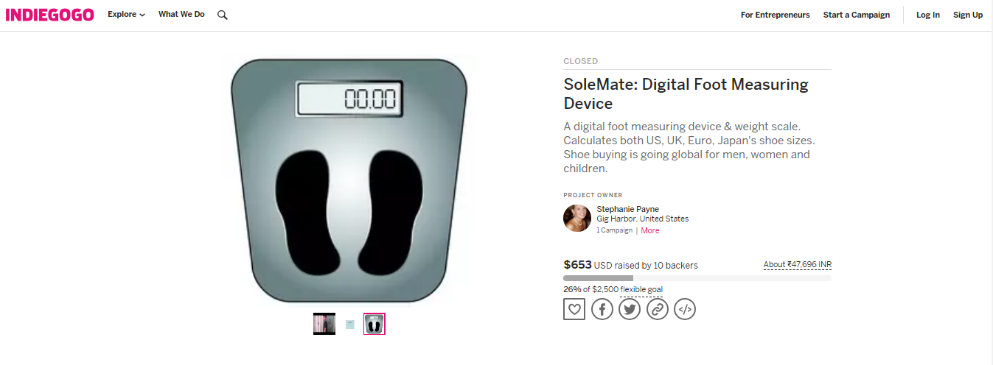
SCOPE OF FUTURE WORK
The above image shows a foot-measuring instrument from the website INDIEGOGO that costs approx. $653, in Indian rupee.
In future this can be incorporated in any of the E-Commerce application where just clicking picture and uploading should be able display the size of the foot wear.
08-11-2018
19

Slide 20
REFERENCES
http://cds.cern.ch/record/400313/files/p21.pdf
https://www.pyimagesearch.com/2016/03/28/measuring-size-of-objects-in-an-image-with-opencv/
https://docs.opencv.org/3.4/dd/d49/tutorial_py_contour_features.html
https://www.pyimagesearch.com/2016/04/11/finding-extreme-points-in-contours-with-opencv/
https://docs.opencv.org/3.4.3/d7/d4d/tutorial_py_thresholding.html
08-11-2018
20

Slide 21

08-11-2018
21

