Slide 1

School of computer Science and Engineering
Name of the School: School of Computer Science and Engineering
Course Code:R1UC424T Course Name:Data Analytics
FRAUD DETECTION SYSTEM
Guided By :
Dr. Ravi Sharma
Presented By :
Naman Tiwari -23scse1410235
Priyanshu -23scse1410281
Gopal- 23scse1570003

Slide 2

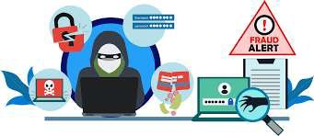
TODAY’S PROBLEM
In the modern world, fraud has become more widespread, sophisticated, and harder to detect than ever before. With the rapid rise of digital technology, online banking, mobile payments, e-commerce, and remote work, the opportunities for fraudsters to exploit systems have dramatically increased.
In our everyday lives, we swipe cards, shop online, transfer money, and even manage our entire finances through a phone app. It’s convenient—but it also means we’re constantly exposed to risks we can’t always see. Today’s fraud isn’t just someone stealing a wallet or writing a bad check. It’s silent, invisible, and often digital.

Slide 3
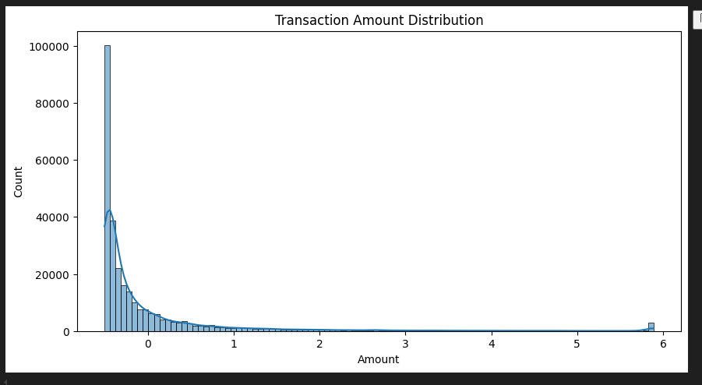
What is Fraud?
Fraud is when someone uses lies or tricks to steal something—usually money or personal information—from someone else. It’s not
always loud or obvious. Sometimes, it’s as simple as a fake phone call pretending to be your bank, or an email that looks real but isn’t. Other times, it’s someone secretly using your credit card, or a company changing numbers to hide the truth.
Today, because so much of life happens online,
fraud has become smarter and harder to
detect. That’s why learning to recognize it, and using tools like data analysis and systems like Power BI, is so important to protect ourselves and our communities.

Slide 4
Role of Data Analysis in Fraud Detection
Data analysis plays a critical role in identifying fraudulent activity by detecting patterns, trends, and anomalies in large datasets. Fraud is often not immediately obvious, and traditional methods of detection can miss subtle indicators. This is where data analysis shines—it can sift through vast amounts of transaction data to uncover suspicious behavior that might go unnoticed by the human eye.
The process starts by analyzing historical transaction data, customer profiles, and other relevant factors, looking for unusual patterns. For example, a customer who typically makes small, local purchases suddenly makes a large overseas purchase—this could trigger an alert. Data analysis also helps develop risk models, scoring transactions or users based on their likelihood of being fraudulent. These models constantly evolve as new data is fed into the system, allowing the detection of more sophisticated fraud tactics over time.
Moreover, data analysis enables real-time detection. This means, as transactions happen, the system can immediately flag anything out of the ordinary—such as duplicate transactions, rapid changes in spending patterns, or purchases made at odd hours. By catching fraud early, businesses can minimize losses and prevent the spread of fraudulent activity before it escalates

Slide 5
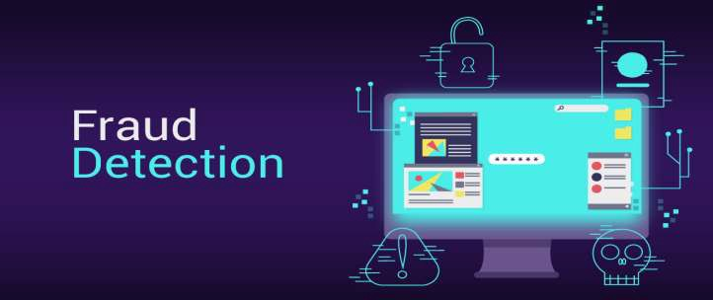
Fraud Detection
Fraud detection is essential in today’s digital world where transactions happen in seconds and personal data is constantly shared online. Without strong fraud detection systems, individuals can lose their savings, businesses can face massive financial damage, and public trust can quickly erode. Detecting fraud early means stopping criminal activity before it spreads—protecting not just money, but people’s identities, reputations, and peace of mind. As fraud becomes more sophisticated and harder to spot, effective
detection isn’t optional—it’s a critical layer of defense for every organization and individual navigating
today’s connected world.

Slide 6
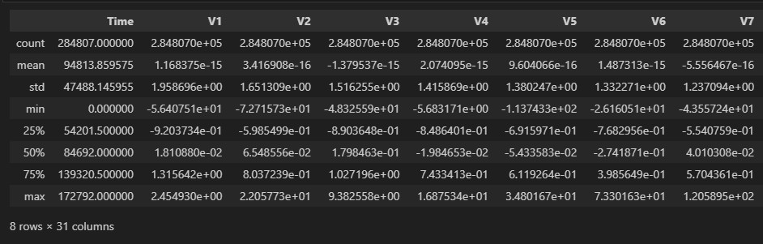
Data Used in the System
To effectively detect fraud, the system relies on several types of data that help build a comprehensive profile of each transaction and customer behavior. These data points are crucial for identifying patterns, anomalies, and potential fraud. Below are the key types of data used:
Transaction Data
Amount
Time
Location
Merchant Information
Customer Profile Data
Age, Region, Spending History
Account History
Device/IP Data
Device Information
IP Address
Historical Fraud Labels (Training Data)

Slide 7
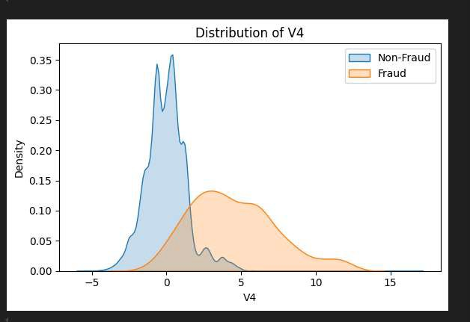
Data Preparation and Modeling
Data Cleaning: Removed duplicates, handled missing values, and standardized formats using Power Query.
Feature Engineering: Created new features like transaction frequency, deviation from usual amounts, and time-of-day indicators.
Relationship Modeling: Linked key tables (Users, Transactions, Locations) to build a connected data model.
Goal: Make patterns of fraud more visible and support deeper insights through structured, connected data.

Slide 8
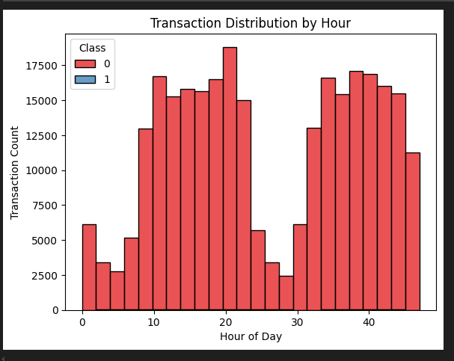
Technologies Used
Power BI: For dashboards, visualizations, and
interactive reporting.
Power Query: For data cleaning and transformation.
DAX (Data Analysis Expressions): For custom
calculations and measures.
Power Automate: For triggering alerts and
automating responses.
Microsoft SQL Server / Excel: As data sources.
Optional: Python/R and Azure ML for predictive
analytics and advanced modeling.

Slide 9
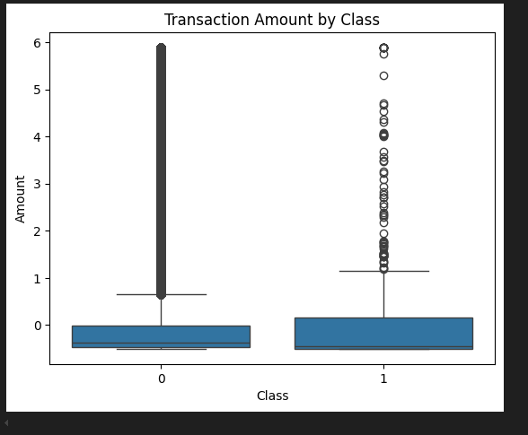
Benefits
Benefits of the System
Fast and visual fraud detection.
Saves investigation time and resources.
Customizable and scalable.
Empowers business users with real-time insights.

Slide 10
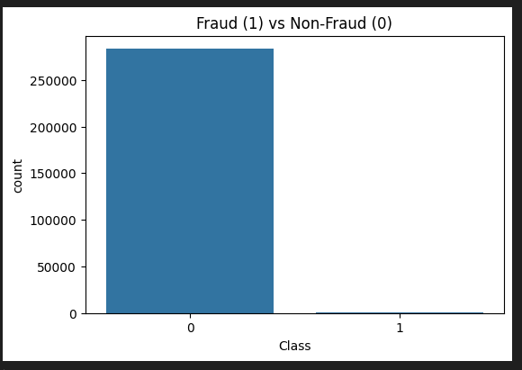
Conclusion and Future Scope
Power BI provides an accessible and powerful way to
detect fraud visually and interactively.
It helps organizations react faster and make data- driven decisions to combat fraud.
Future improvements:
Integrate real-time data feeds for instant detection.
Apply machine learning models for predictive fraud
analysis.
Enhance automation and alert mechanisms.
Continuously refine detection logic based on new
fraud patterns.

Slide 11
THANK YOU

