Slide 1
✈ SkyBook
Flight Booking Portal
Project Review – Updated Implementation
Frontend + Node.js/Express Backend + MySQL Database
1

Slide 2
1. Project Objective
Develop a web-based flight booking portal named SkyBook.
Allow users to search available flights using origin, destination and travel date.
Connect the frontend to a Node.js/Express REST backend.
Store and retrieve flight information using the existing MySQL database.
Build the foundation for user authentication and flight booking.
2

Slide 3
2. Technologies Used
Frontend
HTML5, CSS3, JavaScript
Backend
Node.js + Express.js
Database
MySQL
ORM
Sequelize
Authentication
JWT-based API authentication
API
REST endpoints
Development
Chrome + PowerShell + npm
3

Slide 4
3. System Architecture
Current implemented flow
SkyBook Frontend
REST API
MySQL Database
HTML / CSS / JavaScript
Node.js / Express
Sequelize ORM
Browser → REST API → Database → JSON response → Flight results displayed in the UI
4

Slide 5
4. Backend Implementation
Express server is running on port 5000.
Sequelize is used to connect the application models to MySQL.
REST endpoints are available for authentication, airports, flights, bookings, passengers and analytics.
The backend successfully authenticates with MySQL and synchronizes the models.
The flight API returns structured JSON data including airport details and seat availability.
5

Slide 6
5. MySQL Database Integration
The project uses the existing MySQL database configured in the backend.
Sequelize handles database connectivity and model mapping.
Flight records are stored in the database and retrieved through the API.
The current flight API successfully returns 20 records.
Each flight includes route, departure/arrival time, price, total seats, available seats and status.
MySQL → Flights → API
6

Slide 7
6. Frontend Implementation
SkyBook interface contains Home, Flights and Services sections.
Flight search form accepts From, To and Departure Date.
The frontend calls the backend flight API using fetch().
Returned flight data is displayed dynamically in the browser.
The frontend is now served through localhost:3000 for reliable API communication.
7

Slide 8
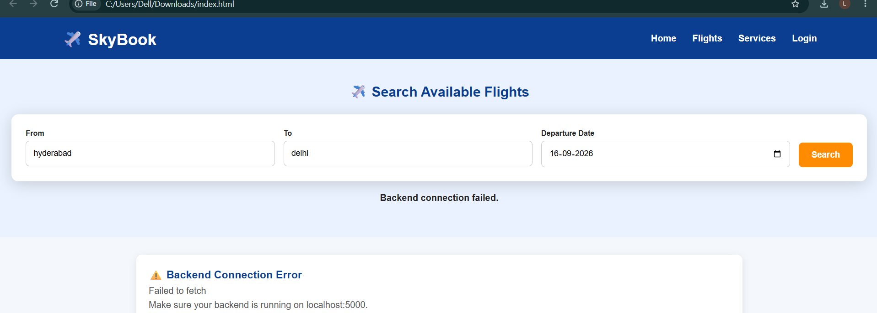
7. Working Demo
8

Slide 9
8. Integration Issue Resolved
Initial browser testing showed a CORS error because index.html was opened directly using file://.
The backend API itself was working correctly.
The frontend was moved to a local HTTP server using npx http-server -p 3000.
SkyBook is now accessed through http://localhost:3000/index.html.
This allows the browser frontend to communicate correctly with the backend on port 5000.
9

Slide 10
9. Current Project Status
Frontend UI
Completed
Node.js / Express API
Completed
MySQL connection
Working
Flight data retrieval
Working
Frontend ↔ Backend integration
Working
Authentication / Booking flow
Backend endpoints implemented; further end-to-end demo/testing can continue
10

Slide 11
10. Next Steps
Complete and demonstrate user registration and login.
Complete end-to-end flight booking from the UI to the database.
Show booking confirmation and booking history.
Add/verify passenger and seat handling during booking.
Perform final testing and prepare the project for final review.
11

Slide 12
Thank You
SkyBook – Flight Booking Portal
Frontend • Backend • MySQL • REST API

