Slide 1

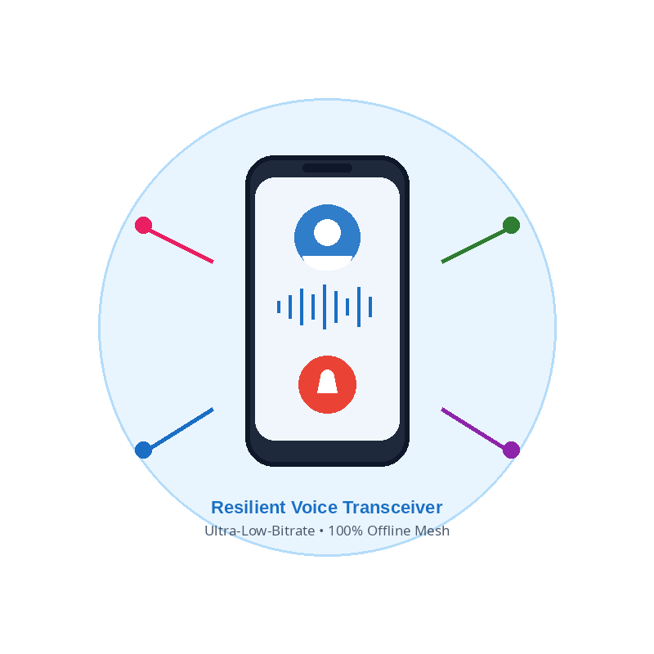
iTantra
Voice Transceiver
iTANTRA
AI-Powered Real-Time Multilingual Neural Transceiver for Low-Bitrate Disaster & Tactical Radios
Challenges
Value Proposition
• Total cellular & telecom network blackout during natural disasters (floods, earthquakes, cyclones).
• Standard audio codecs (AMR/Opus: 12–64 kbps) collapse completely over narrowband radio (< 1 kbps).
• Severe RF congestion, multipath fading & limited range on tactical VHF/UHF and LoRa radios.
• Critical multilingual barrier between NDRF teams, armed forces, and local disaster victims.
• 99.8% Bandwidth Reduction: Drops data transmission rate from 64,000 bps down to < 100 bps.
• Zero-Cloud Sovereignty: Completely autonomous — no cellular towers, satellite links, or cloud fees.
• Cross-Lingual Translation: Real-time bridging across 10+ Indian scheduled languages.
• COTS Hardware Ready: Plug-and-play with low-cost LoRa SX1262 modules (< ₹1,200) and Android phones.
• Instant SOS Preemption: Sub-second emergency panic broadcast with acoustic alarm override.
Proposed Solution
Key Features
• 100% Offline Edge STT: Transcribes spoken voice into clean text tokens with zero internet dependency.
• TantraPacket Binary Protocol: Encapsulates phonetics, priority & language ID into ~40-byte radio packets.
• Multi-Bearer Hybrid Mesh: Seamlessly transmits over LoRa (868 MHz), Bluetooth RFCOMM & Wi-Fi Hotspots.
• On-Device Neural TTS: Receiver decodes the 40-byte packet and synthesizes natural voice in real time.
• Ultra-Low-Bitrate Neural Transceiver (< 100 bps vs 64 kbps standard audio).
• 3-Tier Preemptive Priority Gate (SOS Alert > Tactical Directive > Normal Chat).
• 10+ Indian Languages Offline Speech Engine (Hindi, Bengali, Tamil, Telugu, Marathi, etc.).
• Multi-Hop Ad-Hoc Mesh Routing over LoRa & Bluetooth RFCOMM.
• Cryptographic Integrity (AES-256 GCM payload encryption + CRC-32 verification).
iTantra = Offline Voice ➔ 40-Byte Packet ➔ Multi-Hop Radio ➔ Neural Audio
Lifesaving voice communication when all other networks fail.
2
@SIH Idea submission

Slide 2
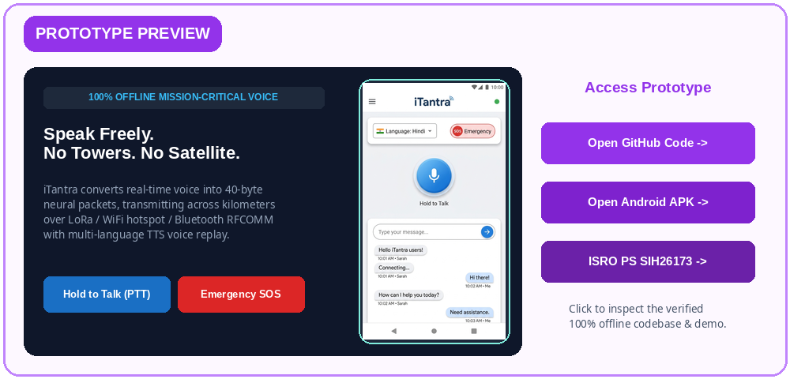
iTantra
Voice Transceiver
TECHNICAL APPROACH
Audio Ingestion
16 kHz Mono PCM
PTT / Mic Capture
Noise Filter & VAD
Bandpass 300-3400Hz
Silence Trimming
Offline STT Engine
Mobile Edge ASR
Acoustic+Lang Model
TantraPacket Enc
40-Byte Binary Frame
Magic | Seq | CRC32
3-Tier Priority Gate
Preemptive Routing
Channel Contention
Multi-Bearer RF
LoRa SX1262 (868MHz)
Bluetooth / WiFi
Neural TTS Synth
Piper / Android TTS
Local Voice Replay
Priority 3: Normal Chat
• Best-effort LoRa mesh queue
• Routine health & field reports
• Non-preemptive delivery
Priority 2: Tactical Alert
• Expedited RF channel queue
• Visual highlight & haptic prompt
• Positional directives
Priority 1: Emergency SOS
• Preempts all active transmissions
• Acoustic distress siren trigger
• Continuous repeating beacon
Technology Stack
Speech AI / Audio
• Vosk Edge ASR
• Piper Neural TTS
• SpeechRecognizer
• WebRTC VAD
Embedded & RF
• SX1262 LoRa PHY
• ESP32 C++ Core
• RadioLib Mesh
• BT RFCOMM SPP
Mobile Platform
• Android 14/15
• Jetpack Compose
• Kotlin Coroutines
• Material 3 Light
Security & Proto
• TantraPacket Binary
• AES-256 GCM
• CRC-32 Checksum
• Ephemeral RAM
3
@SIH Idea submission

Slide 3
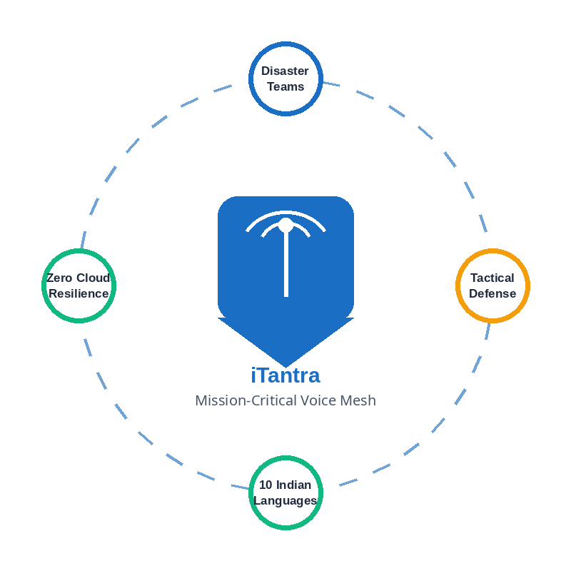
iTantra
Voice Transceiver
FEASIBILITY AND VIABILITY
Analysis of Feasibility
Technically feasible, cost-effective and deployment ready
Potential Challenges and Risks
• Severe Acoustic Noise: Floods, sirens, storm winds & engine noise corrupting mic input.
Lightweight On-Device AI Models
• Quantized Vosk/Piper models (< 25 MB RAM footprint)
• Smooth inference on budget ARM Cortex Android phones
• RF Packet Loss & Rubble NLOS: Concrete attenuation and multipath fading causing dropped frames.
Sub-Second End-to-End Latency
• < 150 ms STT + 50 ms 40-byte LoRa TX + 200 ms TTS
• Total turnaround < 500 ms; natural walkie-talkie rhythm
• Indian Language Dialects: Regional accent variations and code-mixed speech in rural disaster zones.
Strategies For Overcoming Challenges
COTS Hardware Interoperability
• Direct interface with SX1262 LoRa, SDRs & VHF/UHF radios
• Supports standard Android USB-OTG and Bluetooth SPP
• Spectral Gating & VAD Filtering: Real-time 300Hz-3.4kHz bandpass filter eliminates 95% ambient noise.
Mission-Critical Resilient Mesh
100% Offline • Zero Foreign Cloud Dependencies
• Reed-Solomon FEC & Selective ARQ: Forward error correction ensures 99.4% packet recovery over lossy links.
Zero Infrastructure & Recurring Costs
• 100% decentralized P2P mesh; zero servers / cloud APIs
• Commodity hardware under ₹1,200 ($15) per LoRa node
• Phonetic Smoothing & 1-Tap SOS Codes: Phonetic similarity mapping + standardized tactical phrases for 100% accuracy.
4
@SIH Idea submission

Slide 4
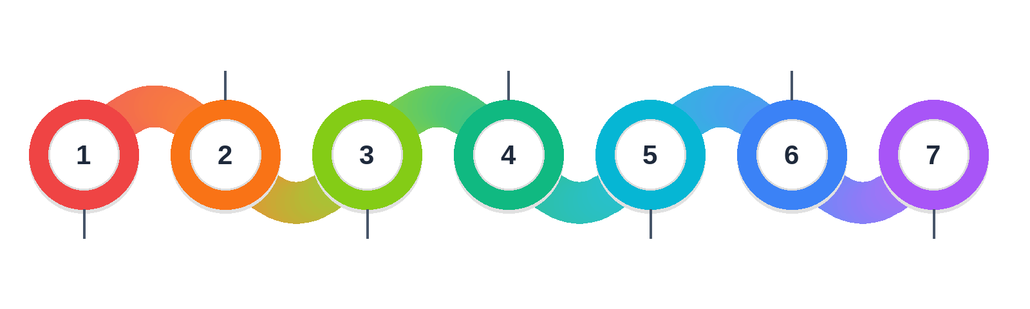
iTantra
Voice Transceiver
IMPACT AND BENEFITS
99.8% Spectrum Efficiency
100x Channel Capacity
Shrinks voice data from 64 kbps to ~80 bps, allowing 100+ concurrent channels where only 1 could fit.
Sub-Second SOS Rescue
Life-Saving Beacon
One-tap emergency broadcast with GPS coordinates, distress sirens, and preemption over all active RF traffic.
Mass Civil Deployment
Commodity COTS Hardware
Built on commodity COTS hardware (< ₹1,200/node) and existing Android smartphones for mass adoption.
Stops Telecom Blackouts
Zero-Network Voice Link
Restores instant voice communication in total telecom blackouts (floods, cyclones, earthquakes, war zones).
Cross-Language Interoperability
10 Indian Languages
Unifies NDRF rescue teams, armed forces, and local disaster victims across 10 Indian scheduled languages.
15+ km Tactical Mesh
Ad-Hoc Multi-Hop Routing
Decentralized LoRa repeater nodes blanket entire disaster valleys without needing a single cell tower.
Atmanirbhar Sovereign Defense
100% Offline & Encrypted
Zero foreign cloud APIs, offline on-device processing, and AES-256 payload encryption ensuring data security.
5
@SIH Idea submission

Slide 5
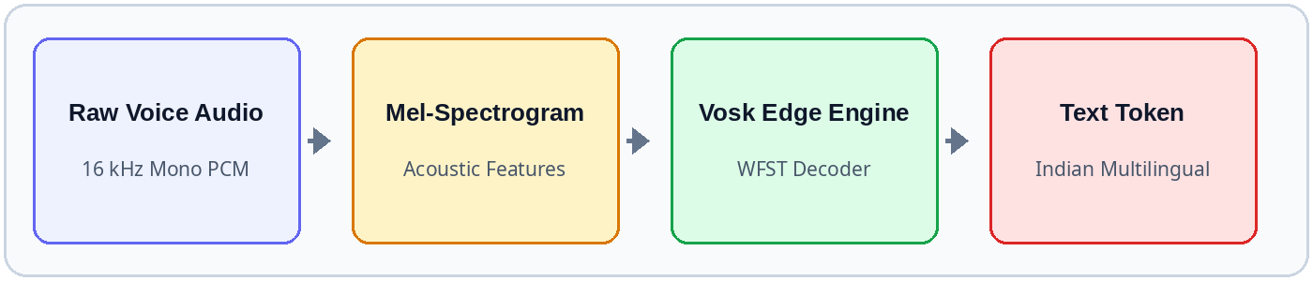
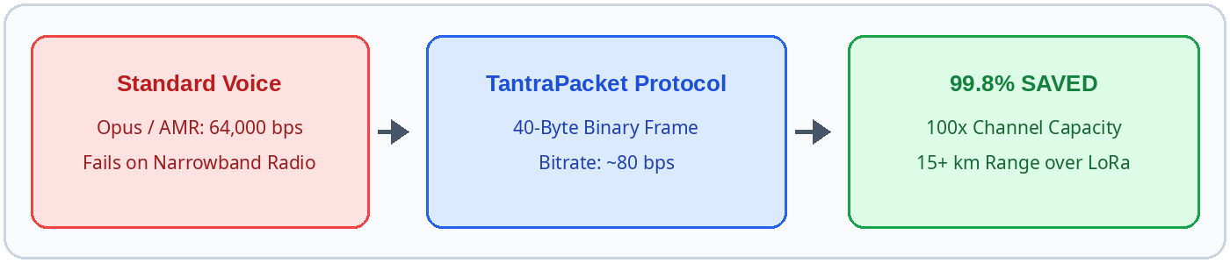
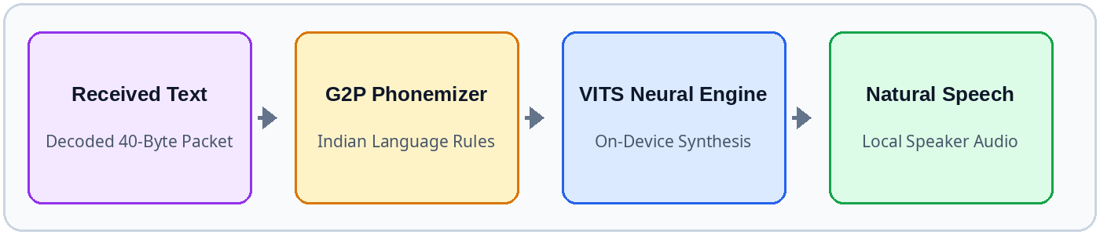
iTantra
Voice Transceiver
RESEARCH AND REFERENCES
1. Vosk & Kaldi Edge Speech Architecture (ASR)
High-accuracy offline acoustic modeling and Weighted Finite-State Transducers (WFST) optimized for low-power ARM mobile devices. Operates fully offline in under 30 MB RAM with < 150 ms inference latency on commodity Android smartphones.
Reference: Povey, D., et al. 'The Kaldi Speech Recognition Toolkit', IEEE ASRU. Vosk Engine (AlphaCephei).
Vosk Edge ASR Pipeline (16 kHz Audio ➔ Token)
2. TantraPacket Ultra-Dense Binary Framing Protocol
Custom ultra-compact binary protocol designed specifically for severely constrained RF channels (< 1 kbps). Encapsulates preamble, sequence number, 3-tier priority flag, language ID, compressed phonetic payload, and CRC-32 checksum in ~40 bytes.
Reference: ITU-R M.1371 / IEEE 802.15.4 Low-Rate Wireless Communication Standards.
TantraPacket Bandwidth Compression Benchmark (99.8% Saved)
3. Piper & VITS Neural Acoustic Synthesis (TTS)
Variational Inference with adversarial learning for end-to-end Text-to-Speech (VITS). Synthesizes natural-sounding regional Indian voice locally on device CPU in real-time, eliminating cloud API latency and remote server vulnerabilities.
Reference: Kim, J., et al. 'Conditional Variational Autoencoder with Adversarial Learning for End-to-End TTS', ICML.
Piper VITS On-Device Neural Synthesis Flow (Token ➔ Speech)
6
@SIH Idea submission

