Slide 1

Kotlin Introduction To Android
Naman Kanwar

Slide 2
Why Kotlin?
Created by JetBrains
Type Inference: don’t have to declare the types of variables
Reduces Null pointer exception
Operates on JVM so works along Java
Other uses: backend, frontend web development, iOS development and more
Used by AWS, Pinterest, Coursera, Netflix, Uber, and more…

Slide 3
What are we going to look at?
Variables
Intent
Context
List View
Recycler View
Fragments

Slide 4
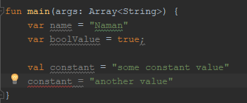
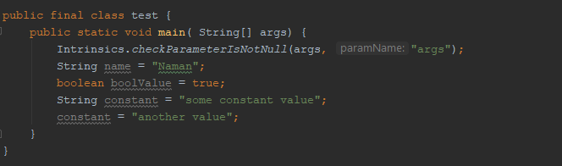

Variables

Slide 5
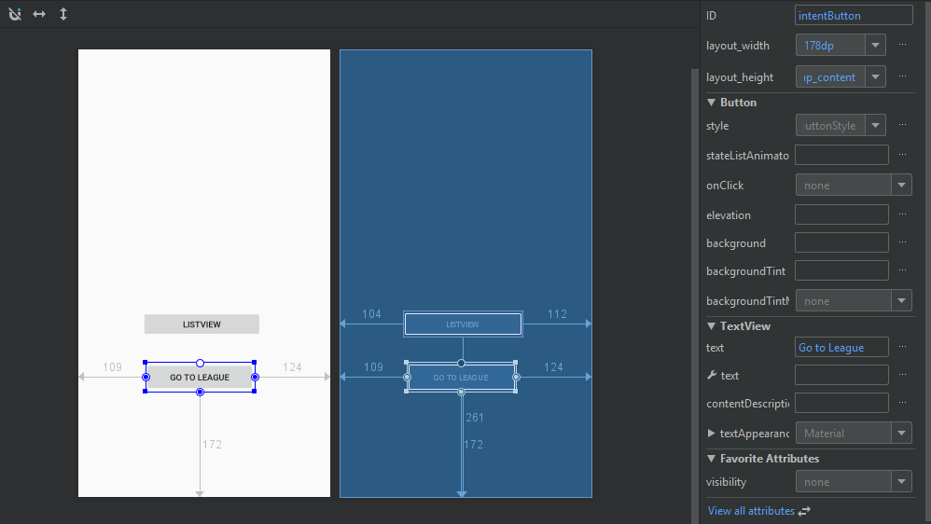
Intent XML

Slide 6
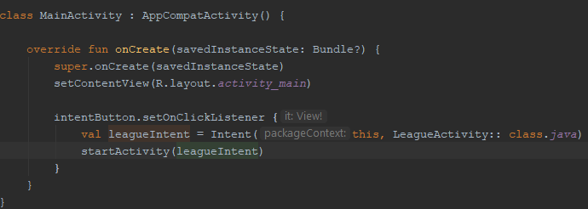

Intent
Helps with previous version of SDK
Interaction with other and own applications
Context

Slide 7
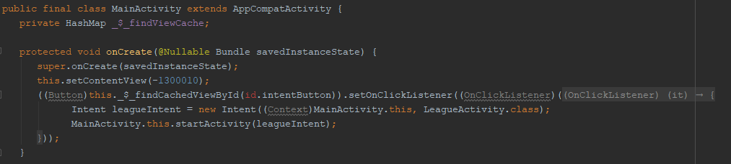
Intent

Slide 8
Intent and Context
Types Explicit Intent Implicit Intent
Context Sending information about activity

Slide 9


List View
Database List View
Adapter

Slide 10
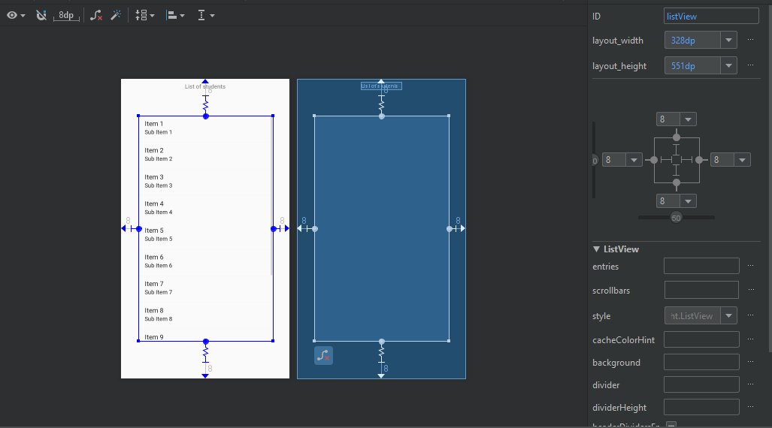
List View XML

Slide 11
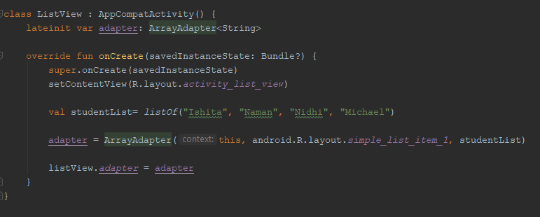
List View
Not initialized
Val?
Data
Layout type
Context

Slide 12
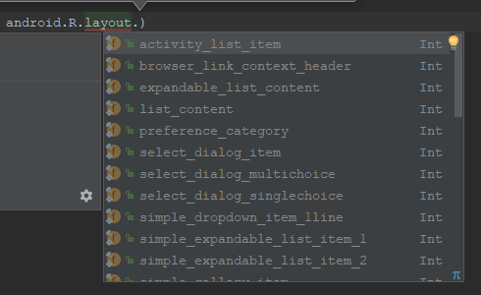
List View

Slide 13
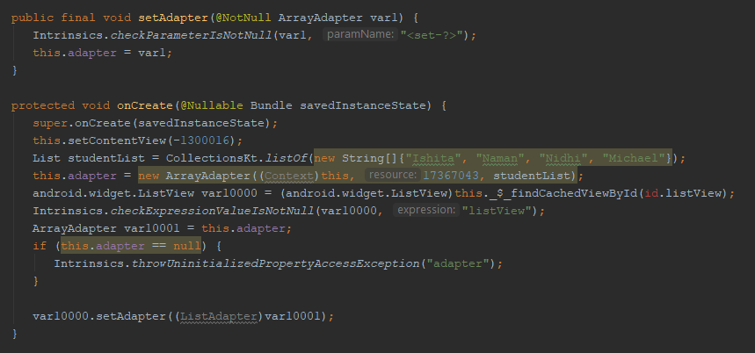
List View

Slide 14
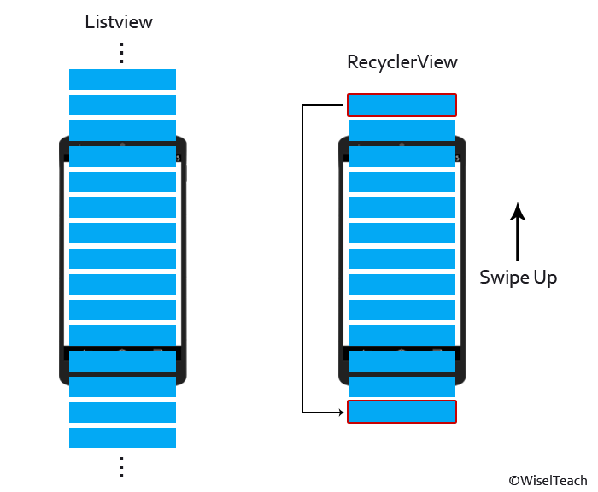
Recycler View

Slide 15
Recycler View- what do we need?
Recycler View Activity
View Holder
Data
Adapter

Slide 16
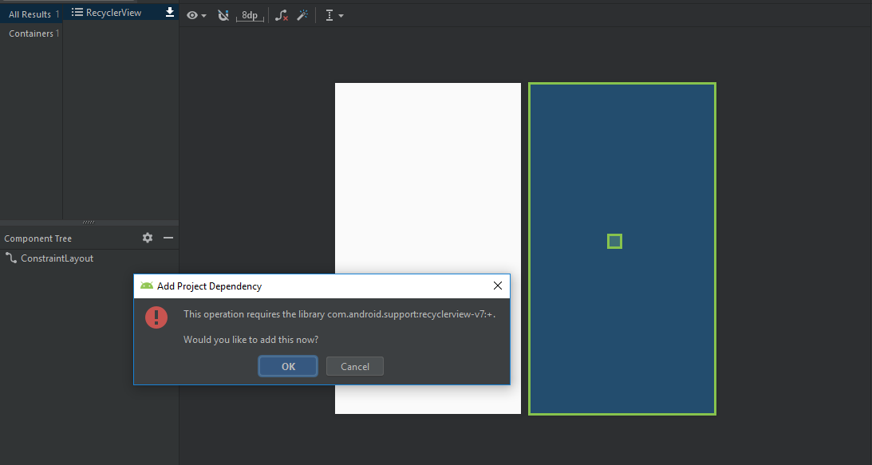
Recycler View

Slide 17
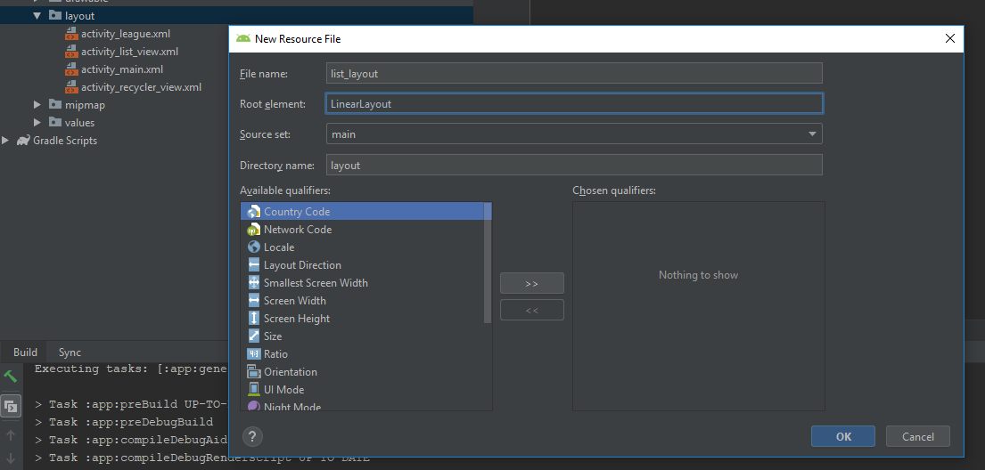
Recycler View- List Layout

Slide 18
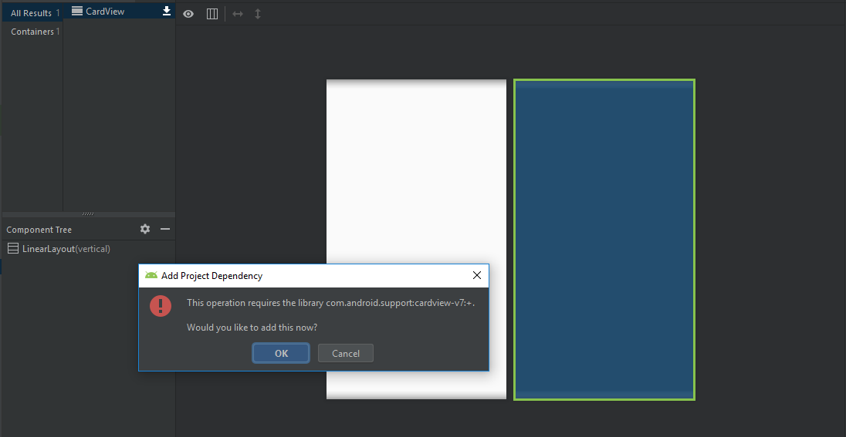
Recycler View- List Layout

Slide 19
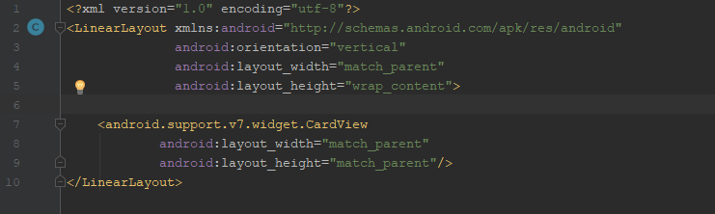
Recycler View- List Layout
Match parent’s dimensions
Large enough to fit own content

Slide 20
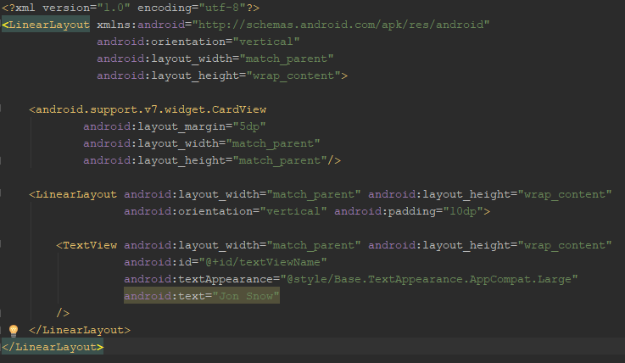
Recycler View- List Layout
Container
Element Type

Slide 21
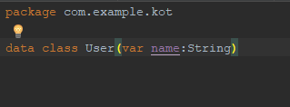
Recycler View- Data
Class for storing data
This could take multiple data types depending on the desired layout

Slide 22
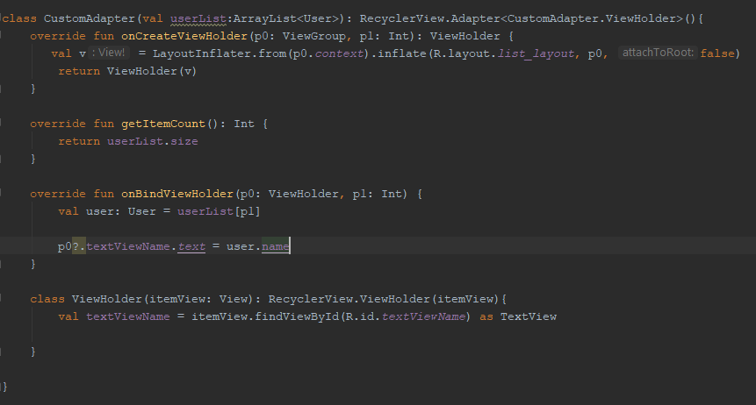
Recycler View- Adapter
Extends to RecyclerView.Adapter
View group is a container for views
Define a View Holder
Returns a view holder
View Holder contains only a TextView

Slide 23
Recycler View- Adapter
Converts XML layout file into View Group or Widget
If you would like to attach this view with existing View group
Creating/ rendering a layout
Returns the length of list

Slide 24
Recycler View- Adapter
In p0’s layout add user’s name

Slide 25
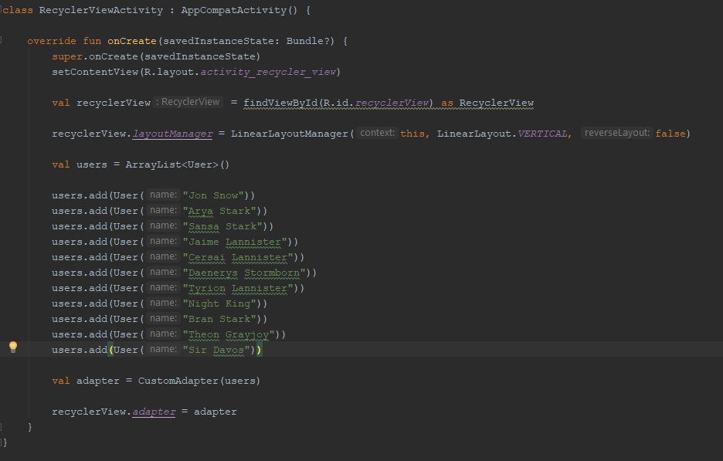
Recycler View Activity
Sending context, type of layout, and
Reverse layout (attribute of LinearLayout)

Slide 26
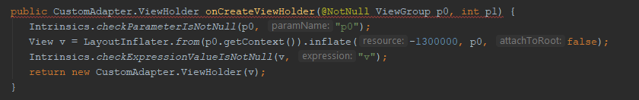
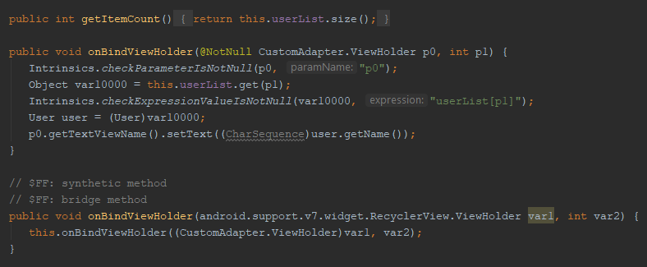
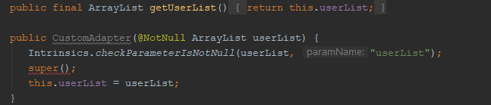
Recycler View- Java

Slide 27
Thank you
Resources
https://github.com/naman26
https://www.youtube.com/namankanwar

