Slide 1
Leaf Disease Classification and Affected-Area Analysis
VGG16 + SVM vs. CNN on apple and corn leaves, with severity staging
Naman Agarwal
20233195
Naman Katiyar
20233196
Nishant Mohan
20233367
Nitya Binoy Vettical
20233540
Department of Computer Science and Engineering, MNNIT Allahabad
Notes:
Team project: leaf disease classification (healthy vs diseased) and affected-area analysis. First SVM on VGG16 features, then a CNN.

Slide 2
Why leaf disease analysis matters
1
2
3
Detect
Measure
Compare
Manual scouting is slow and needs experts. A photo of one leaf can flag the disease.
Treatment urgency depends on spread, so we also compute the % of leaf area affected.
Two approaches, tried in order: deep features + SVM, then a CNN trained from scratch.
Leaf Disease Classification & Analysis | MNNIT Allahabad

Slide 3
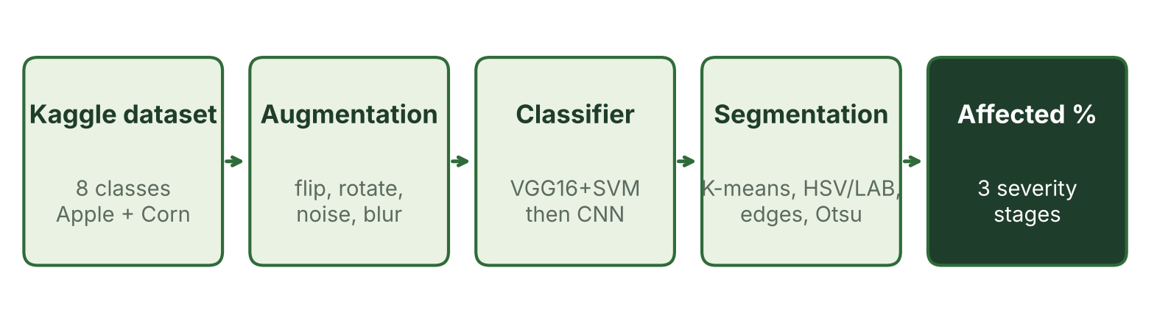
Data and pipeline
Kaggle New Plant Diseases Dataset: 87,000+ images, 38 classes
Subset: Apple + Corn = 8 classes (6 diseases, 2 healthy)
Augmentation: flips, rotation, brightness, noise, blur, crop, hue shift
Testing: dataset gives only 10 test images, so we also tested on part of the train set
Leaf Disease Classification & Analysis | MNNIT Allahabad

Slide 4
Phase 1: VGG16 features + SVM
Frozen ImageNet VGG16 + global average pooling gives a 512-d feature vector
Standardise, then RBF-kernel SVM
Grid search (C, γ) with 3-fold CV: best C = 20, γ = scale (CV 95.2%)
Train: 16,000 images (500 per class × 4 with augmentation); validation: 800
97.88%
validation accuracy
783 of 800 images
every class F1 ≥ 0.96
Leaf Disease Classification & Analysis | MNNIT Allahabad

Slide 5
Phase 2: CNN trained from scratch
Conv 32
Conv 64
Conv 128
Dense 256
Softmax 8
3×3 conv + ReLU, batch norm, max-pool, global average pooling, Dropout 0.5
Adam (lr 0.001), batch 32, up to 30 epochs with early stopping
Only 129,736 parameters (about 0.5 MB), ~20 s per epoch
Train: 12,000 images; validation: 800 (100 per class)
99.12%
accuracy, precision and recall on 800 validation images
Leaf Disease Classification & Analysis | MNNIT Allahabad

Slide 6
Results: SVM vs. CNN
CNN 99.12% vs. SVM 97.88% validation accuracy
Both labelled all 10 test leaves correctly
CNN: ~20 s per epoch; SVM feature extraction took 59 min on CPU
CNN is small enough for mobile use
Leaf Disease Classification & Analysis | MNNIT Allahabad

Slide 7
Affected area and severity
Blur, then HSV and LAB colour spaces
Lesion masks: K-means, colour threshold, edges; keep pixels where 2 of 3 agree
Otsu threshold isolates the leaf
Affected % = diseased px ÷ leaf px
Stages: 0–15% Initial, 15–40% Middle, 40–100% Severe
9 of 10 leaves in Initial stage; corn common rust up to 15.4% (Middle). Mean 3.95%.
Leaf Disease Classification & Analysis | MNNIT Allahabad

Slide 8
Uses and limitations
Where it helps
Limitations
Smartphone advisory app (small CNN exports to TFLite)
Early warning: flag Initial-stage infection
Targeted spraying by affected %
Extension services, insurance records, teaching
Severity not checked against expert masks
Needs good lighting; misses subtle early symptoms
Must be tested in a real environment (real farm) to measure true accuracy
Only overall CNN metrics were logged (no per-class analysis)
Leaf Disease Classification & Analysis | MNNIT Allahabad

Slide 9
Conclusion
VGG16 + SVM: 97.88%; compact CNN: 99.12% validation accuracy
Both correct on all 10 test leaves; CNN is smaller, faster to train and mobile-ready
Severity module turns a label into an actionable % and stage
Next: test on a real farm to measure true accuracy, then fine-tune EfficientNet/MobileNet and learned lesion segmentation
Naman Agarwal · Naman Katiyar · Nishant Mohan · Nitya Binoy Vettical

