Slide 1


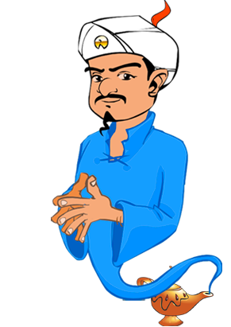
OTAKUNATOR
ASHISH(2017UCO1551)
SAQUIB(2017UCO1556)
SUMIT YADAV(2017UCO1558)

Slide 2
Akinator : An Introduction
Akinator is an interesting guessing game where a genie guesses the character you have in mind. Basically, all you have to do is to pick a character in your mind and proceed to answer the questions Akinator asks about your character. Akinator will then try to get as many clues as possible and at the end, it will guess your character –and he is often right!
Akinator is based on a database made up of about 100000 characters with different fields describing them. This is the initial set of solutions that is reduced every time you answer one of the questions, until only one remains. If the algorithm doesn't find a solution after asking 20 questions, you can add your own character to the list .Thus the database is ever expanding.

Slide 3
Otakunator : A specialized Akinator
Since the initial database for Akinator is practically not viable to create, we have limited our universe of discourse to characters from an anime series named Naruto .
Thus we have created ‘OTAKUNATOR’ a specialized implementation of Akinator .

Slide 4
OTAKUNATOR : Introduction
OTAKUNATOR is an application that attempts to guess the character from Naruto-verse about which you may be thinking based on a few questions that you need to answer.
This application makes use of Naive Bayes to reduce the no. of questions to as small as possible, required to converge to the correct answer .
We started from an initial database of 100 characters and 120 questions.

Slide 5
DATASET COLLECTION
We have self created the database by referring to different websites and of course using the help of few fellow Otakus. A few notable ones are :
>> Naruto Fandom
>> NarutoPedia
>> Anime-Sensei

Slide 6
DYNAMICALLY EXTENDING DATASET
We have created an option for adding the character to database, in case it didn’t already exist in the initial one and therefore wasn’t be guessed correctly.

Slide 7
TECHNICAL ASPECTS
There are two technicalities to be noted:
1.) SELECTION OF QUESTIONS: Each question is chosen so as to partition data as close to half as possible. This is achieved by choosing the question which has conditional probability as close to half. We first choose A such that P(A) is most close to ½ for A of all attributes. Then we choose B such that P(B|A) is most close to ½ for B of all attributes besides A. This process is iteratively repeated.

Slide 8

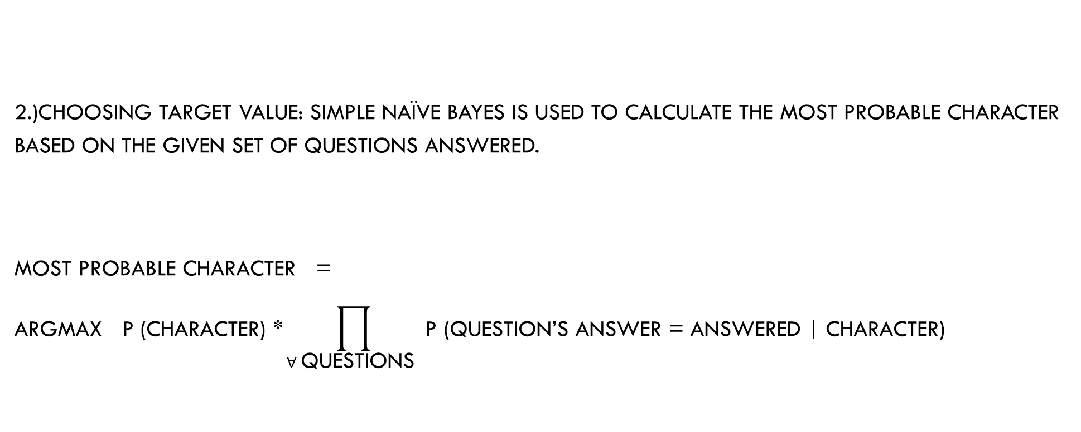
TECHNICAL ASPECTS (Cont…d)
2.)CHOOSING TARGET VALUE: Simple Naïve Bayes is used to calculate the most probable character based on the given set of questions answered.
$$\text{Most} \text{probable} \text{character}\text{ =}$$
$$\text{argmax} \text{P}\text{ (}\text{character}\text{) ∗}\prod_{∀ \text{questions} }{\text{P}\text{ (}\text{question}\text{’}\text{s} \text{answer}\text{ = }\text{answered}\text{ | }\text{character}\text{)}}$$
$$\text{character}$$

Slide 9
U.I.
User Interface is generated using PyQt5 package in python3. The U.I. is easy to use and graphical.
The questions and answers are presented in option format which are answered by clicking on a particular button corresponding to the answer.
Other functionalities like adding a new character are also presented using various graphical components of PyQt5 library.

Slide 10
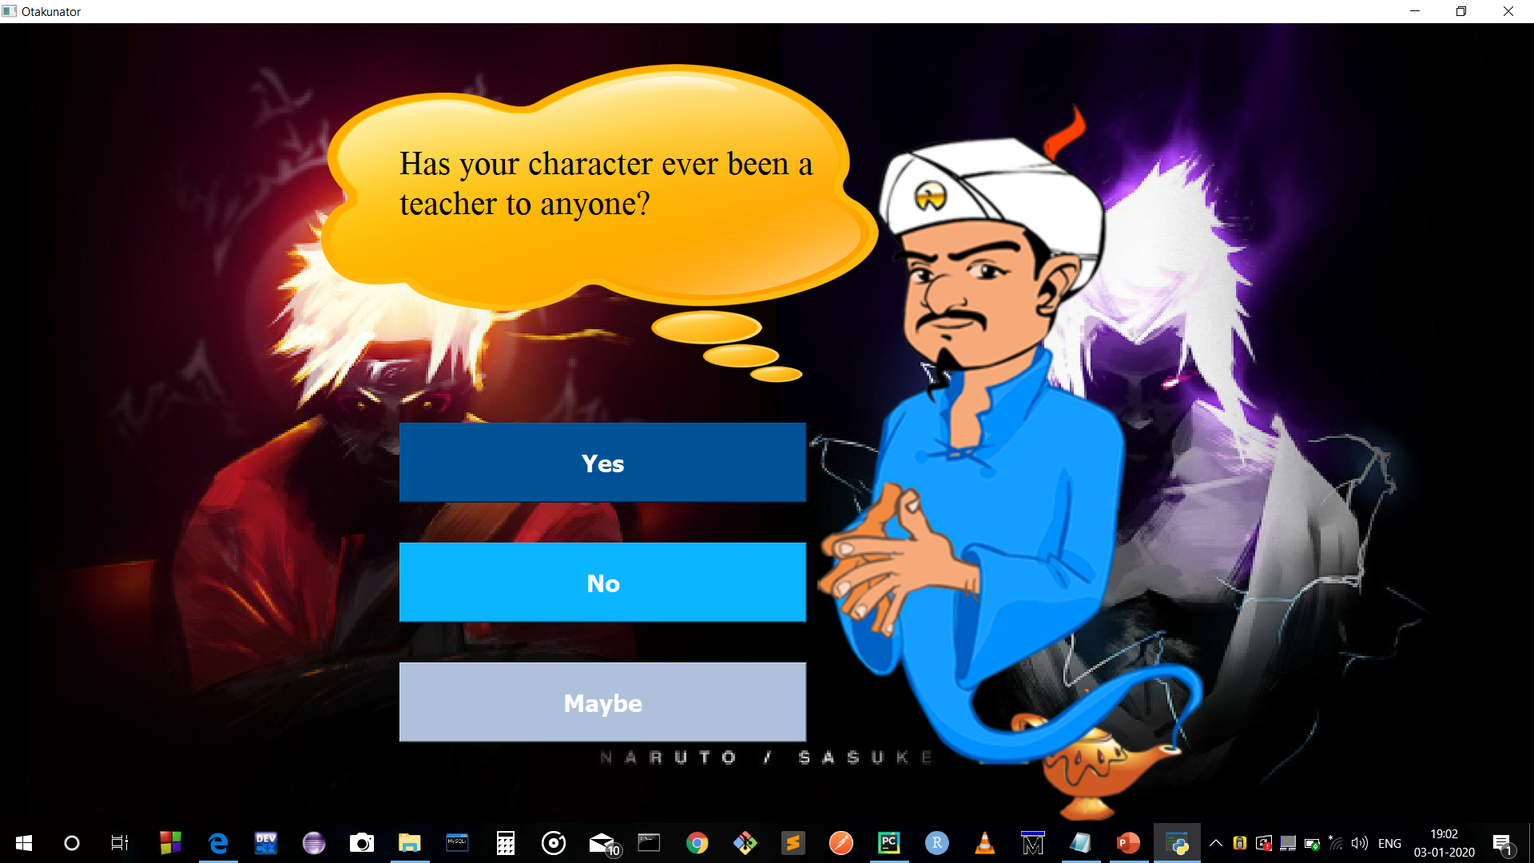
SCREENSHOTS OF A WINDOW OF OTAKUNATOR

Slide 11
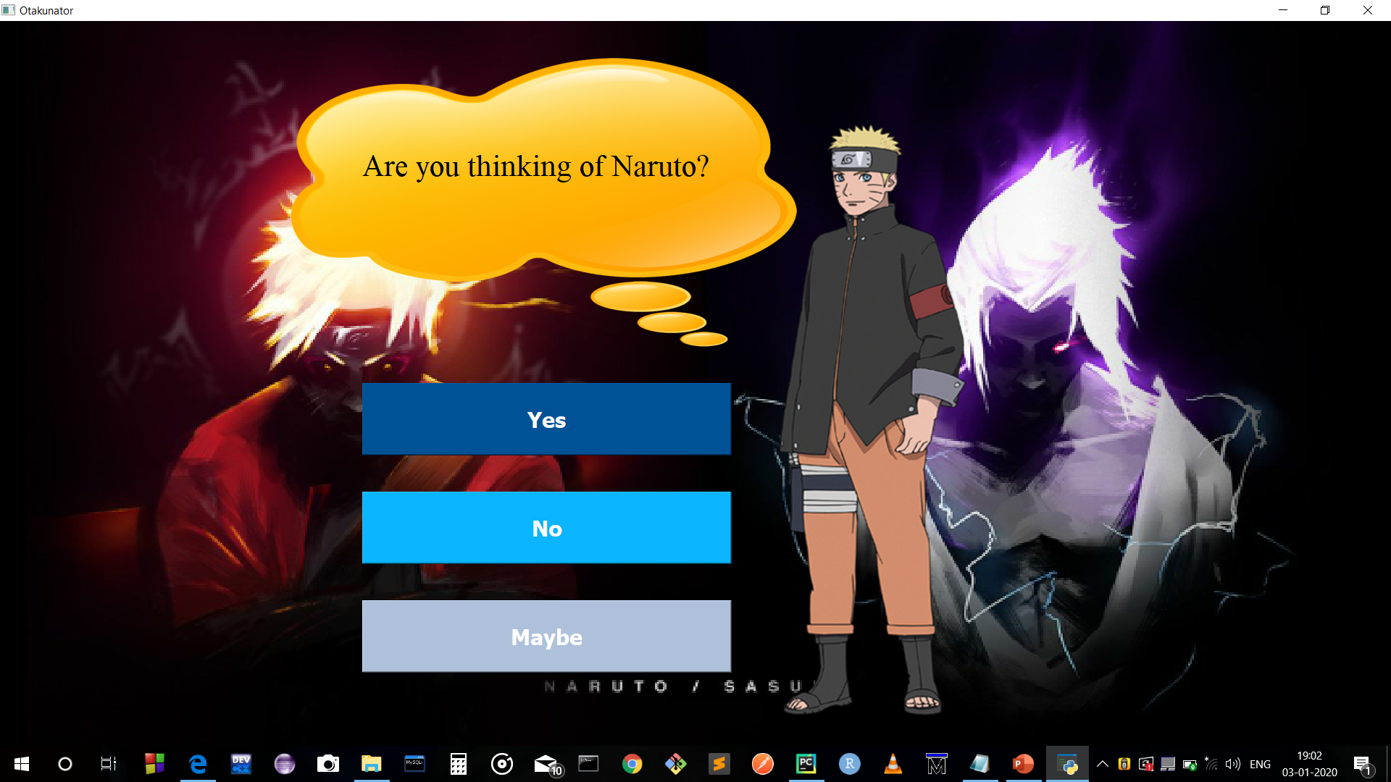
SCREENSHOT WHERE THE CHARACTER GETS GUESSED

Slide 12
Conclusion
This project has given us exposure to various machine learning concepts and their applications. We also gained confidence in expanding our vision and put our knowledge to practical purpose.
We also learnt the importance of team work . With support of each other and by dedication we overcame various hurdles in creation of our project, collection of database being the primary one.
We also interacted with each other to combine our knowledges to combine characteristics of the various algorithm in order to best suit requirements of our application.

